Slide 1

Progress Report
By:
Kanchi Sharma Tanishka Kasal

Slide 2
Contents
Dataset
Research Methodology
Pre-Processing
Training
Results & Discussion
Conclusion
Future Work

Slide 3

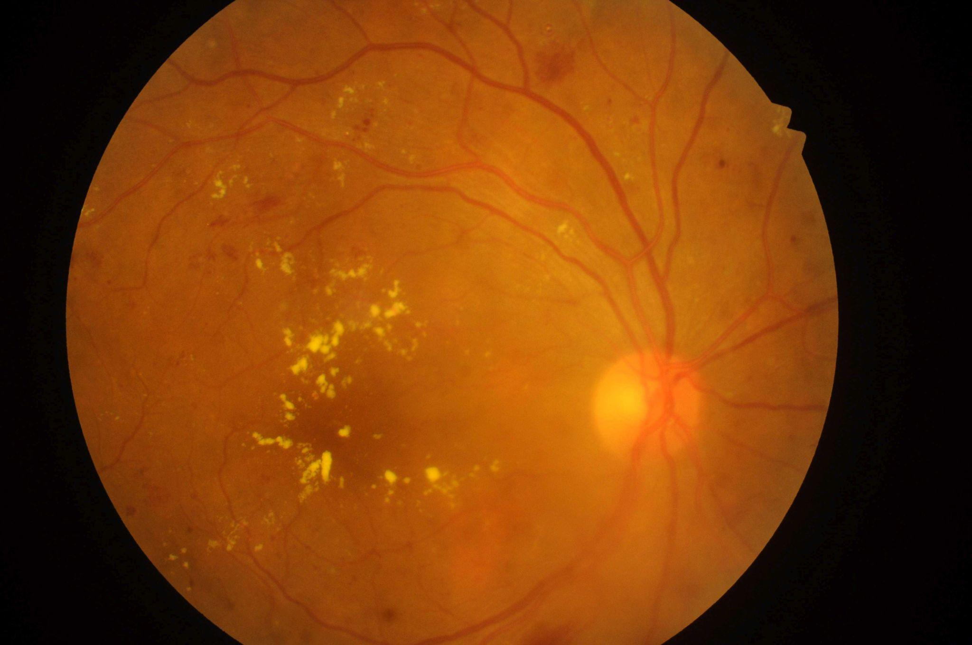
Dataset
Indian Diabetic Retinopathy Image Dataset (IDRiD)
The dataset is divided into three parts:
Segmentation
Disease Grading(used in our study): It consists of
1. Original color fundus images (516 images divided into train set (413 images) and test set (103 images) - JPG Files)
2. Groundtruth Labels for Diabetic Retinopathy and Diabetic Macular Edema Severity Grade (Divided into train and test set - CSV File)
Localisation
Fig: IDRid_001.jpg

Slide 4
Research Methodology
Implementation-1
Implemented the ResNet-18, VGG-16 and AlexNet architectures by training them from scratch to obtain accuracy and performance metrics.
All the three architectures were trained on 50, 70 and 100 epochs with learning rate of 0.01 and 0.001 each.

Slide 5
Research Methodology
Implementation-2
We reviewed research papers utilizing the IDRiD dataset and implemented a study that applied transfer learning to train an EfficientNet(b0) model.
Techniques like weight balancing, dropout and batch normalisation were used to prevent overfitting of the model.

Slide 6
Research Methodology
Implementation-3
Implemented the research paper: Deep residual transfer learning for automatic diagnosis and grading of diabetic retinopathy (Elsevier 2021)
Transfer learning has been applied to test two different architectures: the ResNet-18 and ResNet-50. Two re-training cases of Resnet-50 are proposed: Resnet-50a, only the last fully connected layers are re-trained & Resnet-50b (and ResNet-18), the last residual layer is also been re-trained.
Using the IDRiD, these pre-trained architectures are fine-tuned for the task of disease grading into grade 0, grade 1, grade 2, grade 3 and grade 4.

Slide 7
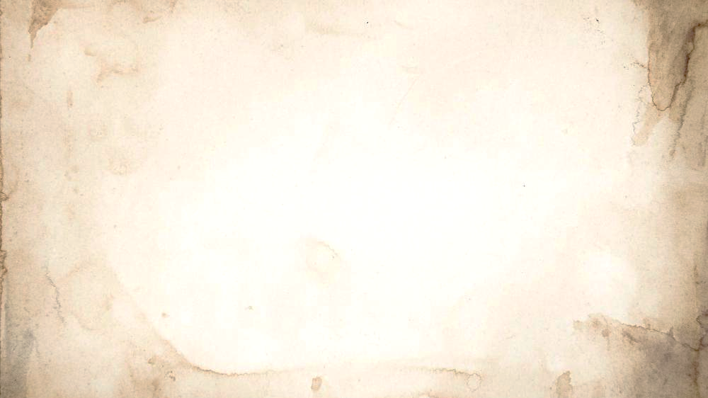
Pre-Processing
(For implementation 3)
Image Transformation:
Implemented transformation techniques: Resizing and Cropping , Normalization, Horizontal and Vertical Flipping , Rotations.
Custom Data Handling:
Developed a customised Data Loader for the IDRiD dataset.

Slide 8

Training
(for implementation 3)
Stage-1
In the initial stage of training, all layers except the fully connected layer are frozen. The first training loop runs for 20 epochs(lr = 1.0) using the Adadelta optimizer. The model captures the weights with the lowest loss, which are then used in the next training loop.
Stage-2
In the fine-tuning stage, we apply stochastic gradient descent with a lower learning rate(0.001) for 50 epochs. Before this stage, the residual layers of ResNet-18 and ResNet-50b are unfrozen.

Slide 9
Training
Case 1: Multiclass classification of retinopathy grades of retinal images among five classes- grade 0: Normal, 1: Mild, 2: Moderate, 3: Severe, 4: Proliferative .
Case 2: Combining classes 1 and 2, which defines 4 class scenario.
Case 3: Binary classification among classes 0 and 4.

Slide 10
Model Evaluation
(For implementation 3)
The trained models are evaluated using a 5-fold stratified cross-validation approach. The results of ResNet based system are compared by training and testing three different models under the same conditions: VGGnet-16, VGGnet-19 and Alexnet.
Performance metrics such as global correct rate, sensitivity, specificity, ROC curve, AUC, MAE, MSE, and confusion matrices are computed to assess the models' effectiveness in retinopathy grading.

Slide 11
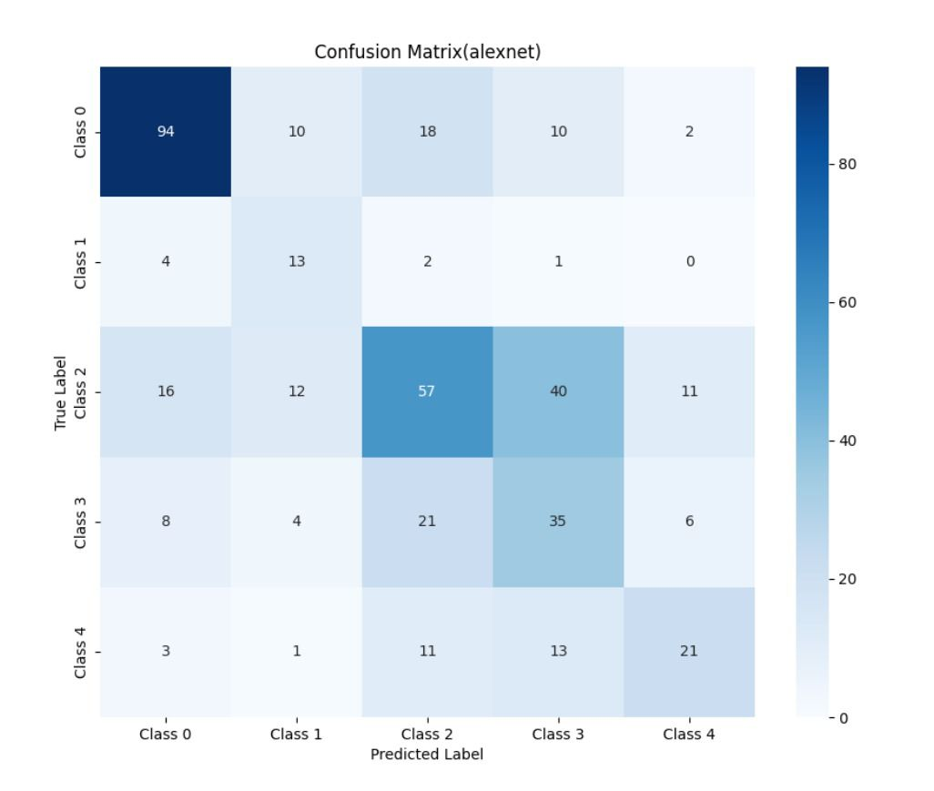
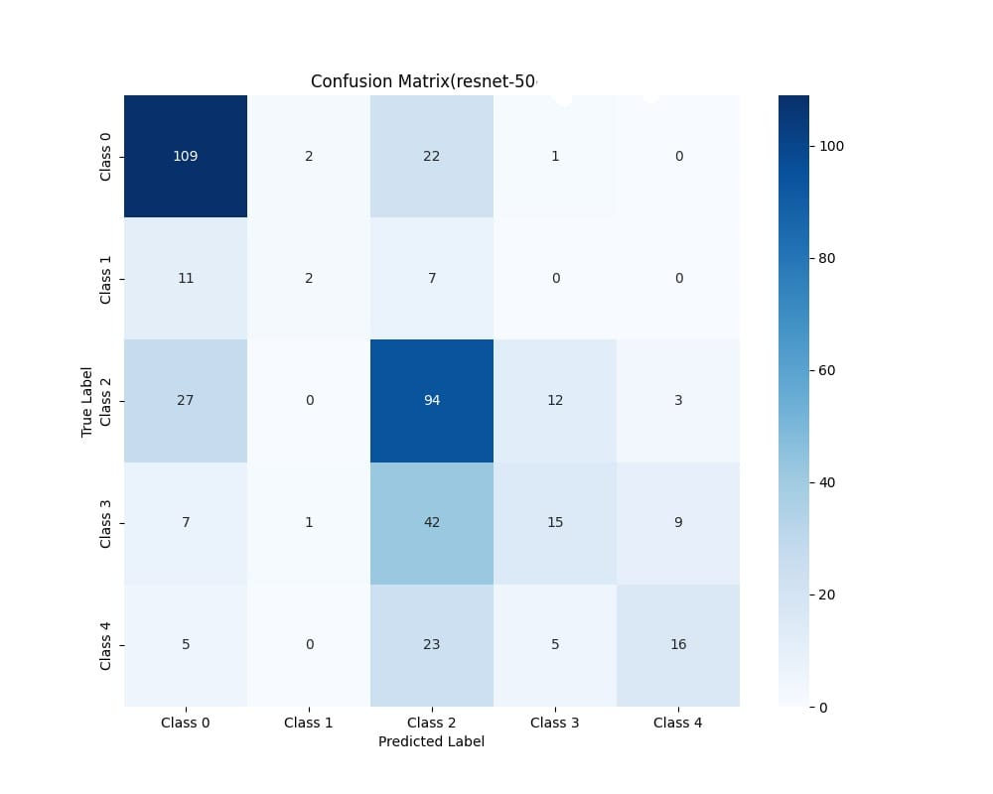

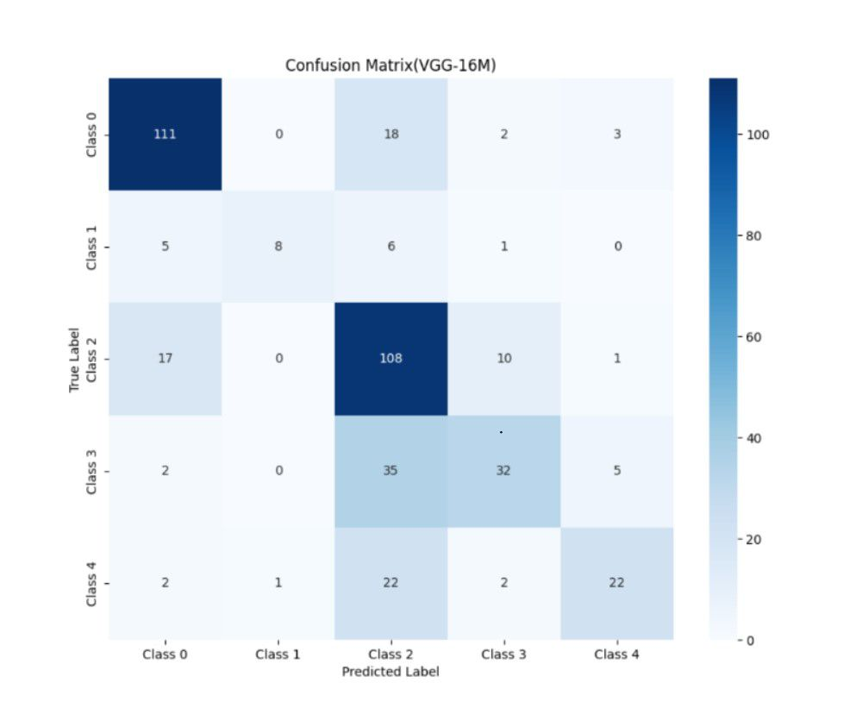
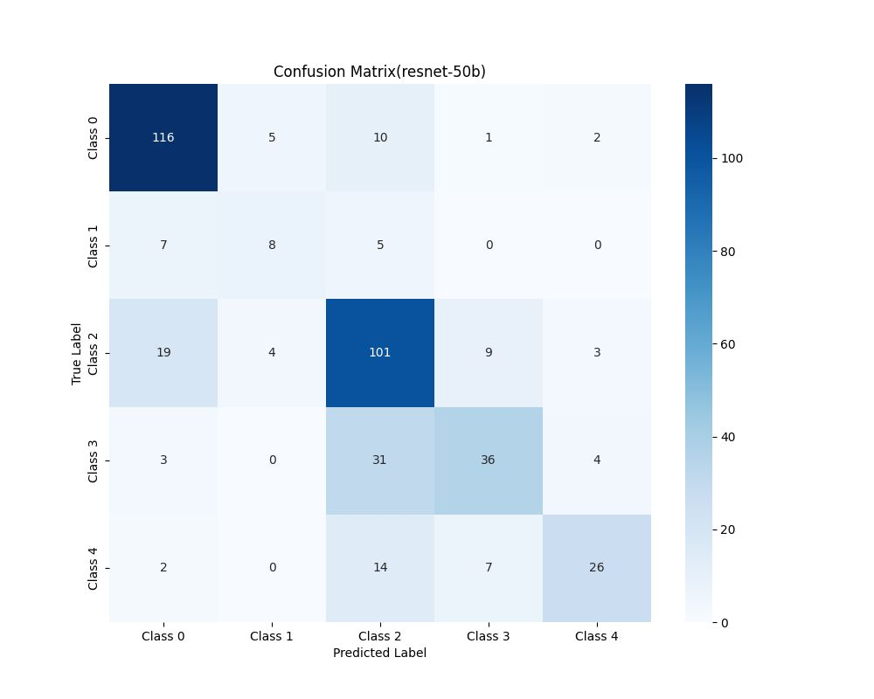
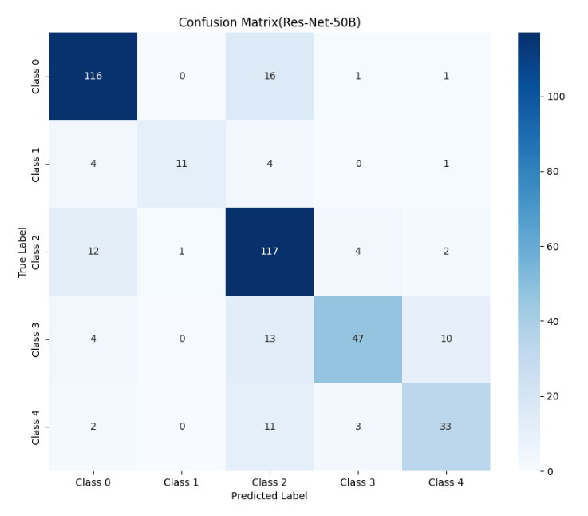
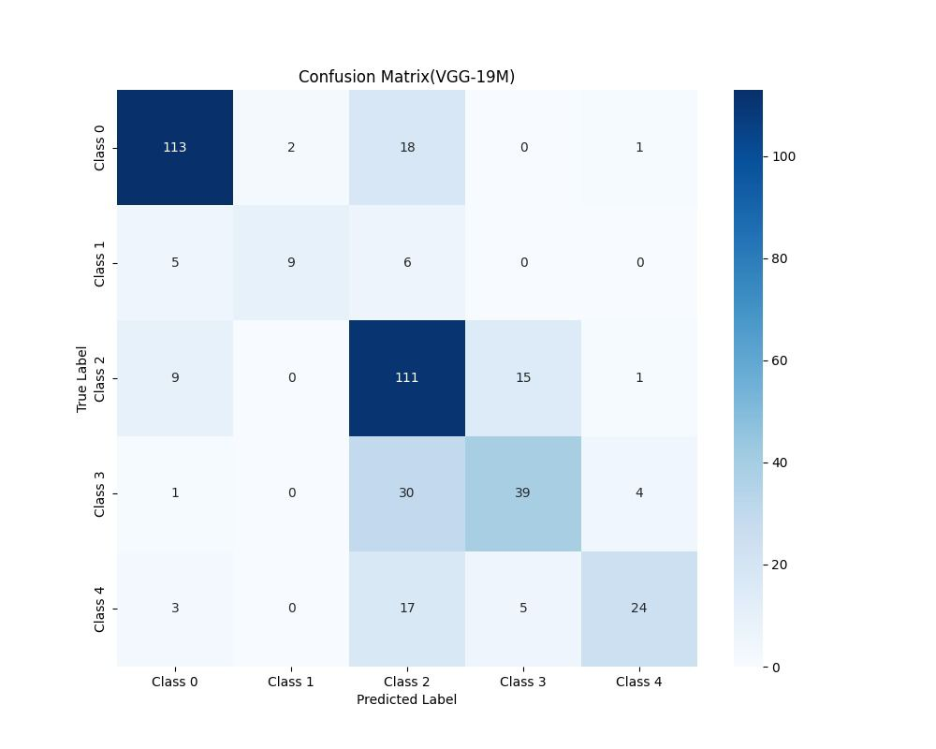
Results & Discussion
Case 1: Multi- class model performance

Slide 12
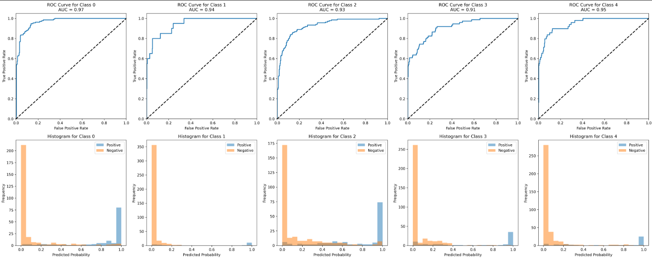
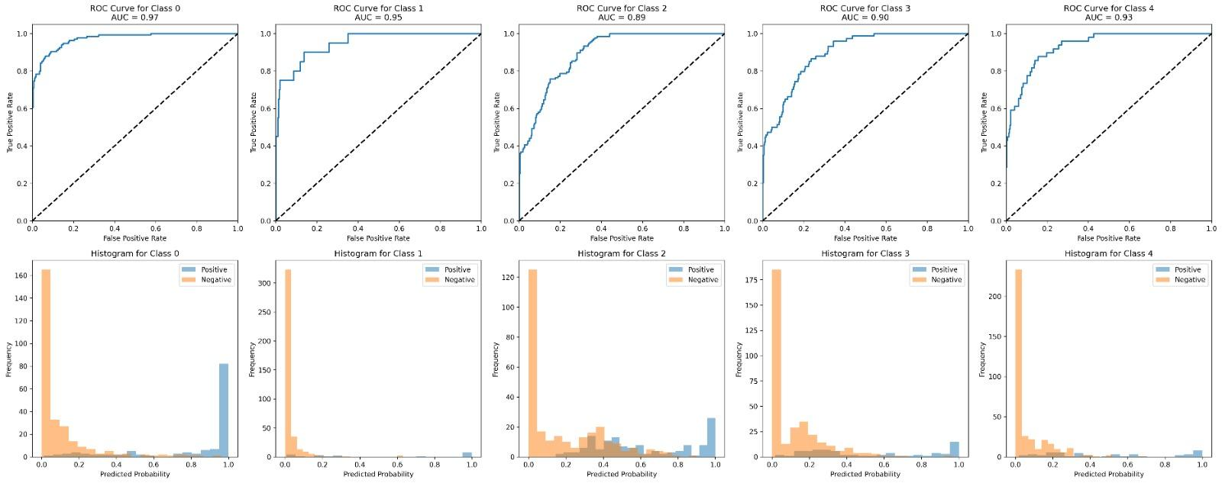
Case 1: Multi- class model performance
ROC AUC curve of ResNet50b

Slide 13
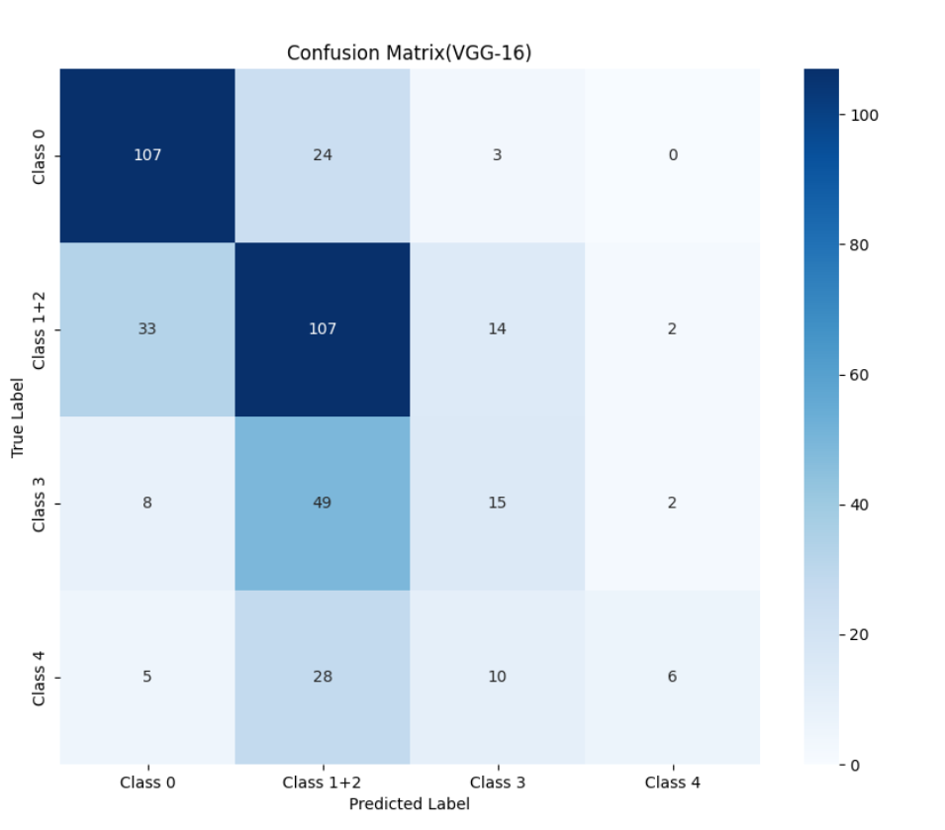
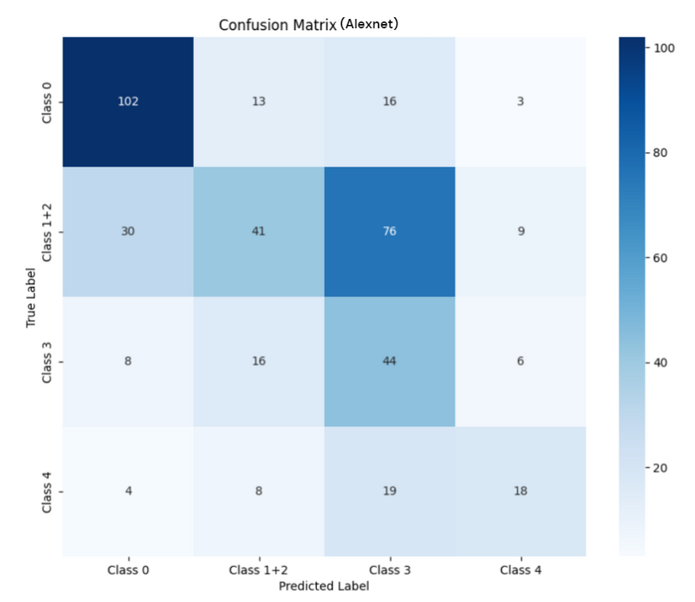
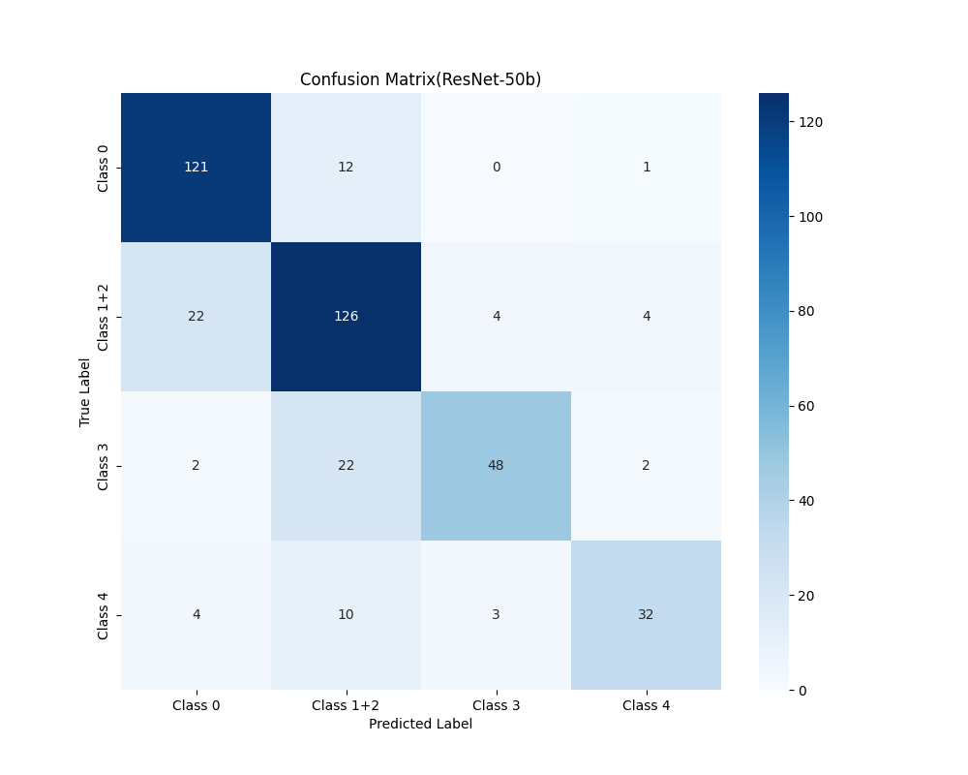
Case 2: 4-class scenario

Slide 14
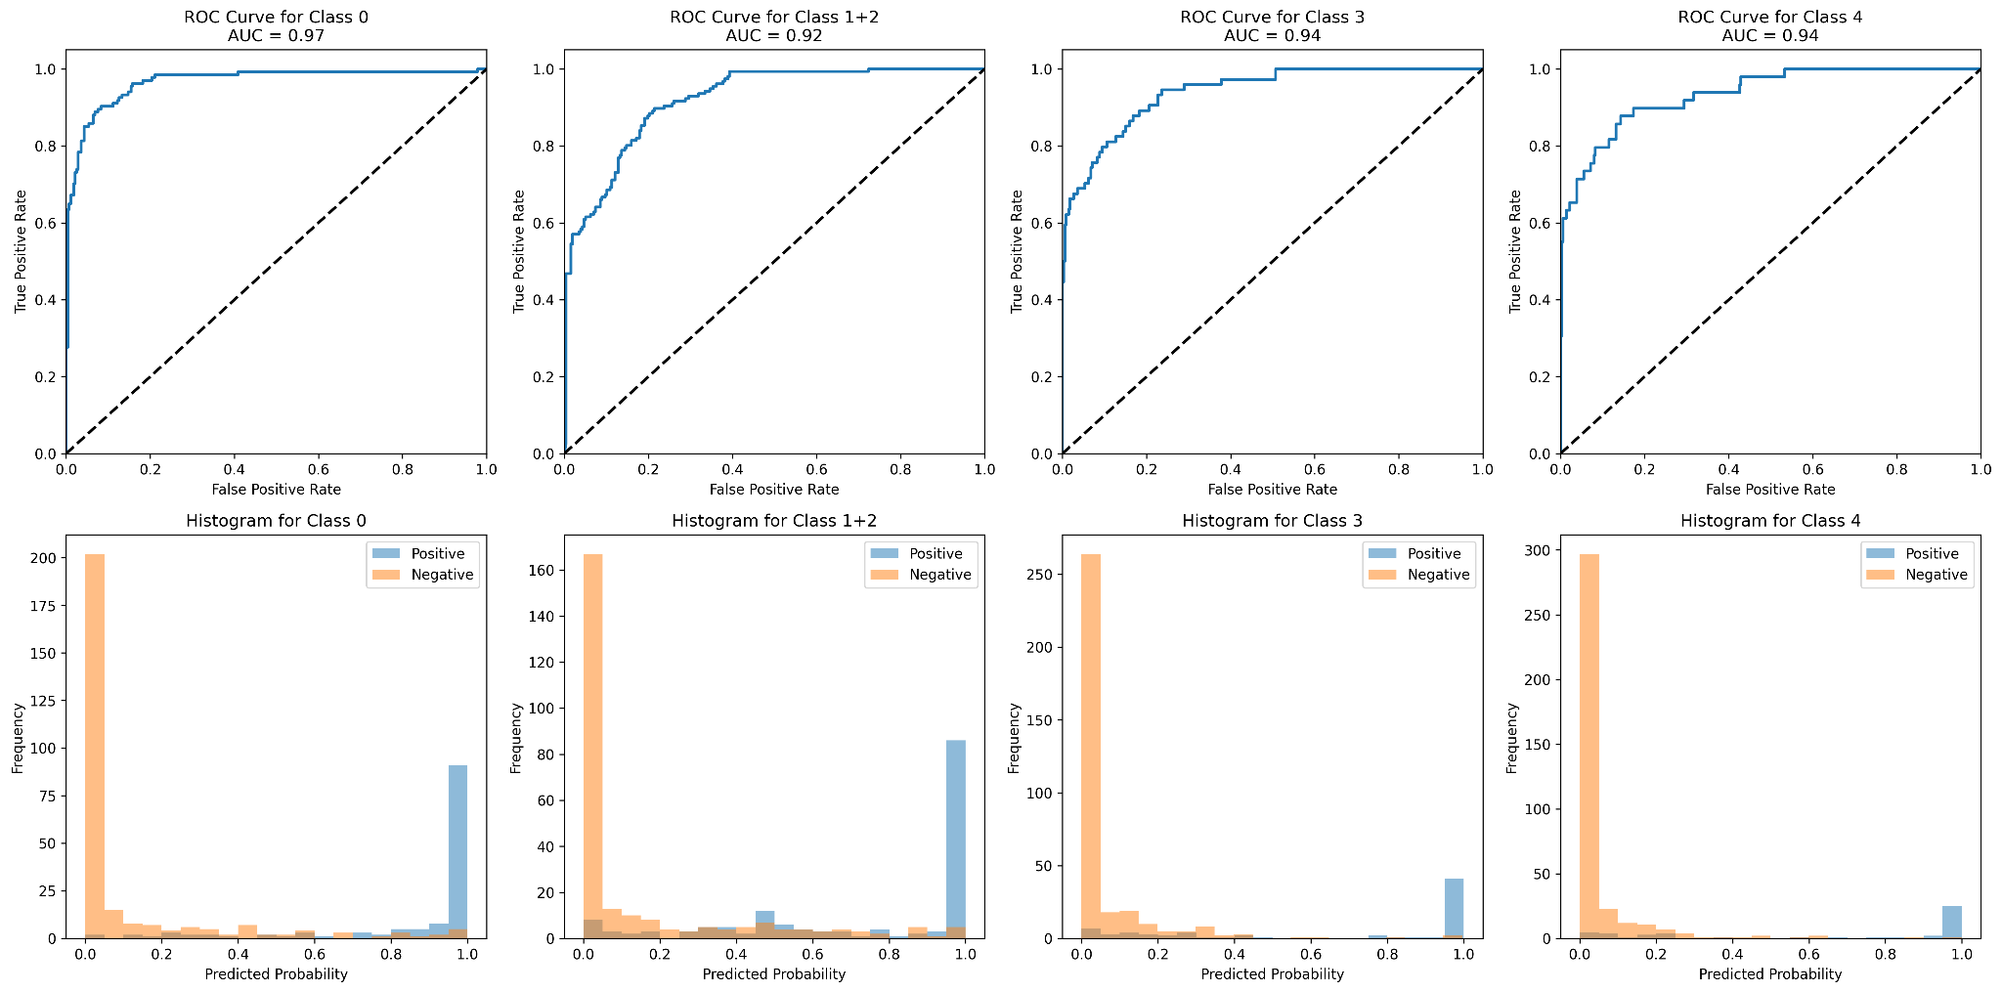
Case 2: 4-class scenario
ROC AUC Curve for ResNet50b

Slide 15
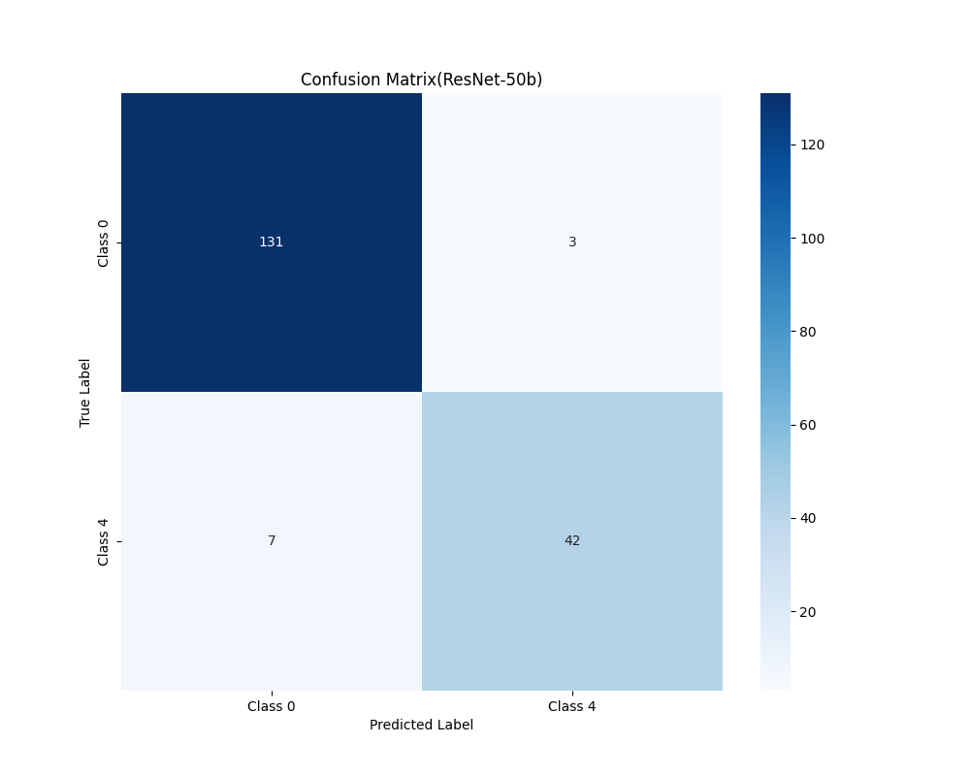
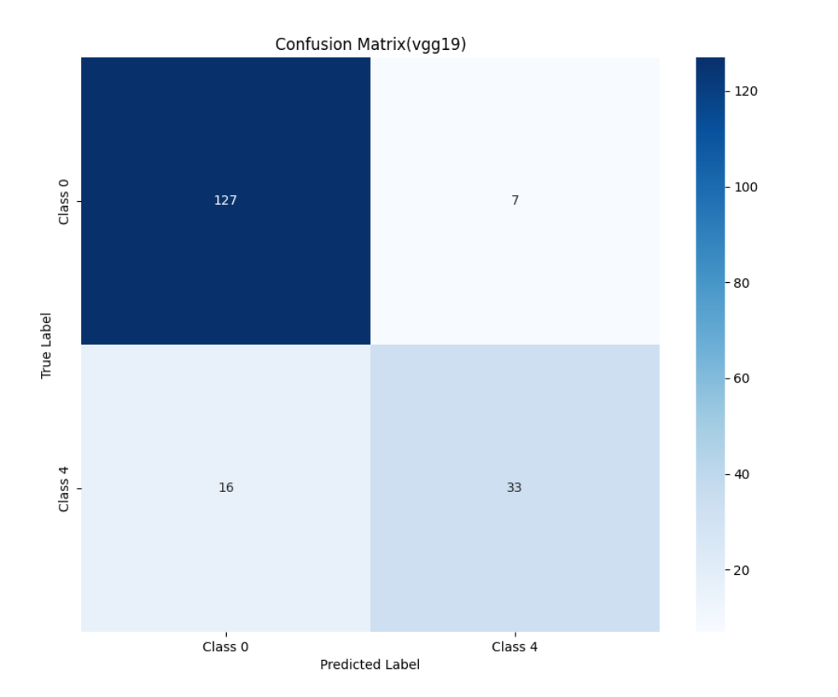
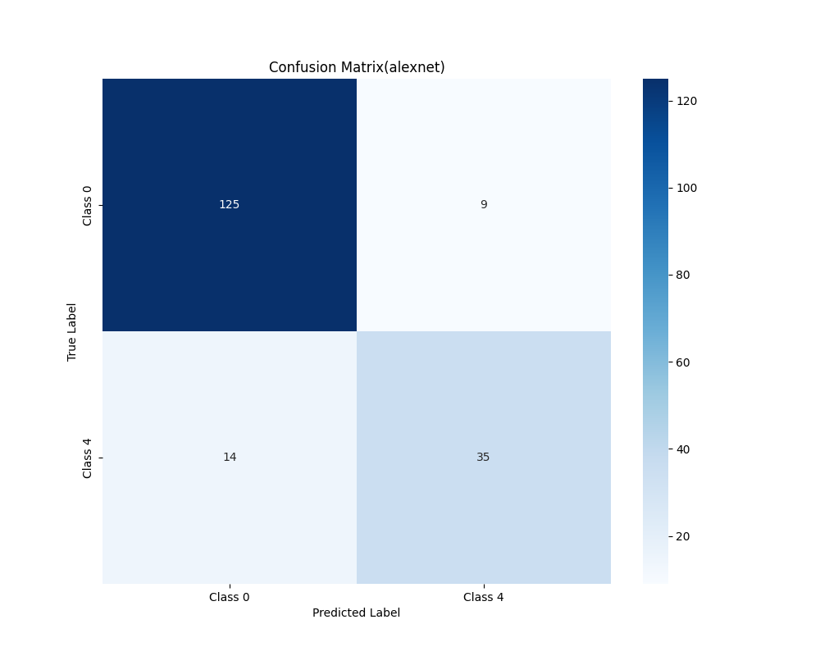
Case 3: Binary Classification

Slide 16
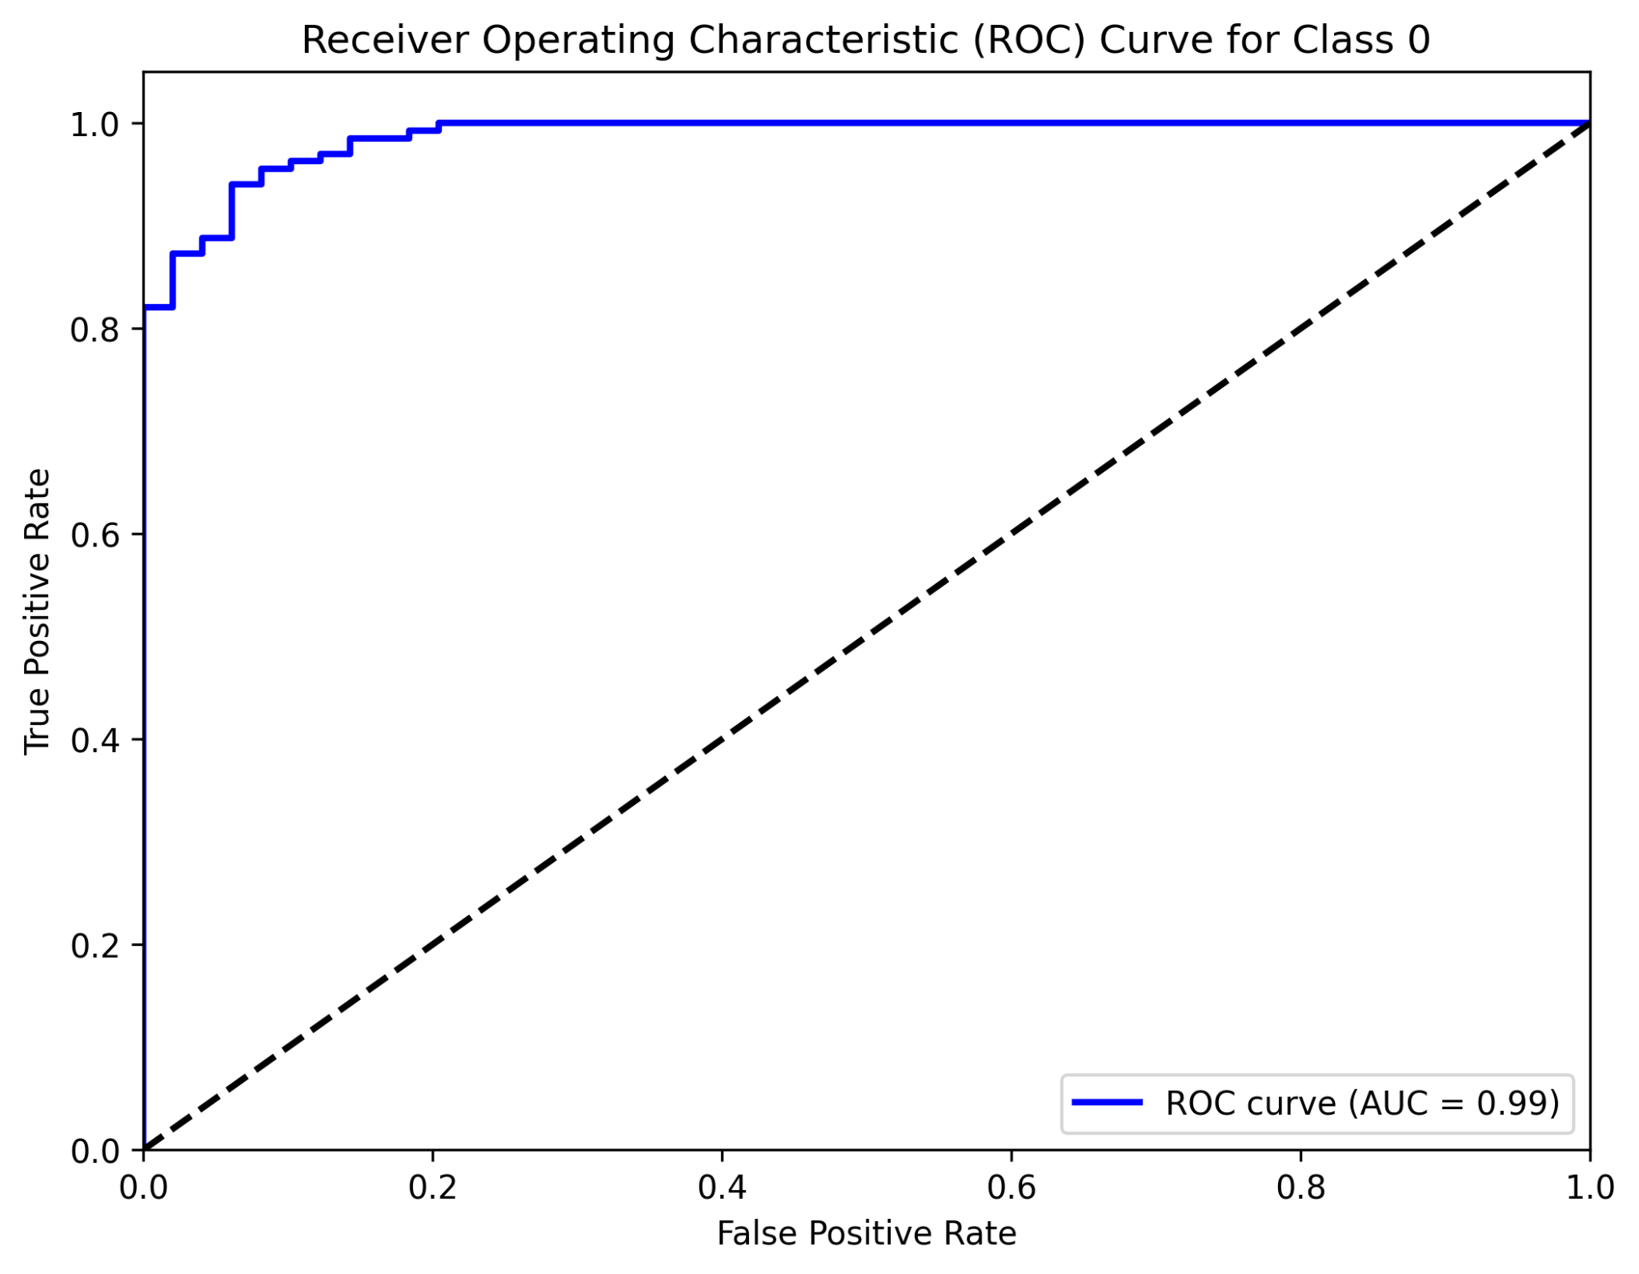
Case 3: Binary Classification
ROC AUC Curve for ResNet50b

Slide 17
Conclusion
In our exploration of all techniques, we've implemented strategies to enhance model performance and generalization. We've learned that reducing overfitting is crucial for creating models that perform well on unseen data, not just the training set. Weight balancing helps address class imbalance issues, ensuring fair representation of all classes. We've also studied the impact of freezing and unfreezing layers, particularly in transfer learning scenarios, to fine-tune models effectively. These techniques collectively contribute to building more robust and accurate machine learning models.

Slide 18
Future Work
We are currently exploring the incorporation of attention mechanisms into our existing classification system. This involves selecting an appropriate attention module and integrating it into our models (ResNet50 and VGG19) to enhance their performance. The goal is to improve the models' ability to focus on the most relevant features of the input images for better classification results.

Slide 19
Thank You
Progress Report

