Slide 1
Integrated Electronic Health Records (EHR) Platform: Enhancing Patient-Centric Healthcare Management
Team Details
K. Sai Sandeep Reddy(20EG105123)
P. Meghana Reddy(20EG105136)
Siddharth Thirkateh(20EG105146)
V. Rishikesh(20EG105159)
Project Supervisor
Mr. MADAR BANDU
Assistant Professor

Slide 2
Introduction
We can see how the patients' records, to this day, are scattered across many providers, facilities, or even on paper. The lengthy process of filling up a new form with each visit to a new doctor, or filling up a patient’s details in the system all over again is a time-consuming and inefficient method to maintain a health record. The hospitals have to conduct the tests again and the patient’s communication about the previous results of the tests is generally ignored due to lack of central proof of all the data. This can result in being time-consuming, inefficient, and expensive.
Patient Health Records (PHR) not only encourage the patients to keep track of their health records, store and manage them but also make it easier for them to share the health records whenever necessary. These PHRs make the maintenance of the records easier but, when facing an emergency, the same repeat of tests, checking of medical history, and need to fill up the general details is required. This will again prove to be a time-consuming and expensive affair. When collecting records from different organizations, the terms start to differ from organization to organization and this might cause a problem in cases of emergencies when one organization tries to interpret the different terms. This is the reason if all the records need to be in the same place then the integration of data will play an important role.

Slide 3
Problem Statement
Currently, some hospitals in India have established their own PR ( Patient Record) systems. Under the trend of Internet globalization, how to integrate and share heterogeneous PR has become one of the main problems that medical information construction faces. This project not only helps in giving the PR to the hospitals which have not established PR yet but also integrates all the PR’s together eliminating heterogeneity between all the hospitals and the data of the patients providing a good basis for achieving the sharing of PR data.
Patient records these days have become very crucial to know the medical history of the patient. The problem occurs when different hospitals consist of heterogenous medical records which are not available in the records of the hospital other than the current one in which the patient was treated. Once all the hospitals have integrated patient records, result of all tests in digital form and the medical history of the patient in one place and accessible to all hospitals, it not only makes the diagnosis and the treatment faster but the hospitals can take more caution while putting the patient on certain medicinal dosage. This helps the hospitals work faster, the patient understands their own medical history and both can avoid unnecessary tests which helps reduce cost.

Slide 4
Problem Illustration
The key challenges identified in the current healthcare data management system include accessibility, potential vulnerabilities, and a lack of optimization for emergency scenarios. To address these issues, our solution leverages the React framework for its speed and efficiency, ensuring a user-friendly experience for both healthcare professionals and patients.
To manage and organize the records efficiently, we have integrated an SQLite database and utilized Flask to create streamlined APIs. This combination allows for quick and reliable retrieval of medical information, crucial for prompt decision-making in emergency cases.
Recognizing the significance of data summarization for treatment in emergency situations, we have incorporated Natural Language Processing (NLP) techniques. These techniques enable the automatic summarization of records, ensuring that essential information is readily available to healthcare practitioners, expediting the treatment process.

Slide 5
Proposed Method
With the old models not being as efficient for the population of India, we came up with the modifications proposing our model which focuses on easy access to the records through our web application. We used the React framework to build our fast and efficient application. To store the data of the records we used SQLite database and flask to create efficient APIs.
We also used the Pegasus model which was launched by Google to summarize the records for easy access and faster treatment in emergency cases. The main focus is on the encryption and the compression of data so that it is safe from any kind of vulnerabilities.

Slide 6
Proposed Method Illustration
Our project is centered around integrating existing CPR (Computer-based Patient Record) systems from various hospitals, aiming to establish a unified platform for effortless data sharing and collaboration. The objective is to create a common ground that simplifies the exchange of patient information across different healthcare institutions.
From a user standpoint, our application offers several features. Users can access their personal information, health data, and hospital-specific reports. This empowers individuals to stay informed about their medical history and make well-informed choices regarding their health. Additionally, the benefits extend to hospitals. Medical institutions can gain comprehensive insights into a patient's medical journey across different hospitals. This holistic view can significantly impact future treatments and overall patient care.

Slide 7
Proposed Method Illustration
The main focus is on the encryption, compression, and summary of data which helps protect the data from any threats and the summarization of the records can be easily understood by the patient as well as the doctors. These additional features in our application will help the treatments, especially in emergency cases to be done faster and the patient records are not vulnerable to any kind of attacks that allow only the patients and the doctors to access the records.
The primary emphasis lies in the meticulous implementation of encryption, compression, and data summarization protocols, fortifying the security and accessibility of sensitive information within our application. These enhanced features are strategically designed to shield data from potential threats, ensuring that patient records remain impervious to unauthorized access and malicious attacks.

Slide 8
Proposed Method Illustration
The amalgamation of robust encryption mechanisms guarantees the confidentiality of patient data, while compression techniques optimize storage efficiency without compromising data integrity. Concurrently, the implementation of effective data summarization facilitates seamless comprehension for both patients and medical professionals, thereby expediting treatment procedures, particularly in critical emergency scenarios.
With encryption and compression of data the functionality of two-factor authentication so that unauthorized users can not login even if the password is breached or compromised. This ensures that there is no bypass to one’s account and no records or documents are accessed by unauthorized people.

Slide 9
Experiment Environment
Windows OS
Python
SQLite
Visual Studio Code
Flask

Slide 10
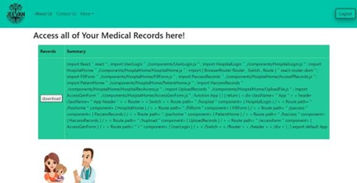
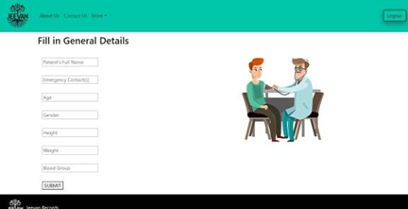
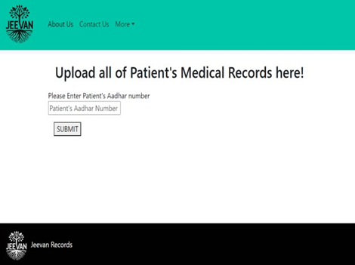
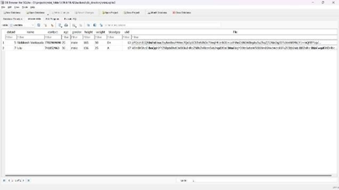
Experiment Screenshots
1. Access Medical Records
2.General Details of Patient
3. Upload Records
4.Encryption in Database

Slide 11
Experiment Results
Security of Medical records:
AES: The Advanced Encryption Standard (AES) is like the guardian angel of our digital world, ensuring the safety of our sensitive information. Picture it as a master lock that operates on blocks of data, each chunk being 128 bits in size. What's impressive about AES is its adaptability, offering different key sizes of 128, 192, and 256 bits, depending on the level of security needed.
AES follows a nifty structure called the Substitution-Permutation Network (SPN). It's like a puzzle-solving algorithm that expands the original key into a unique set of round keys. Each round involves a series of transformations—think of them as secret moves—like swapping bytes, shifting rows, mixing columns, and adding special round keys swapping bytes, shifting rows, mixing columns, and adding special round keys

Slide 12
Experiment Results
But here's where AES truly shines: its commitment to security. It's designed to be like a maze where every twist and turn makes it impossible for anyone without the key to navigate through. Even the tiniest change in the starting point—the plaintext—leads to a completely different path—the ciphertext. This complexity makes AES a formidable fortress against cyber threats.
AES remains the go-to choose for encryption, ensuring our online conversations stay private and our personal data stays safe. So, just like we upgrade our home security systems, it's crucial to stay informed about the latest in encryption technology to keep our digital lives secure. But here's where AES truly shines: its commitment to security. It's designed to be like a maze where every twist and turn makes it impossible for anyone without the key to navigate through. Even the tiniest change in the starting point—the plaintext—leads to a completely different path—the ciphertext. This complexity makes AES a formidable fortress against cyber threats.

Slide 13
Experiment Results
Summarization of Medical Records:
The summary of the patient records when either the hospital or the patient accesses the records is displayed which is an upgrade in our model. This summary was intended especially for emergencies when the procedures are needed to be performed immediately. These summaries display the essential details from the records (e.g. allergies, medications, medical history, surgeries, and more) so that the consulting doctors will not have to check the whole records before operating in emergencies. These even save money as the test results are also displayed in the summary and there is no need to repeat the tests. This feature saves time, money and can be very helpful in emergencies.

Slide 14
Findings
We dedicated considerable effort to optimize our project for maximum efficiency, recognizing the critical importance of securing hospital data and patient records. Given the potential risks associated with data tampering, particularly in healthcare settings, we prioritized implementing robust security measures. After thorough exploration of encryption algorithms such as DES and 3DES, we found that the Advanced Encryption Standard (AES) offered the best balance of speed, key management, and flexibility in key size, making it the optimal choice for ensuring the security and privacy of our data.
Additionally, we introduced a feature for summarizing patient records to streamline the treatment process, reduce costs, and improve responsiveness in emergency situations. While experimenting with various Python packages and natural language processing (NLP) techniques, we encountered challenges with generating concise and relevant summaries. However, our search led us to discover Pegasus, a Google tool specifically designed for text summarization. Leveraging transformer neural networks, Pegasus proved highly effective in producing succinct, accurate summaries, empowering healthcare professionals to expedite treatment decisions and enhance patient care efficiently.

Slide 15
Justification
The strategies we've implemented to ensure patient medical records remain confidential and intact, we've achieved some significant milestones. We've beefed up security by deploying strong encryption methods like AES and 3DES both for safeguarding data in storage and during transmission. This not only bolsters overall security but also puts us in line with important healthcare data protection regulations such as HIPAA and GDPR. We're also staying proactive by regularly assessing risks and classifying data meticulously. Strict access controls and a robust key management system are in place to keep data secure.
We've also paid close attention to addressing potential security incidents and human-related risks through effective incident response, real-time monitoring, and comprehensive user training. To stay ahead of the curve, we conduct regular security audits and keep stakeholders informed about any evolving cybersecurity challenges.

Slide 16
Justification
By successfully implementing these measures, we've instilled trust in the secure management of medical records. The summarization of patient records, powered by the Pegasus model, plays a vital role here. It ensures that the summaries are not just robotic but human-like, making them easily understandable for both doctors and patients. This not only saves time but also cuts costs, as doctors won't need to repeat tests already conducted in the past—the results are conveniently summarized.
In essence, our focus on encryption and data compression keeps patient information secure, while efficient summarization aids doctors in working faster, more affordably, and with greater efficiency.

Slide 17
Any Queries?
Thank You

