Slide 1
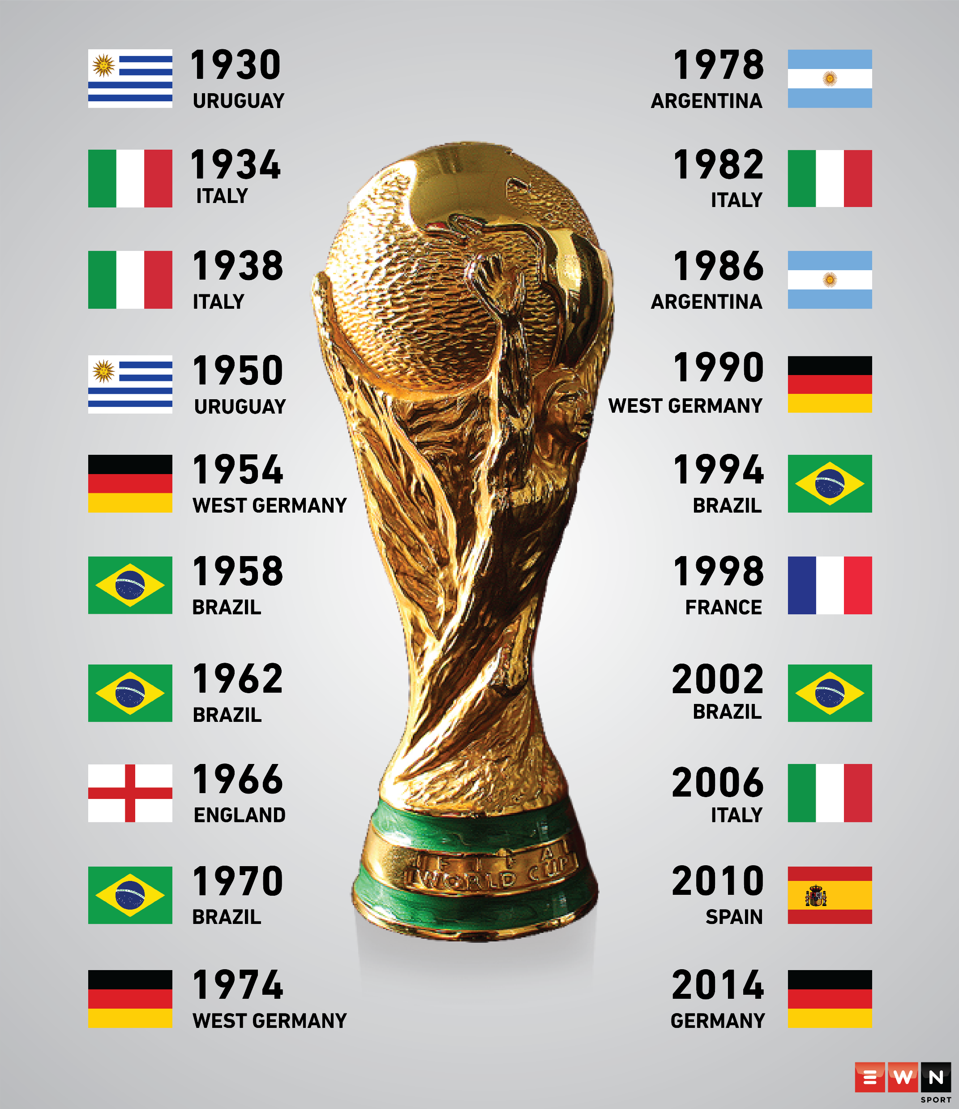
FIFA WORLD CUP ANALYSIS
Presented By:
Kandan . S

Slide 2
Quick Insight
﻿A quick insight for 1930 – FIFA World Cup.
Matches Played | Goals Scored | Count of Players
836 | 2379 | 37784

Slide 3
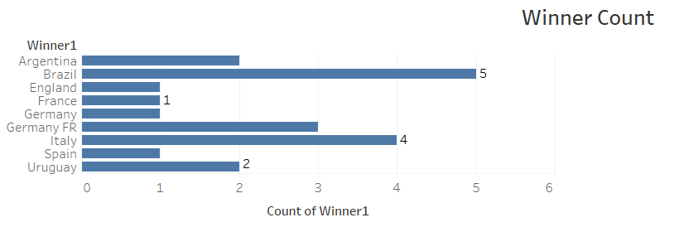
Winner count By Country
Brazil had won highest number of matches flowed by Italy between the year 1930 – 2014.

Slide 4
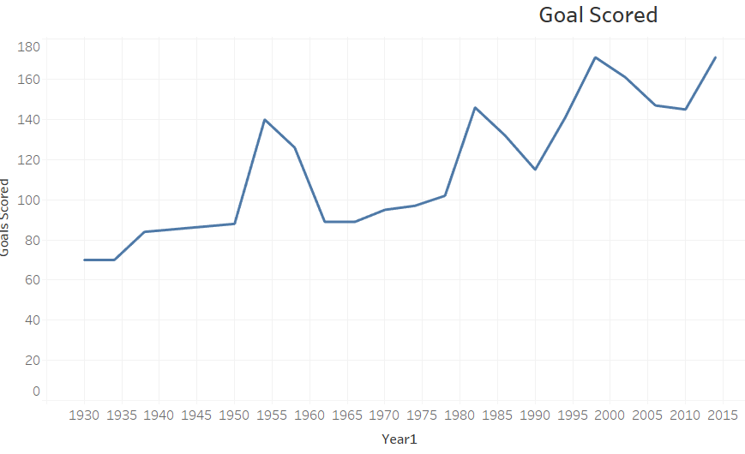
Line chart for goal By Year
Goals has been increased by the consecutive years.

Slide 5
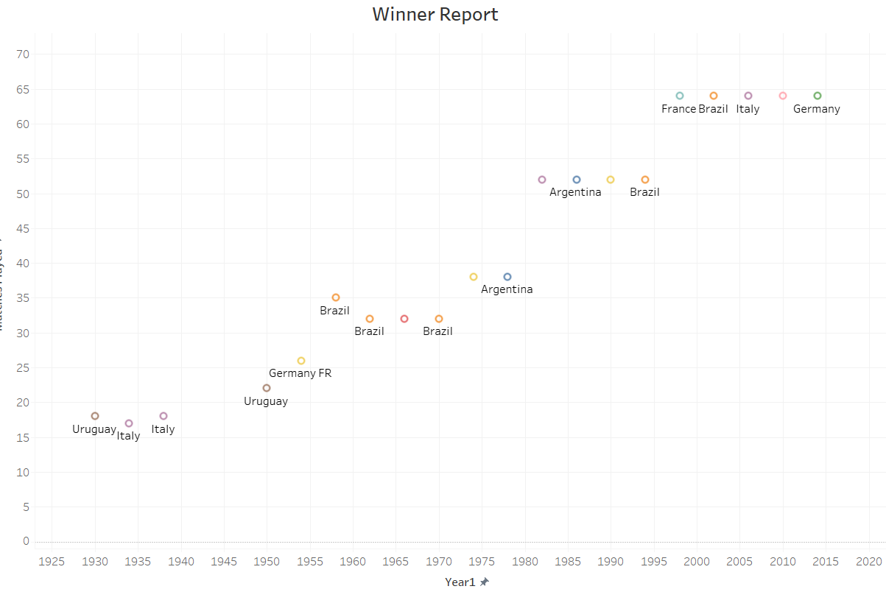
Winner Report With Number of Matches Played
This Scatter Chart shows the data of number of matches played by the country with the year.

Slide 6
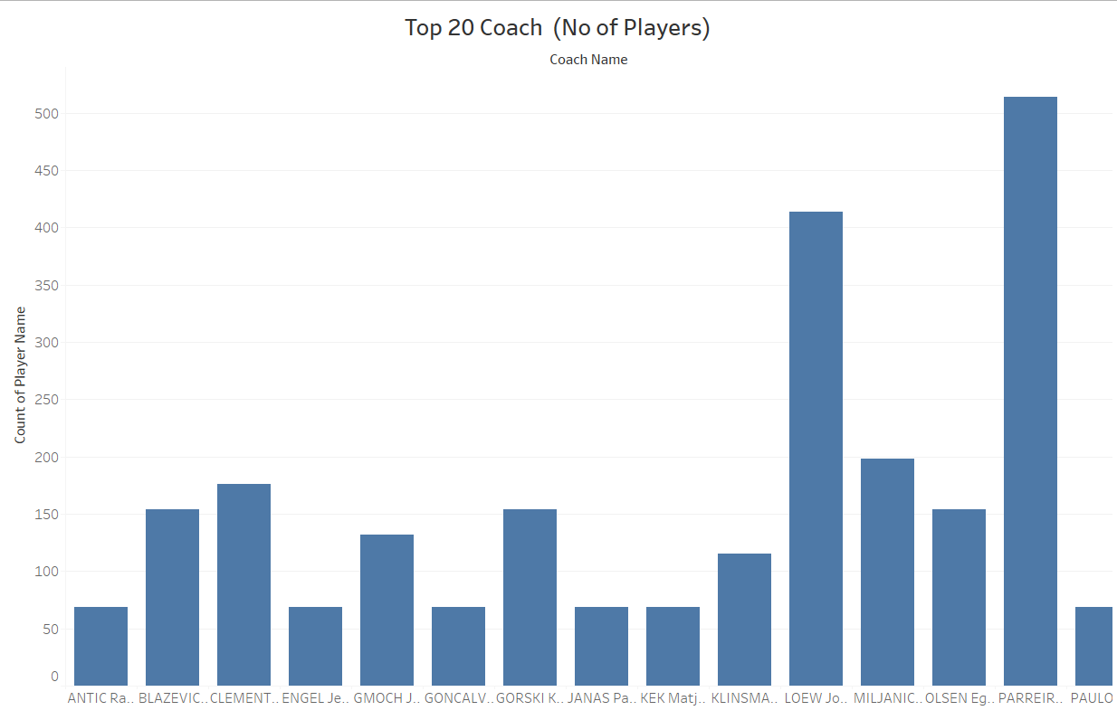
Parreira Carlos Alberto as trained highest number of players (514) all through the Years.

Slide 7
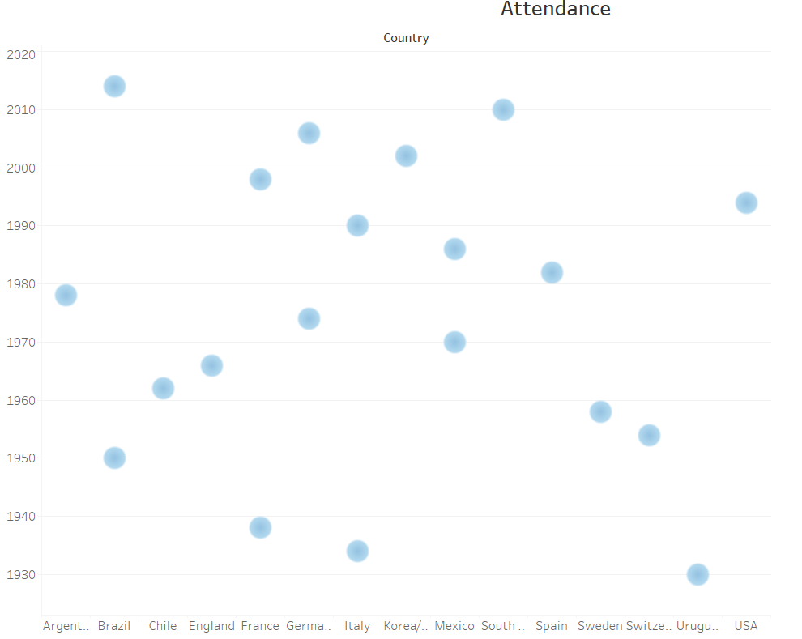
Attendance By Year with Different Countries
Chile has the highest number of attendance (893172) in the year 2014 followed by Sweden (819.2).
The most lowest country that as attendance is Brazil (1.045) in 1950.

