Slide 1
HACKOUT ’22
TEAM - NotFoundError

Slide 2
THEME TRANSPORTATION ISSUES

Slide 3

Our team
Chintankumar Suthar
Kandarp Devmurari
Gangaraju Bopparam
Harshkumar Metkel

Slide 4
Table of contents
01
03
02
Problem statement
solution
04
Target audience
Project idea

Slide 5
01
Problem statement

Slide 6
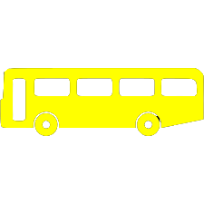

Have you ever travelled in a bus so crowded that there was no place to even stand ? And turns out the next bus that arrived was almost empty
This is a problem that commuters and the other people travelling through local bus have to face everyday.

Slide 7
02
solution

Slide 8
Wouldn’t it be very convenient if you had an application that would predict and estimate which bus you should board, based on the vacancy of the bus.
This is precisely what we want our product and make the travel of our fellow commuters and other people a little more comfortable.

Slide 9
03
Target audience

Slide 10
The product is mainly targeted to people that wish to travel through –
1. bus without prior reservation
2. other modes of travel that don’t require reservation e.g. Local trains/metros.

Slide 11
04
Product idea

Slide 12
We plan to make a web application, which estimates and tells which bus the person should board on the basis of its vacancy and earliest possible arrival time.
Right now our main focus is on developing the product for bus transportation but it can be generalized and also made to work for local train/metro.

Slide 13
Thanks!

