Slide 1

Database Management System Subject Code: 3130703
Prof. Amit Vyas
Department of Computer Engineering
V.V.P. Engineering College

Slide 2
Unit-10
PL/SQL Concepts

Slide 3
Advantages of PL/SQL
Block structure:
PL/SQL consist of block of code, which can be nested within each other.
Each block forms a unit of a task or a logical module.
PL/SQL blocks can be stored in the database and reused.
Procedural language capability:
PL/SQL consist of procedural constructs such as conditional statements (if, if else, nested if, else if ladder) and loops (for, while, do while).

Slide 4
Conti..
Better performance:
PL/SQL engine processes multiple SQL statements simultaneously as a single block, thereby reducing network traffic.
Error handling:
PL/SQL handles errors or exceptions effectively during the execution of PL/SQL program.
Once an exception is caught, specific action can be taken depending upon the type of the exception or it can be displayed to the user with message

Slide 5
View
In SQL, a VIEW is a virtual relation based on the result-set of a SELECT statement.
A view contains rows and columns, just like a real table. The fields in a view are fields from one or more real tables in the database.
In some cases, we can modify a view and present the data as if the data were coming from a single table.

Slide 6
View
Syntax:-
CREATE VIEW view_name AS
SELECT column_name1, column_name2…(s)
FROM table_name
WHERE condition;

Slide 7
Types of View
1. Simple View
2. Complex View

Slide 8
1. Simple View
In a simple view we can delete, update and Insert data and that changes are applied on base table.
Insert operation are perform on simple view only if we have primary key and all not null fields in the view

Slide 9
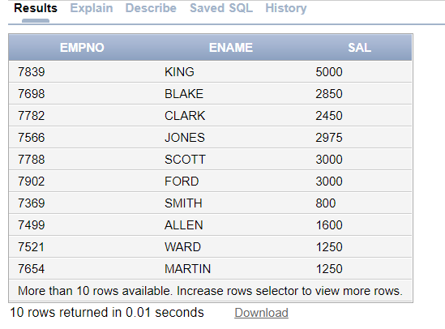
Simple View example
CREATE VIEW emp_view AS
SELECT EMPNO, ENAME, SAL
FROM emp;
select * from emp_view

Slide 10
Complex View
When we create a view on more than one table, it is called complex view.
We can only update data in complex view.
You can't insert data in complex view.
In particular, complex views can contain: join conditions, a group by clause, an order by clause etc.

Slide 11
Create Two table
Employee
Eid | Ename | Salary | Department
101 | Raju | 5000 | Admin
102 | Amit | 8000 | HR
103 | Sanjay | 3000 | IT
104 | Neha | 7000 | Sales
Contact Details
Eid | City | Mobile
101 | Rajkot | 1234567890
102 | Ahmedabad | 1234567891
103 | Baroda | 1234567892
104 | Rajkot | 1234567893

Slide 12
Syntax
CREATE VIEW Empview
AS
SELECT Employee.Eid, Employee.Ename, ContactDetails .City
FROM Employee Inner Join ContactDetails
On Employee.Eid= ContactDetails.Eid;

Slide 13
output
Select * from Empview;
Eid | Ename | City
101 | Raju | Rajkot
102 | Amit | Ahmedabad
103 | Sanjay | Baroda
104 | Neha | Rajkot

Slide 14
Stored procedure
A stored procedure (proc) is a group of PL/SQL statements that performs specific task.
A procedure has two parts, header and body.
The header consists of the name of the procedure and the parameters passed to the procedure.
The body consists of declaration section, execution section and exception section.
A procedure do not return any value(function return). A procedure may return more than one value.

Slide 15
Stored procedure
Create:-It will create a procedure.
Replace :- It will re-create a procedure if it already exists.
IN-parameters: - An IN parameter lets you pass a value to the subprogram. It is a read-only parameter.
OUT-parameters: - This is similar to a return type in functions but procedure can return values for more than one parameters.
IN OUT-parameters: - This type of parameter allows us to pass values into a procedure and get output values from the procedure.

Slide 16
Stored procedure (Syntax)
CREATE PROCEDURE [or REPLACE ] PROCEDURE procedure_name
@parameter_name data_type,
....
parameter_name data_type
IS/AS
BEGIN
-- SQL statements
-- SELECT, INSERT, UPDATE, or DELETE statement
END

Slide 17
Stored procedure (example)
CREATE OR REPLACE PROCEDURE Sum (a IN number, b IN number)
IS
c number;
BEGIN
c := a+b;
dbms_output.put_line('Sum of two nos= '|| c);
END Sum;

Slide 18
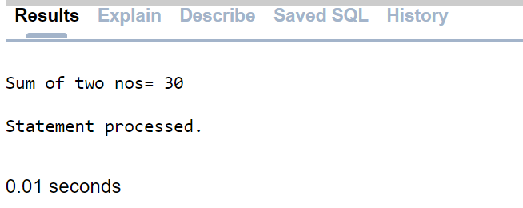
Conti..
DECLARE
a number;
b number;
BEGIN
a := 10;
b := 20;
Sum(a,b);
END;

Slide 19
Stored procedure (example)
CREATE OR REPLACE FUNCTION addition(a IN number, b IN number) RETURN Number
IS
c number;
BEGIN
c := a+b;
RETURN c;
END;

Slide 20
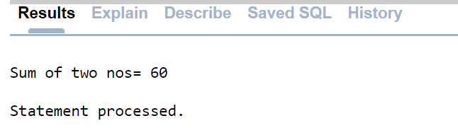
Conti..
DECLARE
no1 number;
no2 number;
result number;
BEGIN
no1 := 20;
no2 := 40;
result := addition(no1,no2);
dbms_output.put_line('Sum of two nos= '|| result );
END;

Slide 21
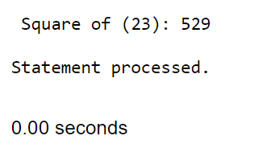
Stored procedure (example)
DECLARE
a number;
PROCEDURE squareNum(x IN OUT number) IS
BEGIN
x := x * x;
END;
BEGIN a:= 23;
squareNum(a);
dbms_output.put_line(' Square of (23): ' || a);
END; /

Slide 22
Advantages of stored procedure
Security:- We can improve security by giving rights to selected persons only.
Faster Execution:- It is precompiled so compilation of procedure is not required every time you call it.
Sharing of code:- Once procedure is created and stored, it can be used by more than one user.
Productivity:- Code written in procedure is shared by all programmers. This eliminates redundant coding by multiple programmers so overall improvement in productivity.

Slide 23
Database triggers
A trigger is a PL/SQL block structure which is triggered (executed) automatically when DML statements like Insert, Delete, and Update is executed on a table.
In SQL Server we can create the following 3 types of triggers:
Data Definition Language (DDL) triggers
Data Manipulation Language (DML) triggers
Logon triggers

Slide 24
Data Definition Language (DDL) triggers
In SQL Server we can create triggers on DDL statements (like CREATE, ALTER and DROP) and certain system-defined Stored Procedures that does DDL-like operations.

Slide 25
Data Manipulation Language (DML) triggers
In SQL Server we can create triggers on DML statements (like INSERT, UPDATE and DELETE) and Stored Procedures that do DML-like operations. DML Triggers are of two types.
After trigger (using FOR/AFTER CLAUSE)
Instead of trigger (using INSTEAD OF CLAUSE)

Slide 26
DML Triggers are of two types.
1. After trigger (using FOR/AFTER CLAUSE) : After triggers are executed after completing the execution of DML statements.
Example: If you insert a record/row into a table then the trigger related/associated with the insert event on this table will executed only after inserting the record into that table.
If the record/row insertion fails, SQL Server will not execute the after trigger.

Slide 27
Data Manipulation Language (DML) triggers
DML Triggers are of two types.
Instead of Trigger (using INSTEAD OF CLAUSE) : Instead of trigger are executed before starts the execution of DML statements.
An instead of trigger allows us to skip an INSERT, DELETE, or UPDATE statement to a table and execute other statements defined in the trigger instead. The actual insert, delete, or update operation does not occur at all.

Slide 28
Data Manipulation Language (DML) triggers
Example: If you insert a record/row into a table then the trigger related/associated with the insert event on this table will be executed before inserting the record into that table.
If the record/row insertion fails, SQL Server will execute the Instead of Trigger.

Slide 29
Logon triggers
This type of trigger is executed against a LOGON event before a user session is established to the SQL Server.

Slide 30
Database triggers
When triggers can be used,
Based on change in one table, we want to update other table.
Automatically update derived columns whose values change based on other columns.
Logging.
Enforce business rules.

Slide 31
Triggers (syntax)
CREATE [OR ALTER] TRIGGER trigger_name
ON table_name
{ FOR | AFTER | INSTEAD OF }
{ [ INSERT ] [ , ] [ UPDATE ] [ , ] [ DELETE ] }
AS
BEGIN
Executable statements
END;

Slide 32
Triggers
CREATE [OR ALTER ] TRIGGER trigger_name:-
This clause creates a trigger with the given name or overwrites an existing trigger.
[ON table_name]:-
This clause identifies the name of the table or view to which the trigger is related.
{ FOR | AFTER | INSTEAD OF }:-
This clause indicates at what time the trigger should be fired. Before executing DML statements or after executing DML statements.

Slide 33
Triggers
{ [ INSERT ] [ , ] [ UPDATE ] [ , ] [ DELETE ] } :-
This clause determines on which kind of statement the trigger should be fired.
Either on insert or update or delete or combination of any or all.
More than one statement can be used together separated by comma. The trigger gets fired at all the specified triggering event.

Slide 34
Triggers example
CREATE OR REPLACE TRIGGER display_salary_changes
BEFORE DELETE OR INSERT OR UPDATE ON customers
FOR EACH ROW
WHEN (NEW.ID > 0)
DECLARE
sal_diff number;
BEGIN
sal_diff := :NEW.salary - :OLD.salary;
dbms_output.put_line('Old salary: ' || :OLD.salary);
dbms_output.put_line('New salary: ' || :NEW.salary);
dbms_output.put_line('Salary difference: ' || sal_diff);
END;
/

Slide 35
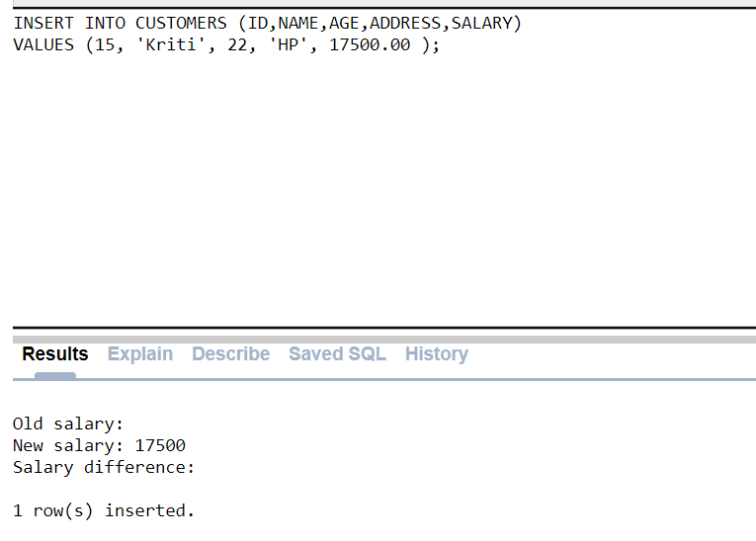
INSERT INTO CUSTOMERS (ID,NAME,AGE,ADDRESS,SALARY)
VALUES (15, 'Kriti', 22, 'HP', 17500.00 );

Slide 36
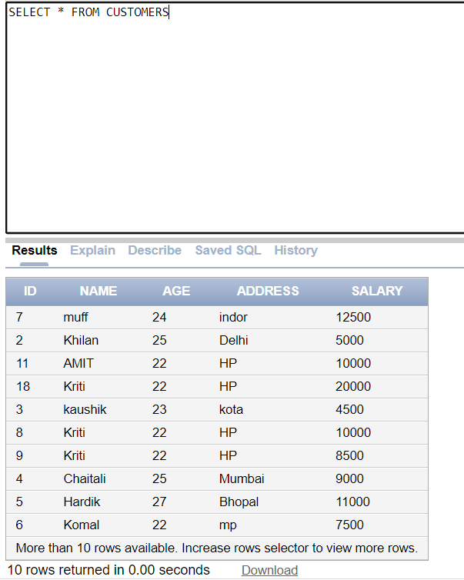
Customers table

Slide 37
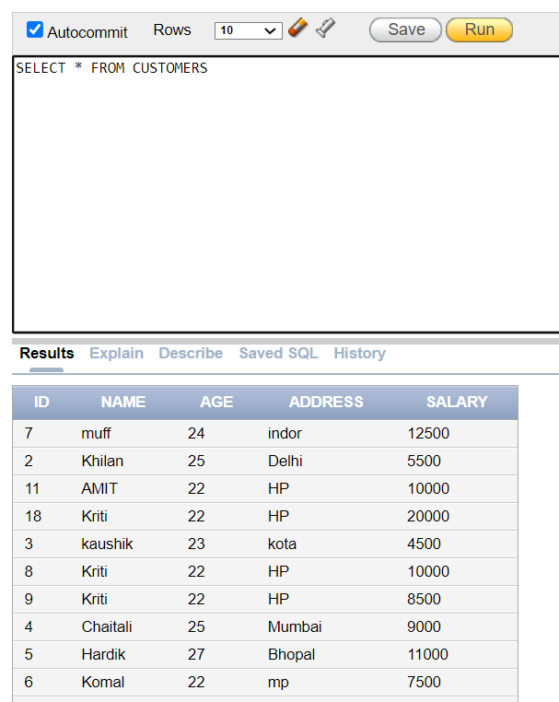
UPDATE RECORD
UPDATE customers
SET salary = salary + 500
WHERE id = 2;

Slide 38
Cursor
Cursors are database objects used to traverse the results of a select SQL query.
It is a temporary work area created in the system memory when a select SQL statement is executed.
This temporary work area is used to store the data retrieved from the database, and manipulate this data.

Slide 39
Conti..
It points to a certain location within a record set and allow the operator to move forward (and sometimes backward, depending upon the cursor type).
We can process only one record at a time.
The set of rows the cursor holds which is called the active set (active data set).
Cursors are often criticized for their high overhead.

Slide 40
Types of cursor
Implicit cursors:
These are created by default by SQL itself when DML statements like, insert, update, and delete statements are executed.
They are also created when a SELECT statement returns just one row.
We cannot use implicit cursors for user defined work.
Explicit cursors:
Explicit cursors are user defined cursors written by the developer.
They can be created when a SELECT statement returns more than one row.
Even though the cursor stores multiple records, only one record can be processed at a time, which is called as current row.
When you fetch a row, the current row position moves to next row.

Slide 41
Steps to manage explicit cursor
Declare Cursor: A cursor is declared by defining the SQL statement that returns a result set.
Open: A Cursor is opened and populated by executing the SQL statement defined by the cursor.
Fetch: When the cursor is opened, rows can be fetched from the cursor one by one or in a block to perform data manipulation.
Close: After data manipulation, close the cursor explicitly.
Deallocate: Finally, delete the cursor definition and release all the system resources associated with the cursor.

Slide 42
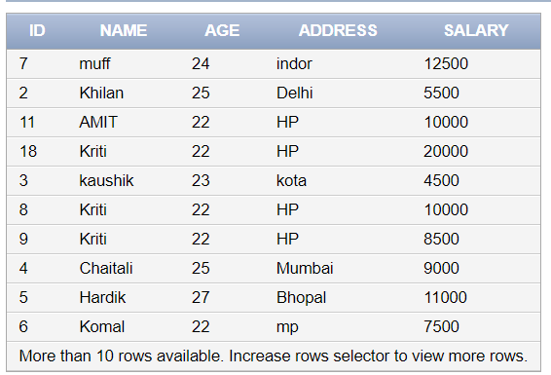
Implicit cursors:
Select * from customer

Slide 43
Cursor example
DECLARE
total_rows number(2);
BEGIN
UPDATE customers
SET salary = salary + 1500;
IF sql%notfound THEN
dbms_output.put_line('no customers selected');
ELSIF sql%found THEN
total_rows := sql%rowcount;
dbms_output.put_line( total_rows || ' customers selected ');
END IF;
END;
/

Slide 44
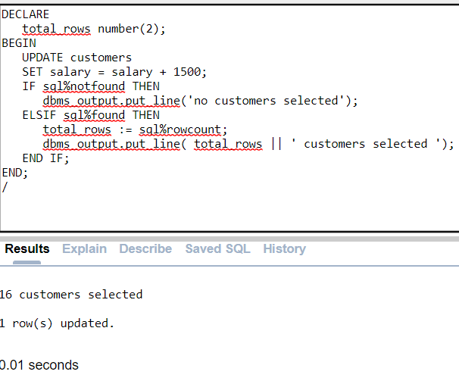

Slide 45
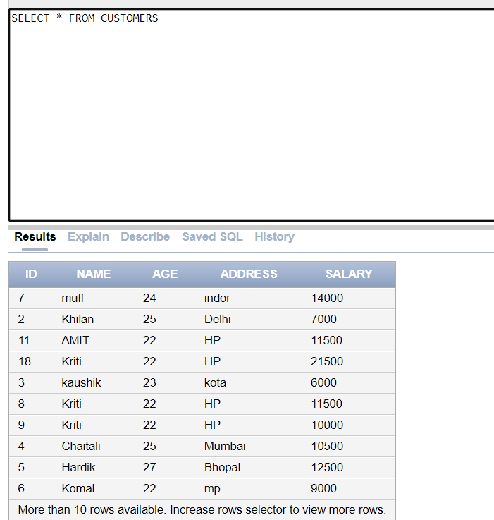
add +1500 values

Slide 46
S.No | Attribute & Description
1 | %FOUND Returns TRUE if an INSERT, UPDATE, or DELETE statement affected one or more rows or a SELECT INTO statement returned one or more rows. Otherwise, it returns FALSE.
2 | %NOTFOUND The logical opposite of %FOUND. It returns TRUE if an INSERT, UPDATE, or DELETE statement affected no rows, or a SELECT INTO statement returned no rows. Otherwise, it returns FALSE.
3 | %ISOPEN Always returns FALSE for implicit cursors, because Oracle closes the SQL cursor automatically after executing its associated SQL statement.
4 | %ROWCOUNT Returns the number of rows affected by an INSERT, UPDATE, or DELETE statement, or returned by a SELECT INTO statement.

Slide 47
Explicit Cursors
Working with an explicit cursor includes the following steps −
Declaring the cursor for initializing the memory
Opening the cursor for allocating the memory
Fetching the cursor for retrieving the data
Closing the cursor to release the allocated memory

Slide 48
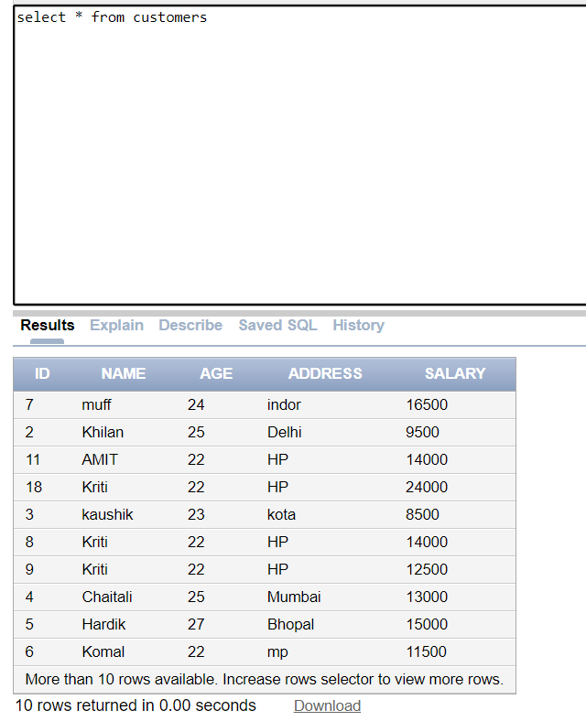

Slide 49
Explicit Cursors
DECLARE
c_id customers.id%type;
c_name customers.name%type;
c_addr customers.address%type;
CURSOR c_customers is
SELECT id, name, address FROM customers;
BEGIN
OPEN c_customers;
LOOP
FETCH c_customers into c_id, c_name, c_addr;
EXIT WHEN c_customers%notfound;
dbms_output.put_line(c_id || ' ' || c_name || ' ' || c_addr);
END LOOP;
CLOSE c_customers;
END;
/

Slide 50
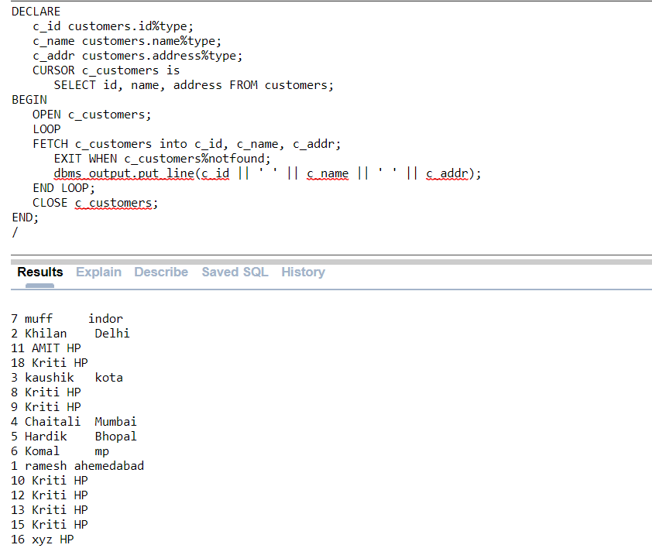

Slide 51
Thank You

