Slide 1

Database Management System Subject Code: 3130703
Prof. Amit Vyas
Department of Computer Engineering
V.V.P. Engineering College

Slide 2
UNIT:5
Query Processing & Optimization

Slide 3
Query Processing:
Scan: reads the language tokens such as SQL keywords, relation names in the text of the query.
Parser: it is check the query syntax to verify it is as per the syntax rules of the query language.
Validate: The query must be validated by checking that all attributes and relation names are valid in schema of particular database being queried by query.

Slide 4
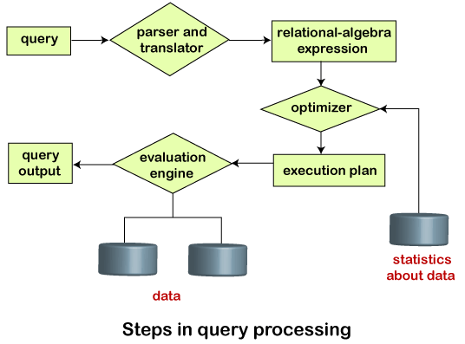

Slide 5
The query is translate into a usable form.
This translation process is similar to the work performed by the parser of a compiler. In generating the internal form of the query, the parser checks the syntax of the user’s query, verifies that the relation names appearing in the query are names of the relations in the database.

Slide 6
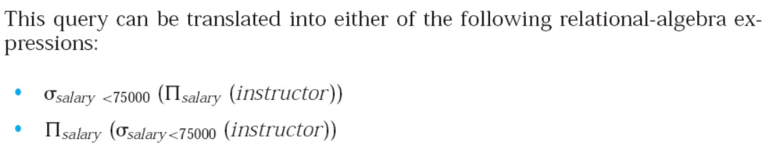
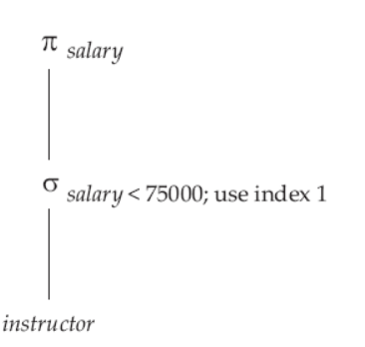
Query Processing/ Relational-algebra expression.
Select salary from instructor where salary < 75000;

Slide 7
The system constructs a parse-tree representation of the query, which it then translates into a relational-algebra expression.
it is the responsibility of the system to construct a query evaluation plan that minimizes the cost of query evaluation; this task is called query optimization.

Slide 8
Once the query plan is chosen, the query is evaluated.
Query evaluation engine, which executes low-level instructions generated by the DML compiler. with that plan, and the result of the query is output.

Slide 9
Measures of Query Cost
Cost is generally measured as the total time required to execute a statement/query.
Factors contribute to time cost
Disk accesses (time to process a data request and retrieve the required data from the storage device)
CPU time to execute a query
Network communication cost

Slide 10
Disk access is the predominant (major) cost, since disk access is slow as compared to in-memory operation.
Cost to write a block is greater than cost to read a block because data is read back after being written to ensure that the write was successful.

Slide 11
Selection Operator
Symbol: σ (Sigma)
Notation: σ _{condition} (Relation)
Operation: Selects tuples from a relation that satisfy a given condition.
Operators: =, <>, <, >, <=, >=, Λ (AND), V (OR)

Slide 12
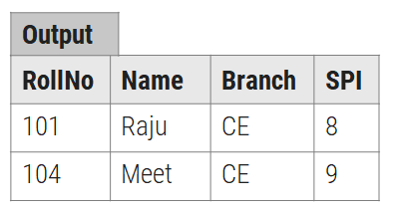
Display the detail of students belongs to “CE” Branch.
Roll.No | Name | Branch | SPI
101 | Raju | CE | 8
102 | Mitesh | ME | 9
103 | Nilesh | CH | 9
104 | Meet | CE | 9
σ_{Branch=‘CE’} (Student)

Slide 13
Linear search (A1)
It scans each blocks and tests all records to see whether they satisfy the selection condition.
Cost of linear search (worst case) = br
br denotes number of blocks containing records from relation r

Slide 14
If the selection condition is there on a (primary) key attribute, then system can stop searching if the required record is found.
cost of linear search (best case) = (br /2)
If the selection is on non (primary) key attribute then multiple block may contains required records, then the cost of scanning such blocks need to be added to the cost estimate.

Slide 15
we search an element or value in a given array by traversing the array from the starting, till the desired element or value is found. It compares the element to be searched with all the elements present in the array and when the element is matched successfully,

Slide 16
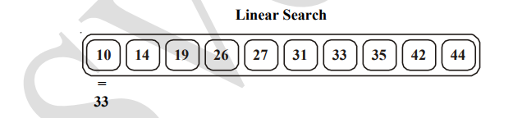
it returns the index of the element in the array, else it return -1.
Linear Search is applied on unsorted or unordered lists, when there are fewer elements in a list.

Slide 17
Binary search (A2)
Generally, this algorithm is used if selection is an equality comparison on the (primary) key attribute and file (relation) is ordered (sorted) on (primary) key attribute.
Worst case: cost of binary search = [log2(br)]
Best case: if find a index O(1)
This algorithm is faster than linear search algorithm.

Slide 18
BINARY SEARCH
Binary Search is used with sorted array or list.
1. We start by comparing the element to be searched with the element in the middle of the list/array.
2. If we get a match, we return the index of the middle element.
3. If we do not get a match, we check whether the element to be searched is less or greater than in value than the middle element.

Slide 19
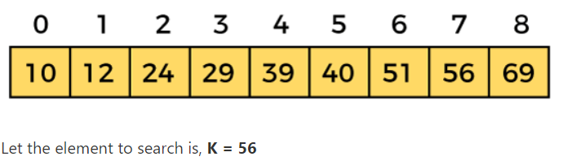
mid = (beg + end)/2
So, in the given array -
beg = 0
end = 8
mid = (0 + 8)/2 = 4. So, 4 is the mid of the array.

Slide 20
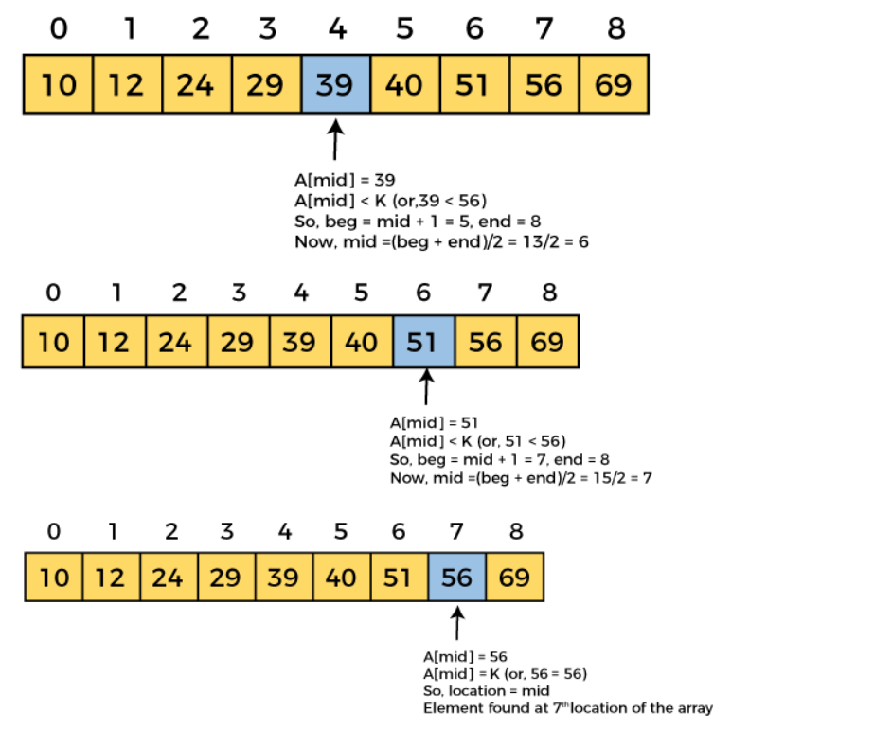

Slide 21
Query optimization

Slide 22
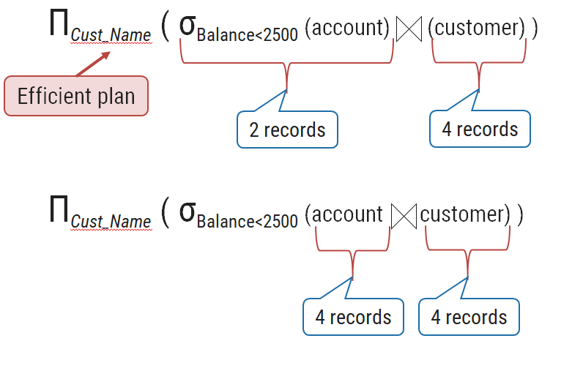
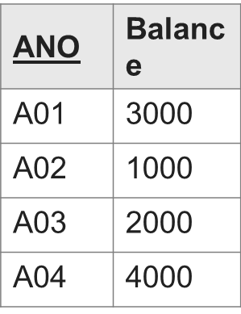
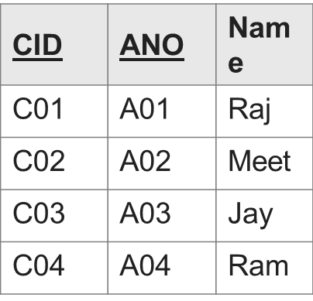
It is a process of selecting the most efficient query evaluation plan from the available possible plans. (balance less than 2500)

Slide 23
Approaches to Query Optimization
Exhaustive Search Optimization
Generates all possible query plans and then the best plan is selected.
Heuristic Based Optimization
Heuristic based optimization uses rule-based optimization approaches for query optimization.

Slide 24
Performs select and project operations before join operations. This is done by moving the select and project operations down the query tree. This reduces the number of tuples available for join.
Avoid cross-product operation because they result in very large-sized intermediate tables.
This algorithms do not necessarily produce the best query plan.

Slide 25
Evaluation of expressions
evaluating an expression that carries multiple operations in it, we can perform the computation of each operation one by one. However, in the query processing system, we use two methods for evaluating an expression carrying multiple operations. These methods are:
Materialization
Pipelining

Slide 26
Materialization
Materialization is an easy approach for evaluating multiple operations of the given query and storing the results in the temporary relations.
The result can be the output of any join condition, selection condition, and many more.

Slide 27
It is similar to the cache memory where the searched data get settled temporarily. But, it leads to a drawback of producing a high number of temporary files. It makes the query-evaluation less efficient.

Slide 28
In the operator tree, we begin from the lowest-level operations (at the bottom of the tree) in the expression.
For example, suppose we want to fetch the name of the student as 'John' from the 'Student' relation. The relation expression will be: σ _{name= "John"} (Student)

Slide 29
Pipelining
In this approach, after evaluating one operation, its output is passed on to the next operation, and the chain continues till all the relational operations are evaluated thoroughly.
Pipelining helps in improving the efficiency of the query-evaluation by decreasing the production of a number of temporary files. Actually, we reduce the construction of the temporary files by merging the multiple operations into a pipeline..

Slide 30
Thus, there is no requirement of storing a temporary relation in pipelining. Such an advantage of pipelining makes it a better approach as compared to the approach used in the materialization method.
Even the costs of both approaches can have subsequent differences in-between. But, both approaches perform the best role in different cases. Thus, both ways are feasible at their place.

Slide 31
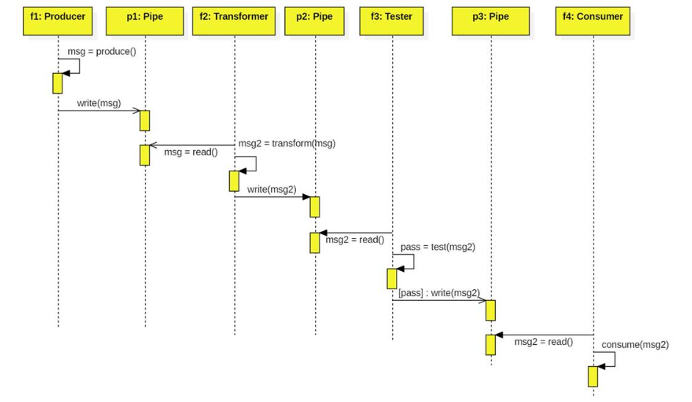

Slide 32
Pipelining | Materialization
It is a modern approach to evaluate multiple operations. | It is a traditional approach to evaluate multiple operations.
It does not use any temporary relations for storing the results of the evaluated operations. | It uses temporary relations for storing the results of the evaluated operations. So, it needs more temporary files and I/O.
It is a more efficient way of query evaluation as it quickly generates the results. | It is less efficient as it takes time to generate the query results.
Poor performance if trashing occurs. | No trashing occurs in materialization

Slide 33
Pipeline
Demand-driven Pipeline:
the system repeatedly makes tuples request from the operation, which is at the top of the pipeline.
In case, the inputs of the operation are not pipelined, then we compute the next returning tuples from the input relations only.

Slide 34
Producer-driven Pipeline
The operations do not wait for the system request for producing the tuples. Instead, the operations are eager to produce such tuples.
In the producer-driven pipeline, it models each operation as a separate thread or process within the system. Here, the system gets a stream of tuples from its pipelined inputs and finally generates or produces a stream of tuples for its output.

Slide 35
Demand vs Producer
Demand-driven Pipeline | Producer-driven Pipeline
It is similar to pulling data up from the top of an operation tree. | It is similar to pushing data up from the below of an operation tree.
Tuples are generated in a lazy manner. | Tuples are eagerly generated.
It is easy to implement. | It is not so easy to implement a producer-driven pipeline.
It is most commonly used for evaluating an expression. | It is typical so rarely used in the systems. But, it is good for systems such as parallel processing systems.

Slide 36
Query
Query optimization is the process of selecting the most efficient query-evaluation plan from among the many strategies usually possible for processing a given query, especially if the query is complex.
We do not expect users to write their queries so that they can be processed efficiently.

Slide 37
Find the name of all customers who have account at any branch located in Pune”
Πcustomer-name (σ branch-city=”pune” (branch (account depositor)))
The above query may be written as below
Πcustomer-name (σ branch-city=”pune” (branch) (account depositor))

Slide 38
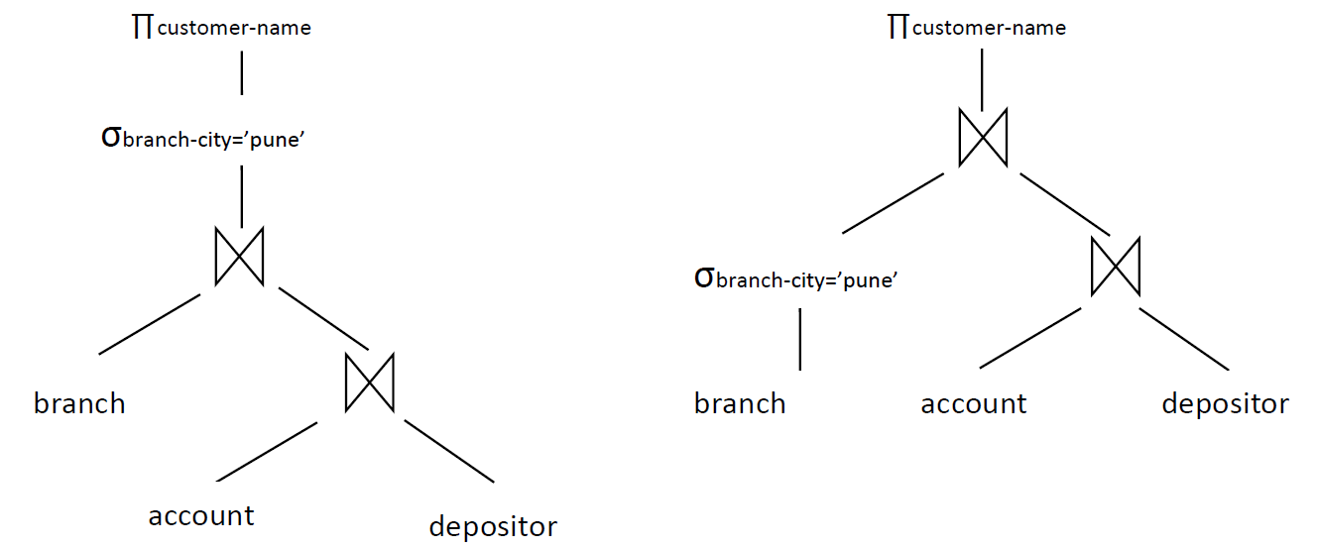
In the second algebra expression the size of intermediate result is smaller than first because it will only contain the records of pune branch city. Final result of both the expression is same.

Slide 39
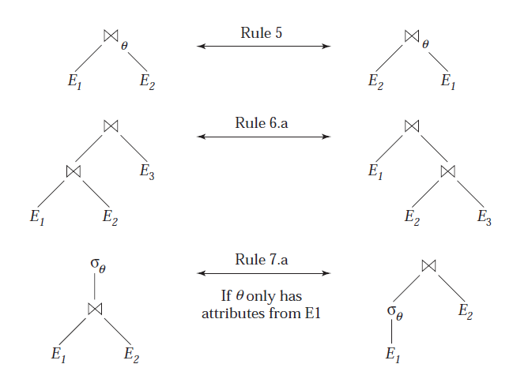
Pictorial representation of equivalences

Slide 40
Transformation of relational expressions

Slide 41
Two relational algebra expressions are said to be equivalent if the two expressions generate the same set of tuples. ( Balance is less than 2500)
Π_{Name} (σ_{Balance<2500}(Account) (Customer) )
Π_{Name} ( σ_{Balance<2500} (Account Customer) )
CID | ANO | Name
C01 | A01 | Raj
C02 | A02 | Meet
C03 | A03 | Jay
C04 | A04 | Ram
ANO | Balance
A01 | 3000
A02 | 1000
A03 | 2000
A04 | 4000
Name
Meet
Jay

Slide 42
Combined selection operation can be divided into sequence
ANO is less than 3 AND Balance is less than 2000
CID | ANO | Name | Balance
C01 | 1 | Raj | 3000
C02 | 2 | Meet | 1000
C03 | 3 | Jay | 2000
C04 | 4 | Ram | 4000
σ_{ANO<3 Λ Balance<2000} (Customer)
CID | ANO | Name | Balance
C02 | 2 | Meet | 1000
σ_{ANO<3} (σ_{Balance<2000} (Customer))
σ_{θ1Λθ2} (E) = σ_{θ1} (σ_{θ2} (E))

Slide 43
Selection operations are commutative.
ANO no is less than 3 AND Balance is less than 2000
CID | ANO | Name | Balance
C01 | 1 | Raj | 3000
C02 | 2 | Meet | 1000
C03 | 3 | Jay | 2000
C04 | 4 | Ram | 4000
σ_{ANO<3} (σ_{Balance<2000} (Customer))
CID | ANO | Name | Balance
C02 | 2 | Meet | 1000
σ_{Balance<2000} (σ_{ANO<3} (Customer))
σ_{θ1} (σ_{θ2} (E)) = σ_{θ2} (σ_{θ1} (E))

Slide 44
If more than one projection operation is used in expression then only the outer projection operation is required. So skip all the other inner projection operation.
CID | ANO | Name | Balance
C01 | 1 | Raj | 3000
C02 | 2 | Meet | 1000
C03 | 3 | Jay | 2000
C04 | 4 | Ram | 4000
Π_{Name} (Π_{ANO, Name} (Customer))
Name
Raj
Meet
Jay
Ram
Π_{Name} (Customer)
Π_{L1} (Π_{L2} (…(Π _{Ln} (E))…)) = Π_{L1} (E)

Slide 45
Transformation of relational expressions
Selection operation can be joined with Cartesian product and theta join.
CID | ANO | Name
C01 | 1 | Raj
C02 | 2 | Meet
C03 | 3 | Jay
C04 | 4 | Ram
ANO | Balance
1 | 3000
2 | 1000
3 | 2000
4 | 4000
σ_{ANO<3} (Customer Account)
Output
CID | ANO | Name | Balance
C01 | 1 | Raj | 3000
C02 | 2 | Meet | 1000
(Customer) σ_{ANO<3} (Account)
σ_{θ} (E1 E2)) = E1 _{θ}E2
σ_{θ1} (E1 _{θ2} E2)) = E1 _{θ1Λ θ2} E2

Slide 46
Theta operations are commutative.
CID | ANO | Name
C01 | 1 | Raj
C02 | 2 | Meet
C03 | 3 | Jay
C04 | 4 | Ram
ANO | Balance
1 | 3000
2 | 1000
3 | 2000
4 | 4000
(Account) σ_{ANO<3} (Customer)
Output
CID | ANO | Name | Balance
C01 | 1 | Raj | 3000
C02 | 2 | Meet | 1000
(Customer) σ_{ANO<3} (Account)
E1 σ_{θ} E2 = E2 σ_{θ} E1

Slide 47
Set operations union and intersection are associative.
Output
(Customer U Employee) U Student
Name
Raj
Meet
Suresh
Customer
Raj
Meet
Employees
Meet
Suresh
Student
Raj
Meet
Customer U (Employee U Student)
(Customer ∩ Employee) ∩ Student
Output
Cst_Name
Raj
Meet
Emp_Name
Meet
Suresh
Stu_Name
Raj
Meet
Name
Meet
Customer ∩ (Employee ∩ Student)
(E1 U E2) U E3 = E1 U (E2 U E3) & (E1 ∩ E2) ∩ E3 = E1 ∩ (E2 ∩ E3)

Slide 48
Equivalence Rules
1. Conjunctive selection operations can be deconstructed into a sequence of individual selections. This transformation is referred to as a cascade of .
2. Selection operations are commutative.
σ_{θ1Λθ2} (E) = σ_{θ1} (σ_{θ2} (E))
σ_{θ1} (σ_{θ2} (E)) = σ_{θ2} (σ_{θ1} (E))

Slide 49
3.Projection : Only the final operations in a sequence of projection operations are needed; the others can be omitted. This transformation can also be referred to as a cascade of .
Π_{L1} (Π_{L2} (…(Π _{Ln} (E))…)) = Π_{L1} (E)

Slide 50


4. Selections can be combined with Cartesian products and theta joins.
This expression is just the definition of the theta join

Slide 51



5. Theta-join operations are commutative.
6.Natural-join operations are associative.
Theta joins are associative in the following manner:

Slide 52


7. The selection operation.
It distributes when all the attributes in selection condition 0 involve only the attributes of one of the expressions (say, E1) being joined.
It distributes when selection condition 1 involves only the attributes of E1 and 2 involves only the attributes of E2.

Slide 53

8. The projection operation distributes over the theta-join operation under the following conditions
Consider a join E1 E2. Let L1 and L2 be sets of attributes from E1 and E2, respectively. Let L3 be attributes of E1 that are involved in join condition , but are not in L1 ∪ L2, and let L4 be attributes of E2 that are involved in join condition , but are not in L1 ∪ L2. Then,

Slide 54
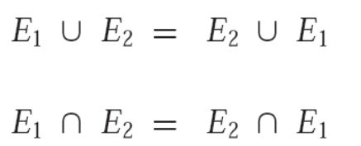
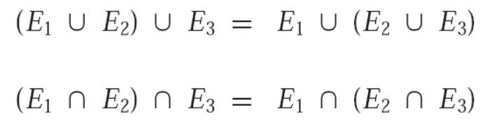
9.The set operations union and intersection are commutative, Set difference is not commutative.
10. Set union and intersection are associative.

Slide 55


11. The selection operation distributes over the union, intersection, and set difference operations
Similarly, the preceding equivalence, with − replaced with either ∪ or ∩, also holds

Slide 56

12. The projection operation distributes over the union operation

Slide 57
Sorting and joins

Slide 58
Sorting
We can sort a relation by building an index on the relation and then using that index to read the relation in sorted order.
Such a process orders the relation only logically rather than physically.
Merge sort

Slide 59
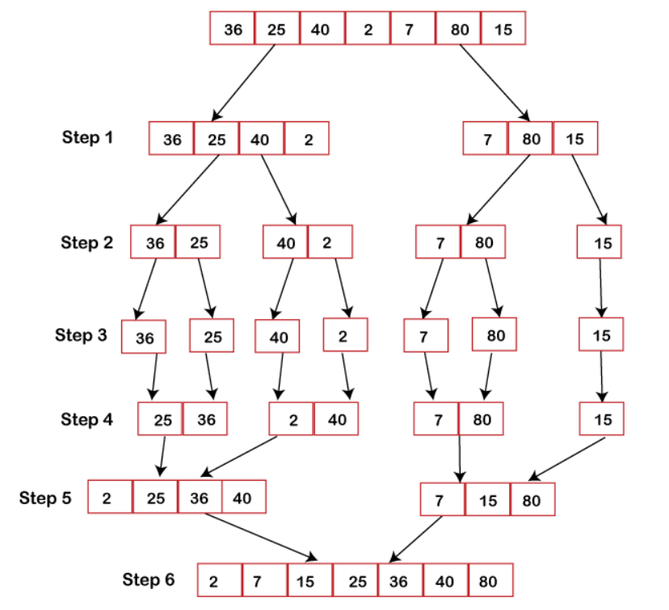

Slide 60
Several of the relational operations, such as joins, can be implemented efficiently if the input relations are first sorted.
We can sort a relation by building an index on the relation and then using that index to read the relation in sorted order.
Such a process orders the relation only logically rather than physically.

Slide 61
reading of tuples in the sorted order may lead to disk access for each record, which can be very expensive.
So it is desirable to order the records physically.

Slide 62
Sorting
Several of the relational operations, such as joins, can be implemented efficiently if the input relations are first sorted.
We can sort a relation by building an index on the relation and then using that index to read the relation in sorted order.
Such a process orders the relation is desirable to order the records physically.

Slide 63
External Sort-Merge Algorithm
Sorting of relation that fit into main memory, standard sorting techniques such as quick-sort can be used.
Sorting of relations that do not fit in main memory is called external sorting.
Most commonly used algorithm for this type of sorting is external sort merge algorithm.

Slide 64
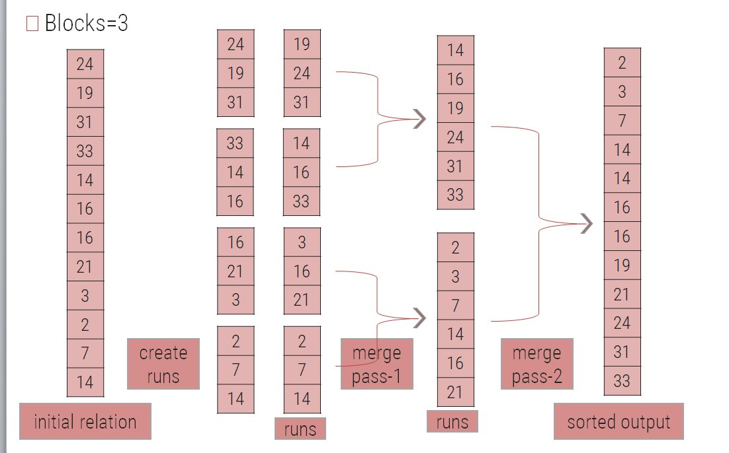

Slide 65
Create sorted runs. Let i be 0 initially.
Repeatedly do the following till the end of the relation:
1) Read M blocks of relation into memory
2) Sort the in-memory blocks
3) Write sorted data to run Ri; then increment i.
Let the final value of i be N

Slide 66
Merge the runs (N-way merge). We assume (for now) that N < M.
Use N blocks of memory to buffer input runs, and 1 block to buffer output. Read the first block of each run into its buffer page
repeat
Select the first record (in sort order) among all buffer pages
Write the record to the output buffer. If the output buffer is full write it to disk.
Delete the record from its input buffer page.
If the buffer page becomes empty then read the next block (if any) of the run into the buffer.
until all input buffer pages are empty:

Slide 67
If N ≥ M, several merge passes are required.
In each pass, contiguous groups of M - 1 runs are merged.
A pass reduces the number of runs by a factor of M -1, and creates runs longer by the same factor.
E.g. If M=11, and there are 90 runs, one pass reduces the number of runs to 9, each 10 times the size of the initial runs
Repeated passes are performed till all runs have been merged into one.

Slide 68
Thank You

