Slide 1

Database Management System Subject Code: 3130703
Prof. Amit Vyas
Department of Computer Engineering
V.V.P. Engineering College

Slide 2
UNIT:7
Transaction Processing

Slide 3
What is transaction?
A set of logically related operations is known as Transaction.
Read(A): Read operations Read(A) or R(A) reads the value of A from the database and stores it in a buffer in main memory.
Write (A): Write operation Write(A) or W(A) writes the value back to the database from buffer.

Slide 4
R(A);
A=A-1000;
W(A);
Assume A’s value before starting of transaction is 5000.
The first operation reads the value of A from database and stores it in a buffer.
Second operation will decrease its value by 1000.
Third operation will write the value from buffer to database. So A’s final value will be 4000.

Slide 5
ACID properties of transaction
Atomicity
Consistency
Isolation
Durability

Slide 6
Atomicity (Either transaction execute 0% or 100%)
Consistency (Database must remain in a consistent state after any transaction)
Isolation (Intermediate transaction results must be hidden from other concurrently executed transactions)

Slide 7
Durability (Once a transaction completed successfully, the changes it has made into the database should be permanent)

Slide 8
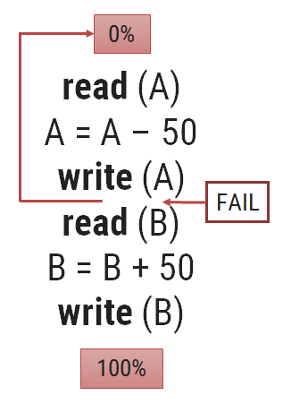
ACID properties of transaction (Atomicity)
This property states that a transaction must be treated as an either all of its operations are executed or none.
Transfer amount A to B.(Assume A=100)
In this transaction, if Rs. 50 is deducted
from account A then it must be added to
account B.

Slide 9
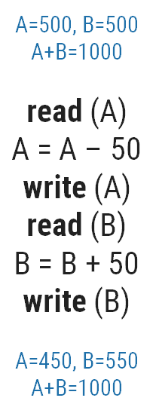
ACID properties of transaction (Consistency)
The database must remain in a consistent state after any transaction.
If the database was in a consistent state before the execution of a transaction, it must remain consistent after the execution of the transaction as well.

Slide 10
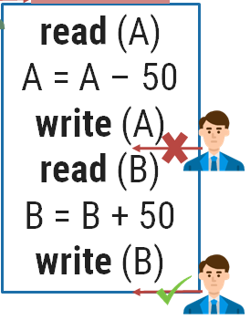
ACID properties of transaction (Isolation)
Changes occurring in a particular transaction will not be visible to any other transaction until it has been committed.
In our example once our transaction starts from first step (step 1) its result should not be access by any other transaction until last step (step 6) is completed.

Slide 11
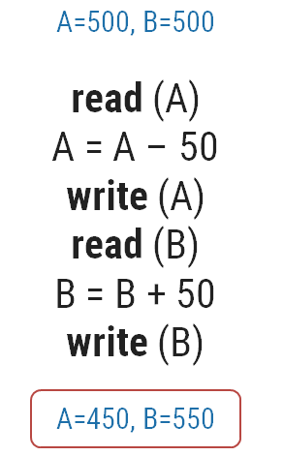
ACID properties of transaction (Durability)
After a transaction completes successfully, the changes it has made to the database permanent, even if there are system failures.
Once our transaction completed up to last step (step 6) its result must be stored permanently. It should not be removed if system fails.

Slide 12
Transaction State Diagram \ State Transition Diagram

Slide 13
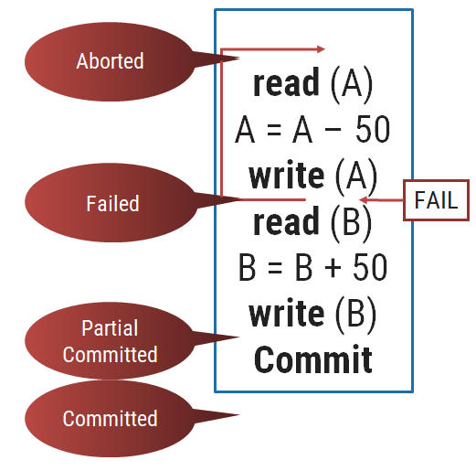
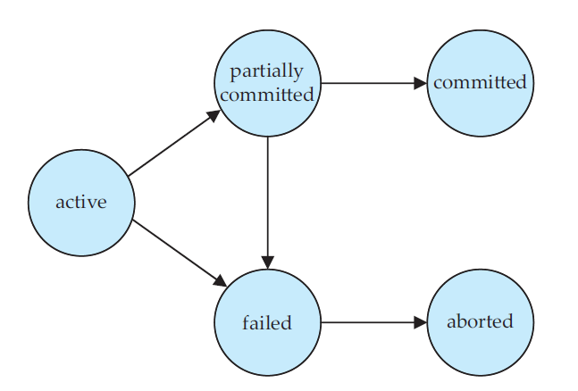
State Transition Diagram
END

Slide 14
Transaction State Diagram \ State Transition Diagram
Active
This is the initial state.
The transaction stays in this state while it is executing.
Partial Committed
When a transaction executes its final operation/ instruction, it is said to be in a partially committed state.

Slide 15
Conti…
Committed
The transaction enters in this state after successful completion of the transaction (after committing transaction).
We cannot abort or rollback a committed transaction.

Slide 16
Conti….
Failed
Discover that normal execution can no longer proceed.
Once a transaction cannot be completed, any changes that it made must be undone rolling it back.

Slide 17
Aborted
The state after the transaction has been rolled back and the database has been restored to its state prior to the start of the transaction.

Slide 18
What is schedule?
A schedule is a process of grouping the transactions into one and executing them in a predefined order.
A schedule is the chronological (sequential) order in which instructions are executed in a system.

Slide 19
A schedule is required in a database because when some transactions execute in parallel, they may affect the result of the transaction.
Means if one transaction is updating the values which the other transaction is accessing, then the order of these two transactions will change the result of another transaction.

Slide 20
T1 : A=1000 B=1000
Read (A)
A = A - 50
Write (A)
Read (B)
B = B + 50
Write (B)
Commit

Slide 21
T2
Read (A) Assume : A=500 B=500
temp = A * 0.1
A = A - temp
Write (A)
Read (B)
B = B + temp
Write (B)
Commit

Slide 22
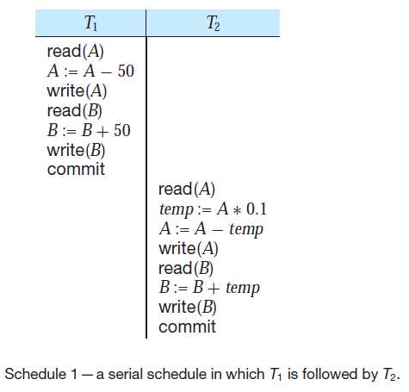

Slide 23
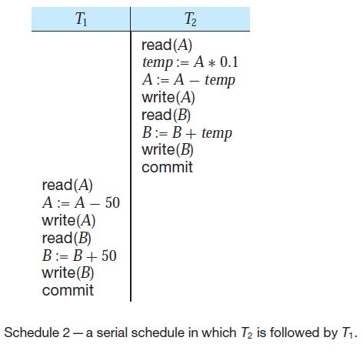

Slide 24
Serial Schedule
T1 | T2
Read (A) A = A - 50 Write (A) Read (B) B = B + 50 Write (B) Commit
 | Read (A) temp = A * 0.1 A = A - temp Write (A) Read (B) B = B + temp Write (B) Commit
Serial Schedule
T1 | T2
 | Read (A) A = A - 50 Write (A) Read (B) B = B + 50 Write (B) Commit
Read (A) temp = A * 0.1 A = A - temp Write (A) Read (B) B = B + temp Write (B) Commit

Slide 25
Non-serial Schedule (Interleaved Schedule)
Schedule that interleave the execution of different transactions.
Means second transaction is started before the first one could end and execution can switch between the transactions back and forth.
It contains many possible orders in which the system can execute the individual operations of the transactions.

Slide 26
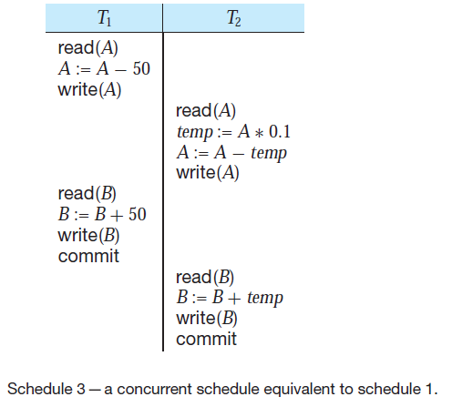

Slide 27
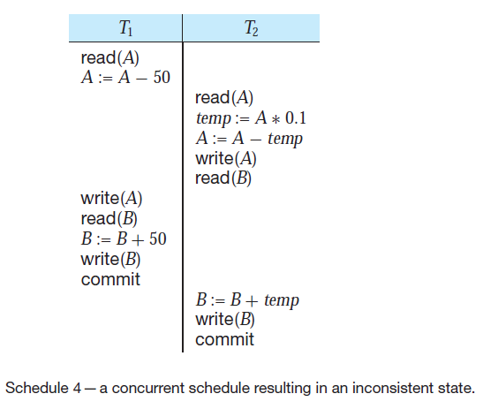

Slide 28
Equivalent Schedule
If two schedules produce the same result after execution, they are said to be equivalent schedule.
They may yield the same result for some value and different results for another set of values.
That's why this equivalence is not generally considered significant.

Slide 29
Serializability
A schedule is serializable if it is equivalent to a serial schedule.
In serial schedules, only one transaction is allowed to execute at a time i.e. no concurrency is allowed.
Whereas in serializable schedules, multiple transactions can execute simultaneously i.e. concurrency is allowed.
Types (forms) of serializability
Conflict serializability
View serializability

Slide 30
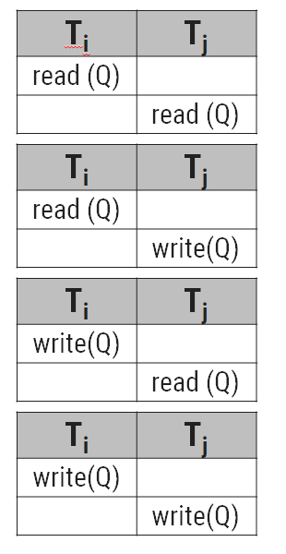
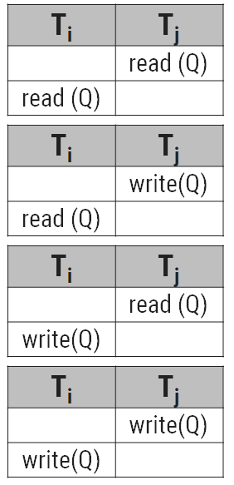
Conflict serializability
Let l_{i} and l_{j} be two instructions of
transactions T_{i} and T_{j} respectively.
l_{i} = read(Q), l_{j} = read(Q)
l_{i} and l_{j} don’t conflict
l_{i} = read(Q), l_{j} = write(Q)
l_{i} and l_{j} conflict
l_{i} = write(Q), l_{j} = read(Q)
l_{i} and l_{j} conflict
l_{i} = write(Q), l_{j} = write(Q)
l_{i} and l_{j} conflict

Slide 31
Conflict serializability
If a given schedule can be converted into a serial schedule by swapping its non-conflicting operations, then it is called as a conflict serializable schedule.

Slide 32
Conflict serializability (Example)
T1 | T2
Read (A) A = A - 50 Write (A) | Read (A) Temp = A * 0.1 A = A - temp Write (A)
Read (B) B = B + 50 Write (B) Commit | Read (B) B = B + temp Write (B) Commit
T1 | T2
Read (A) A = A - 50 Write (A) Read (B) B = B + 50 Write (B) Commit
 | Read (A) Temp = A * 0.1 A = A - temp Write (A) Read (B) B = B + temp Write (B) Commit

Slide 33
Conflict serializability (Example)
Example of a schedule that is not conflict serializable:
We are unable to swap instructions in the above schedule to obtain either the serial schedule <T1, T2>, or the serial schedule <T2, T1>.
T1 | T2
Read (A) Read (A) | Write (A)

Slide 34
View serializability
Let S1 and S2 be two schedules with the same set of transactions. S1 and S2 are view equivalent if the following three conditions are satisfied, for each data item Q
Initial Read
Updated Read
Final Write
If a schedule is view equivalent to its serial schedule then the given schedule is said to be view serializable.

Slide 35
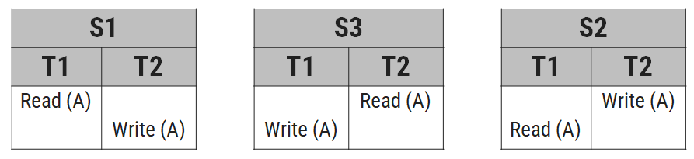
Initial Read
Above two schedules S1 and S2 are view equivalent because initial read operation in S1 is done by T1 and in S2 it is also done by T1.

Slide 36
Initial Read
Above two schedules S1 and S3 are not view equivalent because initial read operation in S1 is done by T1 and in S3 it is done by T2.

Slide 37
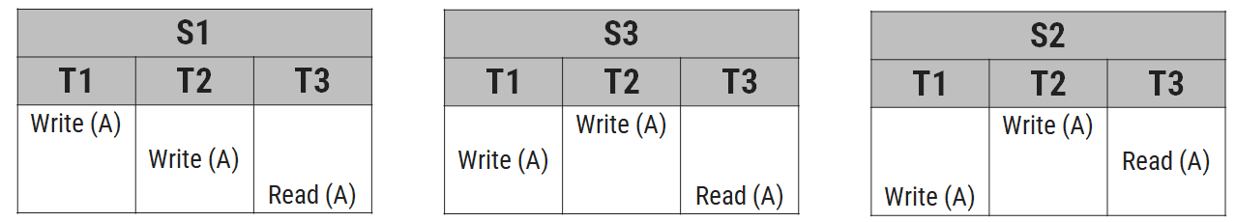
Updated Read
Above two schedules S1 and S2 are view equal because, in S1, T3 is reading A that is updated by T2 and in S2 also, T3 is reading A which is updated by T2.

Slide 38
Updated Read
Above two schedules S1 and S3 are not view equal because, in S1, T3 is reading A that is updated by T2 and in S3, T3 is reading A which is updated by T1.

Slide 39
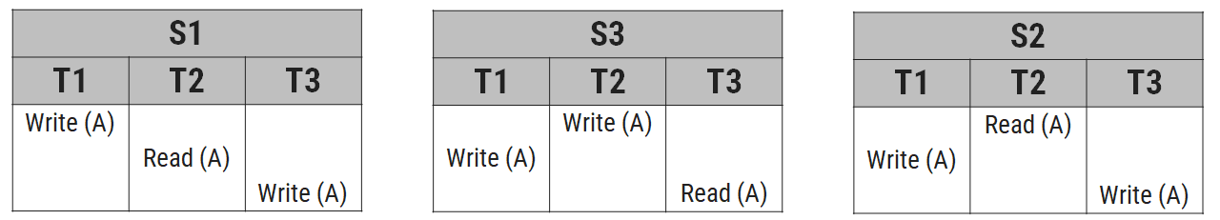
Final Write
Above two schedules S1 and S2 are view equal because final write operation in S1 is done by T3 and in S2 also the final write operation is also done by T3.

Slide 40
Final Write
Above two schedules S1 and S3 are not view equal because final write operation in S1 is done by T3 and in S3 final write operation is also done by T1.

Slide 41
Two phase commit protocol
Two phase commit protocol ensures that all participants perform the same action (either to commit or to rollback a transaction).
It is designed to ensure that either all the databases are updated or none of them, so that the databases remain synchronized.

Slide 42
In two phase commit protocol there is one node which is act as a coordinator or controlling site and all other participating node are known as cohorts or participant or slave.
Coordinator (controlling site) – the component that coordinates with all the participants.
Cohorts (Participants/Slaves) – each individual node except coordinator are participant.

Slide 43
Concurrency
Concurrency is the ability of a database to allow multiple (more than one) users to access data at the same time.
Three problems due to concurrency
Lost update problem
Dirty read problem
Incorrect retrieval problem

Slide 44
Lost update problem
This problem indicate that if two transactions T1 and T2 both read the same data and update it then effect of first update will be overwritten by the second update.
How to avoid: A transaction T2 must not update the data item (X) until the transaction T1 can commit data item (X).

Slide 45
Dirty read problem
Assume X=100
The dirty read arises when one transaction update some item and then fails due to some reason. This updated item is retrieved by another transaction before it is changed back to the original value.
How to avoid: A transaction T1 must not read the data item (X) until the transaction T2 can commit data item (X).
T1 | Time | T2
--- | T0 | ---
--- | T1 | Update X X=50
Read X | T2 | ---
--- | T3 | Rollback
--- | T4 | ---

Slide 46
Incorrect retrieval problem
Balance (A=200, B=250, C=150)
T1 | Time | T2
Read (A) Sum ← 200 | T1 | ---
Read (B) Sum ← Sum + 250 = 450 | T2 | ---
--- | T3 | Read (C)
--- | T4 | Update (C) 150 → 150 – 50 = 100
--- | T5 | Read (A)
--- | T6 | Update (A) 200 → 200 + 50 = 250
--- | T7 | COMMIT
Read (C) Sum ←Sum + 100 = 550 | T8 | ---
The inconsistent retrieval problem arises when one transaction retrieves data to use in some operation but before it can use this data another transaction updates that data and commits.

Slide 47
Through this change will be hidden from first transaction and it will continue to use previous retrieved data. This problem is also known as inconsistent analysis problem.
How to avoid: A transaction T2 must not read or update data item (X) until the transaction T1 can commit data item (X).

Slide 48
Database recovery
There are many situations in which a transaction may not reach a commit or abort point.
Operating system crash
DBMS crash
System might lose power (power failure)
Disk may fail or other hardware may fail (disk/hardware failure)
Human error
Database recovery is the process of restoring the database and the data to a consistent state.
This may include restoring lost data up to the point of the event (e.g. system crash).

Slide 49
Log based recovery method
The log is a sequence of log records, which maintains information about update activities on the database.
A log is kept on stable storage (i.e HDD).
Log contains
Start of transaction
Transaction-id
Record-id
Type of operation (insert, update, delete)
Old value, new value
End of transaction that is committed or aborted.

Slide 50
Lock based protocol
A lock is a variable associated with data item to control concurrent access to that data item.
Particular user can be access a database on valid security.

Slide 51
Lock Manager
A lock manager can be implemented as a process that receives messages from transactions and sends messages in reply. The lock-manager process replies to lock-request messages with lock-grant messages, or with messages requesting rollback of the transaction (in case of deadlocks). Unlock messages require only an acknowledgment in response, but may result in a grant message to another waiting transaction.

Slide 52
Two phase locking protocol

Slide 53
Two phase locking protocol
Locking is an operation which secures: permission to read, OR permission to write a data item. Two phase locking is a process used to gain ownership of shared resources without creating the possibility of deadlock.

Slide 54
Growing Phase
In this phase a transaction obtains locks, but can not release any lock.
When a transaction takes the final lock is called lock point.
Shrinking Phase
In this phase a transaction can release locks, but can not obtain any lock.
The transaction enters the shrinking phase as soon as it releases the first lock after crossing the Lock Point.

Slide 55
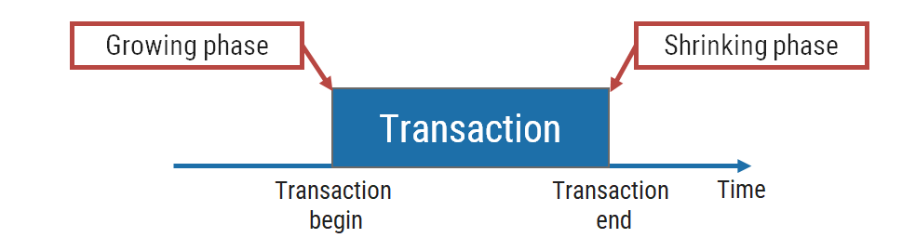
Two phase locking protocol

Slide 56
Strict two phase locking protocol
In this protocol, a transaction may release all the shared locks after the Lock Point has been reached, but it cannot release any of the exclusive locks until the transaction commits or aborts.
It ensures that if data is being modified by one transaction, then other transaction cannot read it until first transaction commits.

Slide 57
Rigorous two phase locking protocol
In this protocol, a transaction is not allowed to release any lock (either shared or exclusive) until it commits.
This means that until the transaction commits, other transaction can not acquire even a shared lock on a data item on which the uncommitted transaction has a shared lock.

Slide 58
Time Stamp Ordering Protocol:
A timestamp is a tag that can be attached to any transaction or any data item, which denotes a specific time on which the transaction or the data item had been used in any way. A timestamp can be implemented in 2 ways.

Slide 59
Time Stamp Ordering Protocol:
One is to directly assign the current value of the clock to the transaction or data item. The other is to attach the value of a logical counter that keeps increment as new timestamps are required.

Slide 60
The timestamp of a data item can be of 2 types:
(i) W-timestamp(X): This means the latest time when the data item X has been written into.
Read time-stamp of data-item X is denoted by R-timestamp(X).
(ii) R-timestamp(X):
This means the latest time when the data item X has been read from. These 2 timestamps are updated each time a successful read/write operation is performed on the data item X.
Write time-stamp of data-item X is denoted by W-timestamp(X)

Slide 61
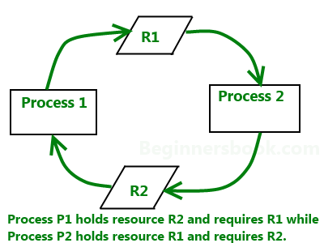
What is deadlock?
A deadlock is a situation in which two or more transactions are waiting for one another to give up locks.

Slide 62
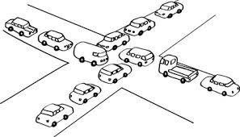

Slide 63
Deadlock detection
A simple way to detect deadlock is with the help of wait-for graph.
One node is created in the wait-for graph for each transaction that is currently executing.
We have a state of deadlock if and only if the wait-for graph has a cycle.
Then each transaction involved in the cycle is said to be deadlocked.
If graph contains no cycles ⇒ no deadlock.

Slide 64
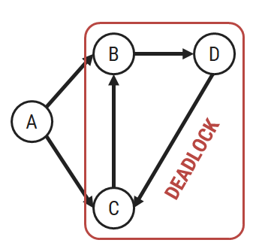
Deadlock detection
A
C
B

Slide 65
Transaction A is waiting for transactions B and C.
Transactions C is waiting for transaction B.
Transaction B is waiting for transaction D.
This wait-for graph has no cycle, so there is no deadlock state.
Suppose now that transaction D is requesting an item held by C. Then the edge D → C is added to the wait-for graph.
Now this graph contains the cycle.
B → D → C → B
It means that transactions B, D and C are all deadlocked.

Slide 66
Deadlock recovery
When a deadlock is detected, the system must recover from the deadlock.
The most common solution is to roll back one or more transactions to break the deadlock.
Choosing which transaction to abort(Kill) is known as victim selection.

Slide 67
Deadlock recovery
In this wait-for graph transactions B, D and C are deadlocked.
In order to remove deadlock one of the transaction out of these three (B, D, C) transactions must be roll backed.
We should rollback those transactions that will the minimum cost.

Slide 68
Deadlock prevention
A protocols ensure that the system will never enter into a deadlock state.
Some prevention strategies :
Require that each transaction locks all its data items before it begins execution (pre-declaration).
Impose partial ordering of all data items and require that a transaction can lock data items only in the order specified by the partial.

Slide 69
Deadlock prevention
Wait-die scheme — non-preemptive
If an older transaction is requesting a resource which is held by younger transaction, then older transaction is allowed to wait for it till it is available.
If an younger transaction is requesting a resource which is held by older transaction, then younger transaction is killed.

Slide 70
Wound-wait scheme — preemptive
If an older transaction is requesting a resource which is held by younger transaction, then older transaction forces younger transaction to kill the transaction and release the resource.
If an younger transaction is requesting a resource which is held by older transaction, then younger transaction is allowed to wait till older transaction will releases it.
 | Wait-die | Wound-wait
O needs a resource held by Y | O waits | Y dies
Y needs a resource held by O | Y dies | Y waits

Slide 71
older transaction : younger transaction
 | Wait-die | Wound-wait
O needs a resource held by Y | O waits | Y dies
Y needs a resource held by O | Y dies | Y waits

Slide 72
Timeout-Based Schemes
A transaction waits for a lock only for a specified amount of time. After that, the wait times out and the transaction is rolled back. So deadlocks never occur.
Simple to implement; but difficult to determine good value of the timeout interval.

Slide 73
Thank You

