Slide 1

Code Refactoring and Bug Fixing

Slide 2
About me
I am currently pursuing M.Sc (Statistics),Osmania Univeersity
I have a huge interest in the field of Data Science
LinkedIn Profile URL :
GitHub Profile URL :

Slide 3
Scenario :
A team of enthusiastic data scientists embarked on a mission to develop a note Taking Application using a python, Flask , and HTML. However, their lack of experience in backend development has led to challenges in making the application fully functional.Recognizing your proficiency in backend development, you have been tasked with fixing the broken code and ensuring the application works seamlessly.
Task :
Refactor the existing codebase and ensure the proper functioning of the Note Taking Application. Document all identified bugs during the debugging process. Remember, the task is not about recreating the app from Scratch. Your goal is to fix the already existing codebase and make the application work as intended

Slide 4

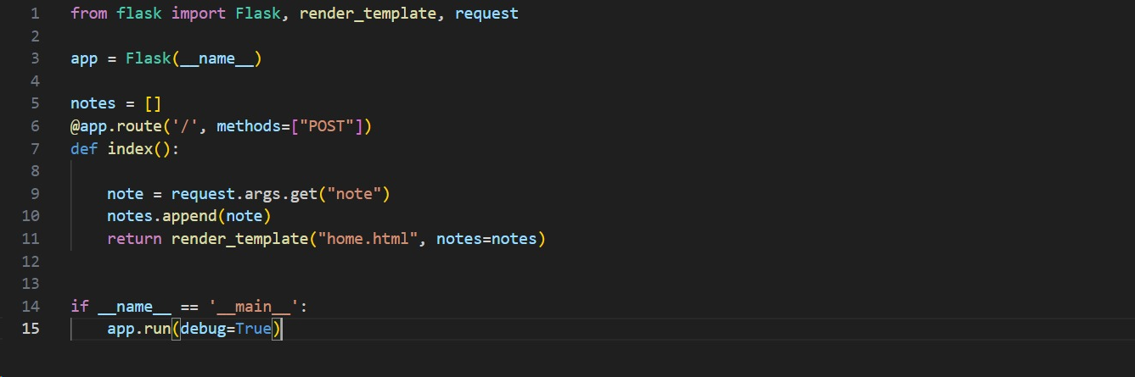
Identifying Bugs in the Application Server

Slide 5
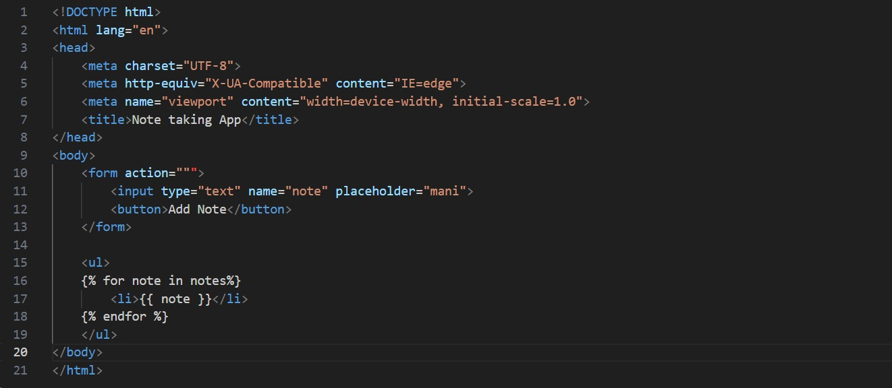
Identifying Bugs in the HTML Method

Slide 6
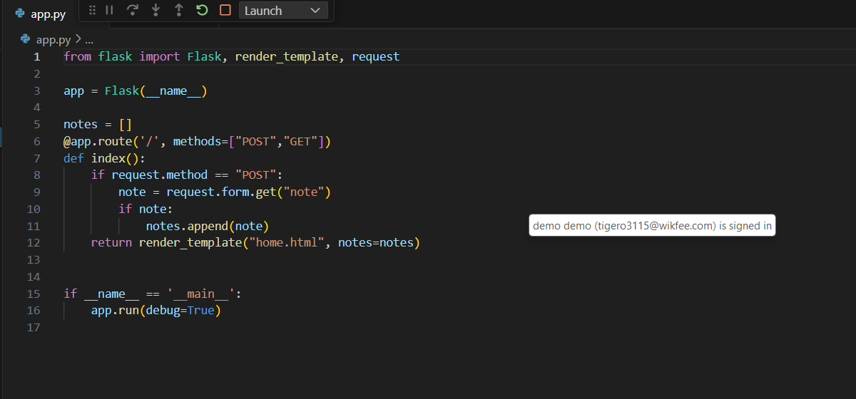
Fixing Bugs in the Application Server

Slide 7
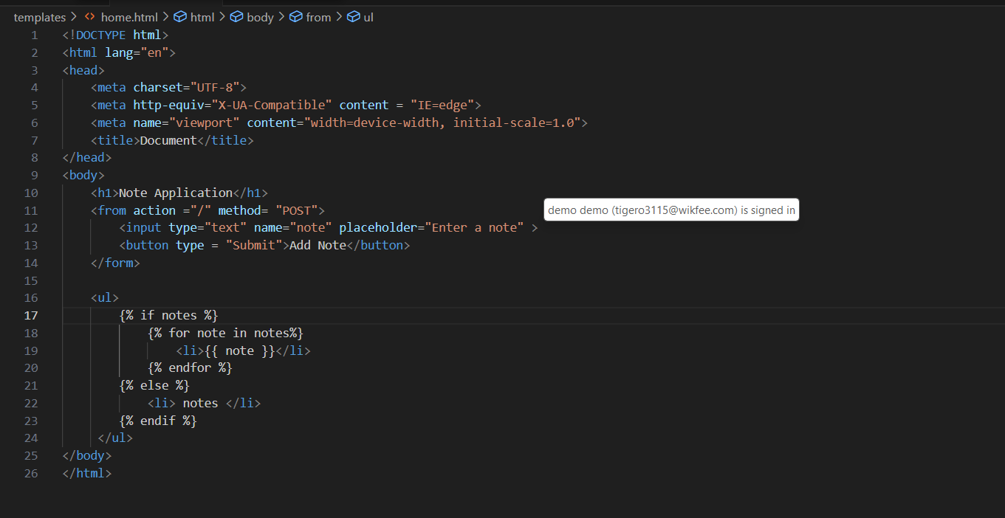
Fixing Bugs in the HTML Method

Slide 8
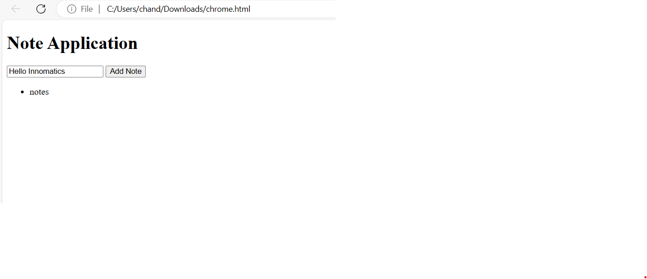
Output

Slide 9

THANK YOU

