Slide 1

Predicting World Happiness for year 2023 using Data Analysis
GURUTEJA KANDERI
ALPHY BENNY
CHANDINI NALAMALAPU

Slide 2
Business Context and problem description
BUSINESS CONTEXT
Understanding global happiness and well-being is crucial for fostering environments conducive to growth and prosperity. Insights from the World Happiness Report enable businesses to prioritize employee satisfaction, societal well-being, and sustainable development, leading to enhanced workplace culture and resilient economies.
PROBLEM DESCRIPTION
Grasping the complex tapestry of global happiness and well-being is vital in our interconnected world. The World Happiness Report delves into human satisfaction, unraveling diverse factors shaping it. This pursuit guides policymaking and interventions, aiming to create a happier and more resilient world. (Analysis based on 2023 data.)

Slide 3
Dataset, Observations and descriptive stats
The World Happiness Report dataset consist of several variables, such as: Country, Region, Ladder Score, GDP, Freedom, Corruption, Life Expectancy, Social Support, Dystopia residual, Generosity.
There are 137 observations and 20 features in dataset.
Mean Happiness score is 5.539796 Variance of Happiness score is 1.299438 Standard Deviation of Happiness score is 1.139929 Median Happiness score is 5.684

Slide 4
Data Cleaning
There are 0 Missing Values in Column name
We are Combing the Similar regions: Western Europe , Middle East, North Africa, North America ,ANZ Central ,Eastern Europe ,Latin America ,Caribbean , Southeast Asia, Sub-Saharan Africa.

Slide 5
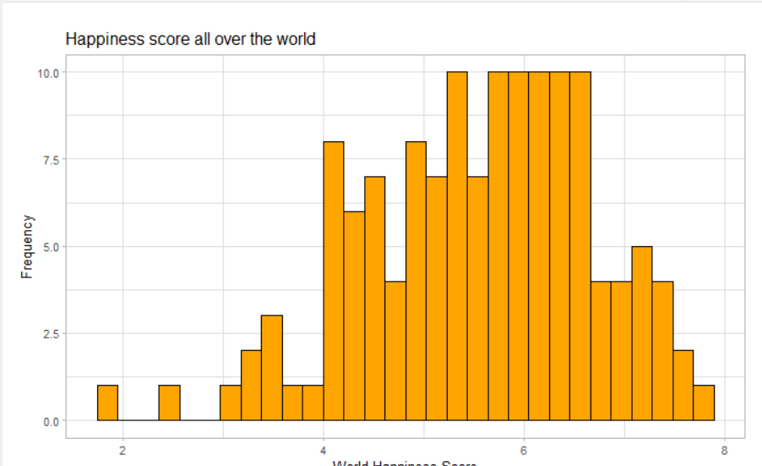
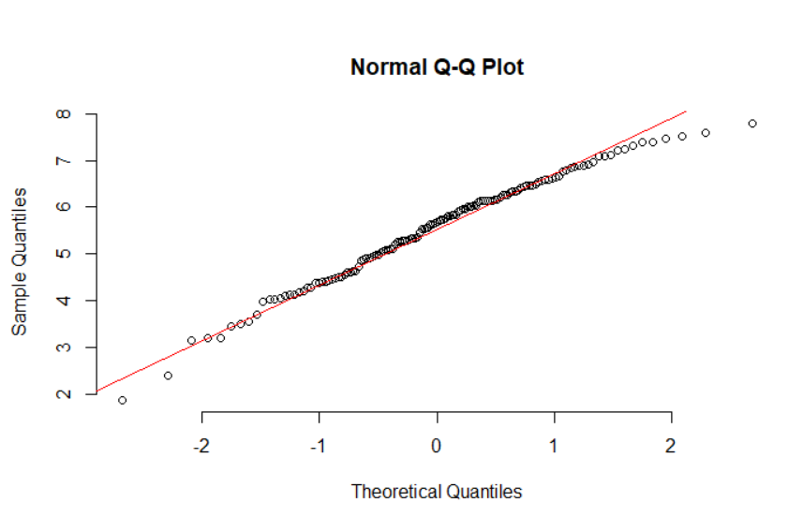
Normal distribution and Normal Probability plot
The plot suggests that the distribution is roughly bell-shaped, with a peak around the score of 6. Additionally, the plot suggests that the distribution is slightly skewed to the right.
In the above normal probability plot , the data points roughly follow a straight line which states that the data follows a normal distribution.

Slide 6
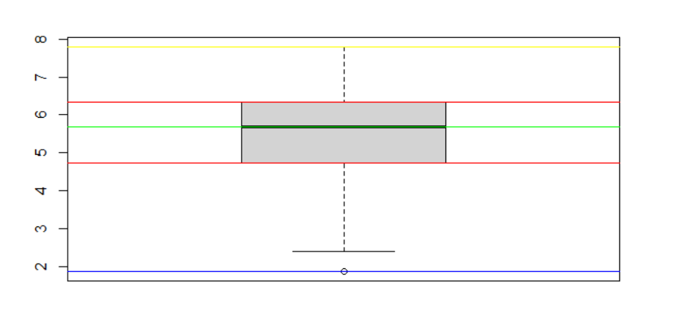
OUTLIERS IN TARGET VARIABLE
The plot displays a box representing the Happiness_score variable's interquartile range (IQR), with whiskers extending to values within 1.5 times the IQR from the lower and upper quartiles. Horizontal lines overlay the box plot, indicating the minimum, maximum, median, and quartile values. Beyond the whiskers, any values may be potential outliers. Notably, one data point lies outside the whiskers, warranting further investigation to ascertain its outlier status.

Slide 7
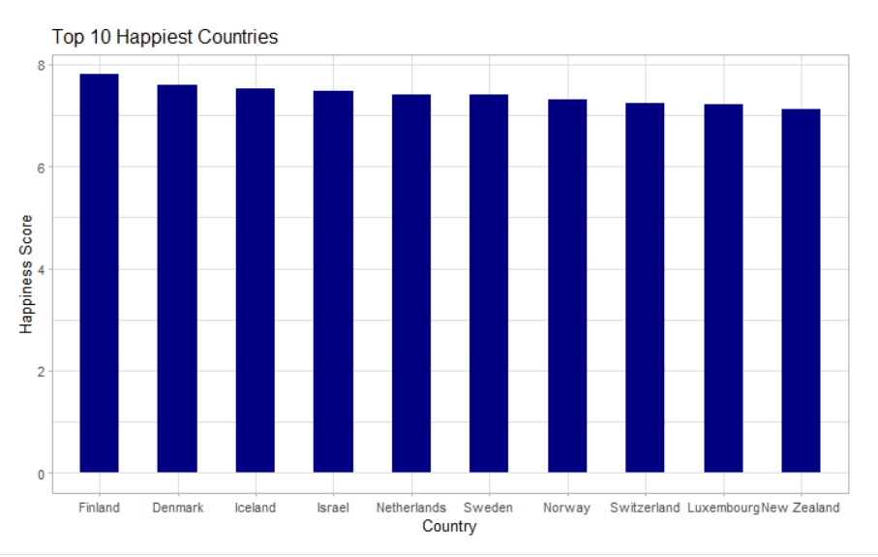
Bar plot
This plot can help us compare the happiness scores of different countries and understand which countries have the highest levels of happiness.

Slide 8
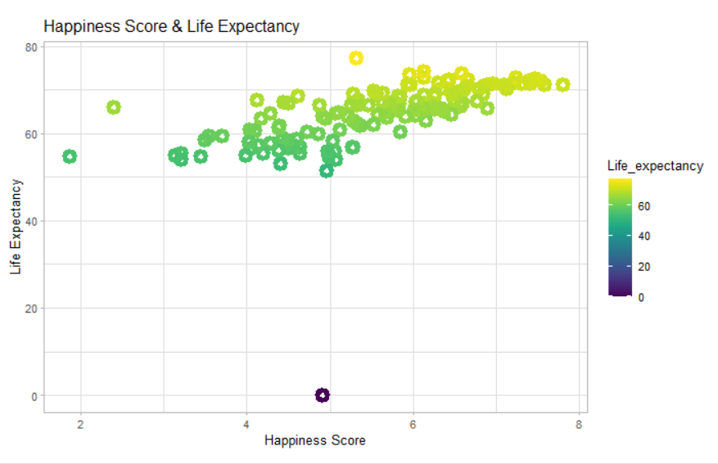
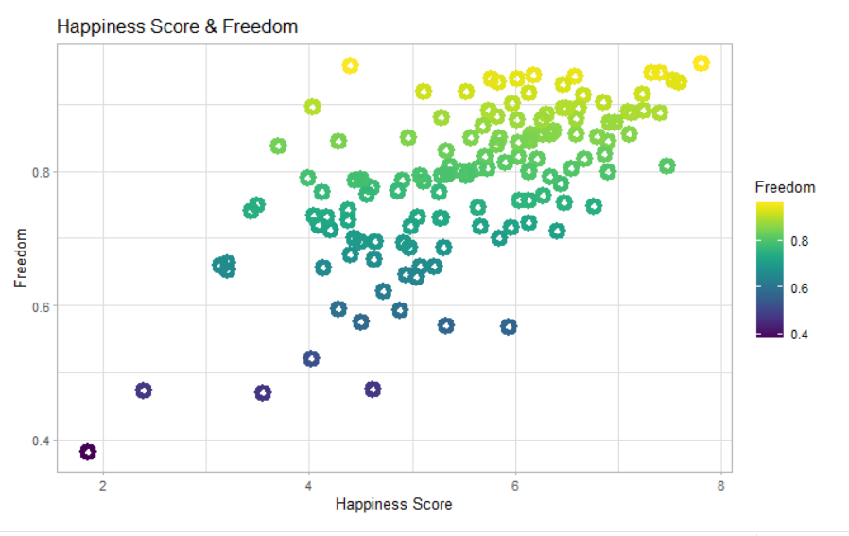
Exploratory Data Analysis
We are using scatter plot to investigate the distribution between 2 continuous variable Happiness score and Life expectancy where each point represents a country. This plot shows that there appears to be a pretty significant relationship between Life Expectancy and the happiness score as the data points appear to show a positive trend.
As predicted this plot shows that as freedom increases so does the happiness score, but we do not know if this relationship is causal and there may be confounds.

Slide 9
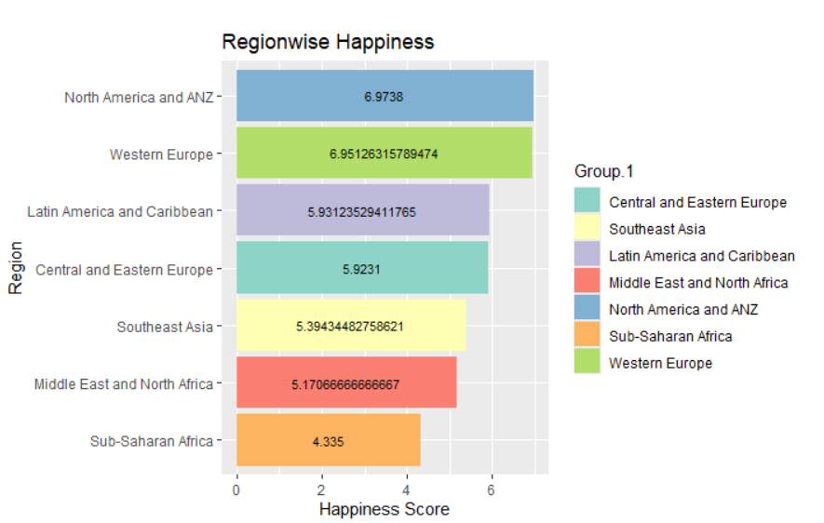
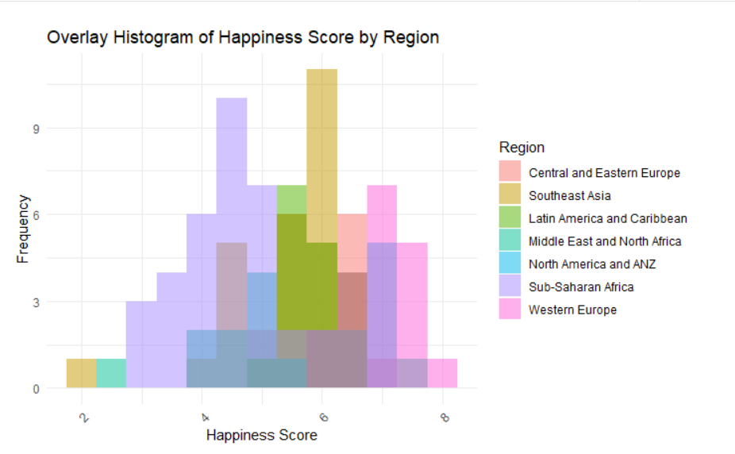
overlay bar plot and overlay histogram
We are using histogram to display the distribution of a continuous variable Happiness score broken down by a categorical variable Region. From the above boxplot, we can say that North America and ANZ has maximum happiness score, and Sub-Saharan Africa has lowest happiness score.
The above barplot gives the region wise Happiness Score from highest to lowest.

Slide 10
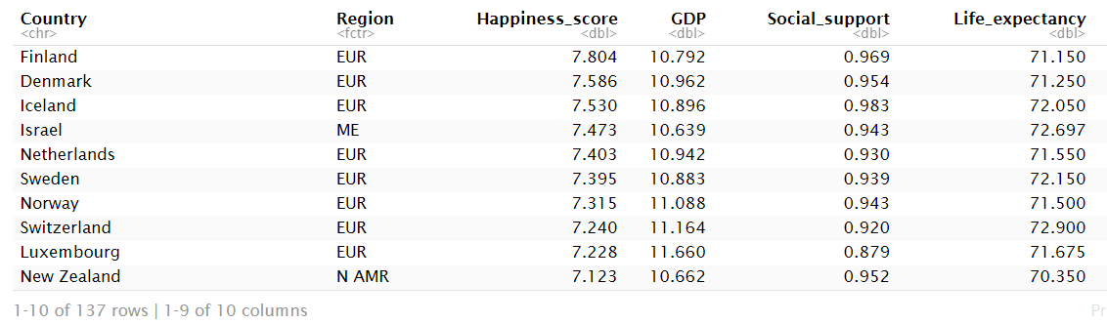
Combine Regions to reduce number of categories
We're simplifying the categorical variable "Region" by combining similar regions into broader categories. This reduction helps streamline our analysis by grouping regions with similar characteristics, enabling clearer insights into regional patterns and their relationships with other variables.

Slide 11
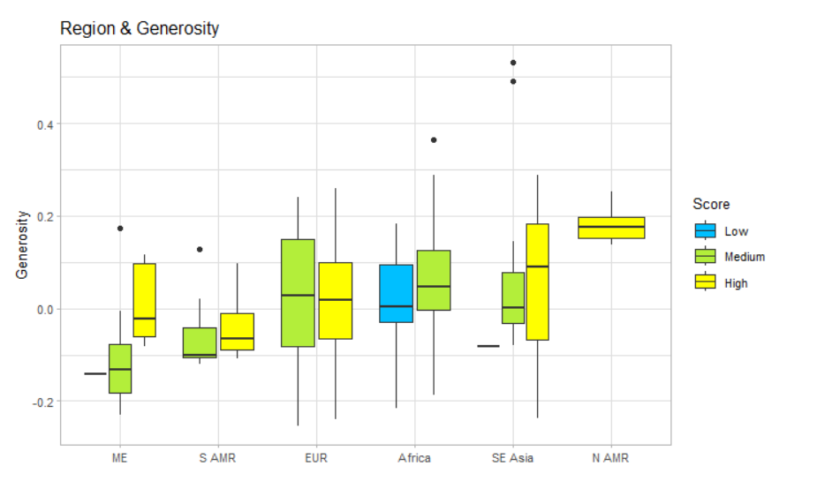
Region by Generosity
This plot suggests that generosity varies significantly across regions and may be related to regional differences in happiness scores.

Slide 12
Hypothesis test
# HYPOTHESIS TEST For one mean:# H0 : NULL Hypothesis : Average Happiness score of countries in South East Asia is 5.# H1 : Alternative Hypothesis : Average Happiness score of countries in South East Asia is not equal to 5.# μ : Mean of Happiness scores of South Asia# H0: μ = 5# H1: μ ≠ 5# Manual calculations dataset for South East Asia.
Sample size is: 16 T-Statistic value is : 3.885354 Degree of freedom is : 15 p-value is : 0.001464336 True mean value is : 5 Confidence Interval is : 95 % Lower bound for confidence interval is : 5.26608 Upper bound for confidence interval is : 5.912795 Mean of Sample is : 5.589437
One Sample t-test data: Southeast_Asia_Data$ Happiness_score t = 3.8854, df = 15, p-value = 0.001464 alternative hypothesis: true mean is not equal to 5 95 percent confidence interval: 5.266080 5.912795 sample estimates: mean of x 5.589437
Here p-value is greater than 0.05 , also the mean 5.589437 is lying within the confidence interval ( 5.26608, 5.912795). Hence, NULL Hypothesis is accepted. We conclude that the mean happiness score of countries in South Asia is 5.

Slide 13
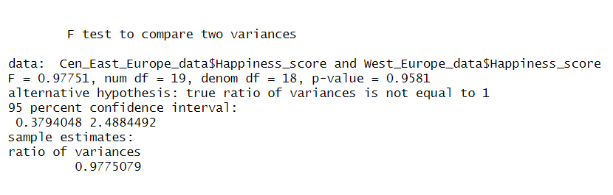
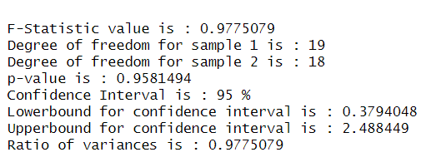
Hypothesis test for 2 mean
The hypothesis test suggests that there is no significant difference in the variance of Happiness scores between Central and Eastern European countries and Western European countries (p > 0.05). Therefore, we fail to reject the null hypothesis, indicating similar variability in happiness scores between the two regions.

Slide 14
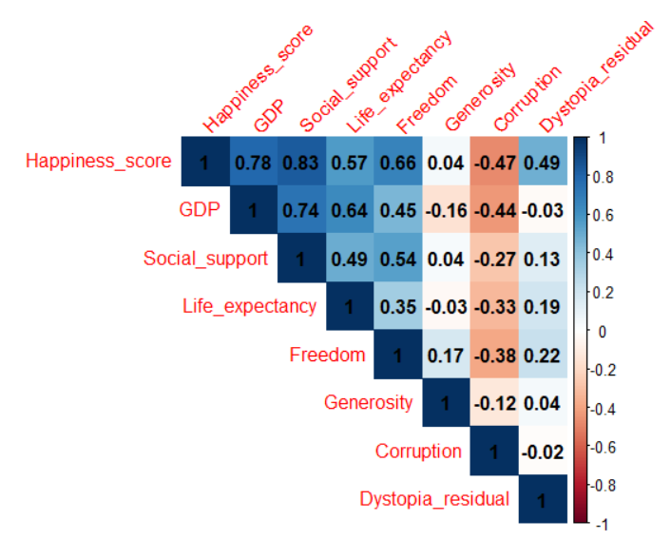
Co-relation graph
Thus, we observe that GDP, Social Support, Life Expectancy, Freedom and Dystopia_residual have positive correlation with Happiness Score. With GDP being highest. On other hand, corruption has negative correlation with Happiness Score. Thus, if a country is highly corrupt, its happiness score is less. Something interesting here is generosity of people has no major affect on Happiness Score. More accurately, it has a very slight negative effect implying that if people of a country are generous the country is slightly unhappier, score wise. GDP is highly correlated with Happiness score.

Slide 15
CREATING TRAINING AND TEST DATASET
Training 80 % and test dataset 20%
Total observations in Training data set is 115 Total observations in Testing data set is 22

Slide 16
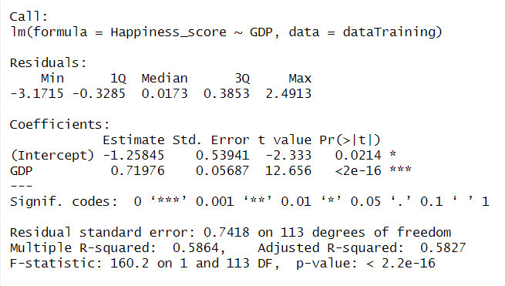
CREATING LINEAR REGRESSION MODELS
Simple Linear Regression Model Constructing a simple linear regression model of Happiness Score by GDP to carry out regression on the data.
> Is there a relationship between GDP and Happiness Score?
The Null hypothesis here is that there is no relationship between GDP and Happiness Score. We observe that the p-value is <0.05, implying we can reject the null hypotheses and thus conclude Happiness score depends on GDP.
> How strong is the relationship between the predictor and the response?
p-value is close to zero, thus relationship is strong
> Is the relationship between the predictor and the response positive or negative?
The coefficient is positive and hence there is a positive relationship

Slide 17
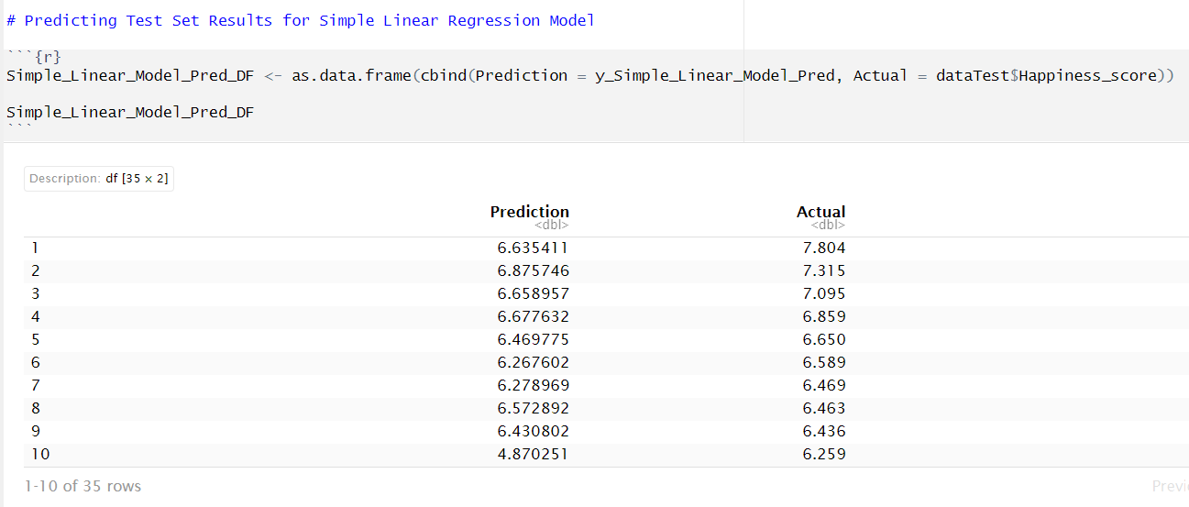
Predicting Test Set Results for Simple Linear Regression Model
The prediction interval is substantially wider than the confidence interval, reflecting the increased uncertainty about Happiness Score in comparison to the average Happiness score. The Simple Linear Regression model uses only one predictor variable, and it appears to have the lowest performance compared to the other models, with a higher RSS, lower R-squared, higher MAE, and higher MSE, higher RSE. This model is useful when we want to study the relationship between two variables and see how a change in one variable affects the other.

Slide 18
Finding RSS, R^2, MAE, MSE, RSE values for simple linear regression model.
RSS For Simple Linear Regression Model is: 29.54364
R Squared For Simple Linear Regression Model is: 0.7440812
MAE For Simple Linear Regression Model is: 0.7377377
MSE For Simple Linear Regression Model is: 1.127645
RSE For Simple Linear Regression Model is: 0.5435406

Slide 19
Multiple Linear Regression Model
The Multiple Linear Regression model uses multiple predictor variables, and it has a lower RSS, higher R-squared, lower MAE, lower MSE and lower RSE than the Simple Linear Regression model. This model is helpful when we want to study the relationship between a response variable and multiple predictor variables and see how these predictors affect the response variable.

Slide 20
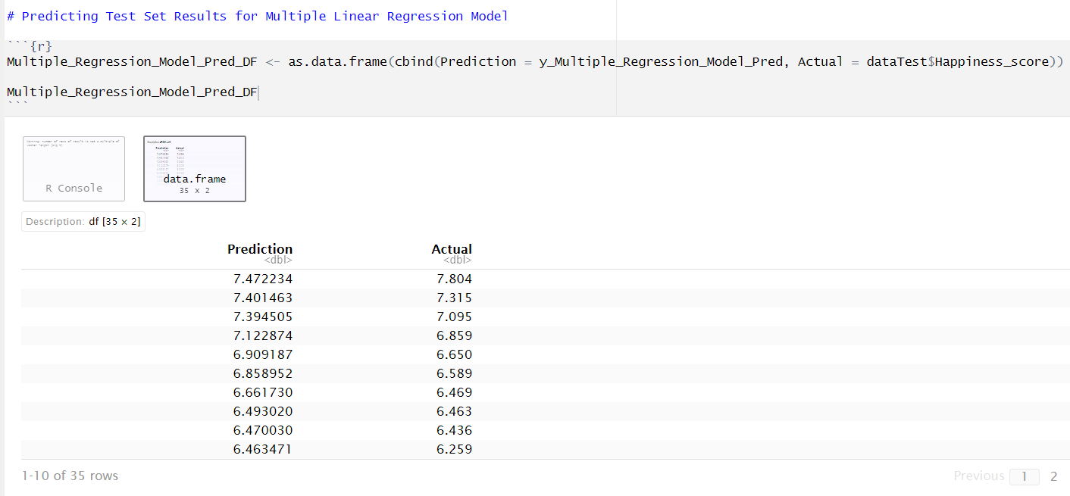
Predicting Test Set Results for Multiple Linear Regression Model
The prediction interval is substantially wider than the confidence interval, reflecting the increased uncertainty about Happiness Score in comparison to the average Happiness score.

Slide 21
Finding RSS, R^2, MAE and MSE values for Multiple linear regression model.
Multiple Linear Regression Model is: 1.335487
R Squared For Multiple Linear Regression Model is: 0.9884315
MAE For Multiple Linear Regression Model is: 0.7110242
MSE For Multiple Linear Regression Model is: 2.195661
RSE For Multiple Linear Regression Model is: 0.1191944

Slide 22
Forward Stepwise Subset Selection Linear Regression Model
The Forward Stepwise and Backward Stepwise Subset Selection Linear Regression models both use a subset of predictor variables, and they have the same performance metrics as the Multiple Linear Regression model. These models are useful when we want to identify a subset of predictors that best explain the variability in the response variable.

Slide 23
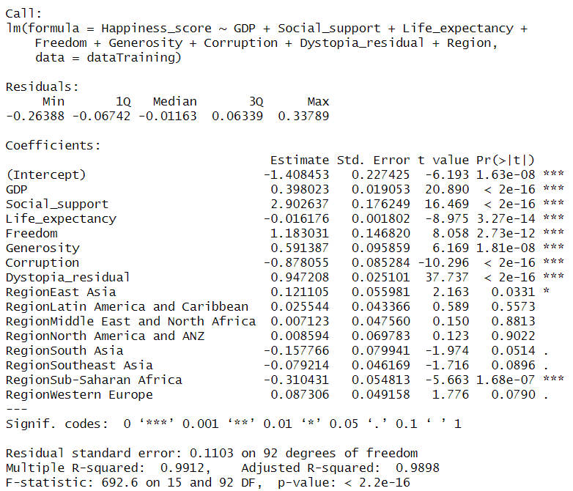
Forward Stepwise Subset Selection Linear Regression Model

Slide 24
Finding RSS, R^2, MAE and MSE values for Forward Stepwise Subset Selection Linear Regression Model.
RSS For Forward Stepwise Subset Selection Linear Regression Model is: 1.119357
R Squared For Forward Stepwise Subset Selection Linear Regression Model is: 0.9912226
MAE For Forward Stepwise Subset Selection Linear Regression Model is: 0.08447786
MSE For Forward Stepwise Subset Selection Linear Regression Model is: 0.01434928
RSE For Forward Stepwise Subset Selection Linear Regression Model is: 0.1103038

Slide 25
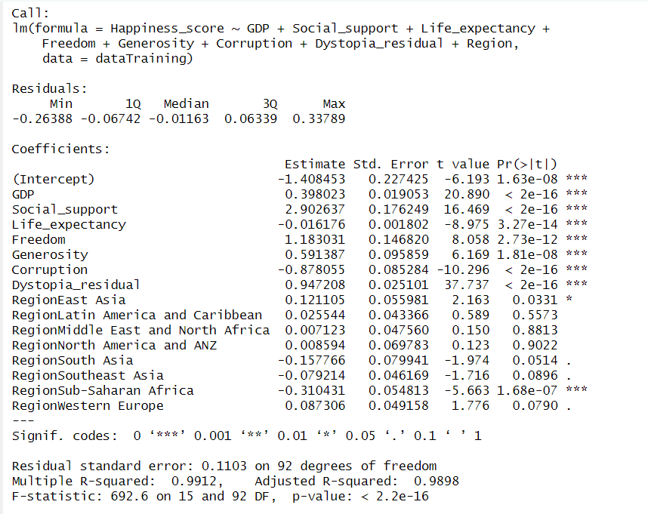
Backward Stepwise Subset Selection Linear Regression Model

Slide 26
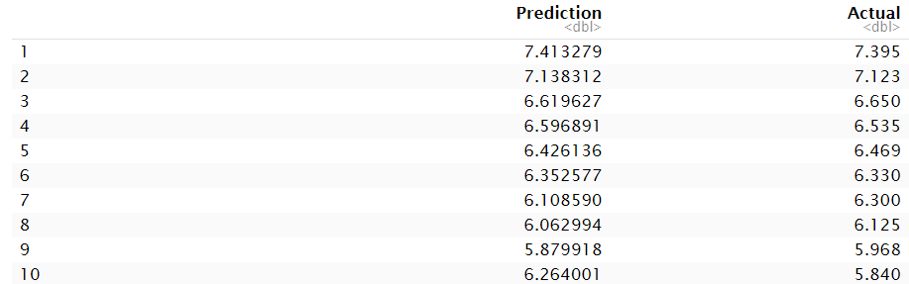
Backward Stepwise Subset Selection Linear Regression Model
RSS For Backward Stepwise Subset Selection Linear Regression Model is: 1.119357
R Squared For Backward Stepwise Subset Selection Linear Regression Model is: 0.9912226
MAE For Backward Stepwise Subset Selection Linear Regression Model is: 0.08447786
MSE For Backward Stepwise Subset Selection Linear Regression Model is: 0.01434928
RSE For Backward Stepwise Subset Selection Linear Regression Model is: 0.1103038

Slide 27
Review of Four Models
Given that all four models have similar performance, the choice of which model to use depends on the research question and the available data. If the research question involves only one predictor variable, then the Simple Linear Regression model is appropriate. If the research question involves multiple predictors, then the Multiple Linear Regression model or one of the Subset Selection models may be more appropriate. If we are interested in identifying the most important predictors, then we should use one of the Subset Selection models

Slide 28

Thank You ☺

