Slide 1
Accessing Caches in
Virtual Memory Environment

Slide 2
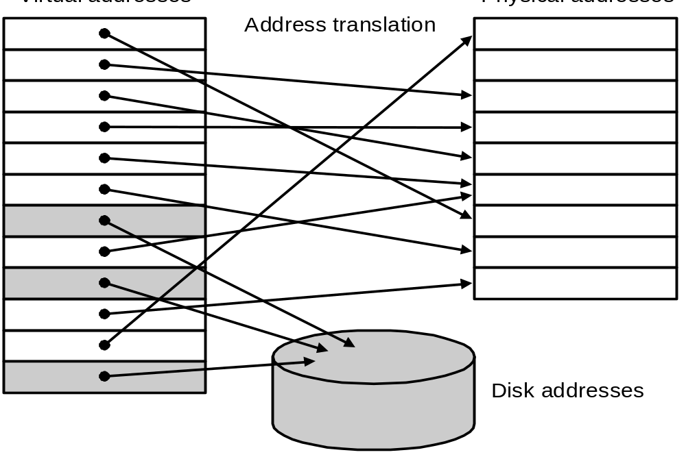
Virtual Memory
Main memory can act as a cache for the secondary storage (disk)
Advantages:
  illusion of having more physical memory
  program relocation
  protection

Slide 3
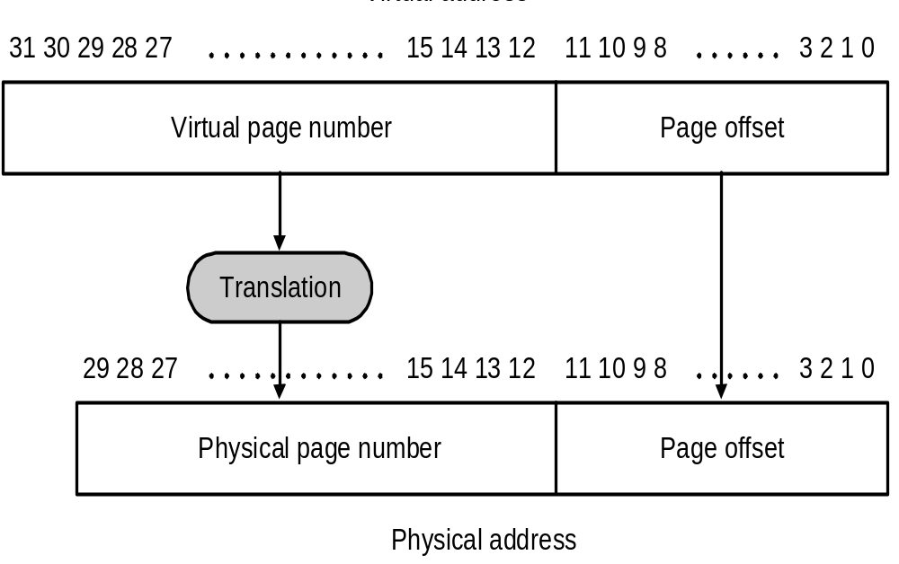
Pages: virtual memory blocks
Page faults: the data is not in memory, retrieve it from disk
  huge miss penalty, thus pages should be fairly large (e.g., 4KB)
  reducing page faults is important (LRU is worth the price)
  can handle the faults in software instead of hardware
  using write-through is too expensive so we use writeback

Slide 4
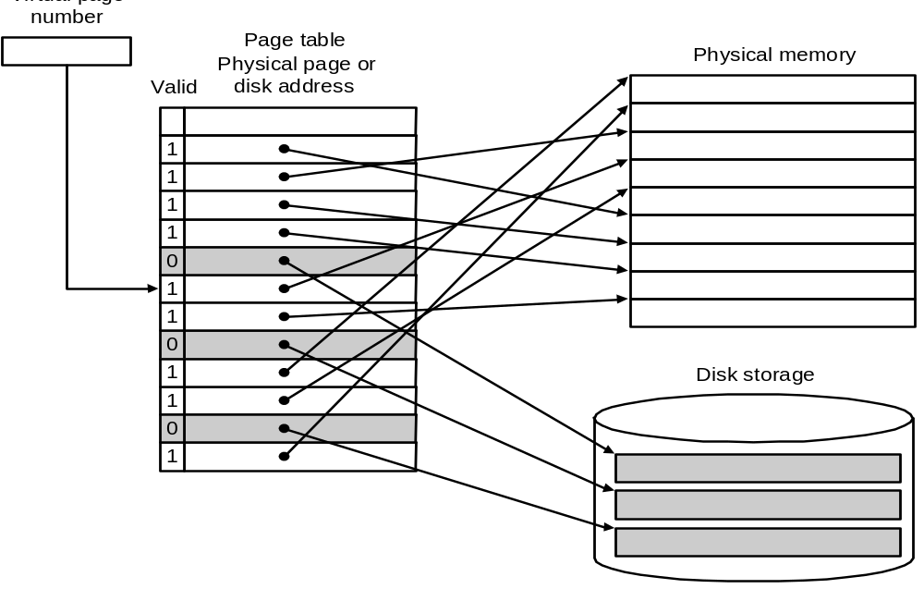
Page Tables

Slide 5
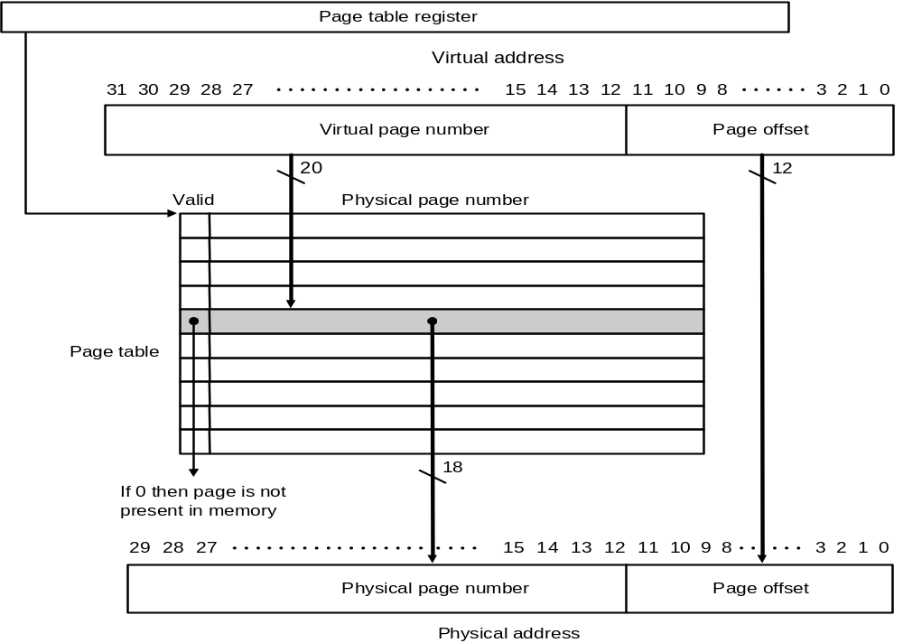
Page Tables

Slide 6
Example Problem
Consider a virtual memory system with the following properties: 40-bit virtual byte address, 16KB pages, 36-bit physical byte address. What is the total size of the page table for each process on this machine? (Assume that disk addresses are not stored in the page table).

Slide 7
Basic Issues in Virtual Memory System Design
size of information blocks that are transferred from
secondary to main storage (M)
block of information brought into M, and M is full, then some region
of M must be released to make room for the new block -->
replacement policy
which region of M is to hold the new block --> placement policy
missing item fetched from secondary memory only on the occurrence
of a fault --> demand load policy
mem
disk
cache
reg
pages
frame
Paging Organization
virtual and physical address space partitioned into blocks of equal size
page frames
pages

Slide 8
Virtual Address and a Cache
VA
PA
miss
Trans-
lation
Cache
Main
Memory
CPU
hit
data
It takes an extra memory access to translate VA to PA
This makes cache access very expensive, and this is the "innermost
loop" that you want to go as fast as possible
ASIDE: Why access cache with PA at all? VA caches have a problem!
synonym / alias problem: two different virtual addresses map to same
physical address => two different cache entries holding data for
the same physical address!
for update: must update all cache entries with same
physical address or memory becomes inconsistent
determining this requires significant hardware, essentially an
associative lookup on the physical address tags to see if you
have multiple hits

Slide 9
TLBs
A way to speed up translation is to use a special cache of recently
used page table entries -- this has many names, but the most
frequently used is Translation Lookaside Buffer or TLB
Virtual Address Physical Address Dirty Ref Valid Access
TLB access time comparable to cache access time
(much less than main memory access time)

Slide 10
Translation Look-Aside Buffers
Just like any other cache, the TLB can be organized as fully associative,
set associative, or direct mapped
TLBs are usually small, typically not more than 128 - 256 entries even on
high end machines. This permits fully associative
lookup on these machines. Most mid-range machines use small
n-way set associative organizations.
hit
VA
PA
miss
TLB
Lookup
Cache
Main
Memory
CPU
Translation
with a TLB
miss
hit
Trans-
lation
data

Slide 11
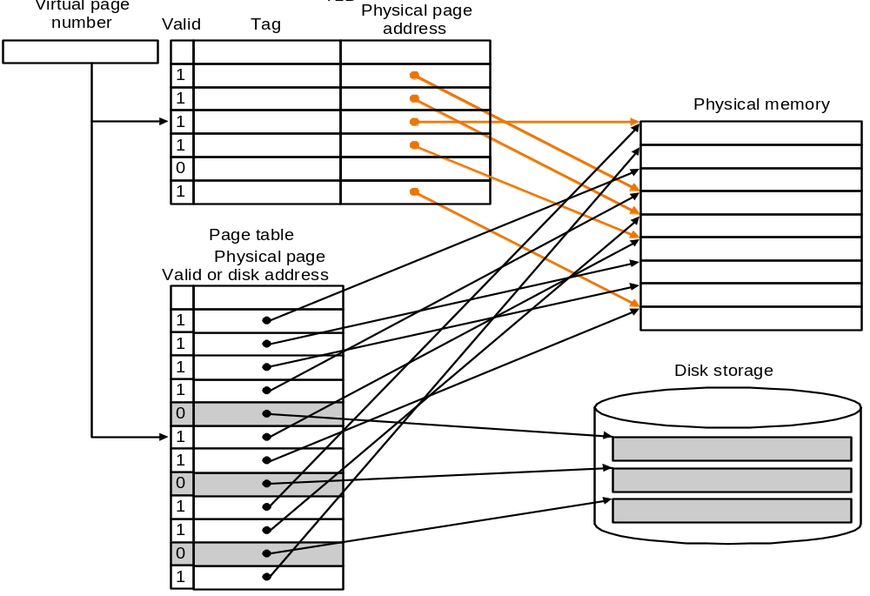
Making Address Translation Fast
A cache for address translations: translation lookaside buffer

Slide 12
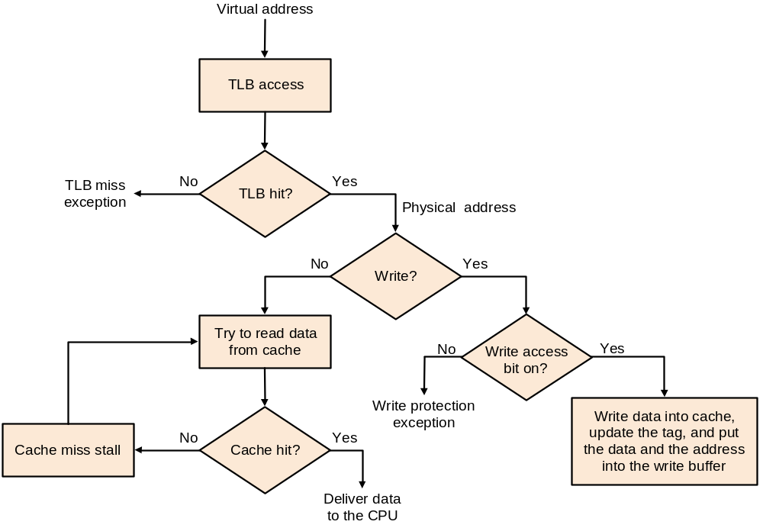
TLBs and caches

Slide 13
Reducing Translation Time
Machines with TLBs go one step further to reduce # cycles/cache access
They overlap the cache access with the TLB access
Works because high order bits of the VA are used to look in the TLB
while low order bits are used as index into cache

Slide 14
Overlapped Cache & TLB Access
TLB
Cache
assoc
lookup
index
1 K
32
4 bytes
10
2
00
PA
Hit/
Miss
Data
Hit/
Miss
20
12
page #
disp
IF cache hit and TLB hit then deliver data to CPU
ELSE IF cache miss and TLB hit THEN
access memory with the PA from the TLB
ELSE do standard VA translation

Slide 15
Can TLB and caching be overlapped?
Virtual Page Number | Page Offset
Index
Byte Select
Virtual
Translation
Look-Aside
Buffer
(TLB)
Cache Block
Cache Block
Physical
Cache Tag
=
Hit
This works, but ...
Q. What is the downside?
Cache Tags
Valid
Cache Data
A. Inflexibility. Size of cache limited by page size.
Data out

Slide 16
Example Problem
Consider a memory system that uses paged virtual memory and physically addressed set-associative cache. Assume that virtual address space is 4 Gbytes, memory is byte-addressable and page size is 8 Kbytes. Further assume that cache block size is 32 bytes and data size of the cache is 64 Kbytes. Determine the minimum associativity of the cache that would allow for the overlap of the cache access with the TLB access. Explain your answer showing all calculations.

Slide 17
Problems With Overlapped TLB Access
Overlapped access only works as long as the address bits used to
index into the cache do not change as the result of VA translation
This usually limits things to small caches, large page sizes, or high
n-way set associative caches if you want a large cache
Example: suppose everything the same except that the cache is
increased to 8 K bytes instead of 4 K:
11
2
cache
index
00
This bit is changed
by VA translation, but
is needed for cache
lookup
20
12
virt page #
disp
Solutions:
go to 8K byte page sizes;
go to 2 way set associative cache; or
SW guarantee VA[13]=PA[13]
1K
2 way set assoc cache
10
4
4

Slide 18
Summary:
The Principle of Locality:
  Program likely to access a relatively small portion of the address space at any instant of time.
    Temporal Locality: Locality in Time
    Spatial Locality: Locality in Space
Three Major Categories of Cache Misses:
  Compulsory Misses: sad facts of life. Example: cold start misses.
  Conflict Misses: increase cache size and/or associativity.
  Nightmare Scenario: ping pong effect!
  Capacity Misses: increase cache size
Cache Design Space
  total size, block size, associativity
  replacement policy
  write-hit policy (write-through, write-back)
  write-miss policy

Slide 19
Summary: The Cache Design Space
Several interacting dimensions
  cache size
  block size
  associativity
  replacement policy
  write-through vs write-back
  write allocation
The optimal choice is a compromise
  depends on access characteristics
    workload
    use (I-cache, D-cache, TLB)
  depends on technology / cost
Simplicity often wins

Slide 20
Summary : TLB, Virtual Memory
Caches, TLBs, Virtual Memory all understood by examining how they deal with 4 questions: 1) Where can block be placed? 2) How is block found? 3) What block is repalced on miss? 4) How are writes handled?
Page tables map virtual address to physical address
TLBs are important for fast translation

