Slide 1
Pumping Lemma
By Kevin Andrade

Slide 2
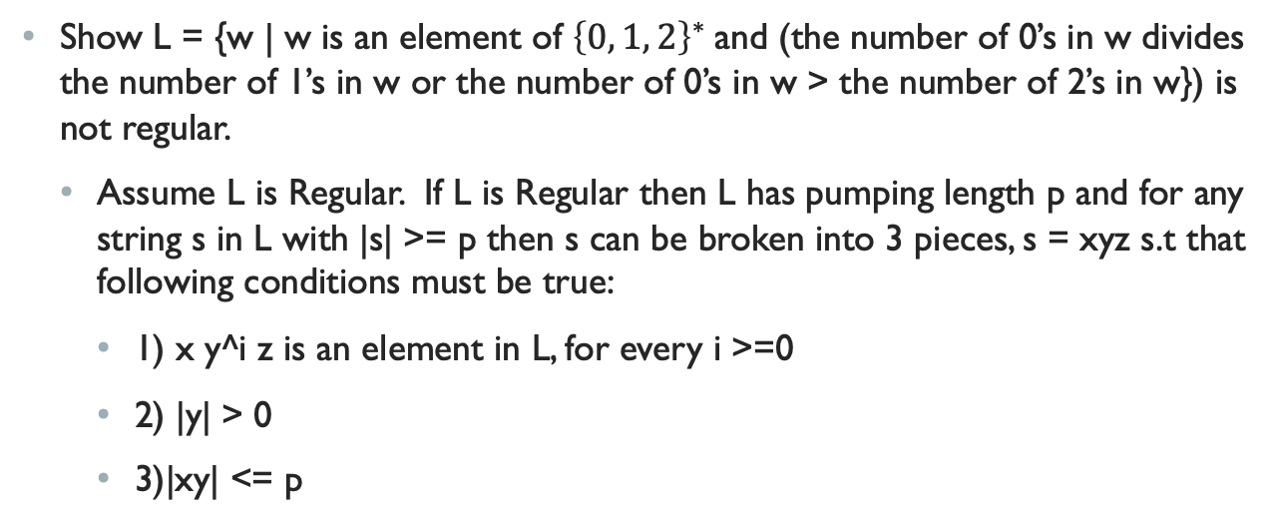
The problem
Show L = {w | w is an element of ${\left\{0, 1, 2\right\}}^{∗}$and (the number of 0’s in w divides the number of 1’s in w or the number of 0’s in w > the number of 2’s in w}) is not regular.
Assume L is Regular. If L is Regular then L has pumping length p and for any string s in L with |s| >= p then s can be broken into 3 pieces, s = xyz s.t that following conditions must be true:
1) x y^i z is an element in L, for every i >=0
2) |y| > 0
3)|xy| <= p

Slide 3
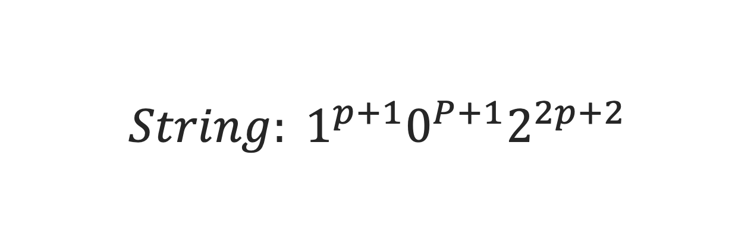
First Step – Finding a string
$$String: 1^{p+1}0^{P+1}2^{2p+2}$$

Slide 4
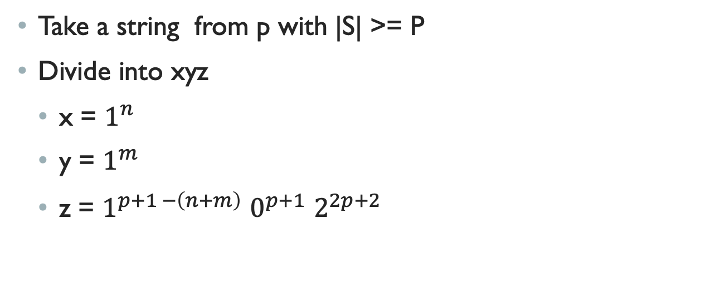
Second Step- Splitting
Take a string from p with |S| >= P
Divide into xyz
x = $1^{n}$
y = $1^{m}$
z = $1^{p+1 −\left(n+m\right)}$ $0^{p+1}$ $2^{2p+2}$

Slide 5
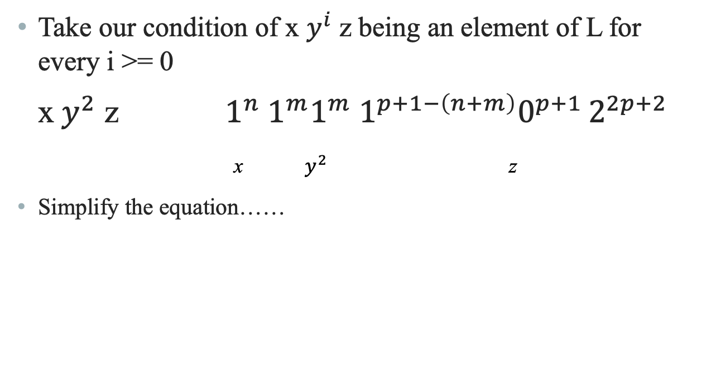
Third Step - Pumping up
Take our condition of x $y^{i}$ z being an element of L for every i >= 0
x${ y}^{2}$ z $1^{n}{ 1}^{m}1^{m} 1^{p+1−\left(n+m\right)}0^{p+1 }2^{2p+2}$
x $y^{2}$ z
Simplify the equation……

Slide 6

Algebra Magic
$$1^{m}1^{p+1}0^{p+1}2^{2p+2}$$
# 1’s #0’s #2’s

Slide 7
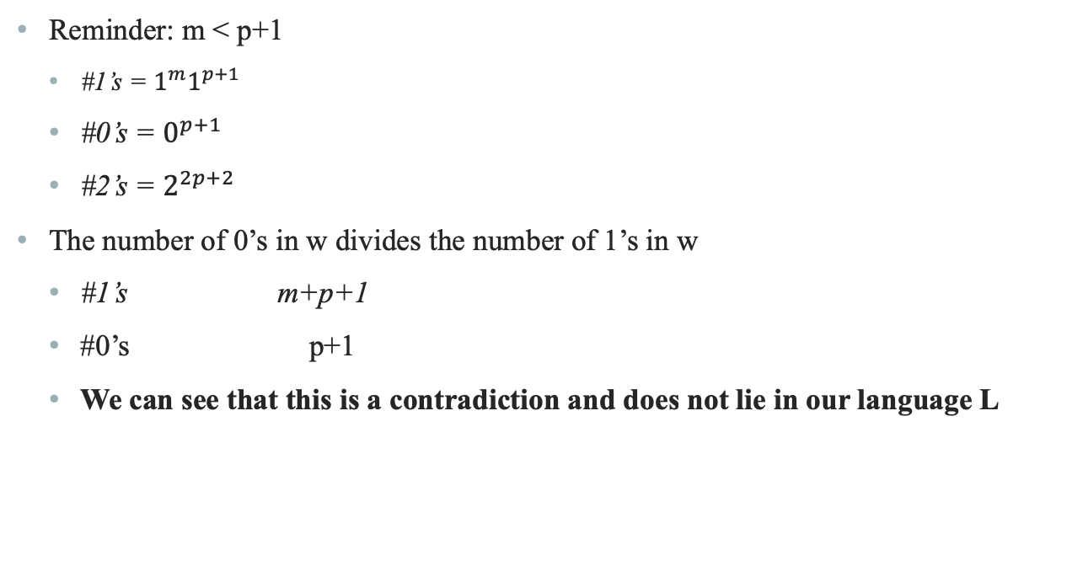
Step 5 – contradiction 1
Reminder: m < p+1
#1’s = $1^{m}1^{p+1}$
#0’s = $0^{p+1}$
#2’s = $2^{2p+2}$
The number of 0’s in w divides the number of 1’s in w
#1’s m+p+1
#0’s p+1
We can see that this is a contradiction and does not lie in our language L

Slide 8
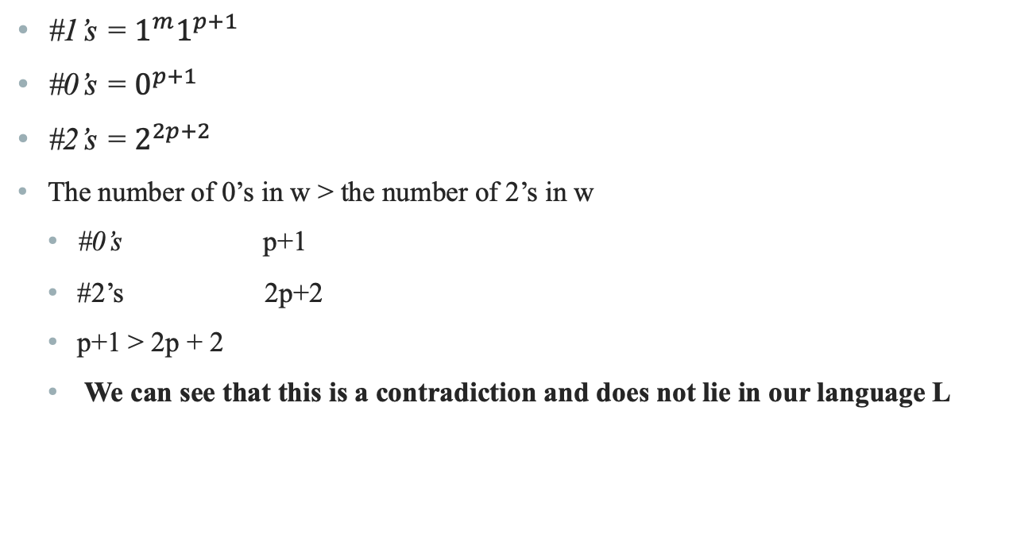
Step 6 – contradiction II
#1’s = $1^{m}1^{p+1}$
#0’s = $0^{p+1}$
#2’s = $2^{2p+2}$
The number of 0’s in w > the number of 2’s in w
#0’s p+1
#2’s 2p+2
p+1 > 2p + 2
We can see that this is a contradiction and does not lie in our language L

Slide 9
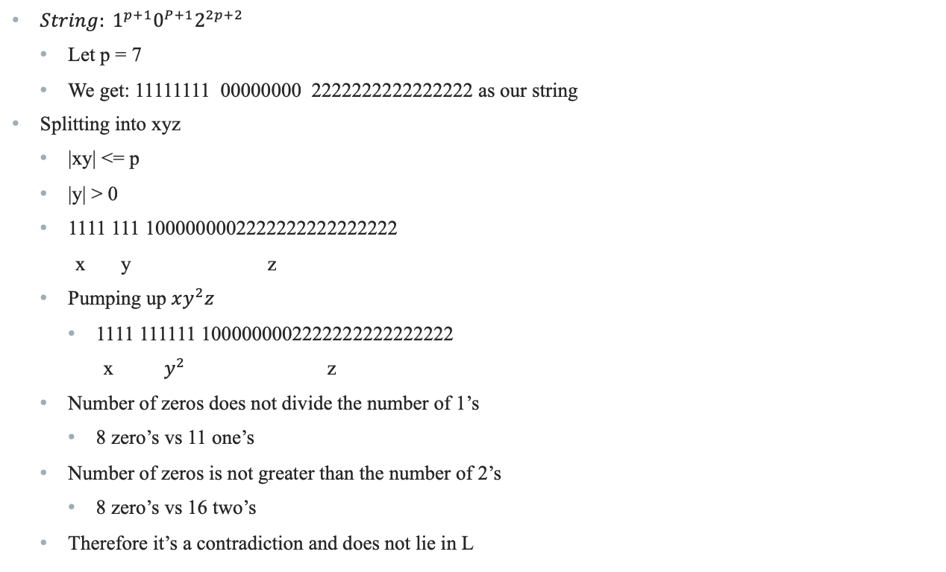
Example
$String: 1^{p+1}0^{P+1}2^{2p+2}$
Let p = 7
We get: 11111111 00000000 2222222222222222 as our string
Splitting into xyz
|xy| <= p
|y| > 0
1111 111 1000000002222222222222222
x y z
Pumping up $xy^{2}z$
1111 111111 1000000002222222222222222
x $y^{2}$ z
Number of zeros does not divide the number of 1’s
8 zero’s vs 11 one’s
Number of zeros is not greater than the number of 2’s
8 zero’s vs 16 two’s
Therefore it’s a contradiction and does not lie in L

