Slide 1
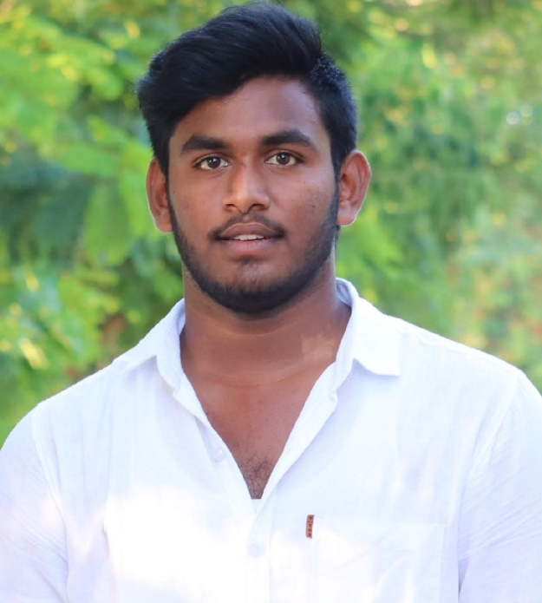

Kandregula Bulli Manikanta
Bachelor of Mechanical Engineering
(2018- 2022)
Analyst/Software Engineer
Skills
Bangalore
manikantakandregula185@gmail.com
Java 8 /J2EE | Java Basics, OOPS, Generics, Collections, Arrays, Loops, Lambda Exp, Stream API Junit, Mockito, Servlets
Spring core | IOC & Dependency Injection, Autowired
Spring REST | REST controllers, Implementation of GET, POST, PUT & DELETE, Bean Validation & Exception Handling, Testing Services, Controller & Repository layer
Spring Boot Microservices | Spring Boot Starters, annotations, Swagger API documents
Spring Cloud | Eureka,Netflix Hystrix, Netflix Zuul & Config Server
React | Components, Hooks, Event handling, Redux, Reducers
Angular | Components, Services, Modules, Routing, Forms & Validation.
Database | MongoDB
UI Tech | HTML 5 & CSS 3,JavaScript, ES6 & TypeScript Reusable templates, Optimized UI Designed
Tools | Git, Postman
Add On skills | Communications, Team management. Peer learning
9553076862
A4
Full Stack Developer
Hands on experience in creating microservices with Springboot, Spring Security, Spring Cloud API Gateway, Eureka server.
Proficient in creating Single page Web Application in Angular with Authentication with route guards, Angular reactive forms, angular routing, CSS.
Hands on experience in implementing polyglot architecture with NodeJs & spring boot.
Experience in creating documentation with Java docs and swagger and in unit testing using Junit, Mockito.
On Demand Car Wash Application
Completed end to end case study of On demand car wash Application along with Swagger and responsive UI with CSS and Angular used for user interface.
Health Care System Application
Completed end to end case study of Health Care System along with React and springboot.
HTML CSS JAVASCRIPT for web developers at Coursera Completed this course and Designed responsive Restaurant website using HTML5 CSS3 Bootstrap and Javascript.

