Slide 1
Web Application
Mojtaba Rostami Kandroodi
13 August 2019

Slide 2
Outline
Problem Definition
Input Data
Data Model
Data Cleaning and Preparation
HTML Implementation

Slide 3
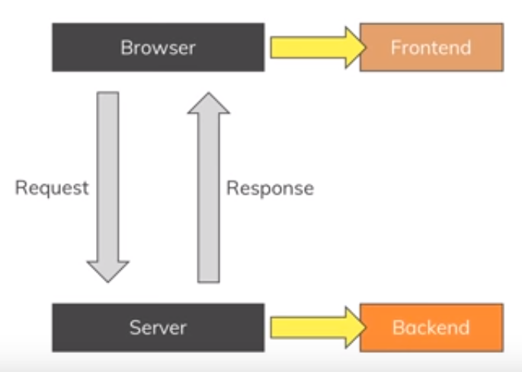
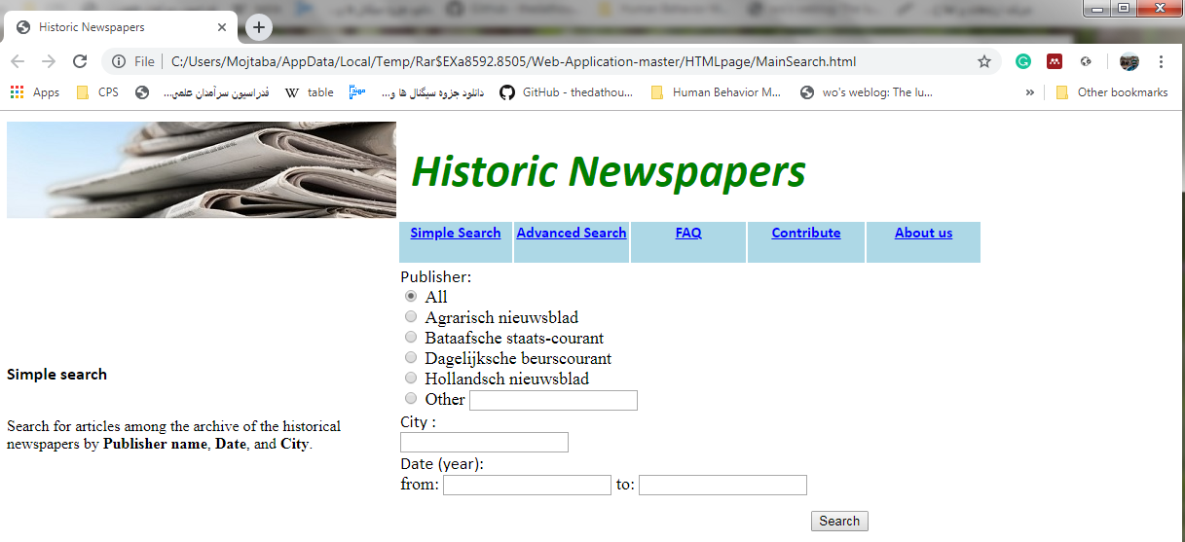
Problem Definition
Web Application for search among the data
Front end
  What user interact with
Back end
  How things work
Notes:
Front-end: this part is related to what the user can see and interact in the browser. It contains text, button, dropdown lists and etc. (appearance of the site)
Back-end: this part is related to the calculations and analyses which needed to answer to the user request. (this contains the data reading and analyzing in interaction with the database)
Server, Application, Database

Slide 4
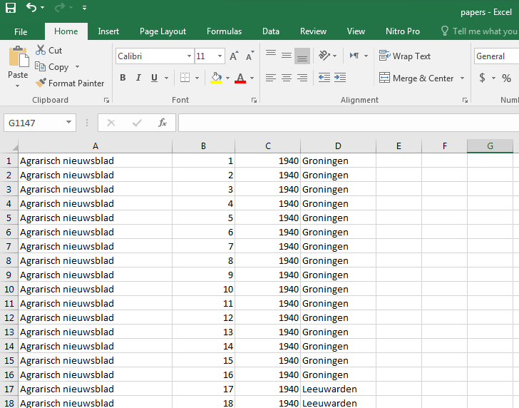
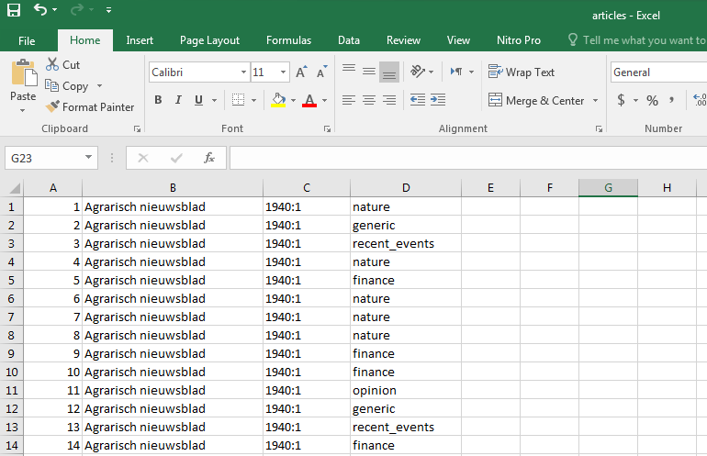
Input Data
Excel files
Papers, 3015 records
  Publisher Name, No, Year, City
Articles, 134334 records
  Row, Publisher Name, Year:No, Article Topic

Slide 5
Input Data (Continue)
Excel files
Papers, 3015 records
  Repeating the publisher name in the paper list is not needed and we need the PublisherID which prevents the error happening.
Articles, 134334 records
  Repeating the publisher name and number and year of publication in the article list are redundant. Instead we need a external key which is NewspaperID.
  There different names that point to a single publication.

Slide 6
Data Model
Publisher
  PublisherID
  Name
  Domain
Newspaper
  NewspaperID
  PublisherID, external key
  Number
  Year
  city
Article
  ArticleID
  NewspaperID, external key
  Topic
  Title
  Author
  Abstract
  Pages
  City
Publisher
PublisherID
Name
Domain
Newspaper
NewspaperID
PublisherID
Number
Year
city
Article
ArticleID
NewspaperID
Topic
Title
Author
Abstract
Pages
Notes:
This data can be modeled using 3 objects; Publisher, Newspaper, Article.
This model is extendable if we have extra information. Either new attributes for an object or a new object.
The Publisher linked to the Newspaper via a one to many relationship, also Newspaper linked to Article via a one to many. Its important to notice that if we have a symmetric article that repeated in two different newspaper (here we have same topics), that we should extend the Article object.
I add the publisher object for two reason, 1) add info about publisher, 2) prevent from creation of error (typo).
We can add City object if we want to provide more info about the city, like, geo longitude latitude x y coordinates, population, country, area. But, for this data we don’t need that.

Slide 7
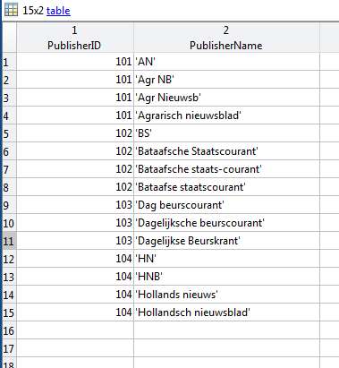
Data Cleaning and Preparation Publisher table
All newspapers belong to 4 publishers. So we need to define a ‘PublisherID’ for each publisher. We need this key to correct the article list data.
PublisherID | Name
101 | Agrarisch nieuwsblad
102 | Bataafsche staats-courant
103 | Dagelijksche beurscourant
104 | Hollandsch nieuwsblad

Slide 8
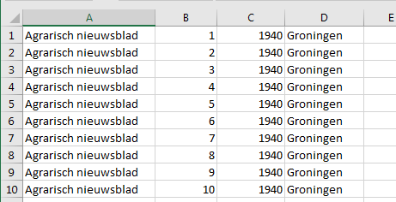
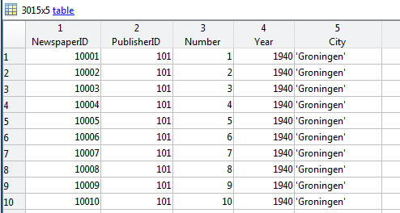
Data Cleaning and Preparation Newspaper table

Slide 9
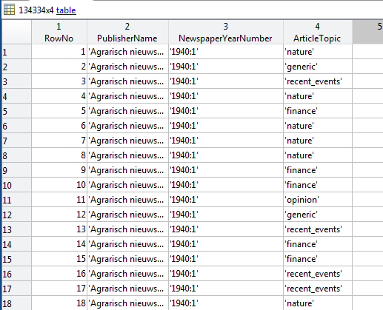
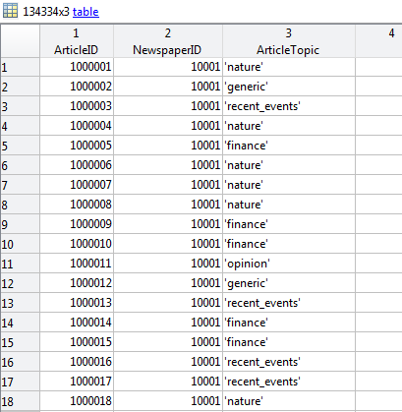
Data Cleaning and Preparation Article table

Slide 10
HTML implementation

