Slide 1
Dashboard Insights
Kandukuri Jaswanth

Slide 2
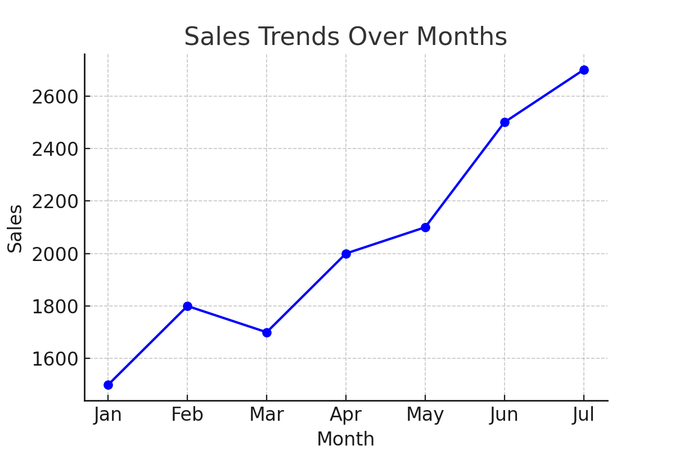
Dashboard Snapshot

Slide 3
Key Sales Data Insights
• Top Performing Region: The South Region leads with the highest total sales.
• Popular Product Categories: Electronics and Groceries dominate sales.
• Seasonal Trends: Sales peak during November and December due to festive shopping.
• High Margin Insights: High-margin products differ from highest-selling items, suggesting opportunities for targeted marketing.

Slide 4
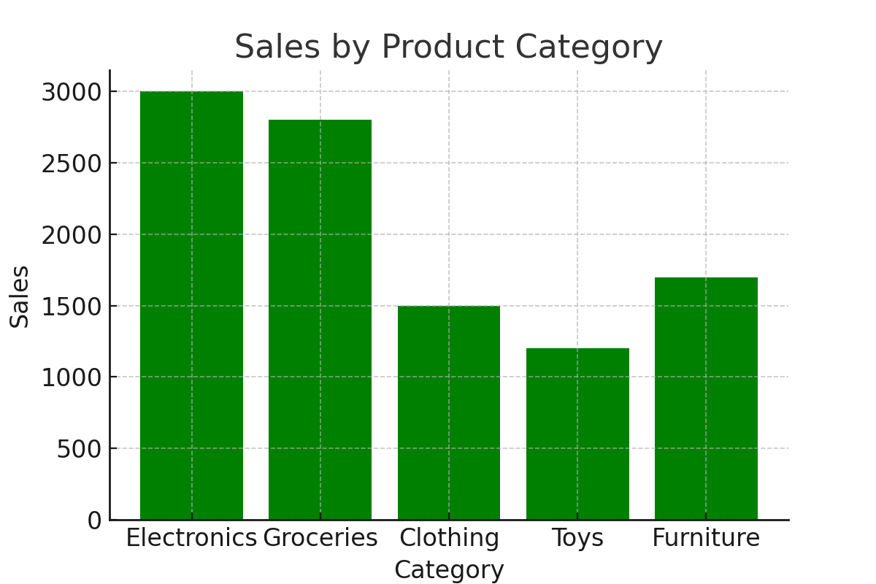
Sales Trend Visualization

Slide 5
Conclusion
The sales dashboard analysis provides valuable insights into business performance and customer behavior. The South region emerges as the most profitable area, while Electronics and Groceries are the top-performing product categories. A clear seasonal pattern is observed, with significant sales spikes during November and December, driven by festive demand. Additionally, the contrast between high-margin and high-sales products reveals untapped opportunities for strategic marketing. These insights can guide data-driven decisions to boost profitability, optimize inventory, and enhance customer targeting.

Slide 6
Thank
you

