Slide 1


Microsoft Power BI

Slide 2
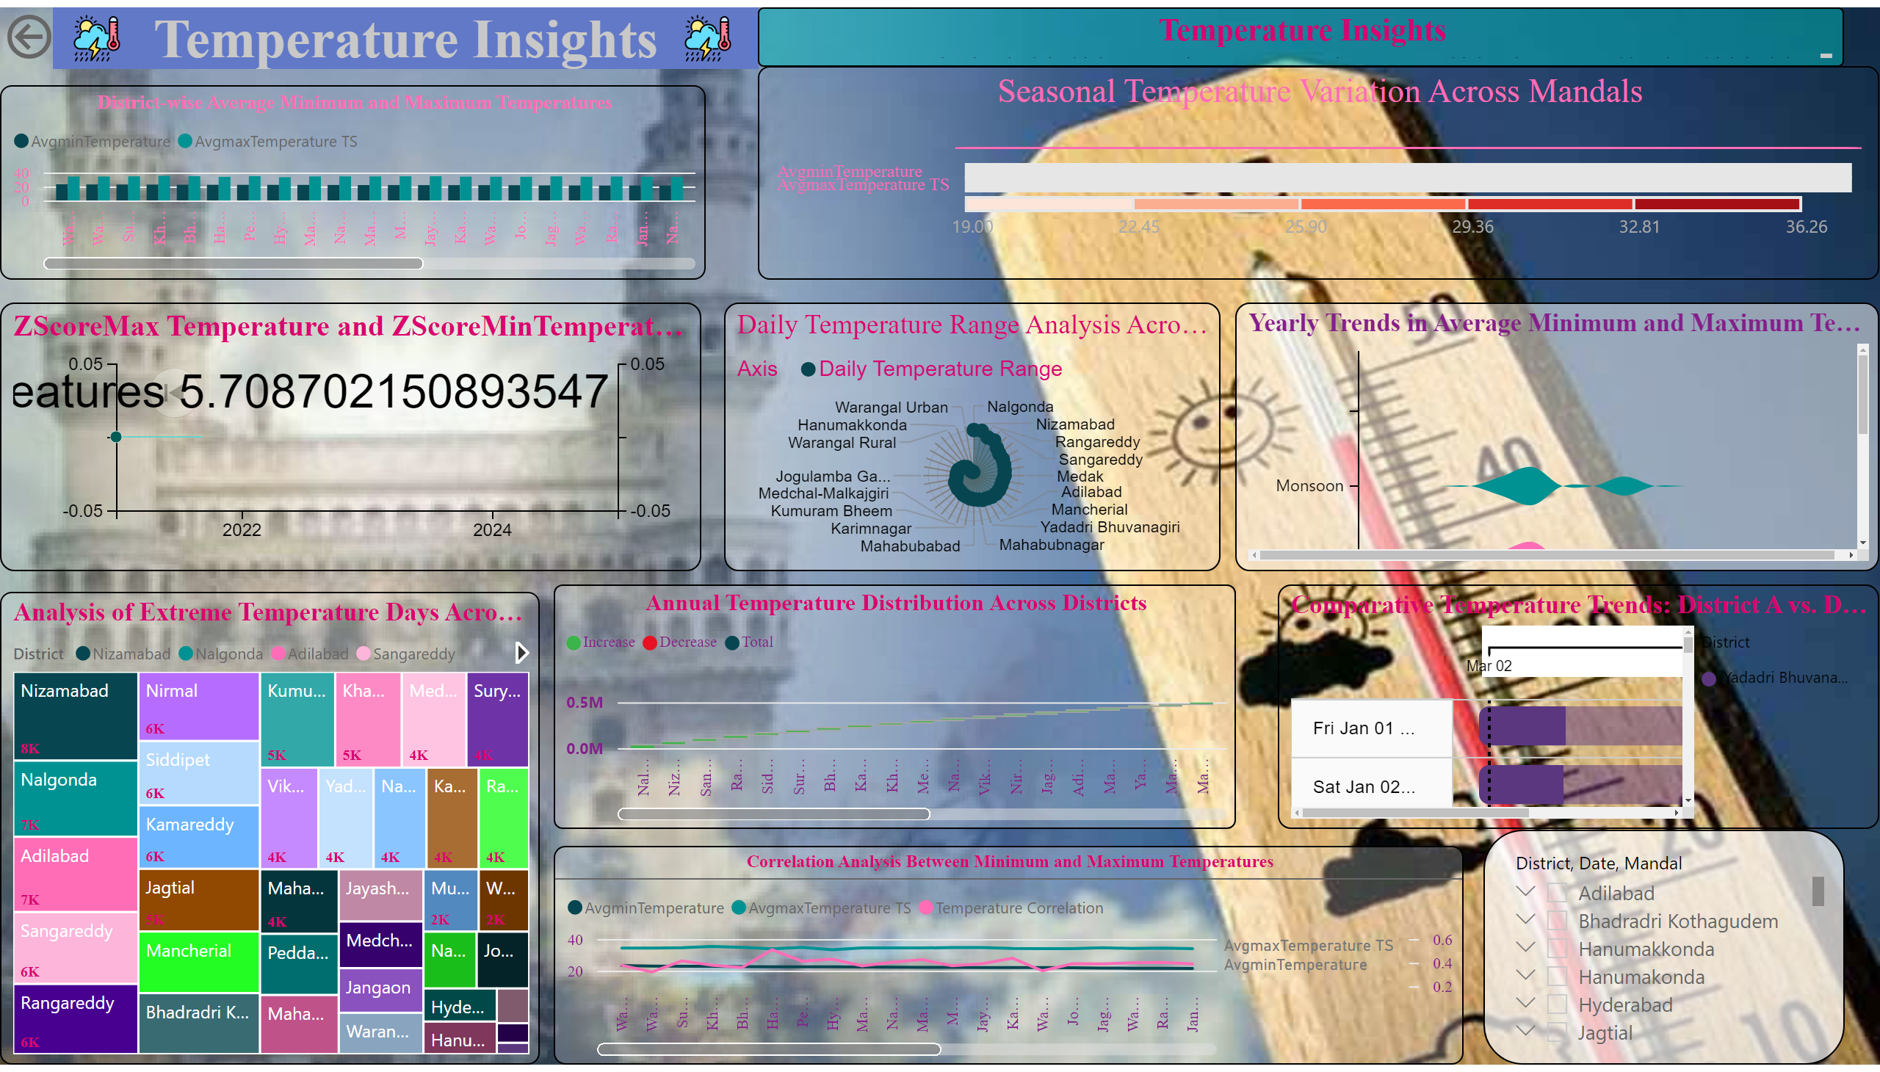
Page 2
Notes:
Seasonal Temperature Variation Across Mandals
No alt text provided
actionButton
No alt text provided
Temperature Insights
No alt text provided
image
No alt text provided
image
No alt text provided
District-wise Average Minimum and Maximum Temperatures
No alt text provided
LineDotChart1460463831201
No alt text provided
Daily Temperature Range Analysis Across Districts
No alt text provided
Yearly Trends in Average Minimum and Maximum Temperatures with Rainfall
No alt text provided
Analysis of Extreme Temperature Days Across Districts
No alt text provided
Annual Temperature Distribution Across Districts
No alt text provided
Comparative Temperature Trends: District A vs. District B
No alt text provided
slicer
No alt text provided
Correlation Analysis Between Minimum and Maximum Temperatures
No alt text provided
Temperature Insights
No alt text provided

Slide 3
Microsoft Power BI

Slide 4
Microsoft Power BI

Slide 5
Microsoft Power BI

