Slide 1
Multi Cloud and Cross Cloud

Slide 2
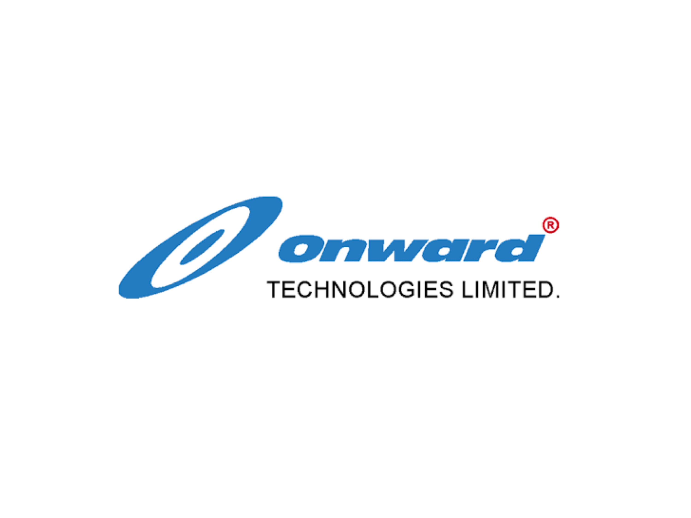
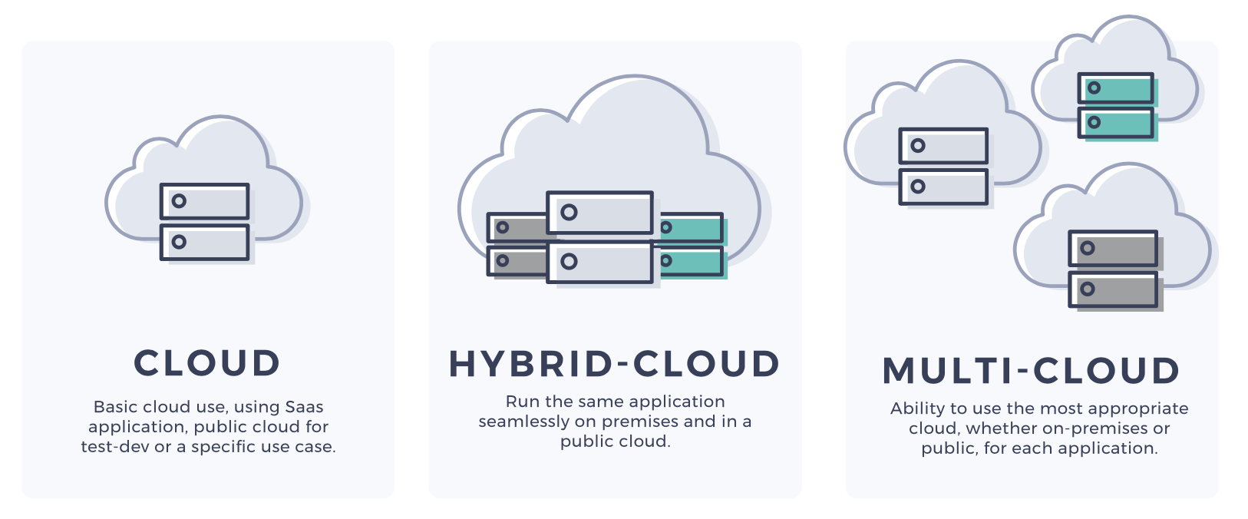
Multi-cloud
Multicloud is a company's use of multiple cloud computing and storage services from different vendors

Slide 3
Advantages
Risk Mitigationes
Avoid Vendor Lock-In
Lower Latency
multi-cloud strategy
Disadvantages
Talent Management
Cost Estimation and Reporting
Security Risks
Management Overload

Slide 4
Thank you.

