Slide 1
Multi Teir Web Application Stack Host and Run on AWS cloud for Production Lift and Shift

Slide 2
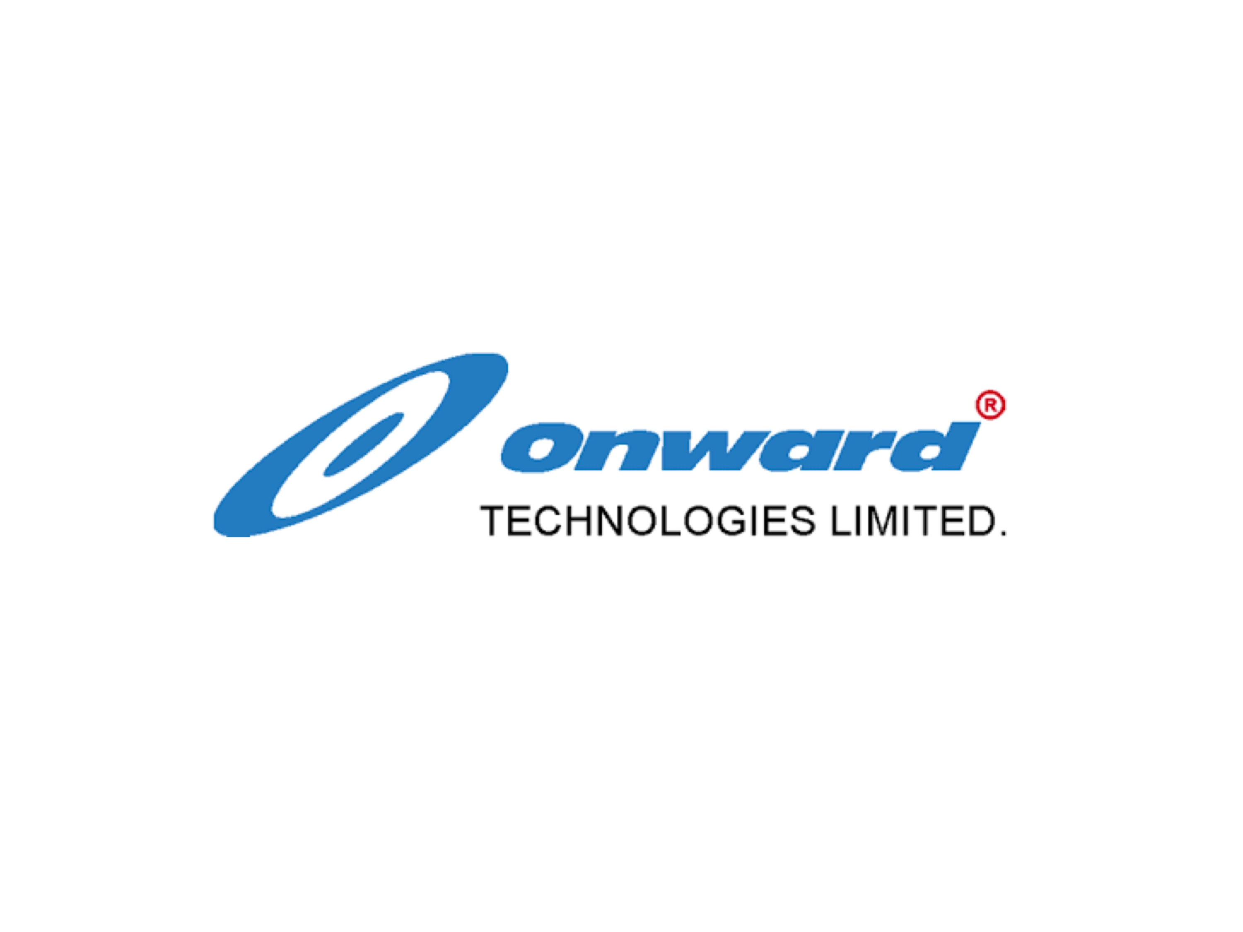
Senarios
Application Services running on physical/virtual machines
Work Load in your Datacenter
Virtualization team
DC OPS Team
Monitoring team
Sys admin team and etc

Slide 3
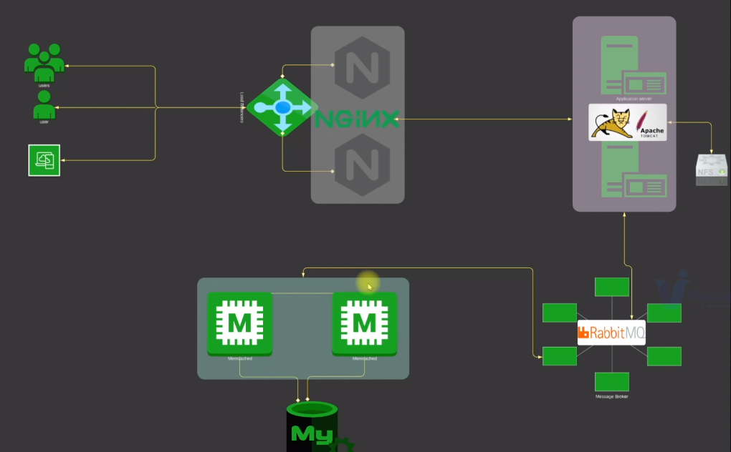

Slide 4
Problem
Complex Management
Scale UP/Down complexity
UpFront CapEx
Regular OpEx
Manual process
Difficult to automate
Time consuming

Slide 5
solution
AWS EC2 instances
AWS ELB
AWS SG
AWS Route 53

Slide 6
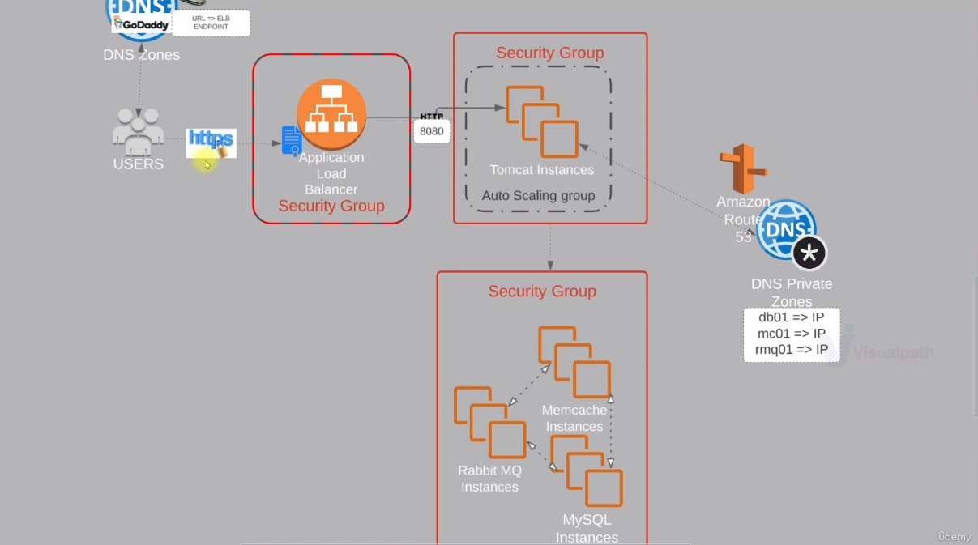

Slide 7
Advantages
Automation
Payasugo
flexibility
Saves money
Saves Time
Saves Resources

Slide 8
Thank you.

