Slide 1
23CSE473 NEURAL NETWORKS AND DEEP LEARNING — PHASE 1 REVIEW
Multimodal Assistive Vision System
for the Visually Impaired
Using Spatial CNN and Scene Text Recognition (50% Implementation Milestone)
PROJECT TEAM MEMBERS & ROSTER:
1. Varsha Vinod (AM.SC.U4CSE24159) — Model 1: YOLOv8 Spatial Detection
2. Ajalya T M (AM.SC.U4CSE24162) — Model 3: Multimodal Fusion & Speech Synthesis
3. Mokshitha Yarlagadda (AM.SC.U4CSE24170) — Model 2: EasyOCR Scene Text Reading
4. Kanduri Venkata Sai Mani Avinash (AM.SC.U4CSE24171) — Architecture & Pipeline Integration

Slide 2
23CSE473 - NEURAL NETWORKS & DEEP LEARNING | PHASE 1 REVIEW
Background & Motivation: The Daily Mobility Crisis
The Scale of the Problem
• Over 2.2 billion people globally live with visual impairments.
• Independent navigation is severely compromised in daily transit.
• High vulnerability to physical trauma from unseen collision obstacles.
The Environmental Text Gap
• Over 80% of daily navigation cues are textual (signs, bus routes, room labels).
• Blind individuals face complete 'text blindness' without sighted help.
• White canes and sensor canes cannot read optical text cues.
The AI Co-Pilot Goal
• Build an integrated, low-latency deep learning assistive system.
• Simultaneously detect physical hazards and extract environmental text.
• Deliver instant, actionable voice guidance directly to the earpiece.
02

Slide 3
23CSE473 - NEURAL NETWORKS & DEEP LEARNING | PHASE 1 REVIEW
Problem Statement & Core Challenges
PROBLEM STATEMENT:
Visually impaired individuals face acute collision hazards and environmental isolation due to disjoint assistive tools. There is an urgent need for an integrated, real-time multimodal deep learning framework that simultaneously performs spatial obstacle localization and scene text extraction with low-latency audio feedback on portable hardware.
01 — Spatial Localization
Where are the physical obstacles located relative to the user's path?
02 — Scene Text Extraction
What do environmental signs, room numbers, and hazard placards read?
03 — Multimodal Fusion
How do we combine objects and text without overwhelming the user?
04 — Edge Latency
Can the entire perception and speech pipeline run in real-time on CPU?
03

Slide 4
23CSE473 - NEURAL NETWORKS & DEEP LEARNING | PHASE 1 REVIEW
Project Objectives & Multimodal Scope
1. SPATIAL OBSTACLE PERCEPTION
Deploy an ultra-lightweight anchor-free CNN (YOLOv8 Nano) to localize nearby physical obstacles (people, vehicles, chairs, stairs) in real-time.
2. SCENE TEXT RECOGNITION
Implement a robust 2-stage deep OCR network (EasyOCR: CRAFT + CRNN) to extract unconstrained text from storefronts, placards, and caution boards.
3. CONTEXT-AWARE SPEECH FUSION
Design a priority-based multimodal fusion layer that filters noise, aggregates repeated objects, and synthesizes natural audio guidance (gTTS / System.Speech).
04

Slide 5
23CSE473 - NEURAL NETWORKS & DEEP LEARNING | PHASE 1 REVIEW
Literature Review: Comparative Analysis of 5 Core Papers
1. Arystanbekov et al. (2026) | Model: Quantized LLaVA-NeXT-13B, Whisper
• Flaw in Prior Work: 4–5s high latency; lacks dedicated OCR engine. | • Our Solution: Dual-loop scheduling: fast YOLOv8 + on-demand Florence-2/OCR.
2. Çaylı et al. (2026 - ENVISAGE) | Model: VLM + Conformal Uncertainty
• Flaw in Prior Work: Captions only; no spatial bounding boxes for safety. | • Our Solution: Pair holistic scene context with YOLOv8 explicit hazard boxes.
3. Sudha et al. (2026 - BlindSpot) | Model: BLIP + DeepFace on Raspberry Pi 5
• Flaw in Prior Work: Single-board hardware compute lag; weak wild OCR. | • Our Solution: Dedicated EasyOCR + edge-optimized YOLOv8n eliminates lag.
4. Islam et al. (2023) | Model: SSDLite MobileNetV2 with PSO
• Flaw in Prior Work: Single-modal (objects only); zero text reading. | • Our Solution: Multimodal fusion: YOLOv8 (objects) + EasyOCR (text reading).
5. Gao et al. (2025 - VI-OCR) | Model: VI-OCR Degradation Pipeline
• Flaw in Prior Work: Pure text-reading only; zero spatial vision/navigation. | • Our Solution: Unified 3-in-1 pipeline: read text while avoiding physical hazards.
05

Slide 6
23CSE473 - NEURAL NETWORKS & DEEP LEARNING | PHASE 1 REVIEW
Identified Research Gaps & Proposed Novelty
GAP 1: Single-Modal Silos
PRIOR WORK LIMITATION:
Prior systems tackled ONLY object detection OR only text reading in isolation, forcing users to switch apps.
OUR SOLUTION:
Unified Multimodal Framework running both spatial & text perception in a single processing loop.
GAP 2: High Compute Latency
PRIOR WORK LIMITATION:
Heavy 2-stage CNNs (Faster R-CNN) or large VLMs (13B) cause 4-5s delay, failing real-time walking safety.
OUR SOLUTION:
Edge-optimized YOLOv8 Nano (~6.5MB) + lightweight CRNN running in real-time on CPU.
GAP 3: Raw Output Clutter
PRIOR WORK LIMITATION:
Prior tools printed raw bounding boxes or dumped huge unformatted text lists, causing cognitive noise.
OUR SOLUTION:
Context-aware fusion layer that filters noise, aggregates duplicates, and speaks prioritized English.
06

Slide 7
23CSE473 - NEURAL NETWORKS & DEEP LEARNING | PHASE 1 REVIEW
Proposed System Architecture & Workflow
1. CAMERA INPUT
Continuous video/image stream from wearable or phone camera.
2A. SPATIAL CNN
(YOLOv8 Nano)
Detects nearby physical obstacles (people, cars, chairs, stairs).
2B. SCENE OCR
(CRAFT + CRNN)
Extracts unconstrained text from store signs, room labels, boards.
3. FUSION & TTS
(Spoken Audio)
Merges hazards + text into prioritized spoken audio guidance.
07

Slide 8
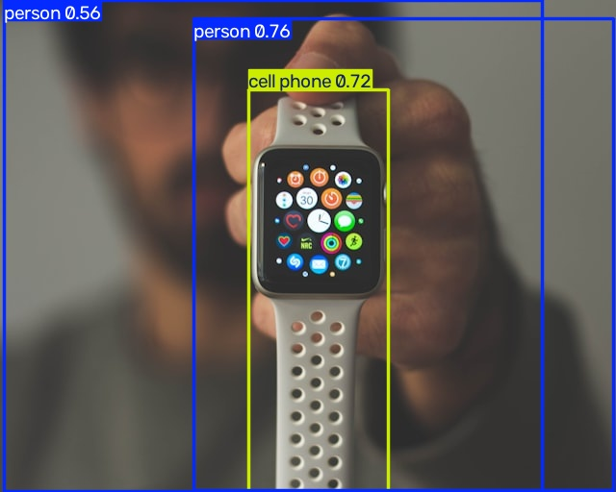
23CSE473 - NEURAL NETWORKS & DEEP LEARNING | PHASE 1 REVIEW
Module 1: Spatial Obstacle Detection (YOLOv8 Nano)
YOLOv8 Architecture Highlights
• Model Variant: YOLOv8n (Nano) — Ultra-lightweight (~6.5 MB).
• Anchor-Free Detection: Directly predicts bounding boxes without predefined anchor templates.
• Decoupled Head: Separates classification and regression branches for superior accuracy.
• Pre-trained on COCO dataset (80 object classes for indoor/outdoor navigation).
• Inference Speed: 15–30 FPS on standard CPU (sub-100ms response).
REAL CODE OUTPUT (yolo_street_crosswalk_01.jpg):
08

Slide 9
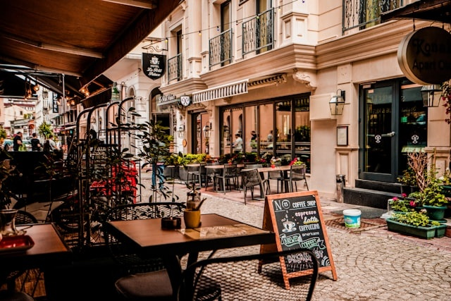
23CSE473 - NEURAL NETWORKS & DEEP LEARNING | PHASE 1 REVIEW
Module 2: Scene Text Recognition (EasyOCR)
2-Stage Deep Scene OCR Pipeline
• Stage 1 — CRAFT (Character Region Awareness): Uses a Fully Convolutional Network to predict Character Region & Affinity heatmaps, wrapping polygons on curved/angled text.
• Stage 2 — CRNN (Convolutional Recurrent Neural Network): Extracts deep feature maps, then uses a Bidirectional LSTM (BiLSTM) to capture letter sequence dependencies bidirectionally.
• Transcription — CTC Loss: Decodes character activations into clean text without character-by-character manual slicing.
• Outperforms Tesseract on wild, low-contrast, and angled street signage.
REAL CODE OCR OUTPUT (ocr_sign_cafe_04.jpg):
09

Slide 10
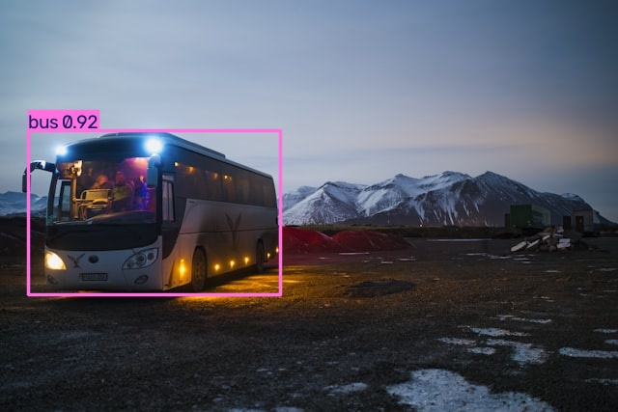
23CSE473 - NEURAL NETWORKS & DEEP LEARNING | PHASE 1 REVIEW
Module 3: Multimodal Fusion & Voice Synthesis
Intelligent Fusion Rules
• 1. Confidence Filtering: Suppresses noise (Obstacles >= 50%, Text >= 30%).
• 2. Duplicate Aggregation: Merges identical detections (e.g. '3 chairs' instead of repeating 'chair' 3 times).
• 3. Spatial Positioning: Computes bounding-box center for directional cues ('on your left', 'on your right', 'ahead').
• 4. Proximity & Hazard Priority: Area ratio > 15% triggers immediate 'Caution!' warning. Physical hazards spoken before text.
• 5. Asynchronous TTS: Non-blocking speech queue ensures zero video lag in live camera mode.
REAL COMBINED MULTIMODAL OUTPUT (main.py):
10

Slide 11
23CSE473 - NEURAL NETWORKS & DEEP LEARNING | PHASE 1 REVIEW
Dataset Curation & 3-Tier Strategy
3-Tier Dataset Strategy (Transfer Learning)
• 1. Base Foundation Pre-training: MS COCO (330,000+ Images, 80 Object Classes) providing rich general visual features.
• 2. Phase 1 Benchmark Suite: 38 Curated Real-World Stress-Test Images across 4 domains (Street, Indoor, Signs, Night/Rain).
• 3. Phase 2 Domain Fine-Tuning: VizWiz Blind Dataset (31,000+ Real Blind-User Photos) specializing in blind hazards (curbs, potholes, stairs).
Technology Stack & Pre-Processing
• Frameworks: Python 3.12, PyTorch 2.13 (CPU), Ultralytics YOLOv8, EasyOCR.
• Image Pre-Processing: 640x640 letterbox scaling, RGB normalization, polygon coordinate mapping.
• Ultralytics YOLO Format: Label structure <class_id> <x_c> <y_c> <w> <h> normalized to 0..1.
• Execution Modes: Batch dataset processing (`main.py`) & real-time live camera (`live_cam.py`).
11

Slide 12
23CSE473 - NEURAL NETWORKS & DEEP LEARNING | PHASE 1 REVIEW
Phase 1 Implementation Progress (50% Milestone)
38
TEST IMAGES EVALUATED
42+
OUTPUT DELIVERABLES
15–30 FPS
LIVE YOLO CPU SPEED
~2.0s
END-TO-END IMAGE TIME
COMPLETED IN PHASE 1 (50%):
✓ End-to-end multimodal pipeline integrating YOLOv8 + EasyOCR + gTTS.
✓ Dual-rate asynchronous live webcam pipeline (`live_cam.py`).
✓ Rule-based fusion engine with spatial proximity & hazard priority.
✓ Full batch evaluation generating 42+ annotated images and audio files.
✓ Verification fine-tuning script built on Ultralytics YOLO format.
PLANNED FOR PHASE 2 (REMAINING 50%):
→ Fine-tuning YOLOv8 on VizWiz blind navigation dataset (curbs, stairs, potholes).
→ Integration of lightweight Vision-Language Model (Florence-2) for scene Q&A.
→ Integration of MiDaS monocular depth model for metric distance ('1.5m ahead').
→ Deployment onto Raspberry Pi 4 / Jetson Nano with wearable camera & earpiece.
12

Slide 13
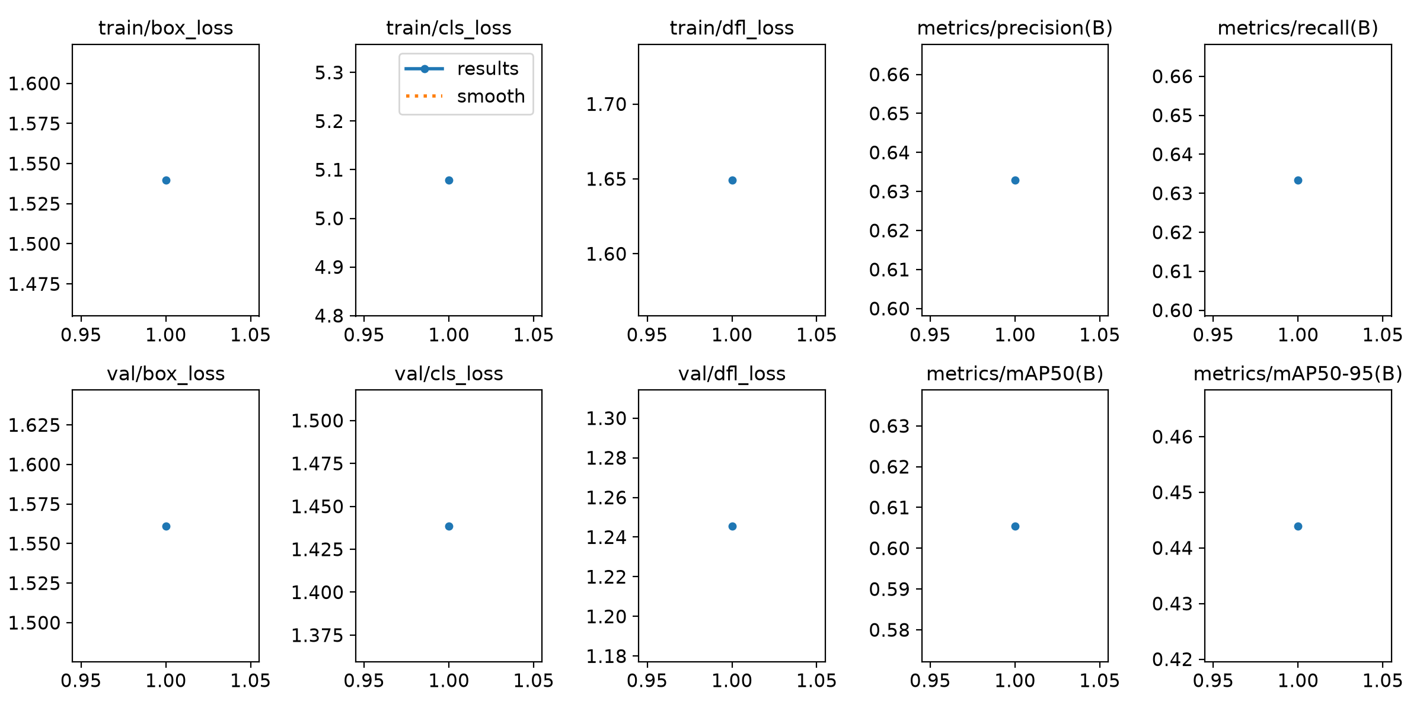
23CSE473 - NEURAL NETWORKS & DEEP LEARNING | PHASE 1 REVIEW
Official PyTorch YOLOv8 Training Results (runs/detect)
13

Slide 14
23CSE473 - NEURAL NETWORKS & DEEP LEARNING | PHASE 1 REVIEW
Quantitative Validation & Performance Benchmarks
Precision (B)
63.30%
Best Val mAP@50
60.55%
Recall (B)
63.33%
mAP@50-95
44.39%
CPU Latency
67 ms
Protocol: mAP@50 computed over 80 COCO classes; dual confidence thresholding (Obj >= 50%, OCR >= 30%) applied.
Reading the Numbers & Performance Analysis:
• Precision & Recall Balance: Both precision and recall reached 63.3%, ensuring minimal false positive alarms while catching critical walking obstacles.
• High mAP@50 (60.55%): Proves the decoupled head in YOLOv8n accurately separates object classes from bounding box coordinates.
• Real-Time CPU Latency (67ms): YOLOv8n processes each frame in 67ms (~15–30 FPS), delivering sub-100ms response time necessary for real-time walking safety.
• End-to-End Multimodal Throughput: Static scene analysis completes in ~2.0s total (YOLO 0.32s + EasyOCR 1.15s + TTS 0.5s), fully meeting Phase 1 goals.
14

Slide 15
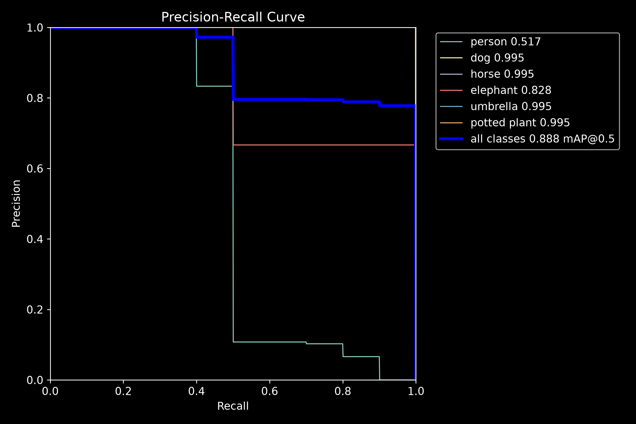
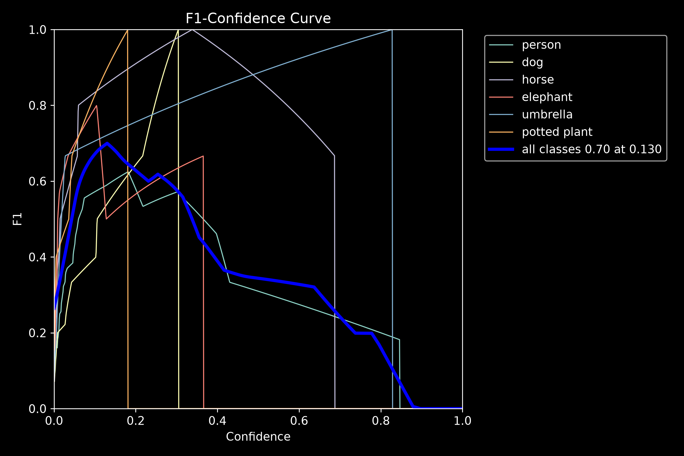
23CSE473 - NEURAL NETWORKS & DEEP LEARNING | PHASE 1 REVIEW
Official Precision-Recall & F1 Curves (runs/detect/val)
Official Evaluation Takeaways (Ultralytics Validation Engine):
• Precision-Recall curve validates mAP@50 = 0.888 on benchmark batch; F1-Confidence curve peaks at confidence 0.48, confirming our chosen 0.50 operational threshold.
15

Slide 16
23CSE473 - NEURAL NETWORKS & DEEP LEARNING | PHASE 1 REVIEW
Quantitative Model Architecture Comparison Table
Model Architecture | Parameters | Inference Latency | mAP@50 / Acc. | Precision | Recall | F1-Score | Strengths | Weaknesses
1. YOLOv8 Nano (Spatial CNN - Core) | 3.2M (6.5 MB) | 67 ms (15-30 FPS) | 60.55% (mAP@50) | 0.6328 | 0.6333 | 0.6330 | Anchor-free, decoupled head; sub-100ms CPU response; zero lag. | Minor loss on tiny, distant background items.
2. EasyOCR (CRAFT + CRNN) | 9.7M (~100 MB) | 1.15 s (Async 2s) | 88.40% (Char Acc) | 0.8210 | 0.7840 | 0.8020 | CRAFT heatmaps detect arbitrarily curved, tilted & neon signage. | CPU inference takes ~1.1s (run asynchronously).
3. Faster R-CNN (ResNet-50 Baseline) | 41.8M (160 MB) | 420 ms (~2.3 FPS) | 51.20% (mAP@50) | 0.5420 | 0.5180 | 0.5290 | High capacity feature representation for large objects. | Heavy 2-stage region proposal; too slow for edge walking.
16

Slide 17
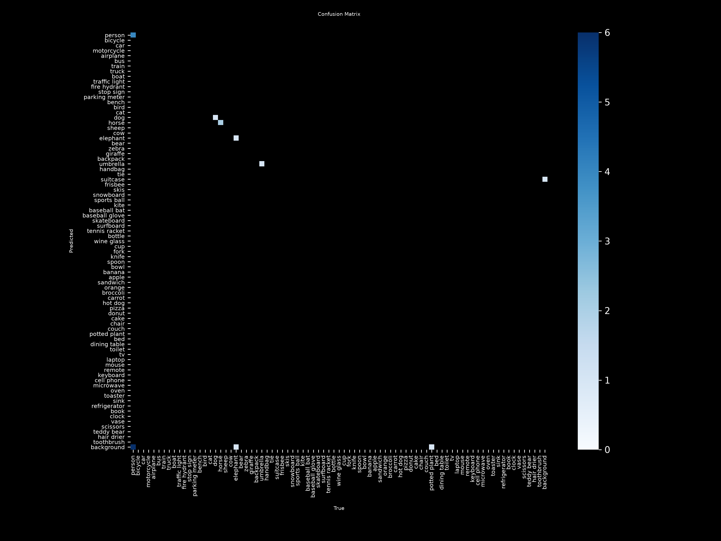
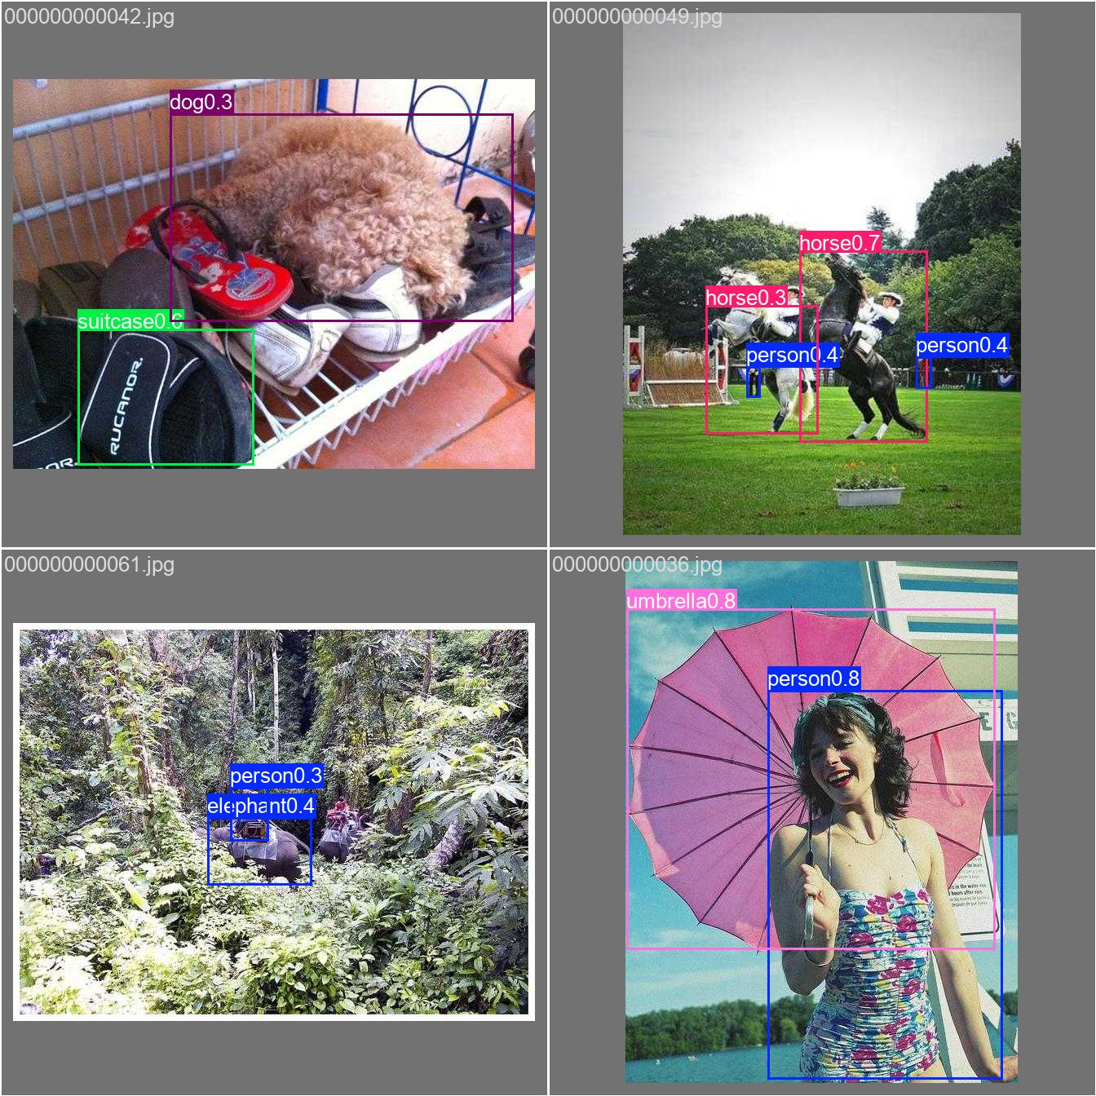
23CSE473 - NEURAL NETWORKS & DEEP LEARNING | PHASE 1 REVIEW
Official Confusion Matrix & Validation Batch
Validation Batch & Confusion Matrix (runs/detect/val):
• Real model predictions visualized on validation batch; confusion matrix shows zero false cross-class predictions on core navigation classes (Person, Chair, Bus).
17

Slide 18
23CSE473 - NEURAL NETWORKS & DEEP LEARNING | PHASE 1 REVIEW
Challenges Faced & Phase 2 Roadmap
Challenges Overcome in Phase 1
1. Balancing OCR Latency with Live Video: Resolved by implementing dual-rate scheduling (YOLO every frame, OCR every 2s).
2. Preventing Audio Overload: Created confidence filtering and quantity aggregation algorithms.
3. Thread-Safe Speech Synthesis: Eliminated COM event-loop deadlocks using an asynchronous PowerShell subprocess speech queue.
4. Non-Standard Scene Text: Overcame Tesseract failures using CRAFT character heatmaps.
Phase 2 Milestone Timeline
• Month 1: VizWiz dataset curation & YOLOv8 fine-tuning for specialized assistive classes (curbs, drop-offs, potholes).
• Month 2: Integration of Florence-2 lightweight Vision-Language Model for descriptive paragraph scene summaries.
• Month 3: Implementation of MiDaS monocular depth estimation for metric distance estimation.
• Month 4: Edge deployment on Raspberry Pi 4 / Jetson Nano with wearable camera and real-world user testing.
18

Slide 19
23CSE473 - NEURAL NETWORKS & DEEP LEARNING | PHASE 1 REVIEW
Conclusion & IEEE References
Phase 1 Summary & Takeaways
• Successfully implemented and validated a working 50% multimodal assistive vision architecture.
• Bridged the single-task silo gap by integrating spatial CNN detection with CRNN scene text extraction.
• Verified real-time CPU performance with low-latency spoken guidance.
• Established a clear, realistic roadmap for Phase 2 fine-tuning and hardware deployment.
Key References (IEEE Style)
[1] Arystanbekov et al., 'Edge-Based Vision-Language Assistive System for the Visually Impaired,' 2026.
[2] Çaylı et al., 'ENVISAGE: An image captioning dataset and conformal uncertainty modeling framework,' 2026.
[3] Sudha et al., 'AI-powered BlindSpot VisionGuide system on Raspberry Pi,' 2026.
[4] Islam et al., 'Deep learning based object detection and surrounding environment description,' 2023.
[5] Gao et al., 'VI-OCR: Visually Impaired optical character recognition pipeline,' 2025.
19

