Slide 1
WEEK 4 • TASK 4.4
CAPSTONE:
END-TO-END ANALYTICS
Data Integration • Cleaning • Business Analysis • Dashboard Design
Prepared by: Sona Kolle Marlyse
Tools Used: Python, pandas, NumPy, Jupyter Notebook, Power BI
WEEK 4 CAPSTONE | END-TO-END ANALYTICS 01

Slide 2
Project Overview
What the capstone demonstrates
• Combine two source files: insurance_data.csv and sales_dataset.csv.
• Inspect the integrated dataset for structure, data types, missing values and duplicate rows.
• Apply reusable cleaning and transformation steps in Python.
• Export a cleaned dataset for business analysis and dashboarding.
WEEK 4 CAPSTONE | END-TO-END ANALYTICS 02

Slide 3
Tools & Technologies
Role of each tool in the workflow
Python
Runs the data preparation workflow.
pandas
Loads, joins, inspects, transforms and exports data.
NumPy
Supports numerical work in the notebook.
Jupyter Notebook
Documents and executes pipeline steps.
Power BI
Presents business metrics and interactive visuals.
WEEK 4 CAPSTONE | END-TO-END ANALYTICS 03

Slide 4
End-to-End Analytics Pipeline
From raw sources to reporting
1
Load CSVs
2
Preview
3
Integrate
4
Inspect
Insurance + sales
head()
Cross join
shape, info, nulls, duplicates
5
Clean
6
Export
7
Analyze
8
Present
standardize, de-duplicate, drop missing
cleaned CSV
KPIs + comparisons
Power BI dashboard
Note: The notebook uses a cross join because it states the datasets have no common keys. Validate that this is the intended business logic.
WEEK 4 CAPSTONE | END-TO-END ANALYTICS 04

Slide 5
Data Cleaning & Quality Checks
Reusable cleaning function
• Standardize column names to lowercase with underscores.
• Convert customer_id to text when the column exists.
• Remove duplicate rows and drop rows containing missing values.
• Cleaned dataset profile: 312 rows and 11 columns.
• Remaining missing cells: 0; duplicate rows: 0.
WEEK 4 CAPSTONE | END-TO-END ANALYTICS 05

Slide 6
Business Performance at a Glance
Summary metrics from the supplied cleaned dataset
TOTAL SALES
TOTAL QUANTITY
UNIQUE CUSTOMERS
INSURANCE RATE
166,140,000 FCFA
598
12
53.85%
These metrics summarize the supplied dataset; validate the cross-join logic before interpreting them as real-world transaction totals.
WEEK 4 CAPSTONE | END-TO-END ANALYTICS 06

Slide 7
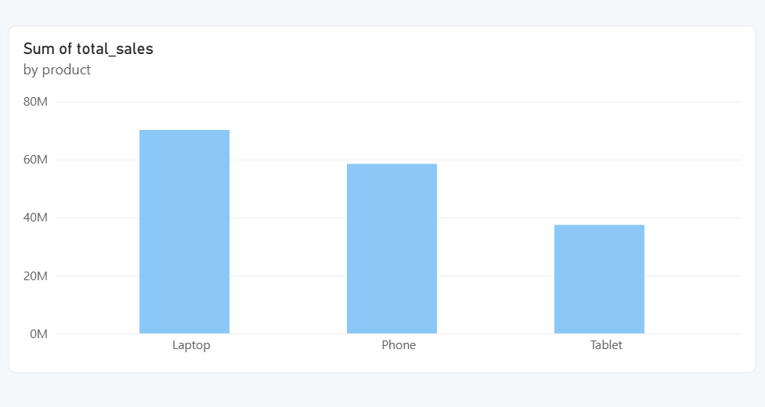
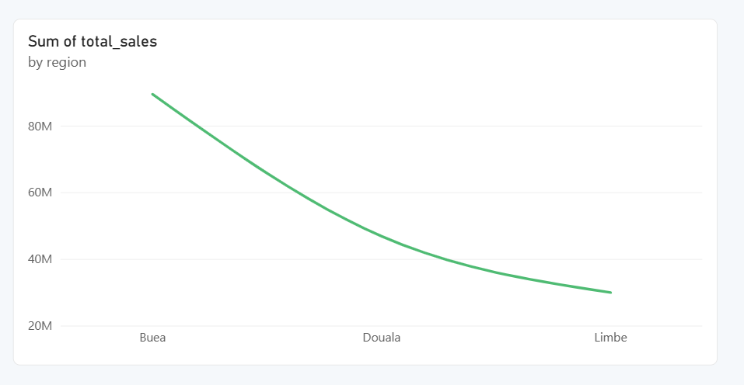
Product & Regional Performance
Highest recorded sales in each category
Top product: Laptop (70,200,000 FCFA). Top region: Buea (89,440,000 FCFA).
WEEK 4 CAPSTONE | END-TO-END ANALYTICS 07

Slide 8
Sales Representatives & Payment Methods
Comparing contribution and payment mix
SALES BY REPRESENTATIVE
SALES BY PAYMENT METHOD
Sona
59,800,000
Mobile Money
67,860,000
Kevin
57,200,000
Cash
58,500,000
Marlyse
49,140,000
Bank Transfer
39,780,000
Leading representative: Sona. Leading payment method: Mobile Money.
WEEK 4 CAPSTONE | END-TO-END ANALYTICS 08

Slide 9
Interactive Dashboard Design
Suggested visuals and slicers for Power BI
VISUALS
INTERACTIVITY
• KPI cards: Total Sales, Total Quantity, Sum of unit price, Insurance Rate
• Total Sales by Product (bar chart)
• Total Sales by Region (line chart)
• Sales by Representative (column chart)
• Payment Method (donut chart)
• Insurance Status and Age (pie chart)
• Slicers: Region
• Slicers: Payment Method
• Slicers: Sales Representative
• Use Edit interactions so slicers filter relevant visuals
WEEK 4 CAPSTONE | END-TO-END ANALYTICS 09

Slide 10
Key Findings & Recommendations
What the analysis suggests
• Laptop has the highest recorded product sales (70,200,000 FCFA).
• Buea is the highest recorded region (89,440,000 FCFA).
• Sona has the highest recorded sales by representative (59,800,000 FCFA).
• Mobile Money is the most common revenue source by payment method (67,860,000 FCFA).
• Validate the cross join and source-data relationships before making operational decisions.
• Document row counts before and after cleaning and review missing values before dropping records.
WEEK 4 CAPSTONE | END-TO-END ANALYTICS 10

Slide 11
CONCLUSION
From raw data to business insight
The project demonstrates source loading, integration, quality checks, reusable cleaning, export, KPI analysis and dashboard planning. The next step is to validate the join logic and save the final interactive report from Power BI Desktop.
Thank you
WEEK 4 CAPSTONE | END-TO-END ANALYTICS 11

