Slide 1

Parallel Programming
with Java
Kaiyuan Tang, Lu Zhang & Yi Yang Dec. 4th, 2019

Slide 2

1
Intuition
Category
2
Implementation
3
Results & Discussion
4
Possible future work

Slide 3

PART O1
Intuition

Slide 4
Part1
Intuition
Problems to solve:
To do the parallel programming in Java
& compare the performance with C.
1. Do the matrix multiplication with parallel programming in Java
2. Do the runge-kutta method with parallel programming in Java
3. Compare the results with serial idea then with the ones in C

Slide 5
Part1
Intuition
Matrix multiplication:
Create n threads first, then try to assign each live thread a multiplication task, finally get the output array as the result.
Runge-kutta method:
Create n threads first, then try to assign each live thread a calculation task, where array k_{i} should wait for array k_{i-1} with a proper barrier, finally get the output array as the result.

Slide 6
Part1
Intuition
Comparison:
Use total sum to add up all the entries of the output array then compare it with the serial one to check whether the implementation is correct.
Use java system time to calculate the code processing time the compare it with the ones in C.

Slide 7
PART O2
Implementation

Slide 8

Part2
Implementation
Java Thread:
implement Runnable
extend Thread
All need to override

Slide 9
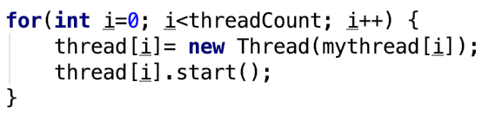

Part2
Implementation
How to write code:
construct Thread array objects and start threads
join threads

Slide 10
Part2
Implementation
Thread pool:
A thread pool reuses previously created threads to execute current tasks and offers a solution to the problem of thread cycle overhead and resource thrashing
the delay introduced by thread creation is eliminated, because the thread is already existing when the request arrives
Java provides sub-interface –ExecutorService and the class-ThreadPoolExecutor

Slide 11
Part2
Implementation
Barrier:
CyclicBarrier
CountDownLatch

Slide 12
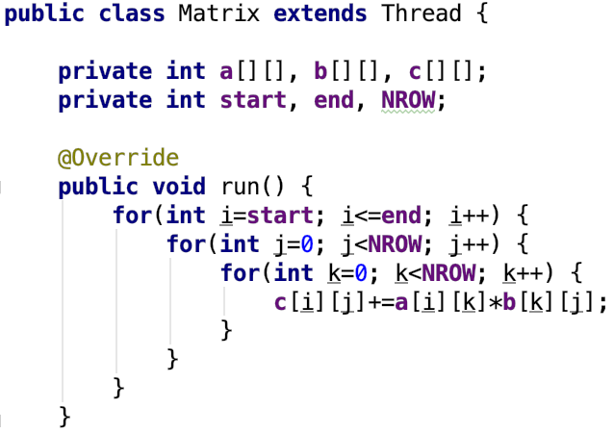
Part2
Implementation
Mmult:

Slide 13
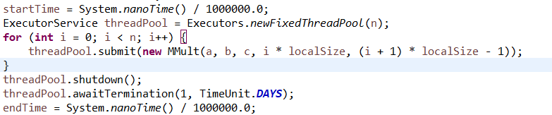
Part2
Implementation
mmult thread pool:

Slide 14
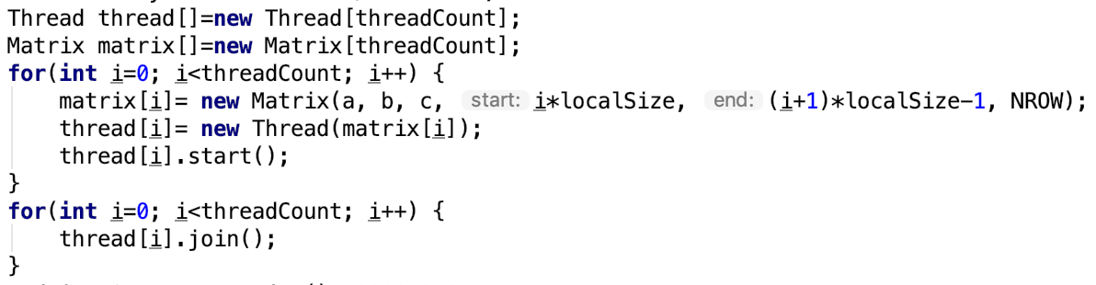
Part2
Implementation
Mmult:

Slide 15
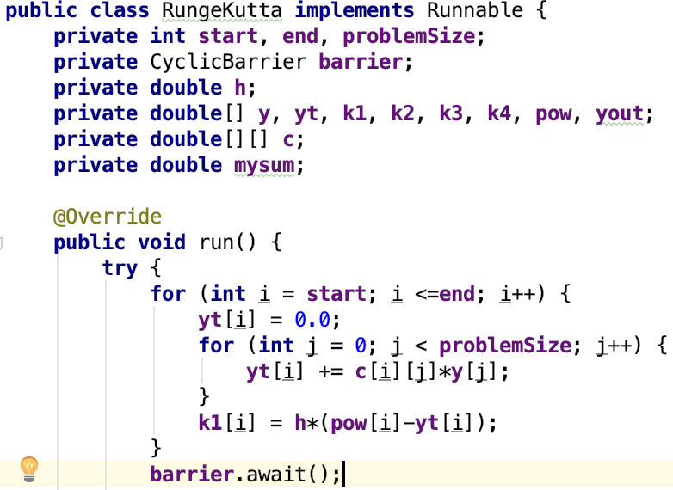
Rk4:

Slide 16

PART O3
Result & Discussion

Slide 17
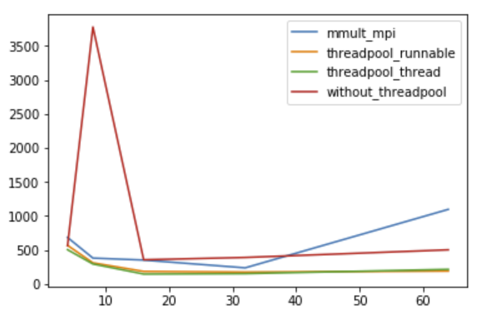
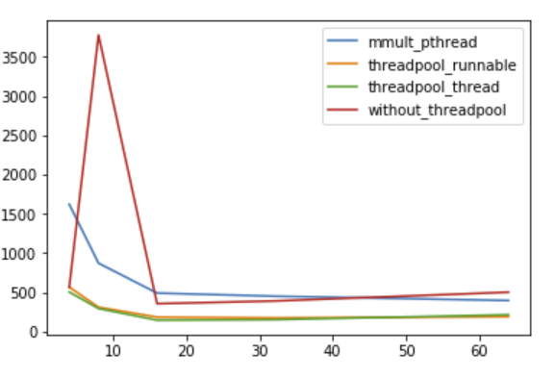
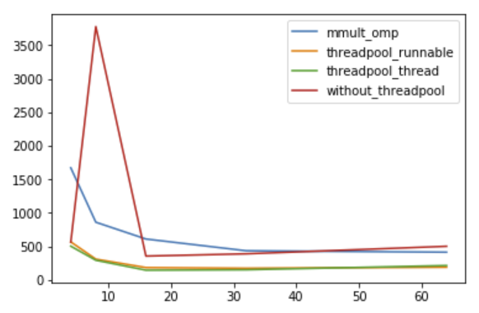
Part3
Result & Discussion
Mmult:

Slide 18
Part 3
Discussion
Thread pool:
As we increase the number of threads, the idea with thread pool performs better.
Java & C:
As we see in the plot Java performs better than c in multi threads.

Slide 19
PART 04
Possible future work

Slide 20
Part 4
Possible future work
Try more algorithms with Java
Read some docs about how Java implements the multi threads
Try more ideas about how to compare the performance

Slide 21
Thank you for watching!

