Slide 1


Project - Idea
You think

Slide 2


In fact

Slide 3



How to choose a good book
Refer from others

Slide 4
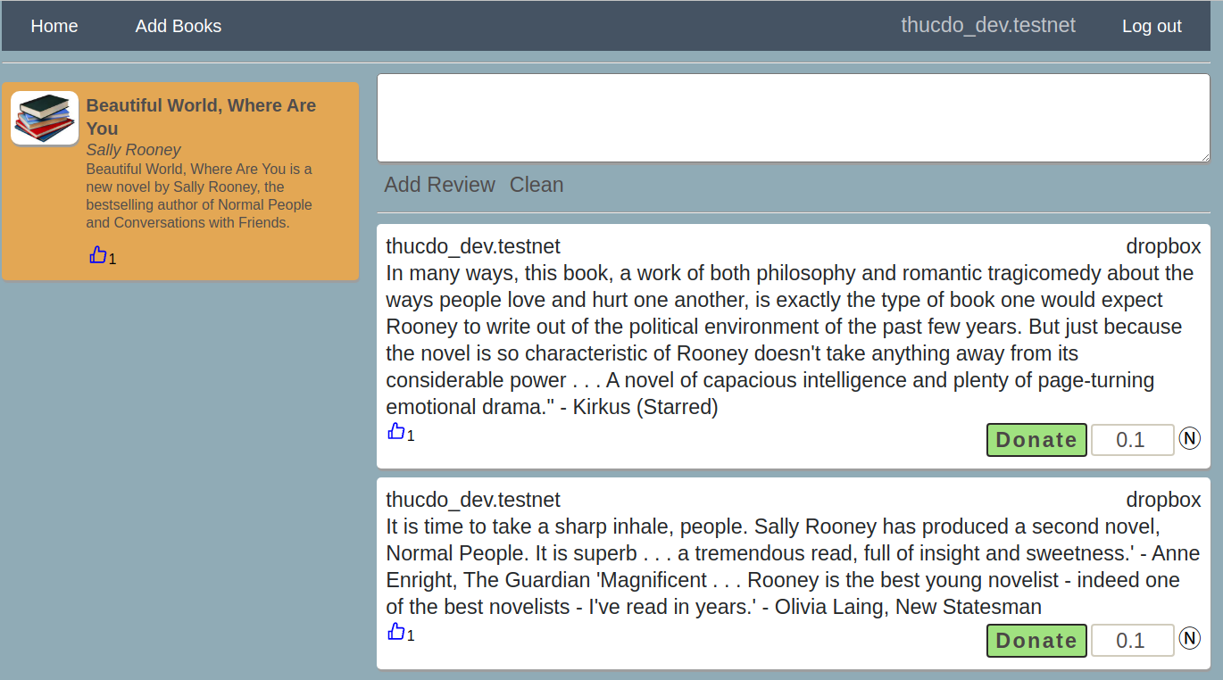
What “book reviews” do

Slide 5
What book reviews do
User can
Add/edit/delete a book
Add/edit/delete a review
Upvote for books/reviews
Donate for reviewer with a good review

Slide 6
What next after demo
Achieve UI/UX
Users can download book from the site
Buy books every month base on the vote of the community
The best reviewer will be received a reward (Near Token) every month
Complete remain courses in https://learnnear.club/

Slide 7
Steps to complete Demo Project(1)
1. Code Smart Contract (SC)
(Assembly Script/Rust)
2. Test SC using Near CLI
-> understand “view/call function”
3. Unit Test SC
4. Code Frontend call SC (near-api-js)

Slide 8
Steps to complete Demo Project(2)
Smart Contract
https://docs.near.org/docs/develop/contracts/as/intro
https://docs.near.org/docs/develop/contracts/as/near-sdk-as
Near CLI
https://docs.near.org/docs/tools/near-cli
Unit Test
https://docs.near.org/docs/develop/contracts/as/testing-as-contracts#step-3---write-a-couple-of-tests-for-the-contract
https://github.com/Kane10009/guest-book/blob/master/assembly/__tests__/guestbook.spec.ts
Frontend
https://docs.near.org/docs/api/naj-quick-reference

Slide 9
Where are you?
Frontend
Your work
Your D-App
Wallet
Smart Contract
view method
change method
Near Blockchain
PersistentUnorderedMap
ContractPromiseBatch
Persistent
…

Slide 10
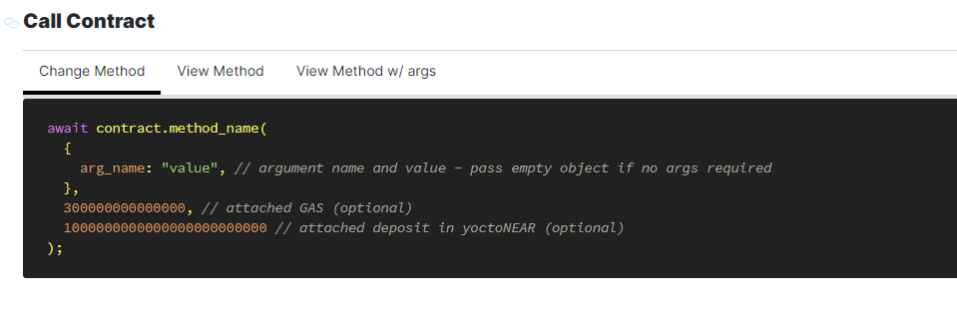
Notes – Change method
Param1 : args of method in smart contract
Param2: attached GAS (optional)
Param 3: attached deposit in yoctoNear (optional)

Slide 11

Notes – Transfer token from contract to user

Slide 12
Notes – transfer from one to other user using contract
You cannot transfer tokens from an arbitrary account. Imagine I have a contract that can transfer tokens from your balance. That does not sound secure, right?
The approach you want to implement is the following: when account a.testnet calls a contract, it attaches some tokens with the call (create a transaction with non-zero deposit in FunctionCall action), and then, inside the contract, create a Transfer to the account b.testnet.
a.testnet
Deposit 1NEAR
Your contract
transfer 1NEAR
b.testnet

Slide 13
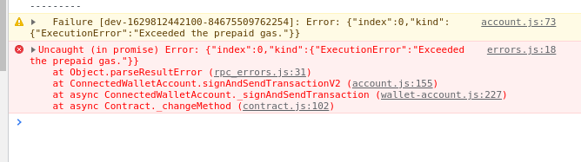
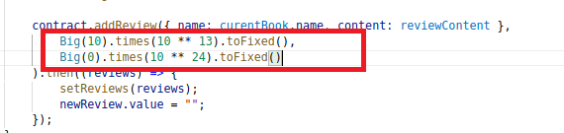
Notes – Exceeded the prepaid gas

Slide 14
Speed up debug time
Yarn deploy will deploy your project to github page so it is take long time (1~2 minutes)
➔ Use ‘yarn dev’ -> your product will is deployed on local pc -> (3~5s) and update UI take <1s

Slide 15
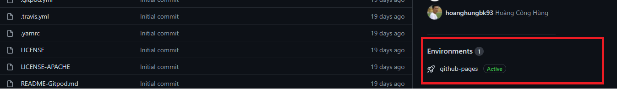
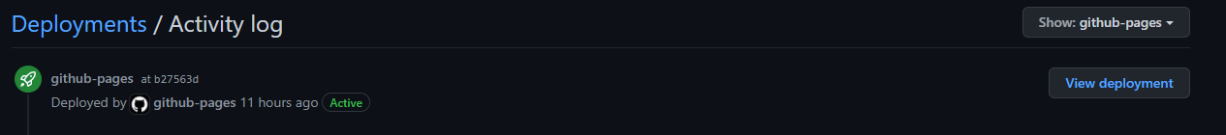
Build guest book error
→ remove yarn.lock, node-modules -> yarn install -> yarn deploy
Then see your product on github

Slide 16
Support/References
https://learnnear.club/vi/huong-dan-xay-dung-va-phat-trien-tren-near/
https://docs.google.com/presentation/d/1jNpzqRAm44HGefgrlOpXV-qwJQQ1X8JOBSpxhkUNchI/edit#slide=id.g86d27c84b2_0_90
https://t.me/neardev
https://t.me/neardev_vncommuity
https://t.me/nearvndevel
https://github.com/orgs/near-examples/repositories?page=2
https://docs.near.org/docs/develop/contracts/as/intro
https://nomicon.io/RuntimeSpec/Transactions.html
https://kiemtienonline360.com/hoc-lap-trinh-tren-nen-tang-near-blockchain-dong-thoi-vua-kiem-chung-chi-near-certified-developer-vua-kiem-tien/

