Slide 1
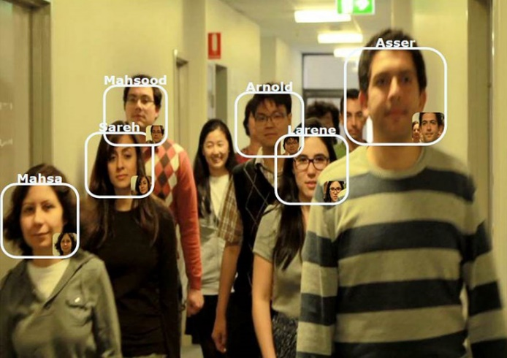
TEAM 2
IP :
192.168.0.8
ID :
admin
PORT:
8008
PW :
*****
LOGIN
Secure Mode
Learning Mode
Run Mode
Test Run Mode
NAME:
Mahsa
Confirm

