Slide 1
Top Prospects for global expansion efforts ranked by country
Kane Monaco

Slide 2
Why expand into new markets
Improved profitability
Becoming an international entity affords the company many benefits. Chief among them being increased margins due to improved customer portfolio, demographic reach, more affordable talent, decrease in research and development, and improved operational costs.
Reduce risk in current market
Hedging instablilities in current markets can be an efficient method to reducing the corporation’s current risks if unforeseen situations present themselves.
Less competition
Many businesses’ greatest hurdle toward the path to profitability is competion in their markets. Globalization efforts have been an incredibly effective method of reducing this competitive pressure by entering markets where these competitors are less numerous.

Slide 3
What are desirable indicators of a profitable new market
Taxes
Countries with the lowest corporate tax rates will be considered prime opportunities as they will have the lowest burden on revenue.
Population
Larger demographics generally coincide with larger market opportunities and therefore, a larger customer base.
Unemployment Rates
Understanding the countries level of employment will indicate the available pool of talent that the business can draw from.
Gross Domestic Product(GDP)
This will reveal how vast the country’s cash flow is and is a good indicator of capital flowing through the specific market.

Slide 4
Data Analysis and its role in this project
Data analysis can be used to extrapolate meaningful information out of larger pools of documentation. This project will use data analysis in conjunction with Python, to compile several individual data sets into interpretable tables that allow us to answer the questions set forth by our market indicators.
This will ultimately allow the Businesses using this information to decide if they should go forward with an international expansion or not.

Slide 5
Why use python as the foundation for this project
Leveraging programming languages such as Python can offer a more substantive view into the analysis of multiple or complex data sets. Which can in turn lead to valuable resources and details being extracted from said data sets that will positively affect business operations or decisions.

Slide 6
Data to be used
Population By Country
Gross Domestic Product
Indicates the market demographic and potential consumer base.
Measure of economic activity in the proposed market.
Corporate Tax Rate
Unemployment Rate
Offers greater opportunity for margin, making ventures less risky.
Gives the business insight into the potential talent the market has available to hire into their workforce.

Slide 7
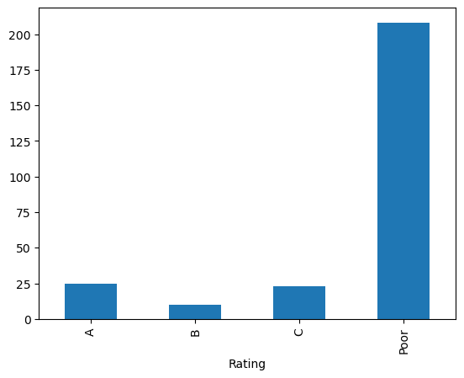
Population By Country
Total Ratings
Highest Ranked
Country | Ranking
China | A
East Asia & Pacific (excluding high income) | A
Early-demographic dividend | A
East Asia & Pacific | A
India | A
OECD members | A
South Asia | A
Sub-Saharan Africa (excluding high income) | A
Sub-Saharan Africa | A
East Asia & Pacific (IDA & IBRD countries) | A
South Asia (IDA & IBRD) | A
Sub-Saharan Africa (IDA & IBRD countries) | A
Upper middle income | A

Slide 8
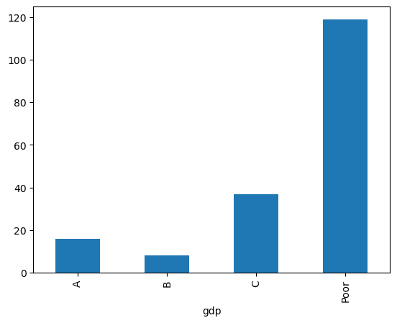
Gross Domestic Product
Total Ratings
Total Rankings
Country | GDP
Australia | A
Brazil | A
Canada | A
China | A
Germany | A
Spain | A
France | A
United Kingdom of Great Britain and Northern I... | A
Indonesia | A
India | A
Italy | A
Japan | A
Republic of Korea | A
Mexico | A

Slide 9
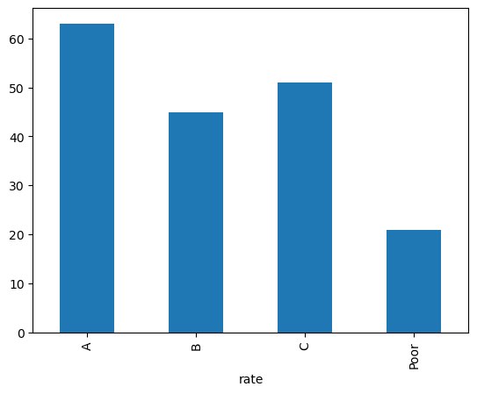
Corporate Tax Rate
Total Ratings
Highest Rankings
country | Tax Rating
Afghanistan | A
Albania | A
United Arab Emirates | A
Armenia | A
Azerbaijan | A
Ukraine | A
Uzbekistan | A
Viet Nam | A
Vanuatu | A
Yemen | A

Slide 10
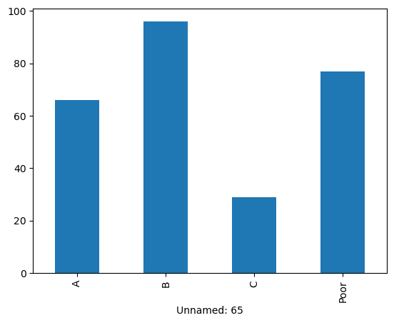
Unemployment Rate
Total ratings
Highest rankings
Country | Rate
United Arab Emirates | A
Burundi | A
Benin | A
Burkina Faso | A
Bahrain | A
Trinidad and Tobago | A
Tanzania | A
Uganda | A
Vietnam | A
Vanuatu | A

Slide 11
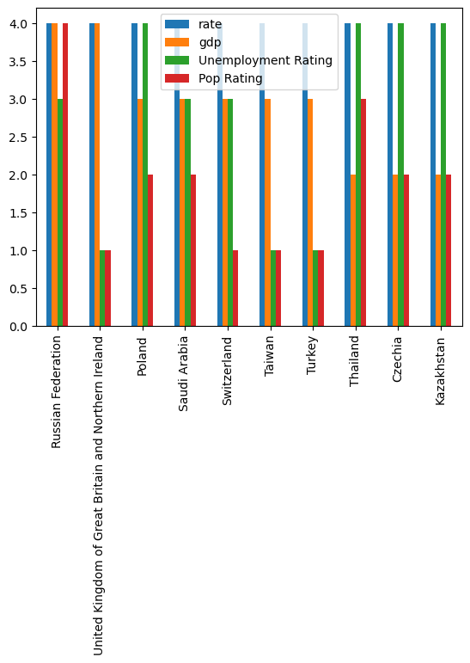
Top ranked countries for global business prospects
4 = A | 3 = B | 2 = C | 1 = Poor

Slide 12
SUMMARY
In conclusion, countries that rank highly in most, or all these categories are more likely to support a successful expansion of a business into a foreign market. This in turn can support new revenue streams, allow for further corporate branding, and add to the company's talent pool while having the added benefit of reducing the capital risk the business.

Slide 13
THANK YOU
Kane Monaco
NYC Data Science Academy
Data Analysis Python Project

