Slide 1

CT#4 · BRAND PRESENTATION
Pages &
Pour
One Place. Every Page. Every Pour.
An Educational Bookstore with a Coffee Shop
John Ruzzel V. Sansait · Stephanie Claire M. Caingcoy · Mark Ian Mudlong · Carlos Aurelius Gervacio
Notes:
Introduce the group and the brand: Pages & Pour, an educational bookstore with a coffee shop. Read the tagline slowly: “One Place. Every Page. Every Pour.”

Slide 2
TODAY’S POUR
What we’ll share.
PT#1
CT#1
CT#2
CT#3
Business Concept
Logo Design
First Brand Post
Event Poster
Name, tagline, mission, market, products & services
Primary & secondary logos, sketch, palette, typography
Our first official social media post
Sip & Story Night: thought process, palette, typography
Notes:
Walk through the four parts quickly so the audience knows where the presentation is going.

Slide 3

PERFORMANCE TASK #1
Business Concept
Development
Notes:
Start the business concept part.

Slide 4
BRAND / COMPANY NAME
Pages
&
Pour
Books, reading, and learning.
Coffee, tea, and other drinks.
TAGLINE
“One Place. Every Page. Every Pour.”
Notes:
Explain the name: it represents our two main experiences. “Pages” for books, reading, and learning, and “Pour” for coffee, tea, and other drinks. The tagline says all of it happens in one place.

Slide 5

HISTORY
Three needs. Three places.
Until now.
Pages & Pour was created from a common problem experienced by students and readers: finding one place where they can buy books, enjoy coffee, and study comfortably.
Bookstore
+
Café
+
Study space
=
Pages & Pour
QUICK QUESTION
Raise your hand if you’ve ever had to go to a bookstore, a café, and a study space on the same day.
Notes:
Students often have to move between a bookstore to buy school materials, a café for food and drinks, and a library or study space to work. Pages & Pour brings these needs together in one location. Ask the audience the quick question to get them involved.

Slide 6
MISSION
VISION
To provide students, readers, and young professionals with a comfortable and convenient place to read, study, work, and relax while enjoying a nice coffee and having convenient access to books and learning materials without having to go somewhere else for each one.
To become the go-to neighborhood hub for students and readers, a place beyond home and school. Known for its books, brews, and its productive and welcoming atmosphere.
Notes:
Read the mission, then the vision. Emphasize “a place beyond home and school.”

Slide 7
TARGET AUDIENCE / MARKET
Who Pages & Pour is for.
15–25 years old
25–35 years old
PRIMARY MARKET
SECONDARY MARKET
Students
Young Professionals and Readers
High school and college students who need a comfortable and affordable place to study, complete assignments, read, or work on group projects.
Young professionals, freelancers, remote workers, and book lovers who want a comfortable environment outside their home or workplace.
Notes:
Our main customers are students aged 15 to 25. Our secondary market is young professionals and readers aged 25 to 35.

Slide 8
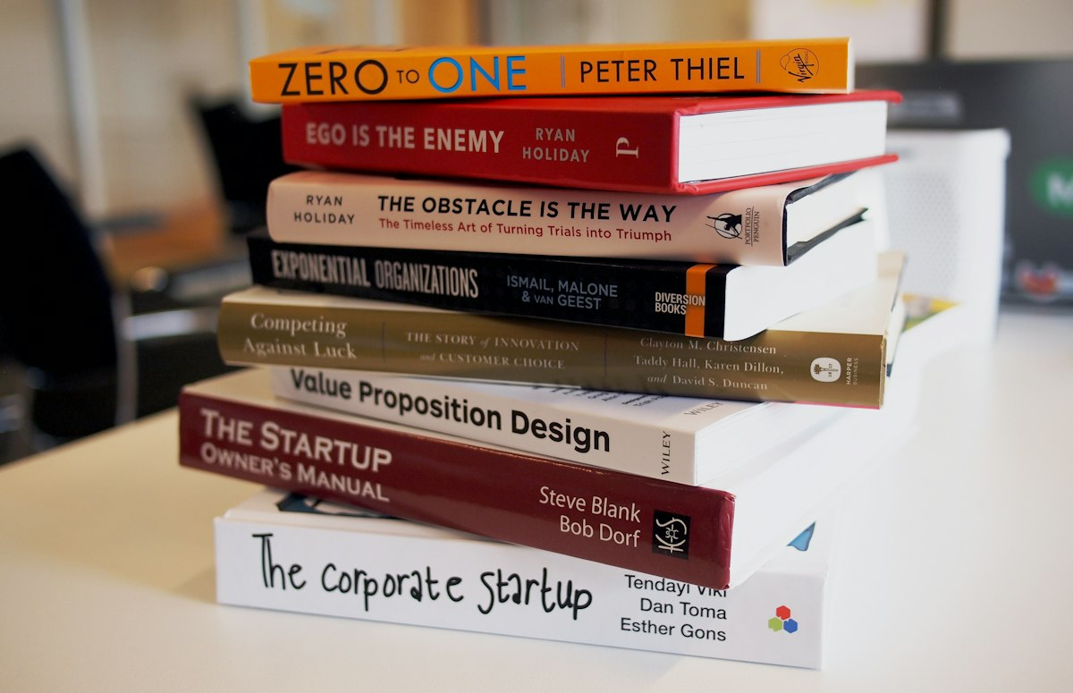
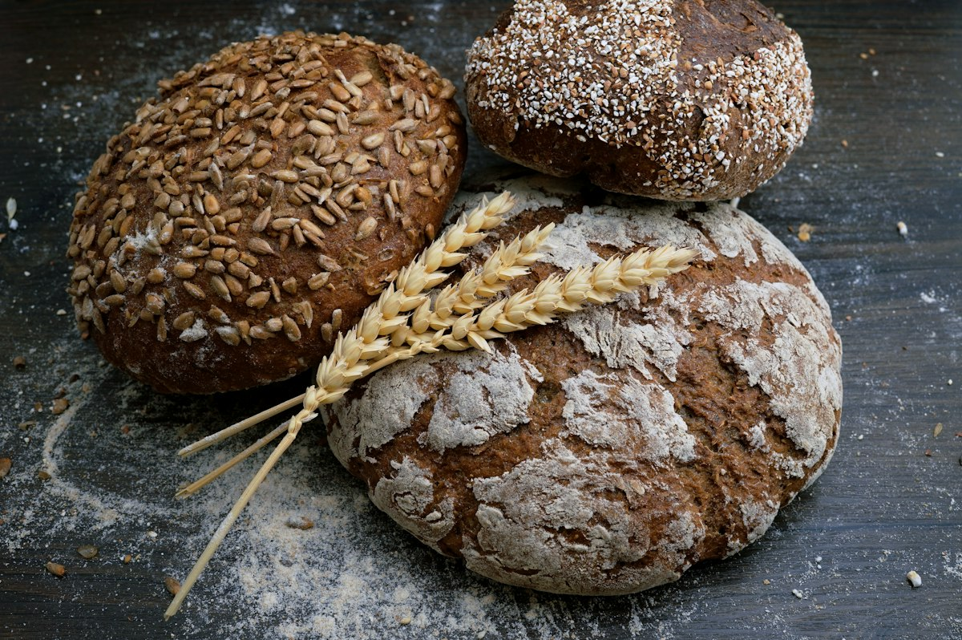
SAMPLE PRODUCTS & SERVICES
Everything you need to learn, in one visit.
02
03
Study Spot Access
Printing & Document Services
01
Study and group tables, quiet reading areas, lounge seating, charging outlets, Wi-Fi
Black-and-white and colored printing, photocopying, scanning, school project printing
Books & School Materials
New and pre-loved books, textbooks, review materials, journals, school supplies
04
05
Pages & Pour Membership
Creative Corner
Discounted drinks, printing credits, priority seating, promotions, study-space discounts
A space to read, journal, sketch, write, or work on creative and school projects
06
Coffee, Tea & Light Meals
Coffee, tea, milk tea, frappes, pastries, sandwiches, student-friendly snacks
Notes:
Books and school materials come first because we are an educational bookstore. The study services support learning, and the coffee shop keeps customers going while they study.

Slide 9
01
Quiet Zone
VALUE PROPOSITION
For individual studying and reading.
One space for three needs: buying books, getting coffee, and finding a comfortable place to study.
02
Group Zone
For discussions and group projects.
03
Reading Lounge
For casual reading and relaxation.
It saves time and money because customers do not need to visit three different locations.
04
Creative Corner
For writing, journaling, sketching, and school projects.
Notes:
Pages & Pour is a 3-in-1 space. Its study zones, books, affordable food and drinks, Wi-Fi, charging outlets, printing, and creative space make it more than a place to drink coffee.

Slide 10

CREATIVE TASK #1
Logo Design
From two needs, one mark.
Notes:
Start the logo design part.

Slide 11
PRIMARY LOGO
The coffee-ring seal.
Pages (the book) and Pour (the cup) become a single icon: a mug resting on a volume, steam rising like a turning chapter.
The frame is a coffee ring, the stain left on a page after a long sit.
Notes:
This is our primary logo. Point out the cup on the book and the coffee-ring frame.

Slide 12


SECONDARY LOGOS
One mark, different sizes.
Pictorial mark
Badge lockup
The name sits on the mug so the icon still reads at small sizes.
EST. 2026, a leaf divider, and the line “One Place. Every Page. Every Pour.”
Notes:
The pictorial mark works for small spaces like icons and stamps. The badge lockup adds EST. 2026 and the tagline.

Slide 13
FROM SKETCH TO LOGO
How the mark was made.
01
Start with the 3-in-1 idea: bookstore, café, study spot — one object that can carry all three.
Logo sketch goes here
Replace this box with a photo or scan of your hand-drawn sketch.
02
Lock the cup-on-book pictorial. Put the name on the mug so the icon still reads at small sizes.
03
Build a badge lockup with EST. 2026, a leaf divider, and the line “One Place. Every Page. Every Pour.”
04
Finish with a coffee-ring seal as the brand frame.
Notes:
Show the sketch first, then explain the four steps from the first idea to the final seal.

Slide 14
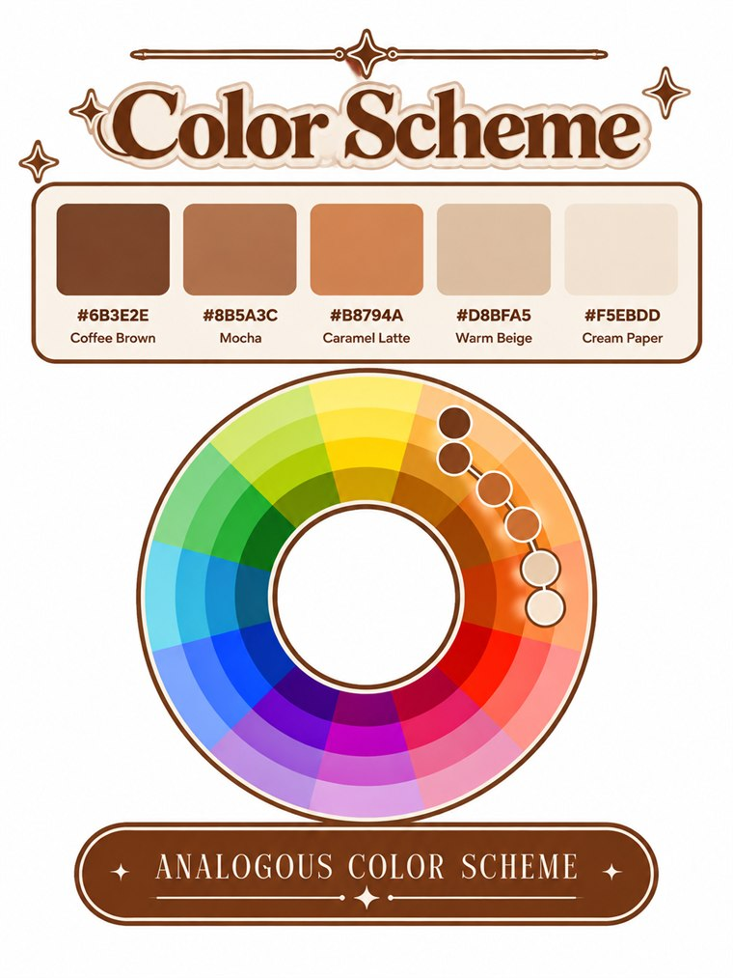
COLOR SCHEME / PALETTE
Analogous coffee tones.
Coffee Brown
Mocha
Caramel Latte
Warm Beige
Cream Paper
#6B3E2E
#8B5A3C
#B8794A
#D8BFA5
#F5EBDD
Notes:
Our palette is an analogous color scheme: five neighboring coffee tones, from Coffee Brown to Cream Paper.

Slide 15
TYPOGRAPHY
Two typefaces, one voice.
DISPLAY · FRAUNCES
BODY · OUTFIT
Pages & Pour
Books · Study · Coffee
ABCDEFGHIJKLMNOPQRSTUVWXYZ
abcdefghijklmnopqrstuvwxyz 0123456789
ABCDEFGHIJKLMNOPQRSTUVWXYZ
abcdefghijklmnopqrstuvwxyz 0123456789
Serif headlines for paper-and-ink warmth.
Clean sans for menus, captions, and wayfinding. Wide tracking on small labels, matching EST. 2026.
Notes:
Fraunces is the display font for headlines; Outfit is the body font for everything else.

Slide 16

CREATIVE TASK #2 · FIRST EVER BRAND POST
The first pour, on paper.
One place. Every page. Every pour.
Pages & Pour is open for long chapters and longer sips — coffee, books, and a study space in one room.
Offers you: Coffee | Books | Study Space
Visit us at 34 Kape St., Brgy. Bookelya
#PagesAndPour #ReadSipCreate #StudySpot
Rust panel, espresso type, steam-beige watermark, cream paper ground. High-contrast serif display, vertical serif wordmark.
Notes:
This is our first official brand post for social media. Read the caption, then point out the colors and the vertical wordmark on the rust panel.

Slide 17
Pages & Pour
SATURDAY · 14 MARCH 2026
CREATIVE TASK #3 · PROMOTIONAL EVENT POSTER
Sip &
Story
Night.
Thought process.
The event
“Sip & Story” pairs our two experiences: Sip for the Pour, Story for the Pages.
The offer
A free first pour with any reserved book links the coffee shop to the bookstore.
First pour free with any reserved book. Acoustic set at 6.
The design
The rust side bar and vertical wordmark repeat the first brand post, so both pieces feel like one brand.
4:00–9:00 PM
34 KAPE ST., BRGY. BOOKELYA
Notes:
Explain how we came up with the event and why the poster looks the way it does. Replace these points with your group’s own words if your reasoning was different.

Slide 18
CT#3 · COLOR SCHEME & TYPOGRAPHY
Sip & Story Night, in detail.
COLOR SCHEME / PALETTE
TYPOGRAPHY
Fraunces for the event title.
Outfit for time and place.
#6B3E2E
#8A3F38
#B8794A
#D8BFA5
#F5EBDD
Vertical serif wordmark on the rust bar, matching the first brand post.
Notes:
The poster uses the brand palette plus the rust from the brand post. Fraunces for the title, Outfit for details.

Slide 19
THANK YOU
One Place.
Every Page.
Every Pour.
Pages & Pour · 34 Kape St., Brgy. Bookelya
Notes:
Thank the audience and invite questions.

