Slide 1

Cloud - Azure
Kaneez Ayesha – Cloud Data Scientist
Notes:
Hello guys. Hope you all are doing great. I am Kaneez Ayesha and I am a cloud data scientist.

Slide 2
Agenda:
What is cloud?
Cloud Models
Pros And Cons Of Cloud Computing
Cloud Providers
Market Share of Cloud Providers
Microsoft Azure
Azure Services
Azure Data Services
Azure Certifications
Resources
Notes:
So, guys this is the agenda of my video. First, I am going to talk about basics of cloud, different cloud models After that I Will discuss about different cloud providers in market their market share and then more specifically, I will talk about azure, its services, its data services and then I will discuss about azure certification path and the resources related to certifications.

Slide 3
What is the cloud?
"The cloud" refers to servers that are accessed over the Internet, and the software and databases that run on those servers.
Cloud servers are located in data centres all over the world. By using cloud computing, users and companies do not have to manage physical servers themselves or run software applications on their own machines.
Notes:
Let's get started with what is cloud
Cloud basically refers to a network of remote servers.
And these remote servers are located in data centers all over the world.
These remote servers are operated by third-party companies.
Cloud offer a range of services to their clients.
their users can easily access their services, data and applications from anywhere with an internet connection.
They can store, manage, and process data, instead of using a local server or personal computer we can easily use cloud servers with low cost.
So that is all about cloud

Slide 4
Cloud Models
Deployment model
Service model
Public Cloud:
Cloud computing that’s delivered via the internet and shared across organizations.
Private Cloud:
Cloud computing that is dedicated solely to your organization.
Hybrid Cloud:
Any environment that uses both public and private clouds.
IAAS: Infrastructure as a Service
PAAS: Platform as a Service
SAAS: Software as a Service
AIAAS; AI as a Service
Notes:
Now let's discuss about different cloud models.
We have two types of models -> deployment models and service models.
And about deployment models we have 3 types of deployment models.
One is public cloud computing that’s delivered via the internet and services are shared across organizations and clients.
The other cloud deployment model is private cloud computing that is designed and dedicated to your organization. Resources are not shared with other organizations. This gives you better control, security, and customization than the public cloud, but it is more expensive and requires more resources to set up and maintain.
The last one is hybrid cloud deployment model that uses both public and private clouds. Here some resources are kept on-premises, while others are hosted in the public cloud.
Let's talk about service models. We have 4 types of service models.
The first one is IAAS -> infrastructure as a service. This service model provides users with access to infrastructure resources such as servers, storage, and networking, where they can build and run their own applications and services. In this service model Users have more control and flexibility over their infrastructure.
The second one is PAAS -> platform as a service. This service model provides users with a platform where they can build, run, and manage their own applications without having to worry about the underlying infrastructure. The cloud provider takes care of the infrastructure, including the servers, storage, and networking and all. users only needs to focus on developing and deploying their applications.
The third one is SAAS -> software as a service. This service model provides users with access to software applications that are hosted by the cloud provider and can be easily accessed over the internet. The cloud provider takes care of everything, from infrastructure to the software application.
The last one is AIAAS -> AI as a Service. This service model is a relatively new cloud service model that provides access to artificial intelligence (AI) and machine learning (ML) tools and technologies over the internet.
So that’s all about cloud models.

Slide 5
Pros And Cons Of Cloud Computing
Pros
Cons
Scalability: Scale when Needed
Cost savings: Auto-scaling
Disaster Recovery.
Accessibility
Resilience
Business Focus
Risk of data confidentiality.
The level of security.
Internet access is mandatory
Compliance.
Weak in the event of an attack.
Data Mobility.
Technical problem.
Notes:
Now let's talk about pros and cons of cloud computing. If I talk about pros, it provides scalability. In cloud you can scale your services whenever you need. Its cost saving because of auto scaling.
Disaster recovery is easy because you have the facility of automatic backups recovery and replications.
Cloud computing provides accessibility that allows employees to access data and applications from anywhere, if they have an internet connection, which can increase productivity and collaboration.
It also provides you the ability to keep working even in the face of disruptive events or failures. Which is more resilience.
And about business focus. Cloud is reliable for small and medium enterprises in terms of cost and budget.
and if I talk about its Cons.
The first one is risk of data confidentiality is high.
cloud computing providers may have advanced security measures but there is always a risk of data breaches and other security threats, which can be a concern for organizations that handle sensitive data. So the level of security is not that reliable.
Internet access is mandatory. Without it its does not work at all.
As you all know that in cloud our data is stored on servers which are managed by 3rd party. So losing authority over our data is a clear violation of their compliance policies. compliance issues are very complex and require careful attention. Organizations must work closely with their cloud providers to ensure that they comply with relevant requirements and that their data is protected in any cases.
Cloud computing is weak in the event of an attack for example hackers stealing data, attacks that make the system stop working, viruses that infect the system To stop these attacks from happening, the cloud provider and customer can use security measures like making sure only the right people can access the system.
Data mobility is a big issue in cloud that means moving data between different cloud providers or back to an on-premises system is a big challenge.
In cloud computing we can face many technical problems like downtime, latency, low connection, data loss.
So guys that’s all about pros and cons.

Slide 6
Cloud Providers
AWS
Microsoft Azure
Google Cloud Platform
Huawei Cloud
Alibaba Cloud
Oracle Cloud
Teradata Cloud
IBM Cloud
Notes:
Now let's discuss about different cloud providers in market. The first one is AWS (amazon web services) which is provided by amazon. The second one is azure which is provided by Microsoft then is google cloud platform which is provided by google and after that we have Huawei cloud and many more. So guys these are top 8 cloud providers in market.

Slide 7
Market Share of Cloud Providers
AWS:
32% Market Share
Azure:
20.5% Market Share
GCP:
9% Market Share
Huawei Cloud:
2.8% Market Share
Notes:
Now lets talk about their market share. As for aws its has the market share of 32%. AWS serves millions of customers, ranging from startups to large enterprises, and is particularly popular among developers due to its extensive toolset and flexibility.
Azure is the second-largest cloud provider, with a 20.5% share. And it is popular among enterprises that already use Microsoft's products and services. As for now azure had the smaller market share as compared to aws but it is the most growing cloud provider in market.
GCP is the third-largest cloud provider, with 9% market share. GCP is popular among developers who prefer open-source technologies and want to take advantage of Google's expertise in data analytics.
Huawei Cloud had a 2.8% share of the cloud computing market. And this is a smaller market share compared to the top cloud providers like AWS, Microsoft Azure, and Google Cloud Platform. It is popular in China and now its expanding its services globally.
So guys that’s all about cloud providers.

Slide 8
Microsoft Azure
Notes:
Now let's move to our main topic which is azure and we will discuss it in detail.

Slide 9
What is Azure?
Microsoft Azure is Microsoft's public cloud computing platform.
It provides a range of cloud services, including compute, analytics, storage and networking.
Users can pick and choose from these services to develop and scale new applications or run existing applications in the public cloud.
Notes:
So, what is azure. It’s a public cloud computing platform. Azure provide range of cloud services, including compute, analytics, storage and networking. User can develop and scale new applications or run existing applications in the public cloud.

Slide 10
Azure Services
Compute:
Virtual Machine: Create an instance of Linux or Windows
Cloud Service:
Service Fabric: Microservice development
Functions: Serverless Functions
Network:
Azure CDN; Content Delivery System.
Express Route:
Virtual Network
Azure DNS: Hosting Service
Storage:
Disk Storage:
Blob Storage: Optimized storage for stroring large data
File Storage: Managed File Storage MFS.
Queue Storage:
Security:
Azure Security Center: A cloud workload protection solution that provides security management and advanced threat protection across hybrid cloud workloads.
Azure Key Vault: A secure secrets store for the passwords, connection strings, and other information you need to keep your apps working.
Azure Monitor logs: A monitoring service that collects telemetry and other data and provides a query language and analytics engine to deliver operational insights for your apps and resources. Can be used alone or with other services such as Security Center.
Azure Dev/Test Labs: A service that helps developers and testers quickly create environments in Azure while minimizing waste and controlling cost.
Azure Devops:
Azure Boards
Azure Repos
Azure Pipelines
Azure Test Plans
Azure Artifacts
Azure Devops Server
Notes:
Now let's discuss about different azure services. Azure provides different services like compute services, network services, storage services, security services and azure devops services. So these are different services provided by azure which we will discuss in next video. For now lets just get the overview of azure.

Slide 11

Azure Data Services
Azure Synapse Analytics
Azure Data factory
Azure Datalake
Azure SQL Database
Azure Cosmos DB
HDinsight
Databricks
Notes:
Moving forward
Lets dive into some of azure data services. First one is Azure synapse analytics that is a data warehouse, azure data factory where you orchestrate workflows using dynamic pipelines, azure data lake it’s a data storage services for storing large amount of structured and unstructured data. Azure sql database is a cloud based relational database service. Azure cosmos DB is a multi models database service. Azure Hdinsight it’s a cloud-based big data platform. It provides customizable environment for processing and analyzing large amounts of data using popular big data technologies such as Apache Hadoop, Spark, and Hive. The last one is azure databricks. It’s a Apache Spark-based big data analytics service designed for data science and data engineering.
So guys this is all about azure data services.

Slide 12
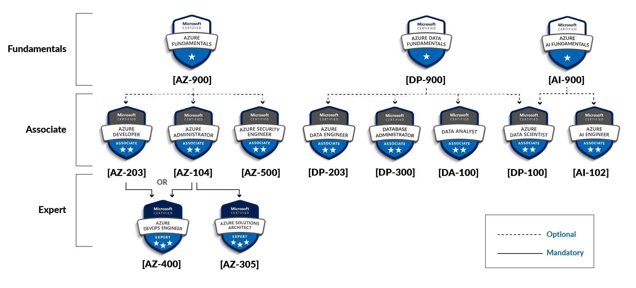
Azure Certifications
Notes:
Moving forward
Now let's discuss about some of azure certifications. Azure certification path start with its fundamental's certification. Where the first one is azure fundamentals which covers the core concepts of azure cloud. the second one is azure data fundamentals which covers the core basics concepts of data engineering on azure and the 3rd one is azure AI fundamentals which covers the basics concepts of artificial intelligence and machine learning. Here after comes the associate level certifications which are specifically based on roles like data engineer, data scientist, data analyst and many more and that here comes the expert level certifications specially for solution architect ad devops engineer of azure.
So this is the path of certifications from basics to expert level.

Slide 13
Resources
Microsoft Learn
Prepare dumps from exam topics website.
Notes:
Now lets talk about resources from where you can prepare for all certifications. One is from official documentation provided by Microsoft on Microsoft learn website. And the second one is preparing dumps from exam topics website.

Slide 14

Any Questions?

