Slide 1
“SkillUp: A Personalized Web Learning Portal for Youth Career Development”
Agustin, Christian John L. (WEB)
Aguinaldo, Jomarie F. (WEB)
Domingo, Emyose P. (WEB)
College of Information and Computing Sciences

Slide 2
Rationale
SkillUp is a personalized web learning portal addressing Filipino youth unemployment through SDG 4 & 8-aligned education and employment pathways. The system delivers tailored TESDA-based learning, skills assessments, and career guidance in one integrated platform—improving upon existing solutions by combining localization, user profiling, and progress tracking to equip young people with market-ready digital economy skills.

Slide 3
Rationale
NEED | SOLUTION | BENEFIT | DIFFERENTIATION
The Skills Mismatch. Fresh graduates in the Philippines often struggle to find work because their academic training doesn't match industry needs (e.g., a huge demand for Data Analytics, but students are trained only in general IT). Students are overwhelmed by generic online courses and don't know which specific skills to prioritize. | A web portal with an Intelligent Assessment Engine. Instead of just listing courses, the system first quizzes the user on their interests and current skills. It then generates a "Career Roadmap"—a step-by-step list of specific modules (videos, tutorials) needed to reach a target job (e.g., "Junior Web Developer"). | For Youth: Saves time by filtering out irrelevant content; provides a clear path to employability. For Society: Increases the employability rate of the local workforce (aligning with TESDA's goals). | Localization & Assessment. unlike Udemy or Coursera which are "content-first" (browse and buy), SkillUp is "assessment-first" (test and recommend). It can also focus on local industry demands (e.g., Philippine BPO skills) rather than just general US-centric tech skills.

Slide 4
objectives
General
To develop and evaluate SkillUp: A Personalized Web Learning Portal for Youth Career Development that addresses skills gaps and enhances career readiness among Filipino youth through tailored learning pathways, assessment tools, and labor market alignment.
Specific
To analyze existing practices, policies, problems, and issues in current skills development and career path systems;
To design and develop a web-based system integrating user profiling, skills assessment, course recommendation, and progress tracking features;
To evaluate the system's compliance with ISO/IEC 25010:2023 software quality standards across eight characteristics (Functional Suitability)

Slide 5
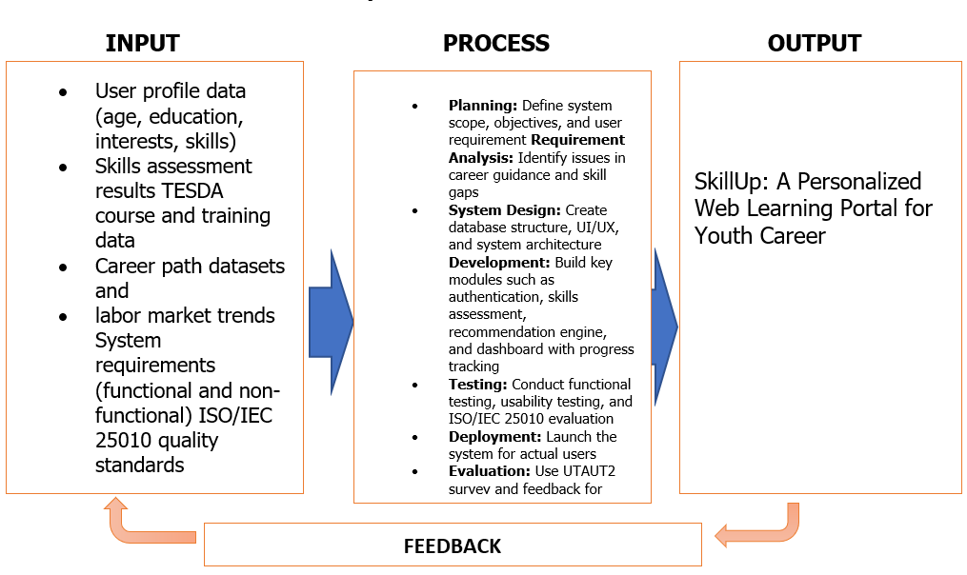
Framework of the study

Slide 6
Scope & Limitation
SkillUp is a web-based career preparation portal for TESDA Aparri Polytechnic Institute youth, mapping online courses to institute programs including Bread and Pastry Production, Cookery, Electrical Installation, Computer Systems Servicing, Dressmaking, Front Office Services, and Caregiving NC II qualifications. The system integrates with TESDA Online Program (TOP) for theory modules, displaying recommended courses and career paths based on user assessments and local labor needs.
Key limitations: web-only access requiring internet; career suggestions depend on input accuracy; does not replace formal counseling, guarantee certification, or provide job placement; covers only registered TESDA API courses without creation rights; excludes long-term maintenance, external government database integration, or automatic enrollment into training programs.

Slide 7
Significance of study
Youth & Learners-Gain personalized, self-paced learning pathways that enhance employability, enable informed career decisions, and foster lifelong learning readiness through data-driven skill development
Educators & Career Mentors-Access integrated tools to track student progress, identify competency gaps, and deliver targeted guidance—improving guidance program effectiveness and learner outcomes
TESDA & Training Institutions-Achieve better alignment between training offerings and industry demands, increasing program relevance, completion rates, and graduate employability

Slide 8
Policymakers & Government-Obtain evidence-based insights for digital education initiatives that reduce youth unemployment, address skills mismatches, and advance regional workforce competitiveness
Researchers & Developers-Establish a replicable framework for personalized learning systems and career recommendation technologies, contributing to knowledge on adaptive educational platforms in developing economies
Future Implementers-Benefit from documented methodologies, technical architectures, and evaluation protocols that enable scaling, adaptation, and integration with national employment systems

Slide 9
Methodology
Research Design
The capstone project employs descriptive-developmental research design to develop and assess "SkillUp: A Personalized Web Learning Portal for Youth Career Development." The developmental research method proves optimal for this research because it enables researchers to build technological solutions through their structured approach which includes planning and design and development and testing stage

Slide 10
Methodology
Study Population
The participants of the study consisted of IT experts, target users, and researchers who will be involved in system evaluation and testing.
Participants | N | %
IT Experts | 10 | 14.92
Users (Students) | 20 | 29.82
TESDA teachers | 37 | 55.22
Total | 67 | 100

Slide 11
Methodology
Data Collection tools
The following instruments will be used to collect data:
ISO/IEC 25010:2023 Evaluation Questionnaire
The evaluation method assesses software quality through eight performance dimensions which include functional suitability, performance efficiency, compatibility, usability, reliability,security, maintainability and portability.
UTAUT2-Based User Acceptance Survey
The survey measures system acceptance through seven factors which include performance expectancy and effort expectancy and social influence and facilitating conditions and hedonic motivation and price value and habit.

Slide 12
Methodology
Data Gathering Procedures
The researchers will follow a structured data gathering process:
1.The study received institutional permission to begin its research activities.
2.The participants received orientation about SkillUp's objectives and its operational processes.
3.The users of the web portal completed their designated tasks through their site interactions
4.IT experts used ISO/IEC 25010 standards to assess system performance.
5.The users finished the UTAUT2 acceptance survey.
6.The researchers prepared collected data for subsequent analysis work.

Slide 13
Methodology
Ethical Considerations
The researchers ensured ethical compliance throughout the SkillUp study by obtaining approval from the Ethics Review Committee and securing informed consent from all participants, who were fully informed of their voluntary right to withdraw without consequence. Data protection was strictly enforced through adherence to the Data Privacy Act of 2012, utilizing anonymization techniques and system security features such as secure login authentication and restricted database access. The study maintained confidentiality of all personal information, used data solely for academic purposes, and upheld principles of non-maleficence, honesty, and transparency by preventing harm, avoiding deception, and presenting findings without manipulation or fabrication.

Slide 14
Methodology
Data Analysis Tools and Techniques
Descriptive statistical methods will be used to analyze collected data. Weighted mean was computed to determine the level of system quality and user acceptance.
Interpretation scale:
Evaluation results made it obvious whether input into SkillUp met ISO/IEC 25010 standards and then was well-received in terms of user acceptance based on UTAUT2 constructs.
Weighted Mean | Interpretation
3.50 – 4.00 | Highly Acceptable
2.50 – 3.49 | Acceptable
1.50 – 2.49 | Slightly Acceptable
1.00 – 1.49 | Not Acceptable

Slide 15
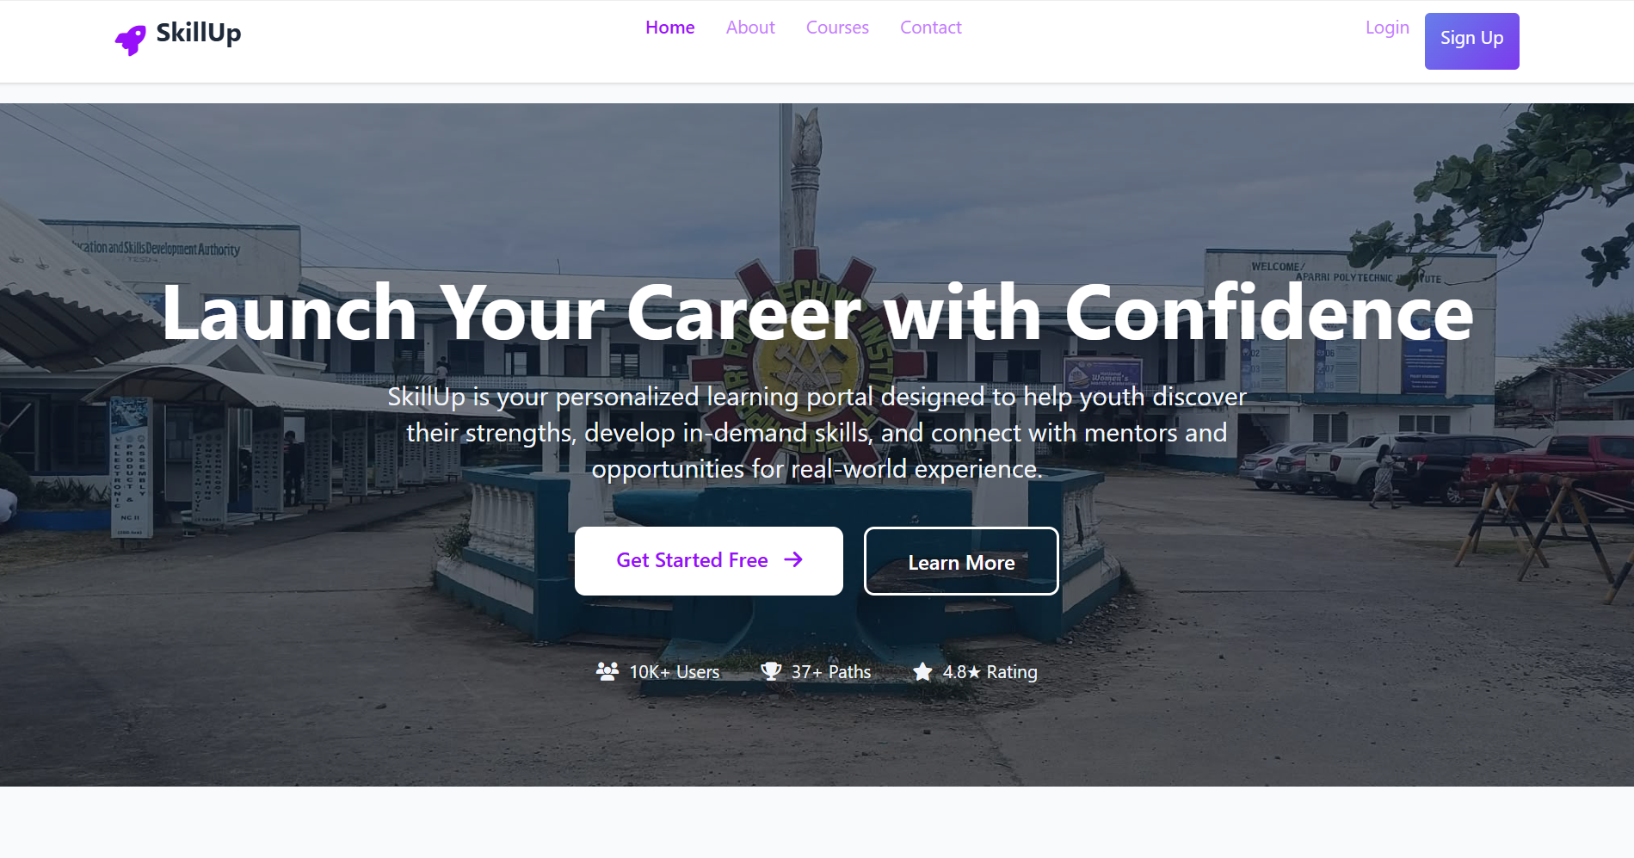
prototype

Slide 16
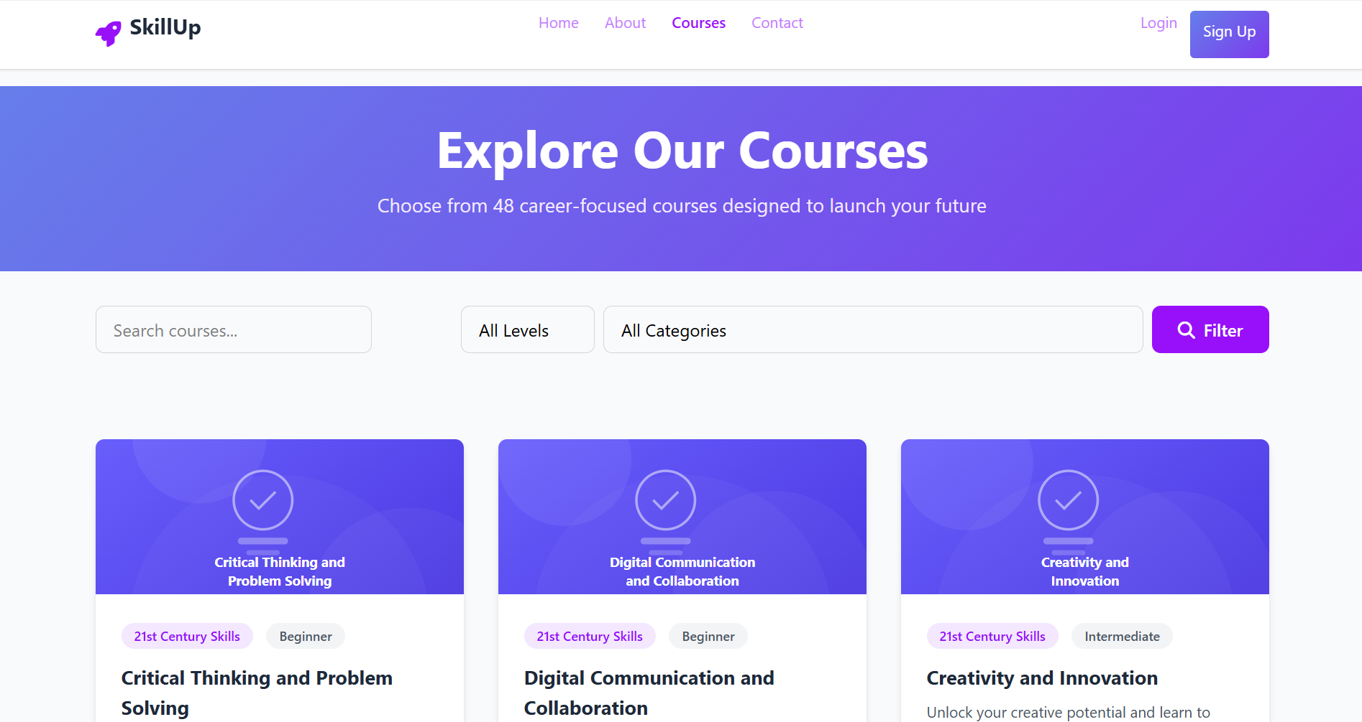

Slide 17
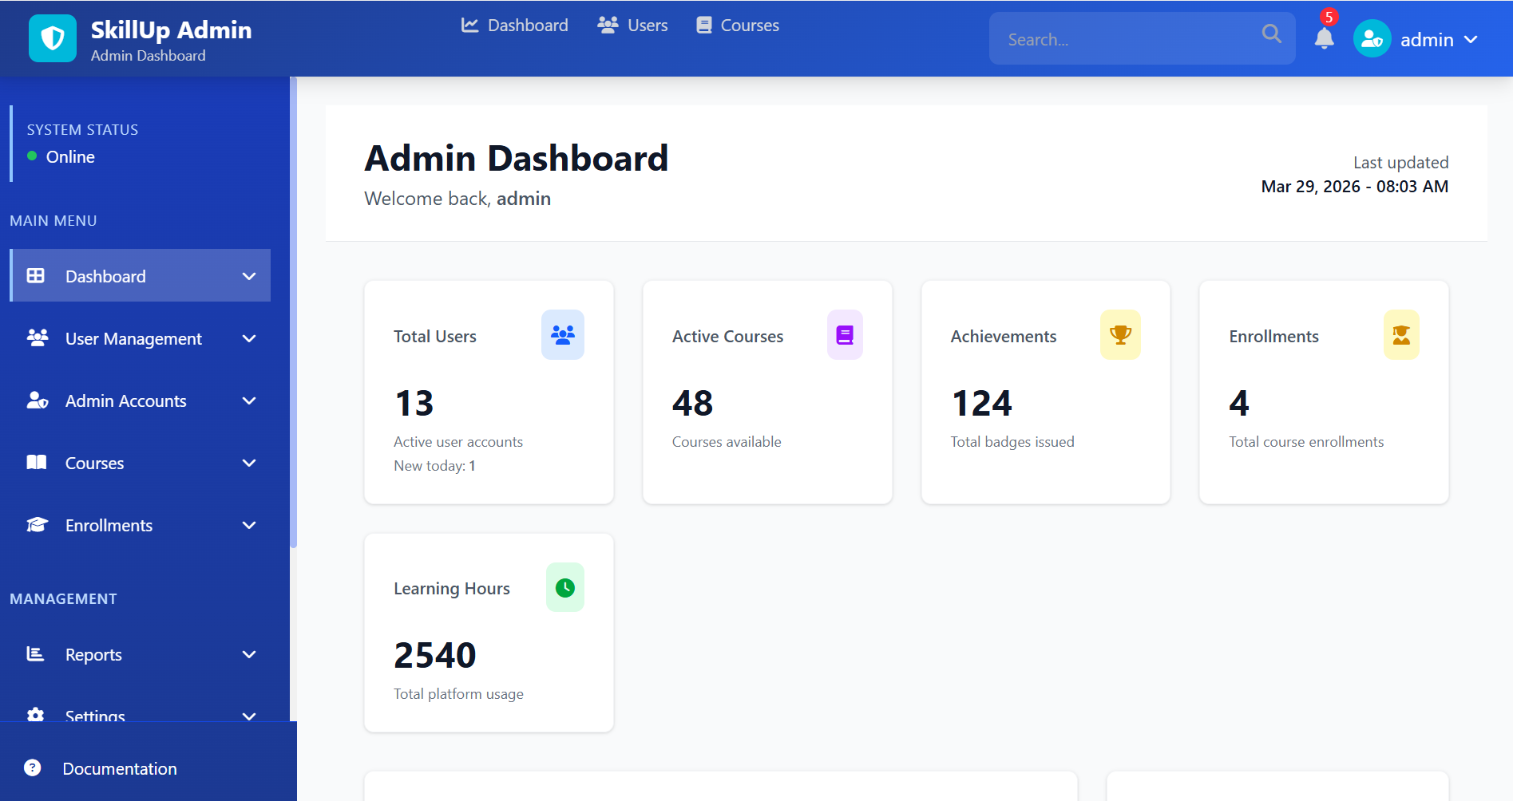

Slide 18
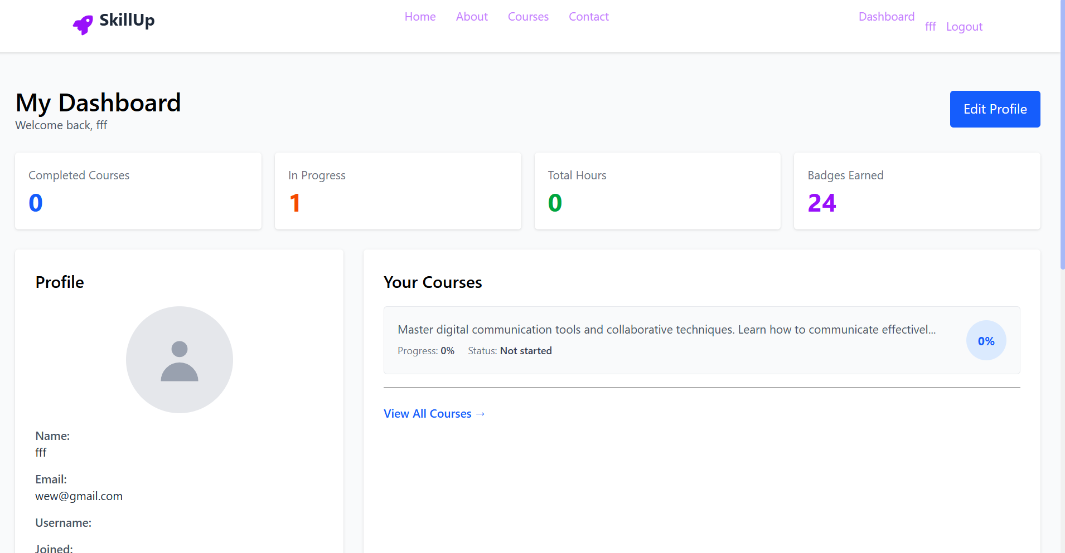

Slide 19
implementation plan
Aspect | Details
Project Duration | 6 months (24 weeks)
Methodology | Agile Software Development (6 phases)
Development Team | 3 researchers/developers
Key Technologies | Node.js, , MySQL,, Visual Studio Code, Git/GitHub, XAMPP
Deployment Target | Web-based platform hosted on AWS

Slide 20
Phase | Duration | Focus | Key Output
Planning | Weeks 1–2 | Define vision, scope, users, tech stack | Project charter, requirements doc
Analysis | Weeks 3–4 | Identify barriers, survey stakeholders, gather requirements | Requirements specification, user journeys
Design | Weeks 5–8 | Database schema, UI/UX wireframes, system architecture | ERD, mockups, API docs
Development | Weeks 9–16 | Build backend (Node.js/Express), frontend (React), integrate TESDA TOP | Functional web portal, source code
Testing | Weeks 17–20 | Functional, usability, ISO/IEC 25010, UTAUT2 testing | Test reports, evaluation results
Deployment | Weeks 21–24 | AWS hosting, pilot testing, feedback integration, documentation | Live platform, user manual, final report
Phase | Duration | Focus | Key Output
Planning | Weeks 1–2 | Define vision, scope, users, tech stack | Project charter, requirements doc

Slide 21
Literature cited
Adhav, S., Potdar, N., Pawar, U., Uchale, S., & Jagtap, N. (2025). Personalized learning platform: Revolutionizing education through adaptive learning technologies. Indian Scientific Journal of Research in Engineering and Management, 9(3), 1–9. https://doi.org/10.55041/ijsrem43230
Ahmed, F., Rahman, M., & Ali, S. (2024). The role of digital learning ecosystems in improving access to education. Journal of Educational Technology, 15(2), 45–58.
Belmonte, Z. J., Cruz, C. S. C., De Castro, P. A. P., Estoesta, L. A., Mitra, E. J. A., & Lira, P. E. V. R. (2022). Factors influencing technopreneurial intention among undergraduate engineering students in the Philippines. Journal of Engineering Education Transformations, 36(1), 148–157. https://doi.org/10.16920/jeet/2022/v36i1/22146
Bird, K. (2018). Reducing youth not in employment, education, or training through JobStart Philippines (ADB Brief No. 84). Asian Development Bank. https://www.adb.org/sites/default/files/publication/396081/adb-brief-084-youth-not-employment.pdf
Brown, W., & Smith, J. (2025). Artificial intelligence in adaptive learning systems. International Journal of AI in Education, 12(1), 23–41.

