Slide 1
“Tres marias: Developing a Progressive Web App (PWA) for Hyper-Local Bakery Delivery and Pre-orders”
AREOLA DENVER O.(WEB)
BALANZA JOHN BENEDICT Q.(WEB)
ANAGARAN RAJAN P.(WEB)
College of Information and Computing Sciences

Slide 2
Rationale
The study identifies a gap in affordable and integrated digital solutions for small, hyper-local bakeries, as existing platforms are often costly and designed for large businesses, while manual processes lead to inefficiency, errors, and poor inventory tracking with limited support for real-time updates and delivery. This project is necessary to modernize bakery operations through digital transformation, as traditional methods cause delays, inaccuracies, and lost sales, making it difficult for small businesses to compete; thus, a Progressive Web App (PWA) offers a cost-effective solution to improve efficiency, accessibility, and customer satisfaction. Furthermore, the study supports SDG 8: Decent Work and Economic Growth** by promoting productivity, enabling small business growth through digital innovation, strengthening local commerce, and contributing to sustainable economic development.

Slide 3
Rationale
NEED | SOLUTION | BENEFIT | DIFFERENTIATION
Manual ordering and record-keeping cause errors and delays | Develop a PWA with digital ordering and automated records | Faster transactions and reduced human error | Tailored specifically for small, local bakeries
anual ordering and record-keeping cause errors and delays | Develop a PWA with digital ordering and automated records | Faster transactions and reduced human error | Tailored specifically for small, local bakeries

Slide 4
objectives
General Objective
To develop a Progressive Web Application (PWA) that improves bakery ordering, inventory management, and hyper-local delivery services.
Specific Objectives
To identify current problems in manual bakery operations.
To design a system for pre-orders and delivery management.
To develop a PWA with real-time inventory and tracking features.
To evaluate the system using ISO/IEC 25010 standards.
To assess user acceptance using UTAUT2 model.

Slide 5
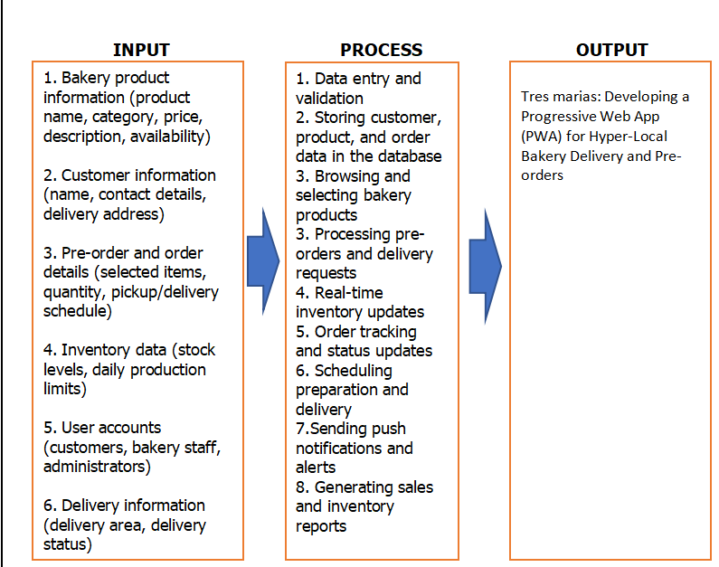
Framework of the study

Slide 6
Significance of study
For local bakery owners, the proposed system provides an organized and efficient tool for managing bakery products, customer pre-orders, inventory levels, and delivery schedules.
For bakery staff and delivery personnel, the system simplifies order handling, preparation scheduling, and delivery tracking through real-time notifications and status updates.
For customers, the Progressive Web App offers a convenient and user-friendly platform for browsing available bakery products, placing advance orders, and requesting hyper-local delivery using internet-enabled devices.
For small business communities, the study supports the digital transformation of local and neighborhood bakeries by providing a cost-effective technology solution tailored to their needs.

Slide 7
Significance of study
For future researchers and developers, this study contributes to the body of knowledge on Progressive Web Applications, hyper-local delivery systems, and small-scale e-commerce solutions.

Slide 8
Methodology
Research Design
The study uses a descriptive-developmental research design. It describes current bakery practices and identifies existing problems. The developmental approach focuses on building a working system solution. Agile methodology is applied for iterative system development. This allows continuous feedback and improvement. The design ensures the system meets real user needs. It also supports flexibility and efficiency in development.

Slide 9
Methodology
Study Population
The study involves 30 respondents composed of bakery owners, IT experts, and researchers. Each group provides different insights into system requirements. Bakery owners share operational challenges and needs. IT experts evaluate technical feasibility and system quality. Researchers contribute to analysis and validation. The population ensures balanced perspectives. This supports accurate and relevant system development.

Slide 10
Methodology
Data Collection tools
The study uses structured interview guides with open-ended questions. These tools gather detailed information about current practices. Questions focus on ordering, inventory, and delivery processes. The format allows participants to share real experiences. It ensures rich and relevant qualitative data. The tool is aligned with the study objectives. It supports accurate requirement analysis.

Slide 11
Methodology
Data Gathering Procedures
Data is collected through interviews, observation, and document analysis. Interviews gather firsthand information from participants. Observation examines actual workflows and processes. Document analysis reviews existing records like orders and inventory. These methods provide comprehensive data. The process ensures reliability and completeness. All data supports system design and development.

Slide 12
Methodology
Ethical Considerations
The study follows ethical standards in data collection and system development. Participants provide informed consent before involvement. Personal data is protected under the Data Privacy Act of 2012. Information is used only for research purposes. The system ensures secure data handling and storage. Transparency and confidentiality are maintained. Ethical practices ensure trust and responsibility.

Slide 13
Methodology
Data Analysis Tools and Techniques
The study uses qualitative data analysis. Responses are categorized into themes such as problems and system needs. Patterns and insights are identified from collected data. Findings guide system design and feature development. The analysis ensures alignment with user requirements. It also supports decision-making in development. This approach improves system effectiveness and relevance.

Slide 14
protoype

Slide 15
implementation plan
Phase | Activities | Output
Planning | Gather requirements through interviews, observation, and document analysis | Defined system requirements
Design | Create system architecture, database design, and user interface layouts | System design and prototypes
Development | Build the PWA with features (ordering, inventory, delivery, notifications) | Functional system modules
Testing | Conduct usability and functionality testing, fix errors | Tested and improved system
Deployment | Launch the system and provide user training and documentation | Operational system ready for use
Monitoring & Feedback | Collect user feedback and monitor performance for improvements | Enhanced and updated system

Slide 16
Literature cited
Marchetto, T., & Morandini, M. (2024). User perceptions of progressive web app features. Lecture Notes in Networks and Systems. Springer.
Murphy, J. (2024). User engagement and loyalty in mobile restaurant delivery apps. Heliyon, 10(7), e28289.
Niño, A. G., & Salas, R. (2024). Digital pre-order platforms and business performance in local bakeries in Iloilo City. (Unpublished manuscript).
Ramos, M. F. (2023). Mobile commerce adoption among MSMEs in Luzon. Philippine E-Commerce Review, 5(2), 102–118.

