Slide 1
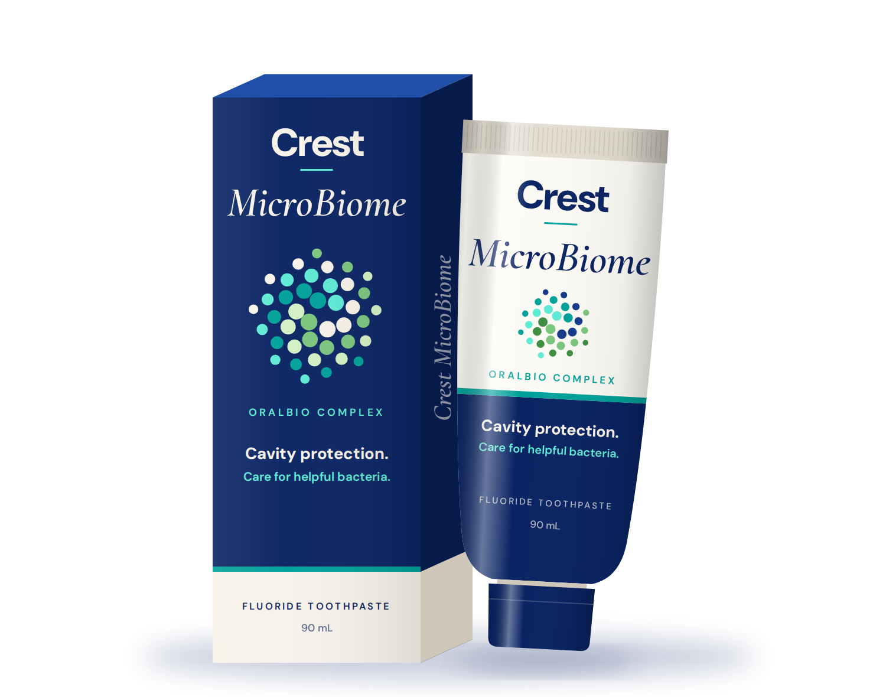
CREST MICROBIOME
Make brushing your first act of self-care
Canadian launch
Summer 2027
Case competition
Team [Name]
[Member 1] · [Member 2]
[Member 3] · [Member 4]

Slide 2
CASE FACT
89%
of Canadians brush daily.
Brushing is an established habit. Awareness of oral microbiome health is low.

Slide 3
Whitening
Fresh breath
Enamel care
Deep clean
Sensitivity relief
Cool mint
Tartar control
CONSUMER PERCEPTION
Advanced
Gum care
To many shoppers, toothpastes can feel interchangeable.
Natural
Charcoal
The category keeps innovating, yet similar-sounding claims can blur together at the shelf.
Fluoride
Clinical
Stain removal
Daily protection
Strengthening
Herbal
Extra fresh
Pro formula
Complete

Slide 4
THE CHALLENGE
An established habit, a low-awareness benefit and a category where many options can feel alike.
How can Crest make an unfamiliar benefit understandable, emotionally relevant and worth choosing?

Slide 5



Target Consumer
Wellness-minded adults, aged 25–45
CASE FACT
Interested in health
Open to premium when the benefit is clear
Prefer simple routines
WHAT IT MEANS FOR US
WHAT IT MEANS FOR US
WHAT IT MEANS FOR US
Show brushing as part of how they already care for themselves.
Make the added benefit simple, specific and credible.
Build on the brushing they already do. Add no new steps.

Slide 6
POSITIONING
Make brushing your
first act of self-care.
For wellness-minded Canadians, Crest MicroBiome makes everyday brushing an act of self-care—with cavity protection and support for the helpful bacteria already in your mouth.
EMOTIONAL RELEVANCE
FUNCTIONAL DIFFERENCE
A small moment of care for yourself before the demands of the day.
Cavity protection plus support for helpful bacteria.

Slide 7
THE PRODUCT
Your mouth has helpful bacteria, too.
Crest MicroBiome helps support them while protecting your teeth against cavities.
Cavity protection
+
Care for helpful bacteria
OralBio Complex: fluoride, zinc, vitamin B3 and a plant-based prebiotic. It supports bacteria already in the mouth; it does not add live probiotics.
CASE FACT
PACKAGING CONCEPT

Slide 8
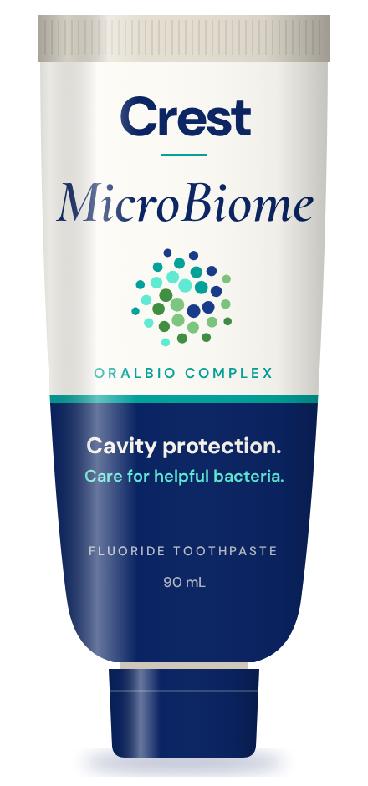
CAMPAIGN IDEA
The first two minutes are yours.
Before messages, work and school begin, take two minutes for yourself. The campaign gives an existing habit new meaning, with no complicated wellness routine to adopt.
Mornings are the hero moment. The message stays consistent with brushing twice a day.

Slide 9
C
R
E
S
T
Connect
Reveal
Experience
Shop
Thrive
Wellness creators + Meta ads
Dentists & hygienists
Dental samples + marathon expos
Retail links, coupons, shelf
Same creators + customer stories
Focus
Build emotional relevance
Explain the product difference
Encourage trial
Convert interest to purchase
Build repeat & community
Goal
Relevance
Understanding
Trial
First purchase
Repeat purchase
Outcome

Slide 10
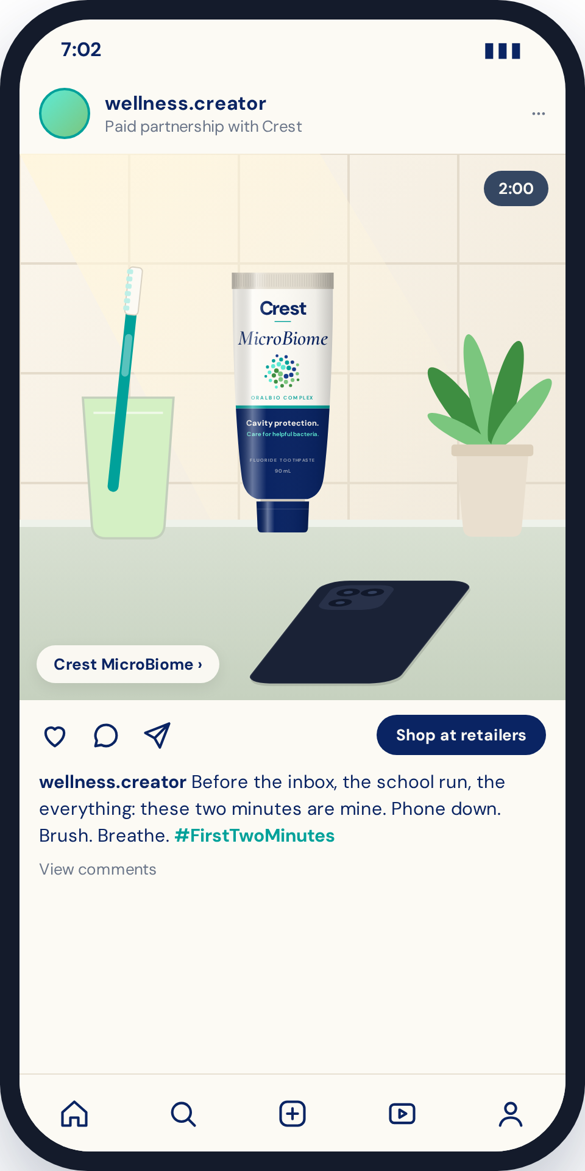



Connect
Build emotional relevance
C R E S T
Recurring wellness micro-influencers
The same recognizable faces all year, sharing relatable morning routines.
Their own words
Each creator shares what their first two minutes mean, without an identical script.
Meta ads amplify what works
Paid media boosts the best-performing creator posts to our 25–45 wellness audience.
PROPOSED TACTIC
Concept post. Crest MicroBiome is always in frame, so the emotion stays tied to the product.

Slide 11

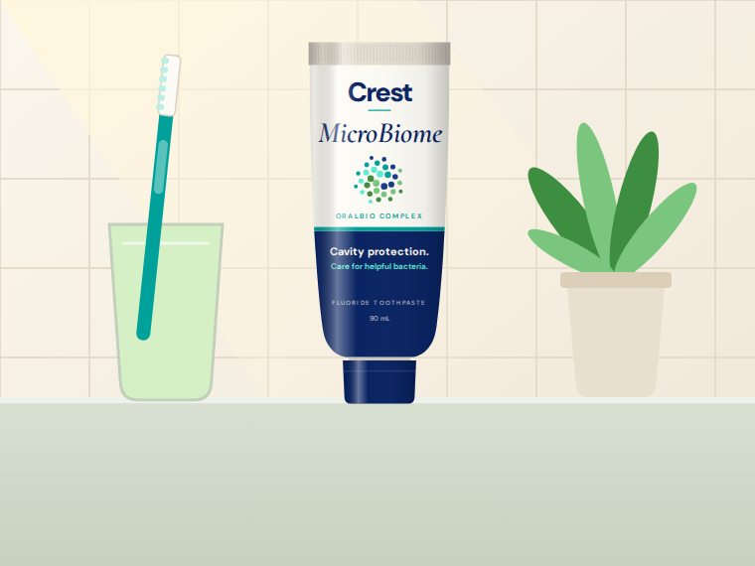
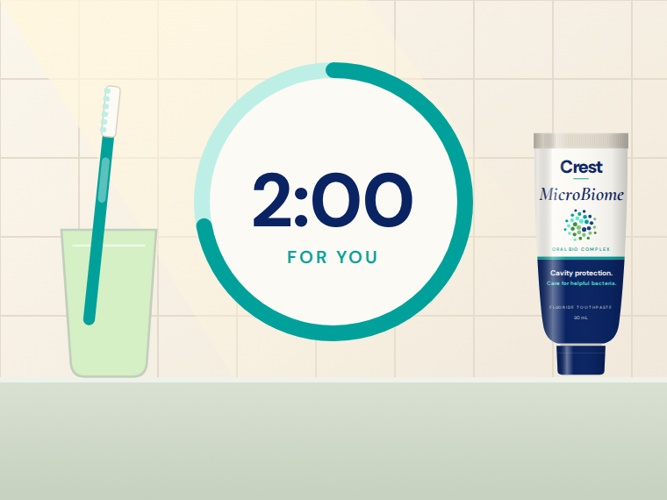

Connect
Build emotional relevance
C R E S T
ONE RECOGNIZABLE CREATOR FORMAT
Phone face down
Crest MicroBiome in view
Brushing as self-care
A personal story
Messages can wait two minutes.
The product is always in frame.
Two calm minutes, just for you.
Why these two minutes matter to them.
PROPOSED TACTIC
Meta ads amplify the posts that perform best. Creator links lead to participating retailers.

Slide 12
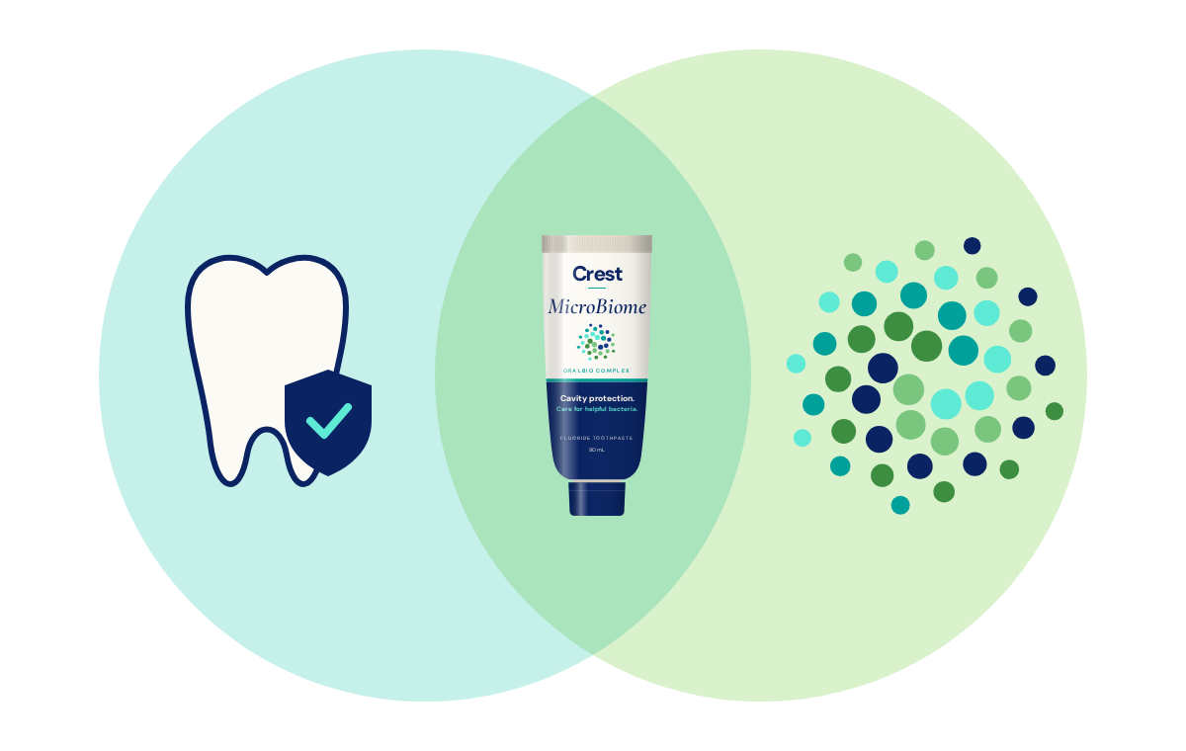

Reveal
Explain the product difference
C R E S T
KEY MESSAGE FROM DENTISTS AND HYGIENISTS
“Cavity protection, plus care for the helpful bacteria already in your mouth.”
Plain language from trusted professionals
Evidence and accurate materials for clinics
Professionals decide whether to recommend it
Cavity protection
Care for helpful bacteria
PROPOSED TACTIC
A simple balance visual, with no frightening germ imagery

Slide 13
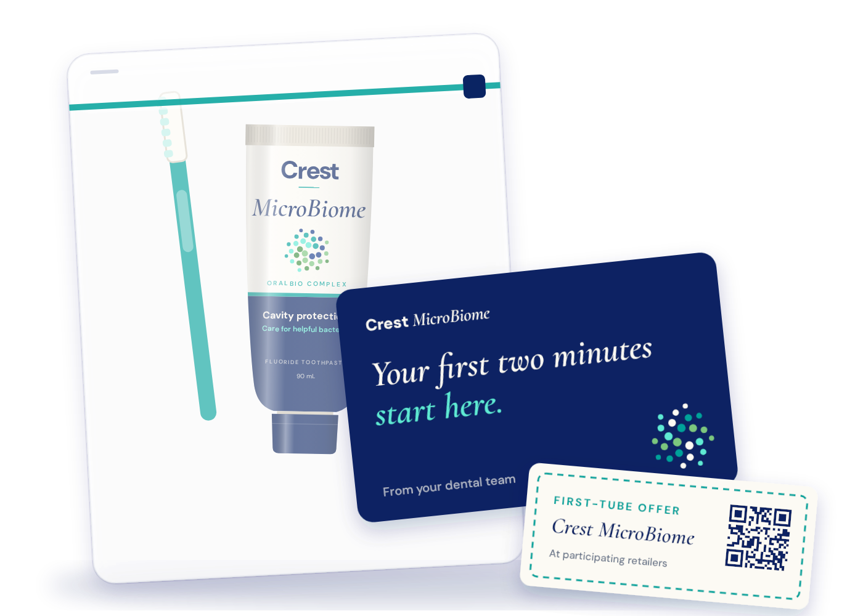
Experience
Encourage trial
C R E S T
DENTAL SAMPLING · CORE TRIAL CHANNEL
Free starter kits for a 50–100-clinic pilot in launch markets
Sealed toothpaste samples
Simple patient education cards
Clinic-specific QR codes
Trackable retailer coupons
A short professional product briefing
Samples and materials are free. No payment per recommendation.
PROPOSED TACTIC

Slide 14
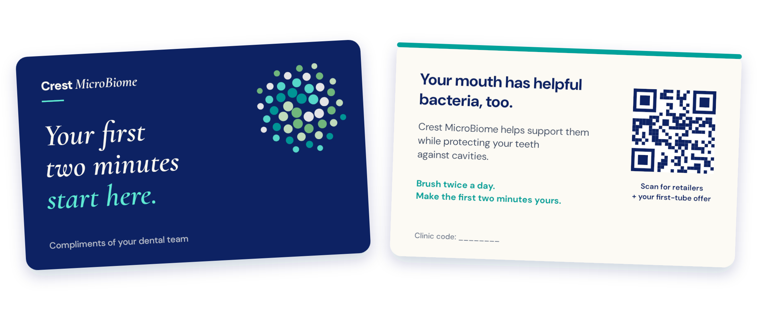
Experience
Encourage trial
C R E S T
PATIENT CARD CONCEPT
Plain-language benefit, twice-daily reminder, clinic QR code and first-tube offer.

Slide 15
Experience
Encourage trial
C R E S T
HOW THE CLINIC PILOT WORKS
1 · Recruit
2 · Brief
3 · Hand out
4 · Track
5 · Replenish
Clinics that reach 25–45s and will report stock
Short product briefing for the clinic team
Brief explanation if appropriate; sample in the take-home bag
Stock reports, QR visits and coupon purchases
Restock by actual distribution; expand on results
PILOT TEST
FOUR SEPARATE MEASURES
Sample only
vs
Sample + brief explanation
Samples delivered
Samples handed out (stock reports)
QR visits
Compare understanding, purchases and cost per buyer before expanding.
Coupon purchases
A scan is not a purchase; a handed-out sample may go unused.

Slide 16
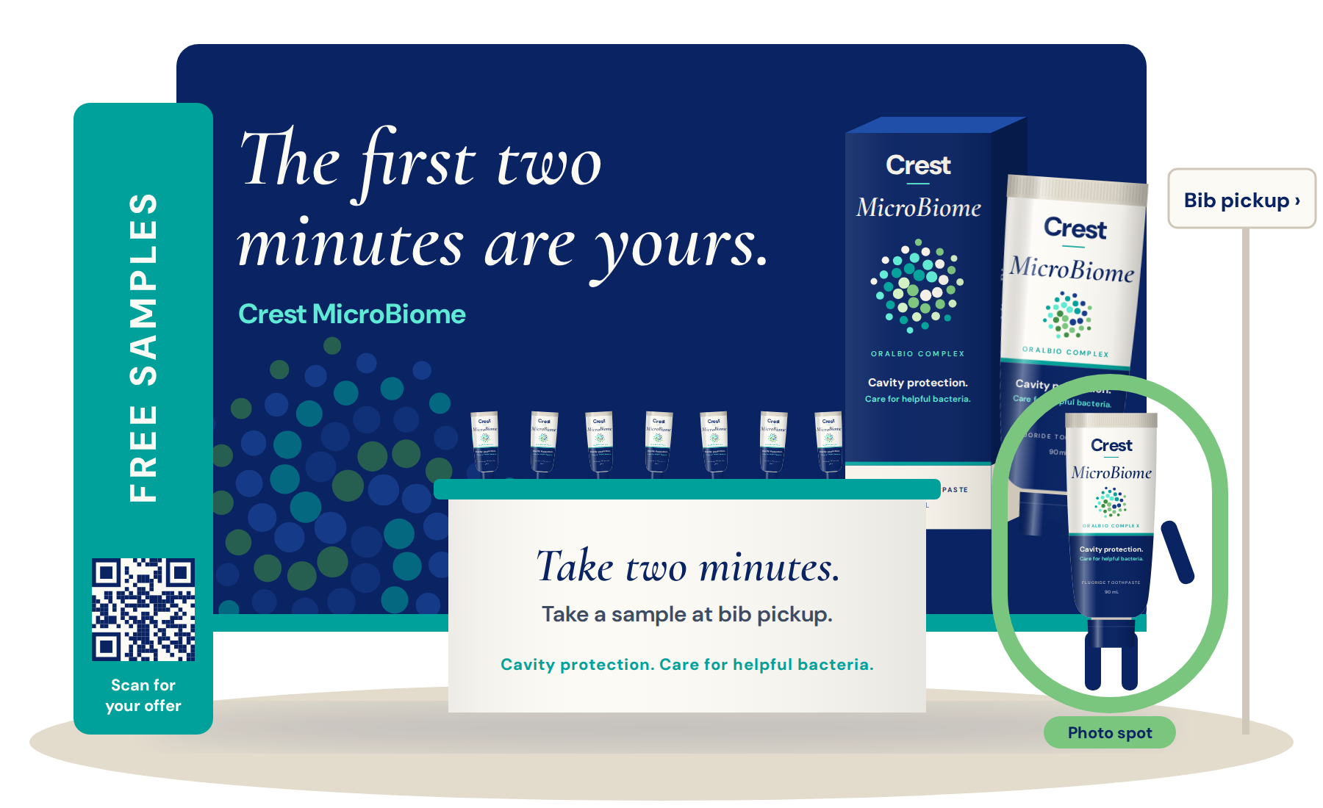
Experience
Encourage trial
C R E S T
MARATHON EXPOS · BIB PICKUP
Targeted trial while attendees have time to browse
Primary: targeted product trial
Secondary: education, offers, content
Sealed samples, short explanation, coupon or QR
MicroBiome suit as a photo element only
The link is wellness and routine, never running performance. Compare cost per acquisition with the dental program before expanding.
PROPOSED TACTIC

Slide 17
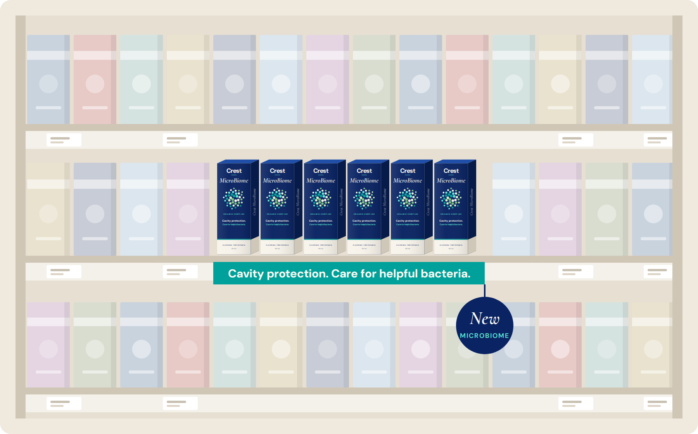





Shop
Convert interest into purchase
C R E S T
PATHS TO PURCHASE
Creator links to participating retailers
A trackable coupon with every sample
QR landing pages with retailer links
Shelf: “Cavity protection. Care for helpful bacteria.”
Retail product pages that explain the benefit
An additional Crest choice for wellness-minded shoppers, never at the expense of confidence in existing Crest products.
Shelf concept: MicroBiome blocked together under one clear message.
PROPOSED TACTIC

Slide 18
Thrive
Build repeat purchase & community
C R E S T
One shared, accessible action: taking two minutes for yourself.
A MOVEMENT NEEDS MORE THAN A HASHTAG
Recognizable faces
Repeat participation
A product connection
Continuing relationships with the same creators, not one-off posts.
Customers share what their first two minutes mean; we feature stories with permission.
Optional replenishment offers through participating retailers.
“Thrive” refers to the routine and the community, not a promised clinical outcome.

Slide 19


Why Crest Can Execute
Brand recognition
Professional relationships
Recognizable human faces
Crest's established name supports reach for a new benefit.
Dental ties support education and clinic sampling.
Recurring creators, dentists and community members.
A SMALL LAUNCH TEAM
Fast on routine content, careful on health claims
Routine post, approved format
Launch team
Publish
New health claim
Claims review
Launch team
Publish

Slide 20
Launch Roadmap
BEFORE LAUNCH
SUMMER 2027
AFTER THE PILOT
Preparation
Launch
Expansion
Validate claims
Recruit creators and clinics
Secure retail partners
Establish tracking
Begin the dental pilot
Creator content and Meta ads
Selected expo tests
Scale effective channels
Replenish samples
Focus on repeat purchase
Decision gate
Pilot results vs. targets
Timing is shown relative to launch.

Slide 21
Year 1 Budget
CAD $1,000,000
PROPOSED ALLOCATIONS
Connect · $450K
Experience · $350K
$100K
$100K
Stage | Line item | Amount (CAD) | Share
Connect | Paid media | $300,000 | 30%
Connect | Creators and content | $150,000 | 15%
Experience | Non-dental sampling and distribution | $150,000 | 15%
Experience | Event activation, staffing and logistics | $100,000 | 10%
Experience | Dental program, including dental samples | $100,000 | 10%
Shop | Retail offers and merchandising | $100,000 | 10%
Measure | Research and measurement | $50,000 | 5%
Reserve | Reserve | $50,000 | 5%
Total | Year 1 marketing budget | $1,000,000 | 100%

Slide 22
Dental Program Budget
PROPOSED ALLOCATIONS
Line item | Amount (CAD)
Sample production | $50,000
Shipping and clinic kits | $15,000
Patient cards and education materials | $10,000
Clinic recruitment, onboarding and support | $15,000
Measurement and contingency | $10,000
Total dental program | $100,000
STAGED RELEASE
$25,000
Released now for the 50–100-clinic pilot
$75,000
Proposed allocations that require supplier quotes. Coupon discounts come from the retail-offers budget, not this one.
Held for replenishment and expansion, released on results

Slide 23
Dental Sales Scenarios
FINANCIAL ASSUMPTION
$50K for samples
→
$1 each (assumed)
→
50,000 samples
→
80% reach recipients (assumed)
→
40,000 recipients
Illustrative dental model | Conservative | Base | Strong
Purchase within 60 days | 5% | 10% | 15%
First-time MicroBiome buyers | 2,000 | 4,000 | 6,000
Full program cost per buyer | $50 | $25 | ≈ $16.67
Initial retail sales at $8 per tube | $16,000 | $32,000 | $48,000
First purchases alone do not recover the $100,000 program. The business case depends on repeat buying and incremental contribution.
Not a launch forecast. Conversion rates and the $8 price are assumptions, not case facts. Retail sales are not Crest net revenue or profit. Repeat purchases are excluded, and some buyers may switch from other Crest products.

Slide 24
Measurement & Decisions
PROPOSED PILOT TARGETS
70%
10%
30%
correctly understand the benefit
of sample recipients buy within 60 days
of buyers repeat within 90 days
WHAT WE TRACK
Correct benefit understanding
Samples distributed
Sample-to-purchase conversion
Cost per buyer
Repeat purchase
Incremental retail sales
New-to-Crest vs. existing Crest buyers
Community participation
Decision rule: scale channels that meet targets at an acceptable cost per buyer; fix or stop the rest. Customers are deduplicated across dental, event, creator and paid-media channels.

Slide 25


Risks & Mitigations
Benefit is misunderstood
Message turns generic
Sales shift within Crest
Costs outrun results
MITIGATION
MITIGATION
MITIGATION
MITIGATION
Plain language, professional explanations and a 70% understanding target before scaling.
A recognizable format with Crest MicroBiome always in frame and retailer links.
Position as an additional Crest choice; track new-to-Crest versus existing Crest buyers.
Release $25K first, restock by actual distribution and compare channel cost per buyer.

Slide 26
THE FIRST TWO MINUTES ARE YOURS
Crest MicroBiome · Make brushing your first act of self-care

Slide 27
A1 Claims guardrails
A2 Dental scenario math
EXHIBITS
A3 Sampling research
Detail for judge questions
A4 Measurement plan
A5 Budget and event notes
HOW WE LABEL INFORMATION
CASE FACT
EXTERNAL RESEARCH
PROPOSED TACTIC
FINANCIAL ASSUMPTION

Slide 28
A1 · Claims Guardrails
CASE FACT
What we say | What we avoid
Supports the helpful bacteria already in your mouth | Adds live probiotics or creates new bacteria
Cavity protection, plus care for helpful bacteria | Ordinary toothpaste kills all bacteria
An additional Crest choice for wellness-minded shoppers | Other toothpastes lack protection or innovation
“Thrive” means a routine and a community | Superior clinical outcomes vs. ordinary toothpaste
Make the morning brush yours; brush twice a day | Athletic performance, immunity or systemic benefits
Dentists and hygienists explain it in plain language | Paying professionals per recommendation
Professionals receive supporting evidence and accurate materials, and decide whether the product is appropriate to recommend. New health claims go through review before use.

Slide 29
A2 · Dental Scenario Math
FINANCIAL ASSUMPTION
Input | Value | Type
Sample production budget | $50,000 | Proposed
Production cost per sample | $1 | Assumed
Samples produced | 50,000 | Derived
Reach distinct recipients | 80% | Assumed
Recipients | 40,000 | Derived
Purchase window | 60 days | Proposed
Retail price per tube | $8 | Assumed
Full dental program cost | $100,000 | Proposed
FORMULAS
Buyers = 40,000 × conversion rate
Cost per buyer = $100,000 ÷ buyers
Initial sales = buyers × $8 (one tube)
Scenario | Rate | Buyers | Cost / buyer | Retail sales
Conservative | 5% | 2,000 | $50.00 | $16,000
Base | 10% | 4,000 | $25.00 | $32,000
Strong | 15% | 6,000 | ≈ $16.67 | $48,000
Repeat purchases are excluded. Retail sales are not Crest net revenue or profit. Not every buyer is new to Crest; some purchases may switch from other Crest products.

Slide 30
A3 · Sampling Research
EXTERNAL RESEARCH
SAMPL · COLGATE, ITALY AND SPAIN
SOPOST · ACROSS ITS CAMPAIGNS
26%
≈ 1 in 6
self-reported purchase rate within two weeks, for a targeted toothpaste campaign that included media, audience profiling and follow-up.
consumers purchase after sampling, as reported by the provider.
sampltech.com/case-studies/40000-marketing-optins-colgate
sopost.com/blog/your-sampling-campaign-is-flying-is-it-working
Provider-reported results from different programs, not verified Canadian dental-clinic benchmarks. Our 5%, 10% and 15% scenarios are planning assumptions informed by this adjacent evidence.

Slide 31
A4 · Measurement Plan
PROPOSED TACTIC
Measure | Source | Watch-out
Samples delivered | Shipments to clinics and events | Not the same as samples handed out
Samples handed out | Estimated from clinic stock reporting | A handed-out sample may go unused
QR visits | Clinic-specific QR codes and landing pages | A scan is not a purchase
Coupon purchases | Trackable retailer coupons | Misses purchases made without the offer; not all incremental
Benefit understanding | Optional follow-up research | Target: 70% correct understanding
Repeat purchase | Retailer data where available | Target: 30% of buyers within 90 days
Incremental sales | Matched retail comparisons where feasible | Split new-to-Crest vs. existing Crest buyers
Community participation | Customer stories shared and featured with permission | Deduplicate customers across all channels

Slide 32
A5 · Budget & Event Notes
PROPOSED ALLOCATIONS
No double-counting
Event costs split
Coupons
Dental samples sit only in the $100K dental program, not the $150K non-dental sampling line.
Event samples come from non-dental sampling; staffing and logistics from event activation.
Coupon discounts are funded from the $100K retail offers and merchandising line.
Quotes needed
Expo audience
MicroBiome suit
All figures are proposed allocations that require supplier quotes.
Pre-race expos at bib pickup, when attendees can browse, not exhausted finishers.
A booth or photo element. Running a race in suits is optional and must justify its cost.

