Slide 1

Python for Data Science (3150713)

Slide 2
Introduction
Project title: IPL data analysis
Name: Dhruv Kaneria
Enrollment no: 200050131043
Name: Omkumar Patel
Enrollment no: 200050131070
Branch: Computer Science Engineering
Divison: CSE-2

Slide 3
Description of Project
Data Analysis with IPL match-by-match dataset from the seasons 2008 to 2019. Dataset has been downloaded from Kaggle and it can be found here: https://www.kaggle.com/nowke9/ipldata. The dataset contains two files: deliveries.csv and matches.csv. The file used for this analysis is matches.csv.

Slide 4
About Data Set
Data available in data set:
1. id
2. season
3. city
4. date
5. team1
6. team2
7. toss_winner

Slide 5
Continuous
8. toss_decision
9. result
10. dl_applied
11. winner
12. win_by_runs
13. win_by_wickets
14. player_of_match
15. venue

Slide 6
Continuous
16. umpire1
17. umpire2
18. umpire3

Slide 7
Things Analysed from Data Set
1. Match won by the maximum margin of runs.
2. Match won by maximum wickets.
3. Match won by the minimum margin of runs.
4. Match won by minimum wickets.
5. Matches where D/L method was and wasn't applied.
6. No. of matches held in each city.
7. No. of matches won by each team.
8. No. of matches held every season.
9. Top 10 players based on no. of Man of Match (MOM) awards won.

Slide 8
Continuous
10. Does winning the toss mean winning the match?
11. What was the decision taken by captains when they won the toss?
12. No. of matches where D/L method was applied every season.
13. Different results for matches.
14. How many times did a team win the toss?
15. Best venue for defending and chasing a total.
16. Best defending and chasing teams.
17. No. of matches played in different stadiums.

Slide 9




Python Libraries we Have Used
1. NumPy
2. pandas
3. Matplotlib
4. seaborn

Slide 10
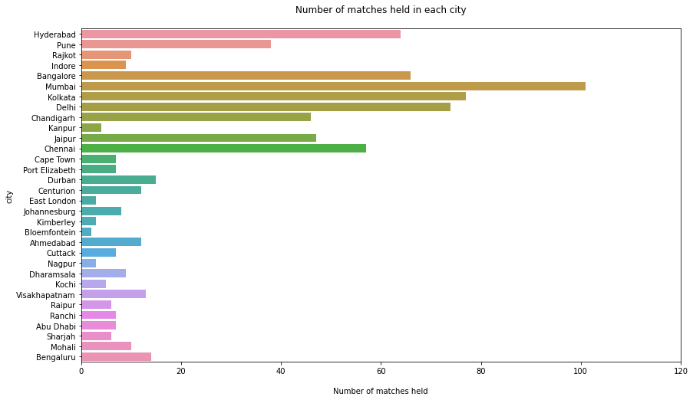
Some Result from Data Set

Slide 11
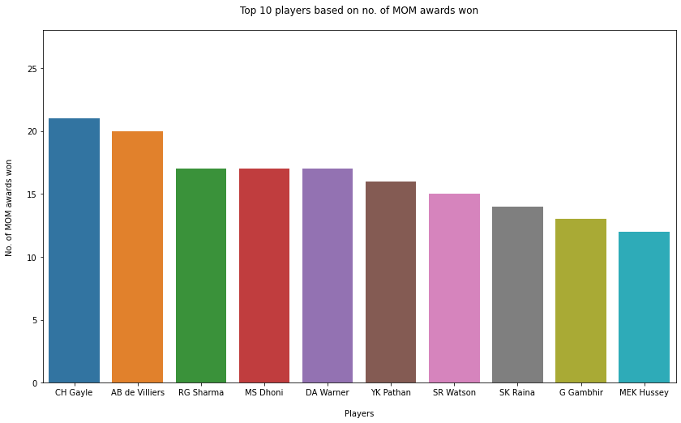
Continuous

Slide 12
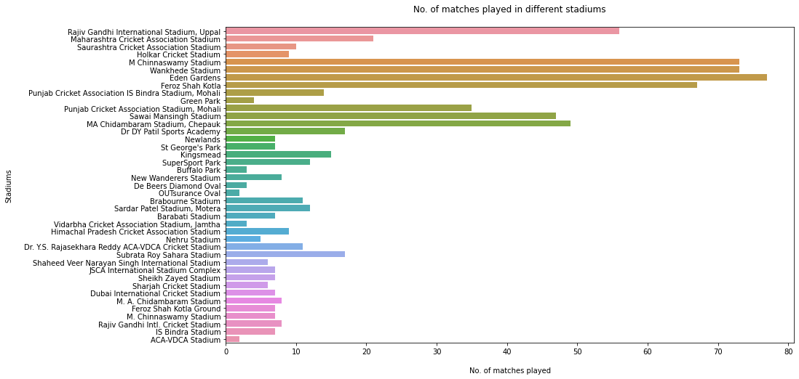
Continuous

Slide 13
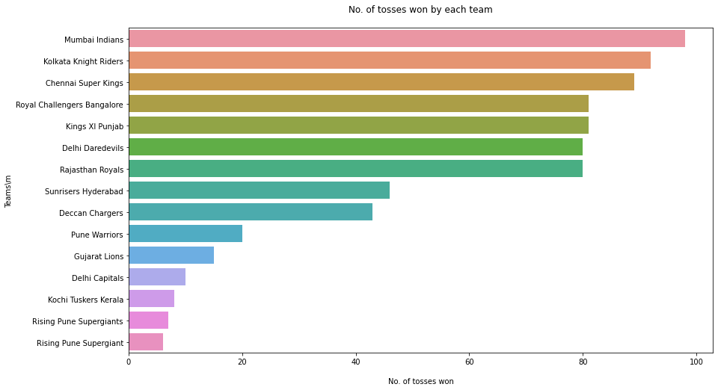
Continuous

Slide 14
Conclusion
The IPL data analysis is use to understand data. With the help of the data analysis we can find out the pros and cons of the player and work on the performance of the individual player and also the whole, it will help in taking decision. This application can be used for the selection commission to select the best player including bowler, batsman and even the fielder for the team and to perform well on the field during match. It is helpful for all type of game to work on the performance and predict the future performance of the player and team.

Slide 15



Use full links
https://github.com/Kaneriadhruv/IPL_data_analysis
https://colab.research.google.com/drive/1rhCyjv7piRq7JlWrIYRPhY6FCdSDCeCU?usp=sharing
https://www.kaggle.com/nowke9/ipldata

Slide 16
Thank you

