Slide 1
Introduction
100D Barber
DANH SÁCH THÀNH VIÊN
1.Lý Khánh Hưng ( nhóm trưởng)
2. Phạm An Hào
3. Dương Tuấn Kiệt
4.Trương Hoàng Nguyên
Date… Month… Year …...

Slide 2
Content
Introduction
Actual requirements
Requirements of the project
Deployment diagram
Test result
Conclusion and development
Task list

Slide 3
Introduction - Actual requirements
Provide function for customers register.
Provide function for customers to booking services.
Provide information of the product to customers.
Provide shopping cart function so customers can order products.
The customers can manage their information by Member Control Panel (MCP).
Receive rating from customers to improve service quality as well as product quality.

Slide 4
Introduction - Actual requirements
An Admin Control Panel (ACP) that support about management system:
Administrators the ability to add, update product and employee information quickly and accurately.
Administrators the ability to manage customers and view their order and rating

Slide 5
Introduction - Requirements of the project
Functional
1. User:
Can register as a member and manage personal account.
Can book services.
Can view and buy products.
Can rate about products.
Can view their orders.
2. Administrator
Can add / edit / deactivate products and categories.
Can view customer’s information or deactivate an account.
Can add / edit / delete employees.
Can view all orders and rating.
Notes:
Non-functional (how the system works)
Functional (what the system should do)

Slide 6
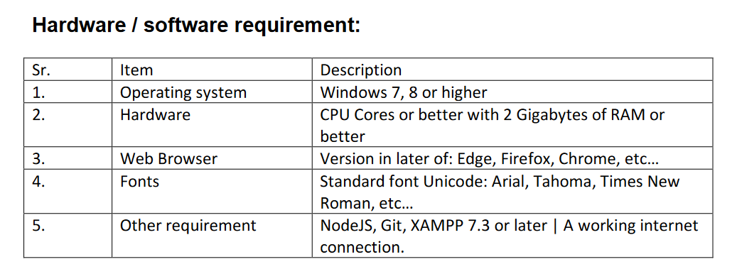
Introduction - Requirements of the project
Non-functional
Notes:
Non-functional (how the system works)
Functional (what the system should do)

Slide 7
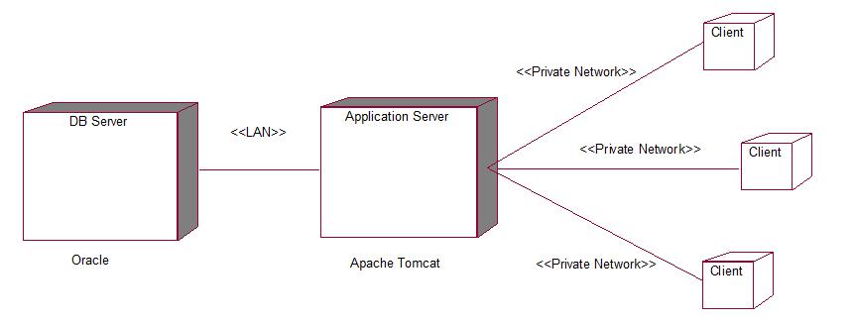
Introduction - Deployment diagram

Slide 8
Test Result [1-n]
Login & register page:
Allow customer to create new account.
Form error handling
Shopping page:
Allow customer to sort products based on categories
Allow customer to add multiple product to shopping cart
Booking page:
Allow customer to choose from three different services
Can book ahead up to 5 days
Can choose specific time in a day

Slide 9
Conclusion
It is very essential for us that will have a clear understanding of the subject. We think we should go through the project and solve the assignments as per requirements given.

Slide 10
Development

Slide 11
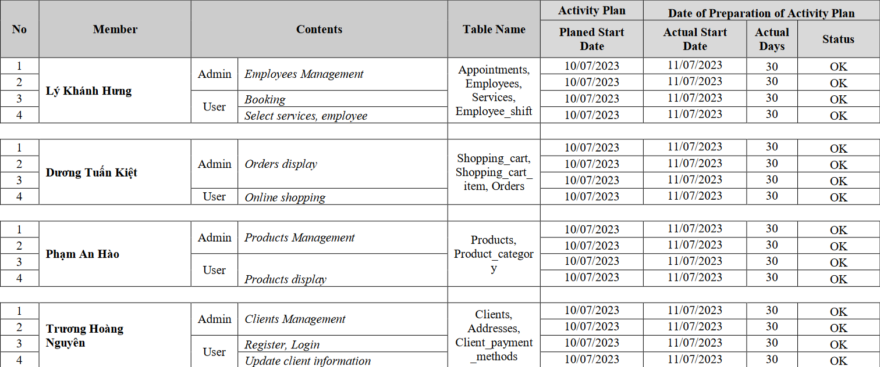
Task List

Slide 12

Thank You

Slide 13
Reference

