Slide 1
MOD004979 / TASK 6 PRESENTATION (10%)
Sports Ontology
Sports Ontology and Semantic Query Evaluation
OWL 2, SPARQL, and natural-language querying
Group project: Member 1, Member 2, Member 3, Member 4, Member 5
October 2026
Notes:
0:00-0:10. Open by introducing the sports OWL ontology and its 25 mapped information questions.
Member names are editable placeholders and should be replaced before submission.

Slide 2
Project Aim and Problem
Organise fragmented sports information into a queryable and reusable semantic model
Problem to solve
Project deliverables
01
Multi-source data
Leagues, media, venues and statistics use different fields and identifiers.
01
Protégé / OWL 2 ontology
Classes, properties, individuals, axioms and constraints
02
Multi-hop relations
25 mapped questions
02
Athletes, teams, events, venues and equipment form connected paths.
10 general questions and 15 specific questions
03
SPARQL query set
03
Query barrier
Joins, filters, aggregation and result validation
Most users cannot write SPARQL or interpret an ontology directly.
04
Python NLP prototype
Natural language, entity recognition and query templates
02
Notes:
0:00-0:20. Explain the problem, project aim and assessment value of a shared semantic model.
The project brief follows the objectives, knowledge gaps and implementation sections of the supplied report.

Slide 3
Ontology Scope and Scale
The final v3.0 ontology combines domain knowledge, application semantics and validation
63
79
5
241
Classes
Modeling properties
Annotation properties
Named individuals
50 domain + 13 application
62 object + 17 data
Dublin Core metadata
222 domain + 19 application
Concept layer
63 classes
Domain entities, user roles, information concepts and system capabilities
Relation layer
62 + 17 properties
Membership, participation, coaching, venues, match results and numeric fields
Data layer
241 individuals
Sports data plus role, benefit, catalogue and reasoning instances
03
Notes:
0:20-0:30. Introduce the final model scale and the separation of domain and application semantics.
Counting rule: unique URI declarations with rdf:type owl:Class, owl:ObjectProperty, owl:DatatypeProperty, owl:AnnotationProperty or owl:NamedIndividual.

Slide 4
Ontology Relationship Map
Core class paths extracted from the final OWL schema. Arrow labels show object properties.
participatesIn
requires
Sport
SportsEquipment
Athlete
competitionSport
memberOf
SportsTeam
competedIn
Competition
finalMatch
Match
hasTeam
hasCoach
hasRecordedVenue
hasResult
SportsLeague
Coach
Venue
MatchResult
Relation classes preserve context: TeamMembership, AthleteParticipation, CoachingAssignment and MatchResult. The map shows the main direct paths used for navigation.
04
Notes:
0:30-0:40. Explain that TeamMembership, AthleteParticipation, CoachingAssignment and MatchResult preserve context.
These relation entities preserve context, while direct properties such as memberOf, participatedIn and hasCoach keep common queries concise.

Slide 5
Five Presenters, Twenty-Five Questions
Every member contributes ontology evidence and owns two general plus three specific questions
Presenter | Ontology and data contribution | General | Specific
Member 1 | User access, athletes and team membership | G01-G02 | S01-S03
Member 2 | Coaches, competitions and recorded venues | G03-G04 | S04-S06
Yanming Gong | Competition venues, equipment, basketball athletes, team coaches and league membership | G07-G08 | S01、S04、S08
Member 4 | Competition context, equipment and participation | G07-G08 | S10-S12
Member 5 | Team comparison, reasoning and data quality | G09-G10 | S13-S15
Coverage: G01-G10 = 10 / 10 | S01-S15 = 15 / 15 | Duplicate assignments = 0
05
Notes:
0:40-1:20. The team lead introduces the model and each presenter states one contribution line.
Replace Member 1-5 and [SID] with the group's real names and student IDs before submission.

Slide 6
User Roles and Athlete Retrieval
Presenter details: Member 1 | Student ID: [SID]
Member 1 / Access | Athlete | Team
Assigned question set
ONTOLOGY AND DATA CONTRIBUTION
GENERAL / 2
Defined and checked UserRole and SportsFanRole access.
Contributed the Athlete, participatesIn and memberOf / hasAthlete paths used to connect people, sports and teams.
G01 Who will use the Sports Ontology?
G02 How can sports fans benefit from this ontology?
SPECIFIC / 3
S01 Which athletes compete in basketball?
S02 Which sport does a particular athlete participate in?
S03 Which athletes belong to a specific team?
Evidence: 37 athlete records. Basketball returns 6 athletes. Argentina has a 26-player roster.
06
Notes:
Member 1: use 7-8 seconds in the 5-minute overview.
State the ontology contribution, then read the two general and three specific question IDs.
Replace [SID] with the student ID before submission.

Slide 7
Coaches and Competition Context
Presenter details: Member 2 | Student ID: [SID]
Member 2 / Coaching | Competition | Venue
Assigned question set
ONTOLOGY AND DATA CONTRIBUTION
GENERAL / 2
Contributed CoachRole, CoachingAssignment, Competition and Venue coverage.
Checked the hasCoach, hasParticipant and hasRecordedVenue links that connect teams, coaches and events.
G03 Why would coaches use the Sports Ontology?
G04 How can sports analysts use this ontology?
SPECIFIC / 3
S04 Who is the coach of a particular team?
S05 Which teams participated in a particular competition?
S06 Where was a particular competition held?
Evidence: Argentina maps to Lionel Scaloni. FIFA World Cup 2022 records 6 teams and 2 venues.
07
Notes:
Member 2: use 7-8 seconds in the 5-minute overview.
State the ontology contribution, then read the two general and three specific question IDs.
Replace [SID] with the student ID before submission.

Slide 8
Search, Equipment, Athletes, Matches and Leagues
Presenter details: Yanming Gong | Student ID: [W261802124]
Member 3 / Search | Match | League
Assigned question set
ONTOLOGY AND DATA CONTRIBUTION
Collected the questions and the facts behind them — venues, equipment, athletes, coaches and league teams. Verified the returned results of all five queries with rdflib (13 / 8 / 6 / 1 / 5). Co-built the OWL ontology file together with the team.
Evidence: World Cup final = 3:3, penalties 4:2; NBA has 5 recorded teams; G7 returns 13 venues, G8 returns 8 equipment items, S1 returns 6 basketball athletes, S4 returns 1 coach.
GENERAL / 2
G07 · Competition venues — Can this ontology help users find information about competitions? (13 results)
G08 · Required equipment — Can this ontology help users find sports equipment? (8 results)
SPECIFIC / 3
S01 · Basketball athletes — List athletes linked to basketball, if participation is recorded (6 answers)
S04 · Team coach — Retrieve the coach linked to the team via hasCoach (1 answer)
S08 · League teams — List teams linked to a league via hasTeam (5 answers)
08
Notes:
Member 3: use 7-8 seconds in the 5-minute overview.
State the ontology contribution, then read the two general and three specific question IDs.
Replace [SID] with the student ID before submission.

Slide 9
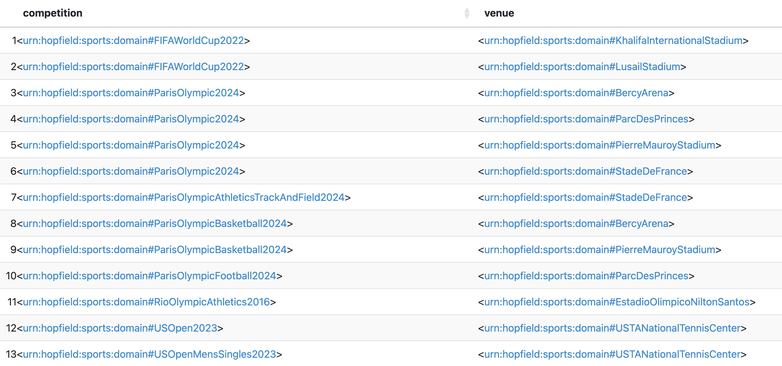
SPARQL Example 1: General Q7: hasRecordedVenue
PREFIX sports: <urn:hopfield:sports:domain#>
SELECT ?competition ?venue WHERE {
?competition sports:hasRecordedVenue ?venue .
}
ORDER BY ?competition
What it retrieves
Can this ontology help users find information about competitions?
Example output
11
Notes:
1:20-1:45. Explain the three links: instance type, sport participation and current team.
The query uses class and property names from the current OWL file. Results come from declared memberOf statements.

Slide 10
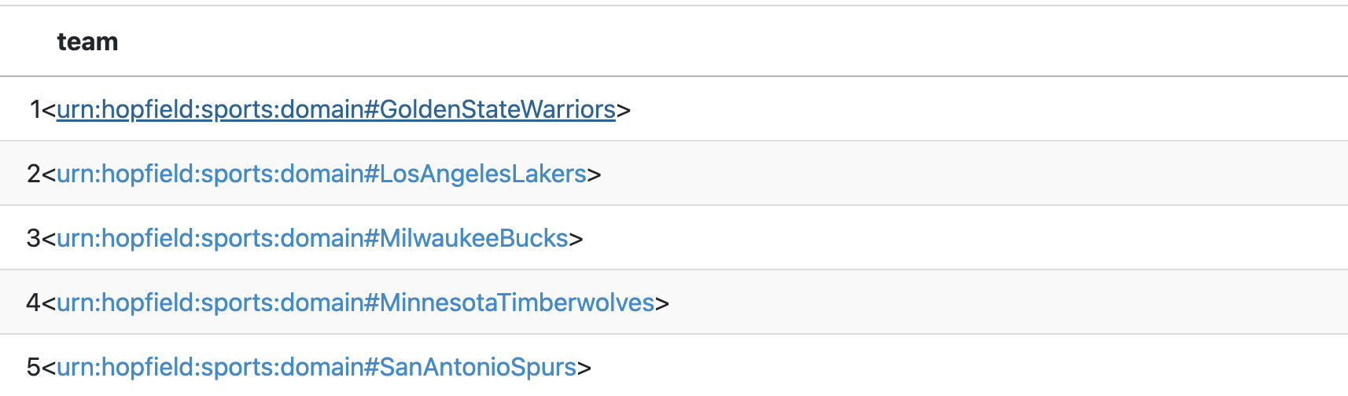
SPARQL Example 2: Specific Q8: hasTeam
PREFIX sports: <urn:hopfield:sports:domain#>
SELECT ?team WHERE {
?league a sports:SportsLeague ;
sports:hasTeam ?team .
FILTER(?league = sports:NBA)
}
ORDER BY ?team
What it retrieves
List teams linked to a league via hasTeam
Example output
11
Notes:
1:45-2:20. The final OWL models competitions and match results separately, so the query joins Competition, Venue, Match and MatchResult.
FIFAWorldCup2022 has two recorded venues in the current file, so the example uses GROUP_CONCAT. State any venue filter explicitly in a live demo.

Slide 11
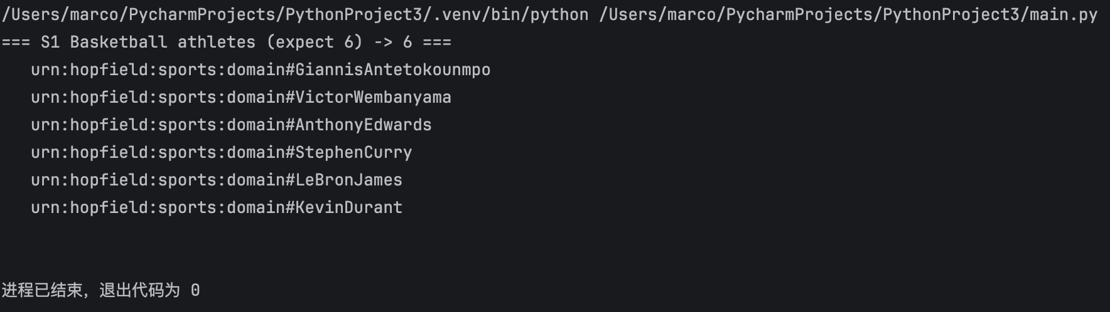
Python NLP Query Pipeline
Result:
AnthonyEdwards, GiannisAntetokounmpo, KevinDurant, LeBronJames, StephenCurry, VictorWembanyama (6)
LIVE DEMO
Which athletes play basketball?
Entity: Basketball
Intent: retrieve the athletes of a sport
PREFIX = "PREFIX sports: <urn:hopfield:sports:domain#> "
queries = {
"S1 Basketball athletes (expect 6)": """
SELECT ?athlete WHERE {
?athlete a sports:Athlete ;
sports:participatesIn sports:Basketball .
}""",
}
for name, q in queries.items():
rows = list(g.query(PREFIX + q))
print(f"=== {name} -> {len(rows)} ===")
for r in rows:
print(" ", " | ".join(str(x) for x in r))
print()
13
Notes:
2:20-3:30. Demonstrate the prototype with the natural-language input, entity recognition, generated SPARQL and result table.
Suggested demos: which sport Messi plays, and the score of the 2022 World Cup final. The second case exercises the match-result template.

Slide 12
Competition and Equipment Data
Presenter details: Member 4 | Student ID: [SID]
Member 4 / Competition | Equipment | Participation
Assigned question set
ONTOLOGY AND DATA CONTRIBUTION
GENERAL / 2
Contributed Competition, SportsEquipment, Ball, Footwear and Racket coverage.
Used AthleteParticipation and TeamMembership records to retain competition and period context.
G07 Can this ontology help users find competition information?
G08 Can this ontology help users find sports equipment?
SPECIFIC / 3
S10 What equipment is associated with a particular sport?
S11 Which competitions has a particular athlete participated in?
S12 Which teams have competed in the same competition?
Evidence: Tennis requires a Ball and Racket. Messi has a FIFA World Cup 2022 participation record.
09
Notes:
Member 4: use 7-8 seconds in the 5-minute overview.
State the ontology contribution, then read the two general and three specific question IDs.
Replace [SID] with the student ID before submission.

Slide 13
Comparison, Reasoning and Data Quality
Presenter details: Member 5 | Student ID: [SID]
Member 5 / Comparison | Reasoning | Validation
Assigned question set
ONTOLOGY AND DATA CONTRIBUTION
GENERAL / 2
Contributed team comparison fields, OwlReasoningCapability and SHACL validation coverage.
Checked inverse and equivalent properties, temporal records and teammate links.
G09 How can this ontology help users compare sports teams?
G10 How can reasoning improve the use of this ontology?
SPECIFIC / 3
S13 Is an athlete linked to a team that does not exist in the ontology?
S14 Can the ontology infer that two athletes are teammates?
S15 Can the ontology detect contradictory sports information?
Evidence: Argentina has 26 athletes, Scaloni and 3 titles. Messi has 25 teammate links.
10
Notes:
Member 5: use 7-8 seconds in the 5-minute overview.
State the ontology contribution, then read the two general and three specific question IDs.
Replace [SID] with the student ID before submission.

Slide 14
Test Cases and Expected Results
Core query paths checked against the final OWL data
Test | Natural-language query | Key path | Expected result from current OWL
T01 | Which sport does Messi play? | LionelMessi → participatesIn | Football
T02 | Who coaches Argentina? | ArgentinaNationalTeam → hasCoach | LionelScaloni
T03 | What equipment does tennis require? | Tennis → requires | TennisRacket + TennisBall
T04 | What was the 2022 World Cup final score? | Final → scores + MatchResult | 3:3; penalties 4:2
T05 | Which league has the most teams? | SportsLeague → hasTeam + COUNT | NBA / 5 teams
The final ontology expresses every core path. Re-import the current OWL into Fuseki before submission and capture screenshots of the five test queries.
14
Notes:
3:30-3:50. Explain the test coverage: attributes, object properties, multi-hop joins, result entities and aggregation.
The final OWL includes penalty result text and five NBA team links, so this slide uses the final data.

Slide 15
Limitations and Next Steps
The final model is demonstrable, but live testing and evidence capture remain
Current limitations
Planned improvements
01 The prototype relies on dictionaries and rule templates, so synonym coverage and nested questions remain limited.
02 Individual data is a teaching sample, and some competitions include only representative teams or matches.
03 A reasoner detects logical conflicts, but it cannot verify every real-world factual error.
04 The final ontology contains 63 classes, 79 modeling properties and 241 individuals. Live Fuseki and HermiT evidence still needs to be captured.
01 Read labels, domains and ranges directly from the OWL to reduce hand-written dictionaries.
02 Add more English and Chinese aliases, intent patterns and clarification prompts.
03 Introduce SHACL or custom checks for missing teams, venues and time fields.
04 Run the full regression suite on Fuseki and refresh report screenshots, statistics and query examples.
15
Notes:
3:50-4:20. State the limitations and present the improvements as concrete next actions.
Avoid claiming that the reasoner validates all facts. It primarily checks ontology axioms and logical constraints.

Slide 16
ASSESSMENT OUTCOME
A query-ready ontology, clear ownership and a working prototype
01
Ontology complete
63 classes, 79 modeling properties and 241 individuals
02
Requirements covered
10 general and 15 specific questions, with each member owning 2 and 3
03
Next milestone
Full Fuseki regression, report alignment, demo captures and final defence
Questions & feedback
16
Notes:
4:20-5:00. Close with the three outcomes and invite questions.
Question coverage is 25 of 25. If names or contributions change, update the tables and notes on slides 5-7.
Main sources: the final Hopfield sports OWL v3.0 file, the general and specific question workbooks, the completed ontology report and the Week 9 assessment rubric.

