Slide 1
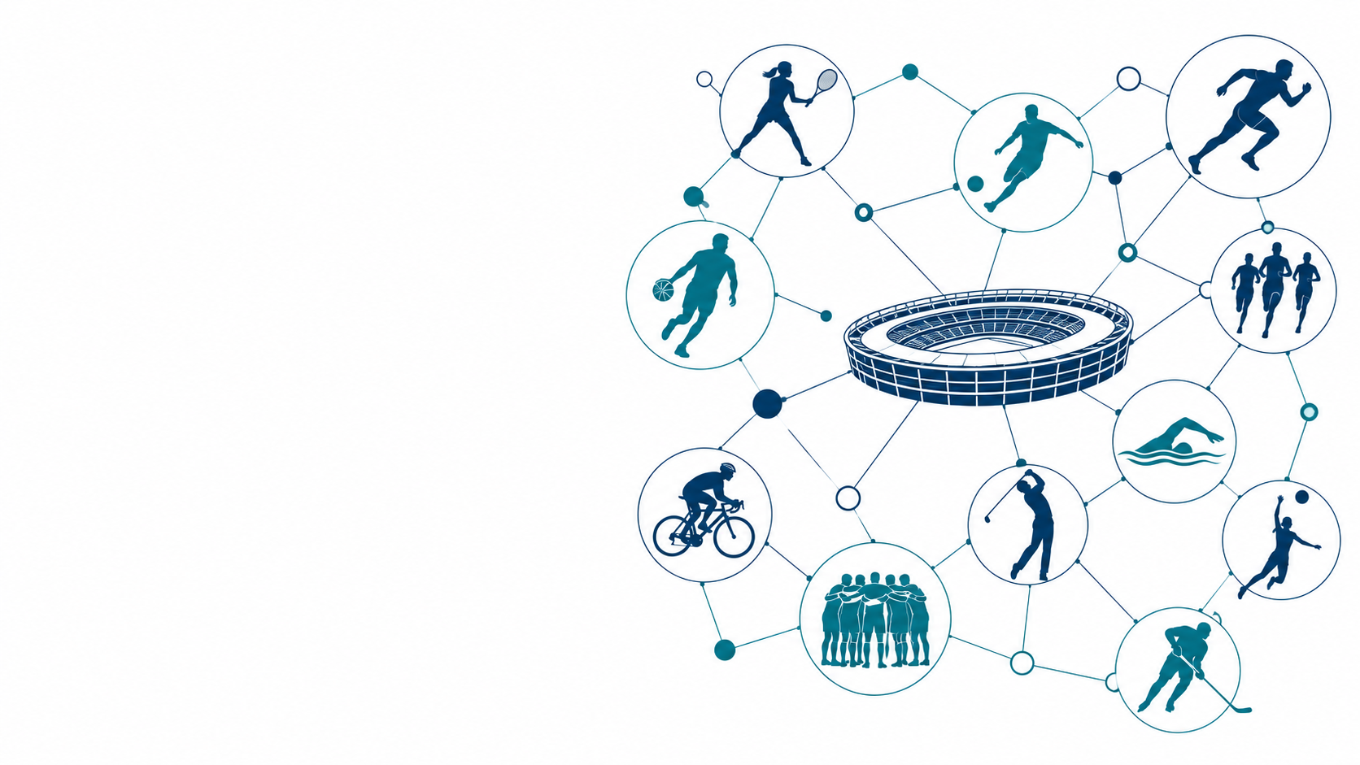
MOD004979 / SEMANTIC DATA TECHNOLOGIES
Semantic Queries for
a Sports Ontology
Athletes · Teams · Competitions
Kangcheng Xu | Student ID 2623912
MSc Artificial Intelligence · Team Hopfield
Semantic modelling and querying of sports knowledge
Notes:
Hello, my name is Kangcheng Xu. My student ID is 2623912. I will talk about my five questions in our sports ontology.

Slide 2
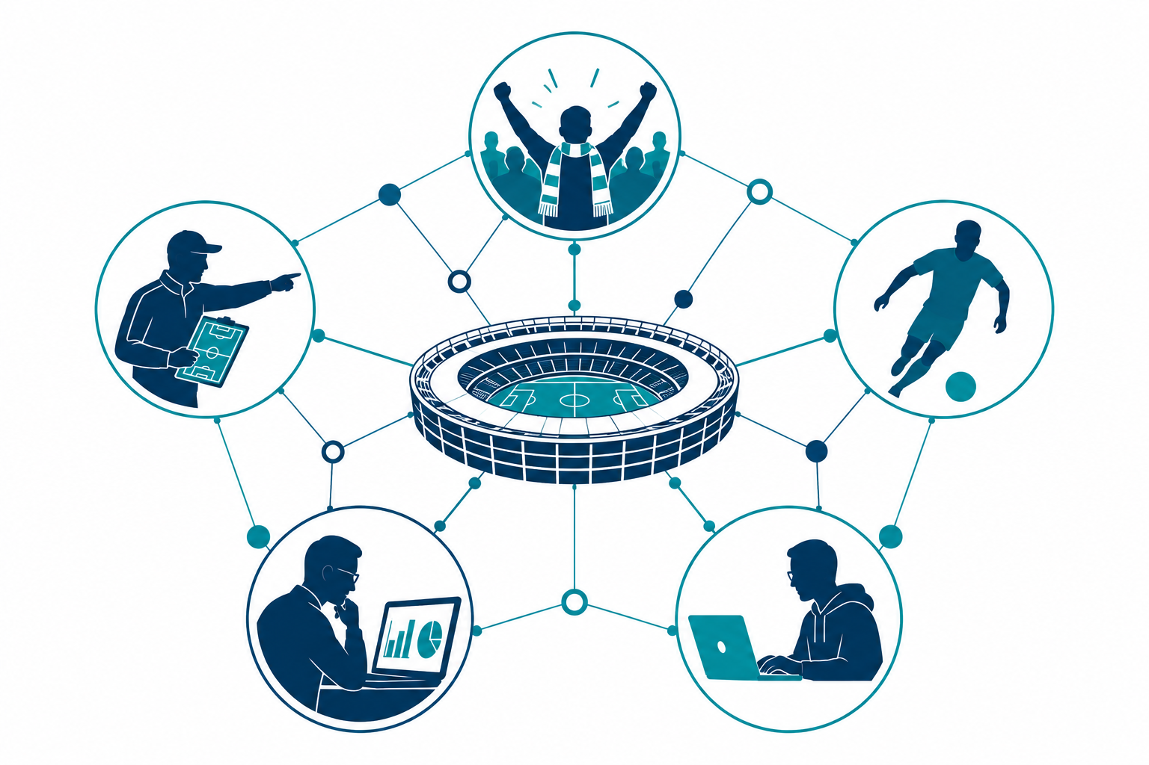
SEMANTIC DATA TECHNOLOGIES / INDIVIDUAL WORK
G01 and G03: users and coaches
Who uses the ontology and why?
G01
Who will use the sports ontology?
Fans, athletes, coaches, analysts and developers.
G03
Why would coaches use the ontology?
They can find information about teams and athletes.
This information can support their preparation.
XU KANGCHENG · 2623912
02
Notes:
G01: Fans, coaches and athletes can use this ontology. Analysts and developers can use it too. The model records seven user roles.
G03: Coaches can use the ontology to find sports information. They can look at teams and athletes. This can support their preparation.

Slide 3
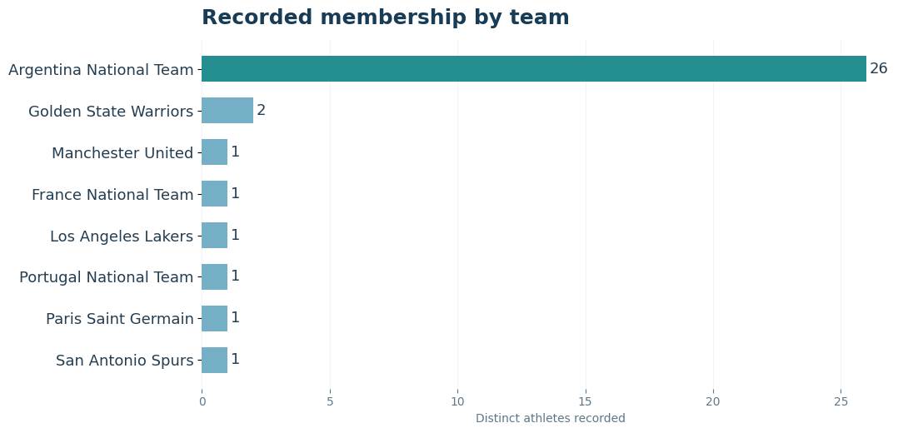
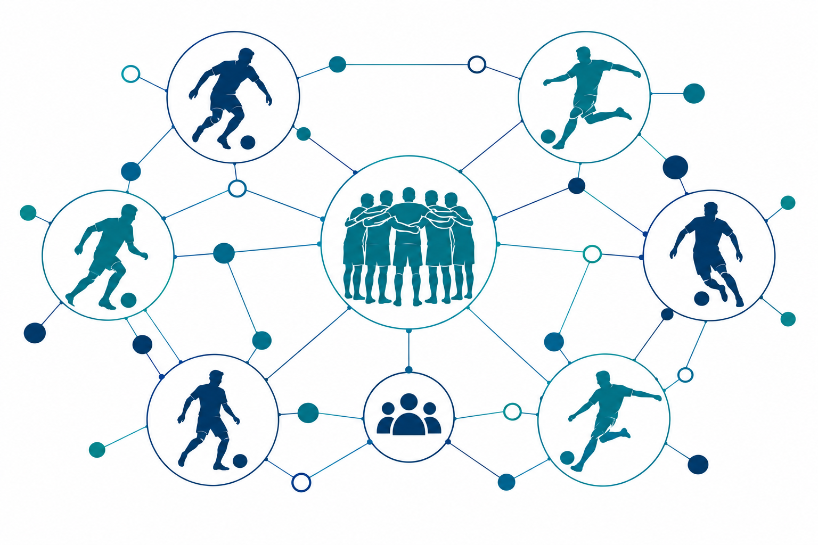
SEMANTIC DATA TECHNOLOGIES / INDIVIDUAL WORK
S03: Which athletes belong to a team?
Querying Argentina through TeamMembership
26 records
Argentina national team memberships
Other teams have fewer recorded examples.
TeamMembership · Athlete · SportsTeam
XU KANGCHENG · 2623912
03
Notes:
This question asks who belongs to a team. I use Argentina as an example. The query returns 26 membership records.

Slide 4
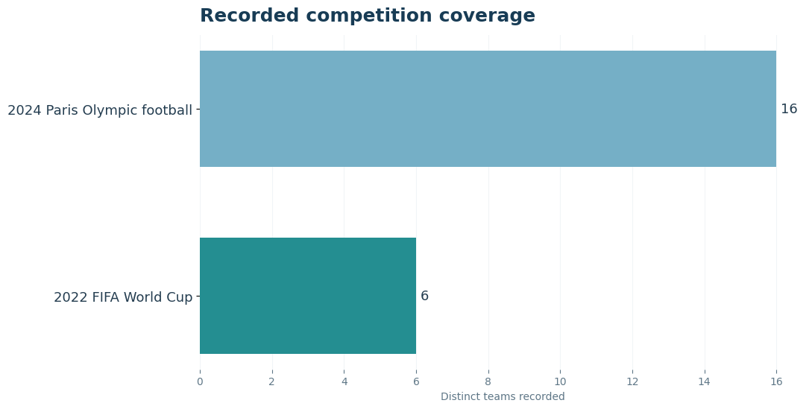
SEMANTIC DATA TECHNOLOGIES / INDIVIDUAL WORK
S11 and S12: competition participation
Which competitions has an athlete entered? Which teams entered the same competition?
135 pairs
Recorded teams in the same competition
Paris Olympic football: 16 teams
2022 World Cup: 6 teams
16 choose 2 plus 6 choose 2 gives 135 pairs.
S11: Messi → 2022 FIFA World Cup (one recorded competition)
XU KANGCHENG · 2623912
04
Notes:
S11: This question asks which competitions an athlete entered. I use Messi as an example. The file returns the 2022 World Cup.
S12: This question finds teams in the same competition. The query returns 135 team pairs. These are pairs recorded in our dataset.

