Slide 1
MOD004979 / TASK 6 MIDTERM REVIEW
Sports Ontology
Midterm Review: Model, Queries and NLP
25 questions traced from OWL concepts to SPARQL routes and controlled natural language
Team Hopfield: Zhengyu Lu, Kangcheng Xu, Lu Yifan, Yanming Gong, Li Wenhan
November 2026
Notes:
开场约20秒：本汇报回答四个问题。25个问题如何在OWL本体中表达，如何用SPARQL查询，NLP如何把自然语言映射到查询，以及哪些证据已经完成。

Slide 2
Project Aim and Problem
Turn fragmented sports information into a traceable path from question to semantic answer
Problem to solve
Project deliverables
01
Multi-source data
Leagues, media, venues and statistics use different fields and identifiers.
01
Protégé / OWL 2 ontology
Classes, properties, individuals, axioms and constraints
02
Multi-hop relations
25 mapped questions
02
Athletes, teams, events, venues and equipment form connected paths.
10 general questions and 15 specific questions
03
SPARQL query set
03
Query barrier
Joins, filters, aggregation and result validation
Most users cannot write SPARQL or interpret an ontology directly.
04
Python NLP prototype
Natural language, entity recognition and query templates
02
Notes:
先说明问题：体育数据来源分散，关系跨越多跳，普通用户不会写SPARQL。项目交付本体、25题映射、查询集和Python NLP原型。

Slide 3
Ontology Scope and Scale
The final v3.0 ontology combines domain knowledge, application semantics and validation
63
79
5
241
Classes
Modeling properties
Annotation properties
Named individuals
50 domain + 13 application
62 object + 17 data
Dublin Core metadata
222 domain + 19 application
Concept layer
63 classes
Domain entities, user roles, information concepts and system capabilities
Relation layer
62 + 17 properties
Membership, participation, coaching, venues, match results and numeric fields
Data layer
241 individuals
Sports data plus role, benefit, catalogue and reasoning instances
03
Notes:
本体的规模与三层结构：63个业务类、79个建模属性、241个命名个体，并增加SHACL质量层。

Slide 4
Ontology Relationship Map
Core class paths extracted from the final OWL schema. Arrow labels show object properties.
participatesIn
requires
Sport
SportsEquipment
Athlete
competitionSport
memberOf
SportsTeam
competedIn
Competition
finalMatch
Match
hasTeam
hasCoach
hasRecordedVenue
hasResult
SportsLeague
Coach
Venue
MatchResult
Relation classes preserve context: TeamMembership, AthleteParticipation, CoachingAssignment and MatchResult. The map shows the main direct paths used for navigation.
04
Notes:
用核心类路径说明问题如何落到本体：运动员、队伍、赛事、比赛、结果、场馆和装备通过对象属性相连；时间敏感关系通过关系记录保留上下文。

Slide 5
Five Presenters, Twenty-Five Questions
Each member owns two general and three specific question-to-query traces
Presenter | Ontology and data contribution | General | Specific
Zhengyu Lu | Integrated materials and presentation structure; documented role, venue, match and equipment queries | G02, G05 | S06, S07, S10
Kangcheng Xu | Athlete/team membership, shared competitions, SPARQL and NLP examples | G01, G03 | S03, S11, S12
Lu Yifan | Natural language to triples, SPARQL and dataset answers | G06, G09 | S02, S05, S14
Yanming Gong | Venues, equipment, athletes, coaches and league teams | G07, G08 | S01, S04, S08
Li Wenhan | Analyst access, reasoning and data quality | G04, G10 | S09, S13, S15
Coverage: 10 of 10 general and 15 of 15 specific questions. Executed means preserved query or validation evidence; Mapped means ontology route only.
05
Notes:
25题没有重复分配。我的五题是G04、G10、S09、S13和S15；其余问题通过交换G09和S14保持每人两题一般问题、三题特殊问题。

Slide 6
Presenter contributions to the ontology and presentation
Each presenter owns a question cluster, its supporting evidence and its inserted slides
Presenter | Ontology and data contribution | Presentation contribution | Questions
Zhengyu Lu | Integrated group materials and presentation structure; documented role, venue, match and equipment cases. | Presents G02/G05 and S06/S07/S10 query and Python demonstrations. | G02, G05 S06, S07, S10
Kangcheng Xu | Modelled athlete/team membership and shared competition paths; built SPARQL and NLP examples. | Presents G01/G03 and S03/S11/S12 examples, queries and notebook. | G01, G03 S03, S11, S12
Lu Yifan | Natural-language conversion to triples, SPARQL generation and dataset answers. | Presents five questions, G06/S05 query examples and NLP steps. | G06, G09 S02, S05, S14
Yanming Gong | Venues, equipment, athletes, coaches and league teams; RDFLib verification. | Presents five questions, G07/S08 queries and S01 NLP output. | G07, G08 S01, S04, S08
Li Wenhan | Analyst access, venue navigation, reasoning capability and SHACL validation. | Presents the five-question cluster, query flows, NLP pipeline and tests. | G04, G10 S09, S13, S15
Question allocations reflect the slides inserted by each presenter.
06
Notes:
分工已按各自插入的 PPT 更新：Zhengyu Lu 负责 G02、G05、S06、S07、S10；Kangcheng Xu 负责 G01、G03、S03、S11、S12；Lu Yifan 负责 G06、G09、S02、S05、S14；Yanming Gong 负责 G07、G08、S01、S04、S08；Li Wenhan 负责 G04、G10、S09、S13、S15。

Slide 7
Zhengyu Lu | User-facing Queries and Query Cases
Presenter: Zhengyu Lu / Student ID: W261802121
Zhengyu Lu / Queries | NLP | Results
Assigned question set
ONTOLOGY AND DATA CONTRIBUTION
GENERAL / 2
Integrated group information, experimental materials and presentation structure.
Documented role, venue, match and equipment query cases; coordinated the SPARQL and Python demonstrations.
G02 How can sports fans benefit from this ontology?
G05 Why would sports website developers use this ontology?
SPECIFIC / 3
S06 Where was a particular competition held?
S07 What was the score of a specific match?
S10 What equipment is associated with a particular sport?
Evidence: G02 role capabilities; S06 returns 2 venues; S07 score 3-3, penalties 4-2; S10 returns football equipment.
07
Notes:
Zhengyu Lu 的五个问题是 G02、G05、S06、S07、S10。其插入页保留原有查询、Python 演示和结果，本页只同步姓名、问题分配与标题。

Slide 8
Zhengyu Lu question trace: user-facing query cases
Contribution: query cases for roles, venues, matches and equipment. Evidence: 2 venues; 3-3 with 4-2 penalties; 2 football equipment records.
Question | Ontology model | SPARQL route | NLP intent and handling
G02 How can sports fans benefit from this ontology? | SportsFanRole / canAccess / canQuery / usesOntologyFor | Bind SportsFanRole and return capability targets | role_benefit / Mapped: access, query, connected information
G05 Why would sports website developers use this ontology? | WebsiteDeveloperRole / WebsiteDevelopmentBenefit / canBuild | Follow the developer role to build capability | developer_capability / Mapped
S06 Where was a particular competition held? | Competition / hasRecordedVenue / Venue | Bind competition and return recorded venues | competition_venues / Executed: 2 venues
S07 What was the score of a specific match? | FootballMatch / teams / scores / hasResult | Bind match and return score plus penalty result | match_score / Executed: 3-3; penalties 4-2
S10 What equipment is associated with a particular sport? | Sport / requires / SportsEquipment | Bind sport and return equipment labels | equipment_for_sport / Executed: Football -> ball, boots
08
Notes:
Zhengyu Lu 的查询覆盖角色收益、网站开发者用例、赛事场馆、比赛比分和运动装备。

Slide 9
Zhengyu Lu | Contribution
- ✅ Integrate scattered group information and experimental materials
- ✅ Sort out presentation manuscript, polish and unify the expression
- ✅ Organize the overall logical framework of the PPT
- 🤝 Ontology & SPARQL implementation: teammates’ work
09
Notes:
Member 1: use 7-8 seconds in the 5-minute overview.
State the ontology contribution, then read the two general and three specific question IDs.
Replace [SID] with the student ID before submission.

Slide 10
Zhengyu Lu | SPARQL Example 1:
G02 | How can sports fans benefit from this ontology?
SPARQL Query (abridged)
Query Result
Capability | Target
canAccess | Hopfield sports ontology resource
canQuery | Recorded sports information
usesOntologyFor | Find connected sports information
PREFIX hsa: <urn:hopfield:sports:application#>
SELECT ?capability ?targetName
WHERE {
hsa:SportsFanRole ?cap ?target .
OPTIONAL { ?target rdfs:label ?targetName }
}
Natural-language Answer
Sports fans can:
access the Hopfield sports ontology resource;
query recorded sports information;
and use the ontology to find connected sports information.
Status: Mapped — semantic definition exists, returns role capability description (no bulk instance data)
10
Notes:
The first general question asks how sports fans benefit from this ontology. The query targets the SportsFanRole class in the application layer, returning three capabilities: access to the ontology, querying recorded sports data, and discovering connected information.

Slide 11
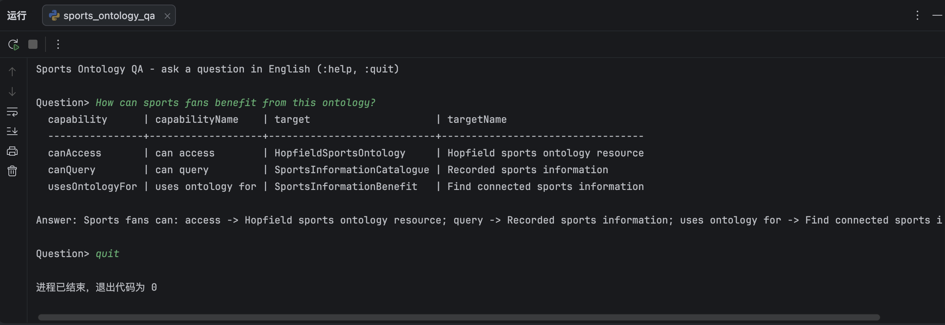
Zhengyu Lu | Python Demo:
G02 | How can sports fans benefit from this ontology?
11
Notes:
To summarize: I have demonstrated a complete NLP query pipeline built on RDFLib, covering all five assigned questions. Three specific instance queries are validated against real ontology data, and two general role-capability queries are mapped to the application layer. Thank you, and I am happy to take any questions.

Slide 12
Zhengyu Lu | SPARQL Example 2:
S10 | What equipment is associated with a particular sport?
SPARQL Query
Demo Input: Football
Sport | Equipment
Football | Football Ball
Football | Football Boots
PREFIX hs: <urn:hopfield:sports:domain#>
SELECT ?sportLabel ?equipLabel
WHERE {
?s a hs:Sport ;
rdfs:label ?sportLabel ;
hs:requires ?e .
?e rdfs:label ?equipLabel .
}
Natural-language Answer
Football requires: Football Ball, Football Boots.
Status: Validated — returns real equipment individuals linked to the sport
12
Notes:
The third specific query finds equipment associated with a chosen sport. Using Football as the example, the system returns two linked equipment individuals: Football Ball and Football Boots. This demonstrates the usesEquipment property traversal.

Slide 13
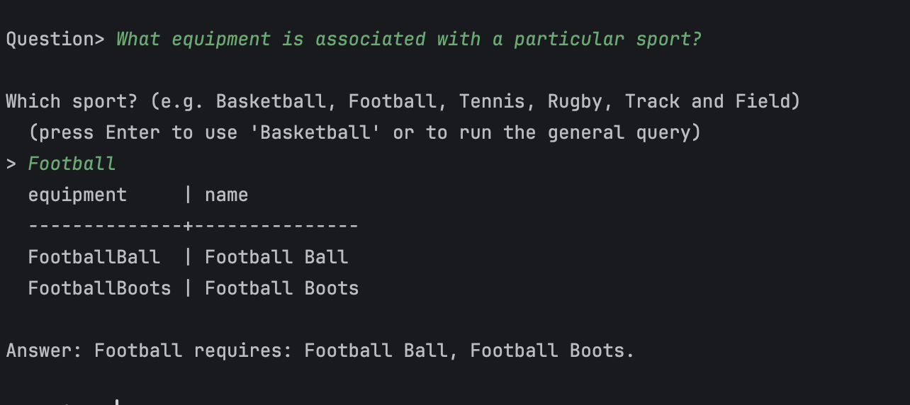
Zhengyu Lu | Python Demo:
S10 | What equipment is associated with a particular sport?
13
Notes:
To summarize: I have demonstrated a complete NLP query pipeline built on RDFLib, covering all five assigned questions. Three specific instance queries are validated against real ontology data, and two general role-capability queries are mapped to the application layer. Thank you, and I am happy to take any questions.

Slide 14
Zhengyu Lu | Five-question demo
Interactive QA powered by RDFLib
How it works:
1. User types a natural-language question.
2. System identifies the query intent
(e.g.sport_equipment, competition_venue).
3. If a slot is missing (e.g. which sport?), it asks interactively.
4. System generates SPARQL automatically and queries the ontology.
5. Results are returned as a table + a plain-English answer.
All Five Questions Demonstrated
 | Question | Result
G02 | Fans benefit? | Access, query, find connected info
G05 | Developers use it? | Access, build website, services
S06 | Competition venue? | WC2022 → 2 stadiums
S07 | Match score? | Argentina 3–3 France, pen 4–2
S10 | Sport equipment? | Football → ball, boots
Summary:
3 specific queries Validated with real instance data;
2 general queries Mapped to role-capability semantics.
All 5 assigned questions covered and reproducible.
14
Notes:
To summarize: I have demonstrated a complete NLP query pipeline built on RDFLib, covering all five assigned questions. Three specific instance queries are validated against real ontology data, and two general role-capability queries are mapped to the application layer. Thank you, and I am happy to take any questions.

Slide 15
Kangcheng Xu | Athletes, Teams and Competitions
Presenter: Kangcheng Xu / Student ID: 2623912
Kangcheng Xu / Athletes | Teams | Competitions
Assigned question set
ONTOLOGY AND DATA CONTRIBUTION
GENERAL / 2
Modelled athlete and team membership across competitions.
Built SPARQL examples for team membership and shared competitions, plus an NLP example that maps a question to the S03 query template.
G01 Who will use the Sports Ontology?
G03 Why would coaches use the Sports Ontology?
SPECIFIC / 3
S03 Which athletes belong to a specific team?
S11 Which competitions has a particular athlete participated in?
S12 Which teams have competed in the same competition?
Evidence: 26 Argentina membership records; 135 shared-competition team pairs; S03 NLP demo returns 26 records.
15
Notes:
Kangcheng Xu 的五个问题是 G01、G03、S03、S11、S12。其插入页保留原有统计、SPARQL 和 Jupyter NLP 示例，本页只同步姓名、问题分配与标题。

Slide 16
Kangcheng Xu question trace: athletes, teams and competitions
Contribution: team membership, athlete competitions and shared-competition queries. Evidence: 26 membership records and 135 team pairs.
Question | Ontology model | SPARQL route | NLP intent and handling
G01 Who will use the Sports Ontology? | UserRole subclasses / role labels | Return the recorded role types | role_usage / Mapped
G03 Why would coaches use the Sports Ontology? | CoachRole / CoachingPreparationBenefit / SportsDataCatalogue | Follow the coach role to preparation benefits and data targets | role_use_case / Mapped
S03 Which athletes belong to a specific team? | TeamMembership / memberAthlete / membershipTeam | Bind ArgentinaNationalTeam and return its membership athletes | team_roster / Executed: 26 records
S11 Which competitions has a particular athlete participated in? | Athlete / participatedIn / Competition | Bind athlete and return recorded competitions | athlete_competitions / Executed: Messi -> 2022 World Cup
S12 Which teams have competed in the same competition? | Two SportsTeam nodes / shared competedIn / Competition | Pair teams by competition and remove duplicate pairs | team_pair_shared_competitions / Executed: 135 pairs
16
Notes:
Kangcheng Xu 的查询覆盖用户角色、教练用途、球队成员、运动员赛事和共同赛事。

Slide 17

SEMANTIC DATA TECHNOLOGIES / INDIVIDUAL WORK
Kangcheng Xu | G01 and G03: users and coaches
Who uses the ontology and why?
G01
Who will use the sports ontology?
Fans, athletes, coaches, analysts, researchers and developers.
G03
Why would coaches use the ontology?
They can find information about teams and athletes.
This helps coaches prepare.
XU KANGCHENG · 2623912
02
Notes:
第 2 页讲稿（建议约 35 秒）：
英文正文：
The first two questions concern users and their needs. The ontology can support fans, athletes, coaches, analysts, researchers and developers. For example, coaches can find information about teams and athletes to help them prepare. These are examples of possible users and uses in our model.
中文对照：
前两个问题关注使用者及其需求。体育本体可以为球迷、运动员、教练、分析师、研究人员和开发者提供支持。例如，教练可以查找队伍和运动员的信息，帮助准备工作。这些是模型中可能的使用者及用途。

Slide 18
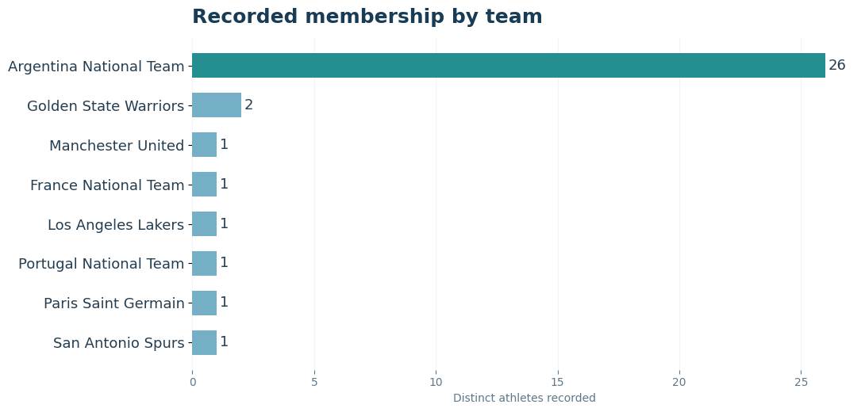
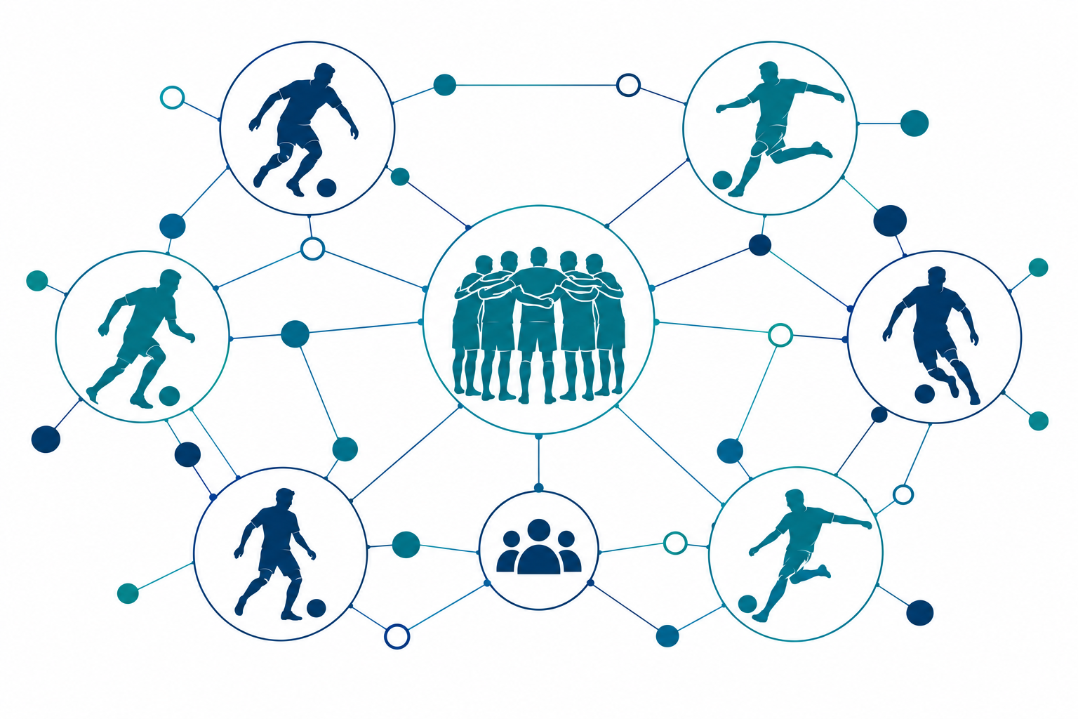
SEMANTIC DATA TECHNOLOGIES / INDIVIDUAL WORK
Kangcheng Xu | S03: team membership
Example: Argentina national team
26 records
We found 26 membership records for Argentina.
Other teams have fewer recorded examples.
TeamMembership · Athlete · SportsTeam
Kangcheng Xu · 2623912
17
Notes:
第 3 页讲稿（建议约 40 秒）：
英文正文：
The third question asks which athletes belong to a team. I use Argentina as an example. A TeamMembership record links an athlete to a team and may include dates. The query returns 26 membership records for Argentina. Other teams have fewer recorded examples. These results describe our dataset, not the complete squads in real life.
中文对照：
第三个问题是哪些运动员属于某支队伍。我以阿根廷队为例。TeamMembership 记录把运动员与队伍联系起来，还可以包含日期。查询返回阿根廷队的 26 条成员记录，其他队伍记录较少。这些结果反映的是数据集，而不是现实中的完整阵容。

Slide 19
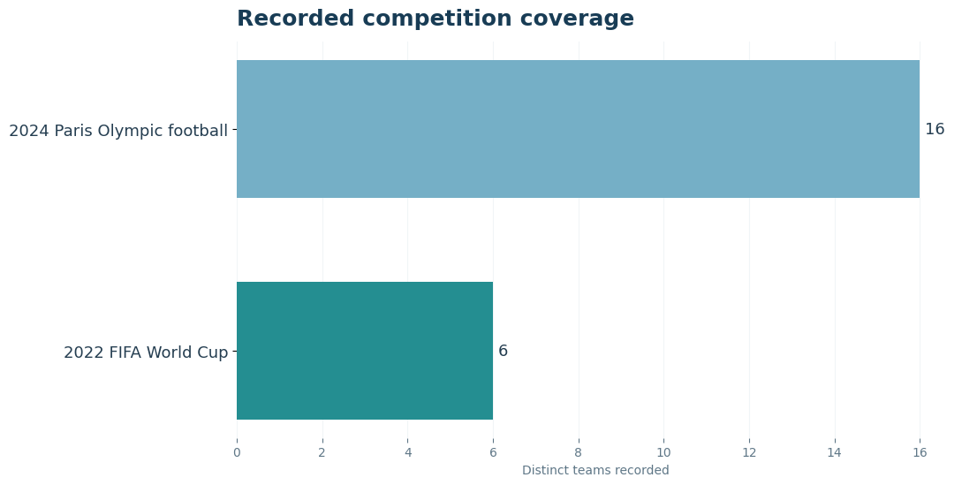
SEMANTIC DATA TECHNOLOGIES / INDIVIDUAL WORK
Kangcheng Xu | S11 and S12
Which competitions? Which teams in the same competition?
135 pairs
Recorded pairs of teams in the same competition.
Paris Olympic football: 16 teams
2022 World Cup: 6 teams
16 choose 2 plus 6 choose 2 gives 135 pairs.
S11: Messi → 2022 World Cup (one competition in our data)
Kangcheng Xu · 2623912
18
Notes:
第 4 页讲稿（建议约 55 秒）：
英文正文：
The fourth question asks which competitions an athlete has entered. In our data, the Messi example returns the 2022 World Cup. This is one recorded competition, not a complete list of his career. The fifth question asks which teams entered the same competition. The query returns 135 team pairs. Our dataset records 16 teams for Paris Olympic football and six for the 2022 World Cup. Counting each pair once gives 120 plus 15, or 135. A pair means both teams entered the same competition; it does not mean they played each other.
中文对照：
第四个问题是一名运动员参加过哪些赛事。在我们的数据中，梅西的例子返回 2022 年世界杯。这是一项已记录赛事，并非他职业生涯的完整列表。第五个问题是哪些队伍参加了同一赛事。查询返回 135 组队伍：数据集中巴黎奥运足球记录了 16 支队伍，2022 年世界杯记录了 6 支队伍。每组只计一次，共 120 加 15，即 135 组。一组只表示两队参加了同一赛事，不表示它们交过手。

Slide 20
SEMANTIC DATA TECHNOLOGIES / INDIVIDUAL WORK
Kangcheng Xu | SPARQL examples
Team membership and shared competition
S03
Team members
S12
Teams in one competition
?m a hs:TeamMembership ;
hs:membershipTeam hs:ArgentinaNationalTeam ;
hs:memberAthlete ?athlete .
?a hs:competedIn ?competition .
?b hs:competedIn ?competition .
FILTER(STR(?a) < STR(?b))
26
membership records
135
recorded team pairs
Core graph patterns, with prefixes omitted.
Kangcheng Xu · 2623912
19
Notes:
第 5 页讲稿（建议约 40 秒）：
英文正文：
Here are the core patterns for two SPARQL queries. The first follows a membership record to find Argentina's athletes and returns 26 records. The second links two teams to the same competition. The filter keeps each pair only once, giving 135 pairs. The prefixes are omitted here to keep the examples short.
中文对照：
这里展示两个 SPARQL 查询的核心模式。第一个通过成员记录查找阿根廷队运动员，返回 26 条记录。第二个把两支队伍关联到同一赛事，通过过滤条件使每组只保留一次，得到 135 组。为便于展示，这里省略了命名空间前缀。

Slide 21
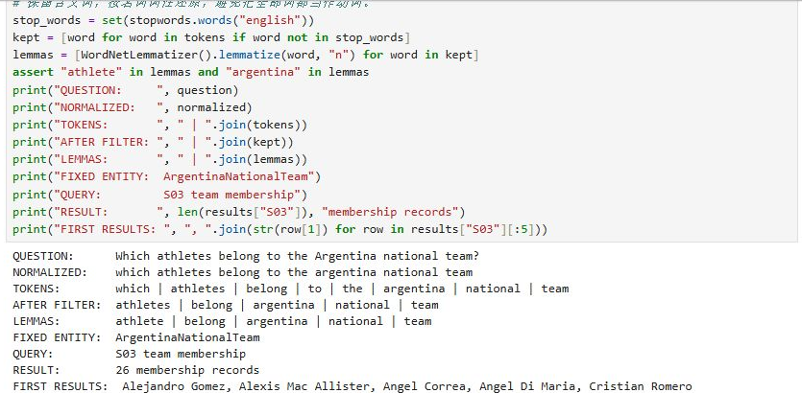

SEMANTIC DATA TECHNOLOGIES / INDIVIDUAL WORK
Kangcheng Xu | NLP example
From an English question to a sports ontology query
Processing the question
01
Identify athlete and argentina
02
Use the fixed S03 query template
03
The query returns 26 records
The example uses a fixed entity and query template.
Kangcheng Xu · 2623912
20
Notes:
第 6 页讲稿（建议约 50 秒）：
英文正文：
Finally, this notebook shows a natural language example. The English question is normalized, tokenized and lemmatized. The example identifies athlete and Argentina, then uses a fixed entity and the fixed S03 query template. The query returns 26 records. This is a demonstration with a fixed example, not a system that automatically answers any question. These are my five questions and examples. Thank you for listening. I am happy to answer your questions.
中文对照：
最后，这个 Notebook 展示一个自然语言处理示例。英文问题经过标准化、分词和词形还原。示例识别 athlete 和 Argentina，然后使用固定实体与固定的 S03 查询模板，返回 26 条记录。这是一个固定示例，并非能够自动回答任意问题的系统。以上是我的五个问题和示例。谢谢大家，欢迎提问。
Notebook 截图来源：doc/screenshots/20261101-xukangcheng-jupyter-nlp.png
答疑备忘（不属于四分钟正文）：
Why do you use a membership record?
It links an athlete to a team. It can also store dates.
为什么使用成员关系记录？
它把运动员和队伍联系起来，也可以记录日期。
Why are there 135 team pairs?
Our data records 16 teams in one competition and six in another. We count each pair once: 120 plus 15 is 135.
为什么有 135 组队伍？
数据中一项赛事记录了 16 支队伍，另一项记录了 6 支。每组只统计一次：120 加 15 等于 135。
Does a team pair mean the teams played each other?
No. It only means both teams are recorded in the same competition.
一组队伍是否表示两队交过手？
不是。它只表示两队都被记录为参加同一赛事。
Why are there only six World Cup teams?
This is a teaching dataset. We only recorded six teams for this example.
为什么世界杯只有六支队伍？
这是教学数据集，这个例子只录入了六支队伍。
Can your system answer any question?
No. The notebook demo uses a fixed example and a fixed query.
系统能回答任何问题吗？
不能。Notebook 演示使用固定例子和固定查询。
What did you contribute?
I worked on these five questions. I checked the questions and their results.
你做了什么？
我负责这五个问题，并检查了问题和结果。请仅在确实做过时这样回答，按实际经历修改。

Slide 22
Natural-language Querying and Data Access
Presenter: Lu Yifan / Student ID: [not provided]
Lu Yifan / Query | Triples | NLP
Assigned question set
ONTOLOGY AND DATA CONTRIBUTION
GENERAL / 2
Converted natural-language questions to triples and generated SPARQL queries.
Sent queries to the dataset and returned answers. Implemented normalization, tokenization, lemmatization, entity linking, triple decomposition and summarization.
G06 What information can users search for using this ontology?
G09 How can this ontology help users compare sports teams?
SPECIFIC / 3
S02 Which sport does a particular athlete participate in?
S05 Which teams participated in a particular competition?
S14 Can the ontology infer that two athletes are teammates?
Evidence: G06 returns 5 information categories; S05 returns 6 teams for FIFA World Cup 2022.
21
Notes:
Lu Yifan 的五个问题是 G06、G09、S02、S05、S14。其原稿中的自然语言转三元组、SPARQL 生成和查询流程保留。

Slide 23
Lu Yifan question trace: search, athletes and team context
Contribution: natural-language querying, SPARQL generation and NLP processing. Evidence: G06 returns 5 categories; S05 returns 6 teams.
Question | Ontology model | SPARQL route | NLP intent and handling
G06 What information can users search for? | GeneralUserRole / canSearch / SportsInformation | Select the five linked information category labels | searchable_catalogues / Executed Q02: 5 categories
G09 How can this ontology help users compare sports teams? | SportsTeam / membership, coach, league / results and trophies | Select comparable team fields | team_compare / Mapped
S02 Which sport does a particular athlete participate in? | Athlete / participatesIn / Sport | Resolve athlete IRI and return the sport | athlete_sport / Mapped
S05 Which teams participated in a particular competition? | SportsTeam / competedIn / Competition / inverse hasParticipant | Bind competition and return participating teams | teams_in_competition / Executed Q05: 6 teams
S14 Can the ontology infer that two athletes are teammates? | hasTeammate / shared TeamMembership | Query stored teammate links; mark inference separately | teammates / Stored links available; reasoner run pending
22
Notes:
Lu Yifan 逐题：G06 查询信息目录；G09 比较队伍；S02 查询运动员项目；S05 查询赛事队伍；S14 检查队友关系及推理状态。

Slide 24
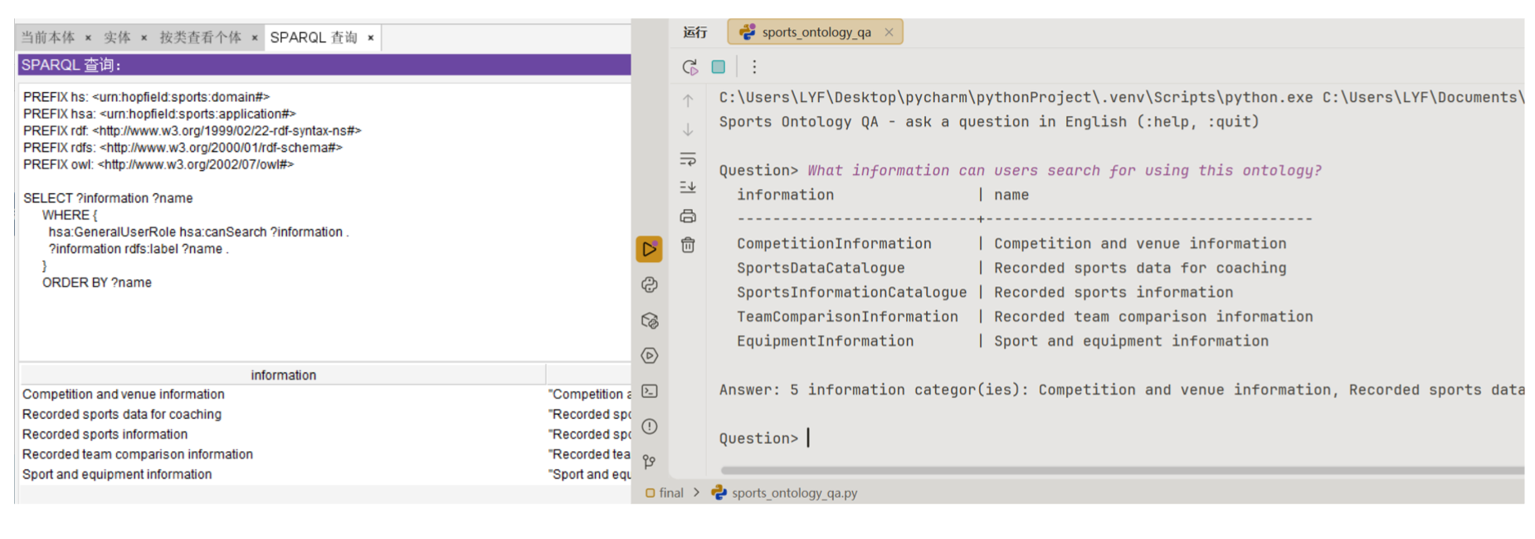
Lu Yifan | Example Query 1 (G06)
What information can users search for using this ontology?
Returned 5 categories: competition and venue, coaching data, sports information, team comparison and equipment.
23
Notes:
这一页替换为 Lu Yifan 新版内容：G06 查询可搜索的信息类别。截图来自用户提供的 Sports_Ontology_lyf(1).pptx 第 3 页；左为 Protégé SPARQL，右为 RDFLib 问答结果。

Slide 25
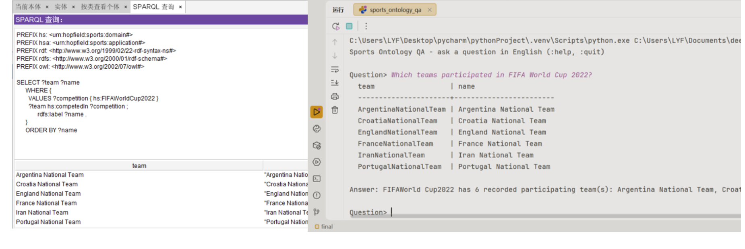
Lu Yifan | Example Query 2 (S05)
Which teams participated in a particular competition? Example: FIFA World Cup 2022.
Returned 6 teams for FIFAWorldCup2022: Argentina, Croatia, England, France, Iran and Portugal.
24
Notes:
这一页替换为 Lu Yifan 新版内容：S05 查询 FIFA World Cup 2022 的参赛球队。截图来自用户提供的 Sports_Ontology_lyf(1).pptx 第 4 页；左侧返回 6 支球队，右侧展示自然语言查询和回答。

Slide 26
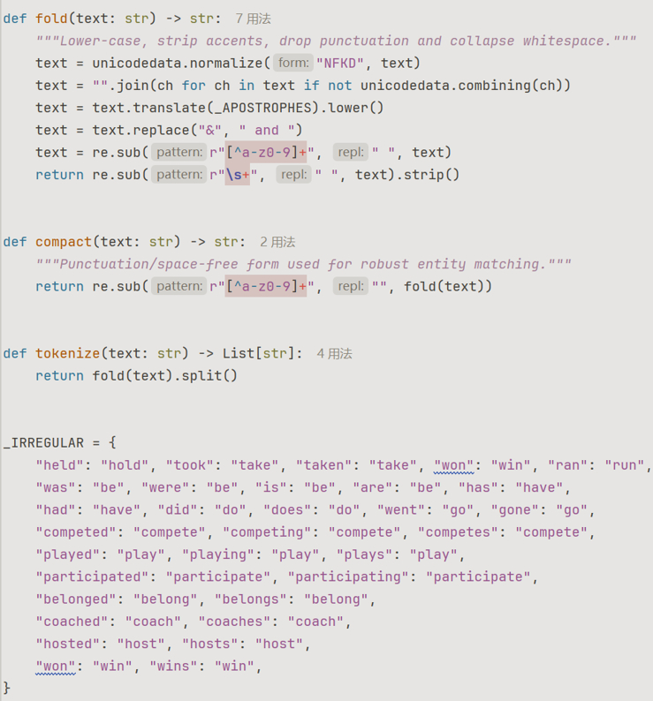
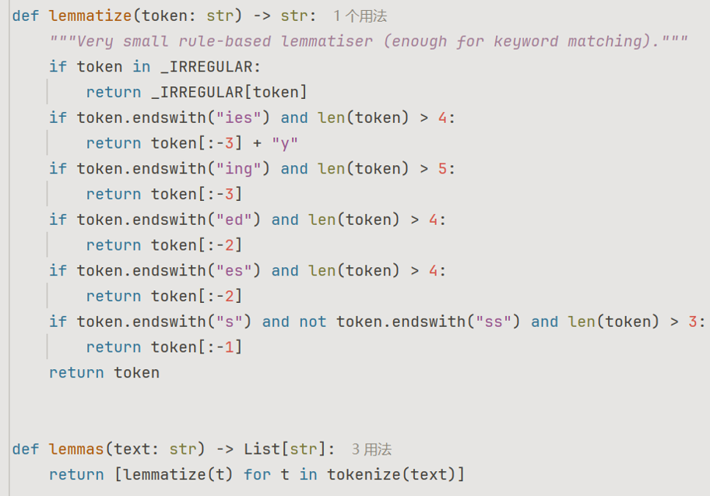
Lu Yifan | Code Explanation 1
Text preparation: normalization, tokenization and lemmatization.
01
NORMALIZATION
02
TOKENIZATION
03
LEMMATIZATION
25
Notes:
这一页替换为 Lu Yifan 新版内容：代码解释前三个步骤。截图来自用户提供的 Sports_Ontology_lyf(1).pptx 第 5 页，保留原有的归一化、分词与词形还原代码。

Slide 27
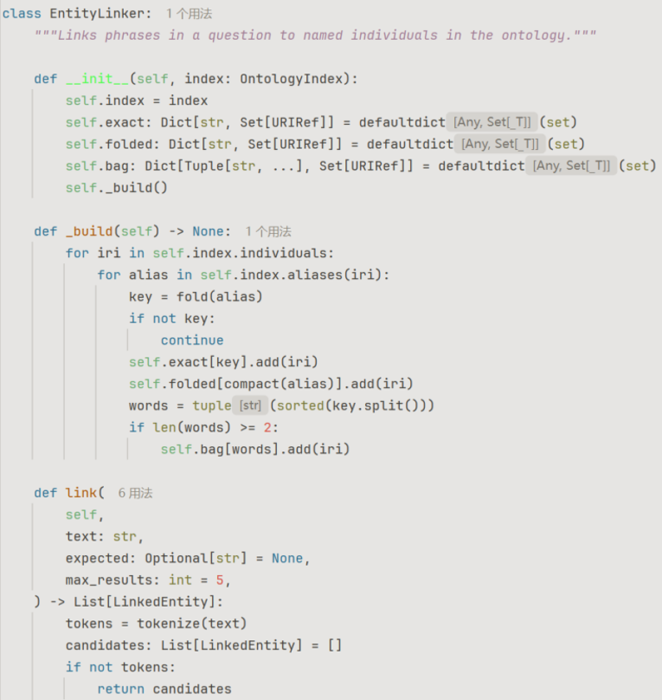
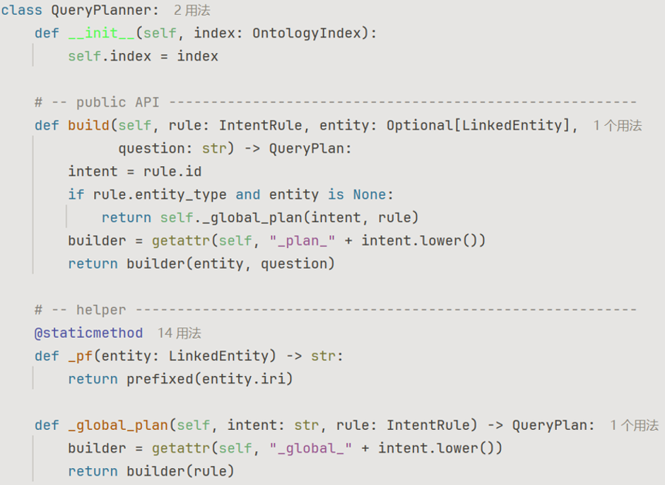
Lu Yifan | Code Explanation 2
Query construction: entity linking, triple decomposition and summarization.
04
ENTITY LINKING
05
DIVIDING TRIPLES
06
SUMMARIZING
26
Notes:
这一页替换为 Lu Yifan 新版内容：代码解释后三个步骤。截图来自用户提供的 Sports_Ontology_lyf(1).pptx 第 6 页，保留实体链接与查询计划代码。

Slide 28
Search, Equipment, Athletes, Matches and Leagues
Presenter: Yanming Gong / Student ID: W261802124
Yanming Gong / Search | Match | League
Assigned question set
ONTOLOGY AND DATA CONTRIBUTION
GENERAL / 2
Collected the questions and facts behind them: venues, equipment, athletes, coaches and league teams.
Verified all five results with RDFLib and co-built the OWL ontology with the team.
G07 Can this ontology help users find competition information?
G08 Can this ontology help users find sports equipment?
SPECIFIC / 3
S01 Which athletes compete in basketball?
S04 Who is the coach of a particular team?
S08 Which teams belong to a particular league?
Evidence: G07 13 results; G08 8 equipment items; S01 6 athletes; S04 1 coach; S08 5 NBA teams.
27
Notes:
Yanming Gong 的五个问题是 G07、G08、S01、S04、S08。其 RDFLib 验证结果数量依次为 13、8、6、1、5。

Slide 29
Yanming Gong question trace: venue, equipment and league evidence
Contribution: venues, equipment, athletes, coaches and league data. Evidence: RDFLib counts 13, 8, 6, 1 and 5.
Question | Ontology model | SPARQL route | NLP intent and handling
G07 Can this ontology help users find competition information? | Competition subtypes / venue, participants and result | Choose the requested venue, participant or result branch | competition_facets / 13 RDFLib results
G08 Can this ontology help users find sports equipment? | Sport / requires / SportsEquipment | Query the equipment edge | equipment_for_sport / 8 RDFLib results
S01 Which athletes compete in basketball? | Athlete / participatesIn / Basketball | Filter by Basketball and return athlete labels | athlete_by_sport / 6 RDFLib results
S04 Who is the coach of a particular team? | CoachingAssignment / assignmentCoach and assignmentTeam / dates | Bind team and return coach with assignment interval | team_coach_in_competition / 1 RDFLib result
S08 Which teams belong to a particular league? | SportsLeague / hasTeam / SportsTeam / inverse inLeague | Bind league and return its team labels | teams_in_league / 5 RDFLib results
28
Notes:
Yanming Gong 逐题：G07 查询赛事与场馆；G08 查询装备；S01 查询篮球运动员；S04 查询队伍教练；S08 查询联盟队伍。

Slide 30
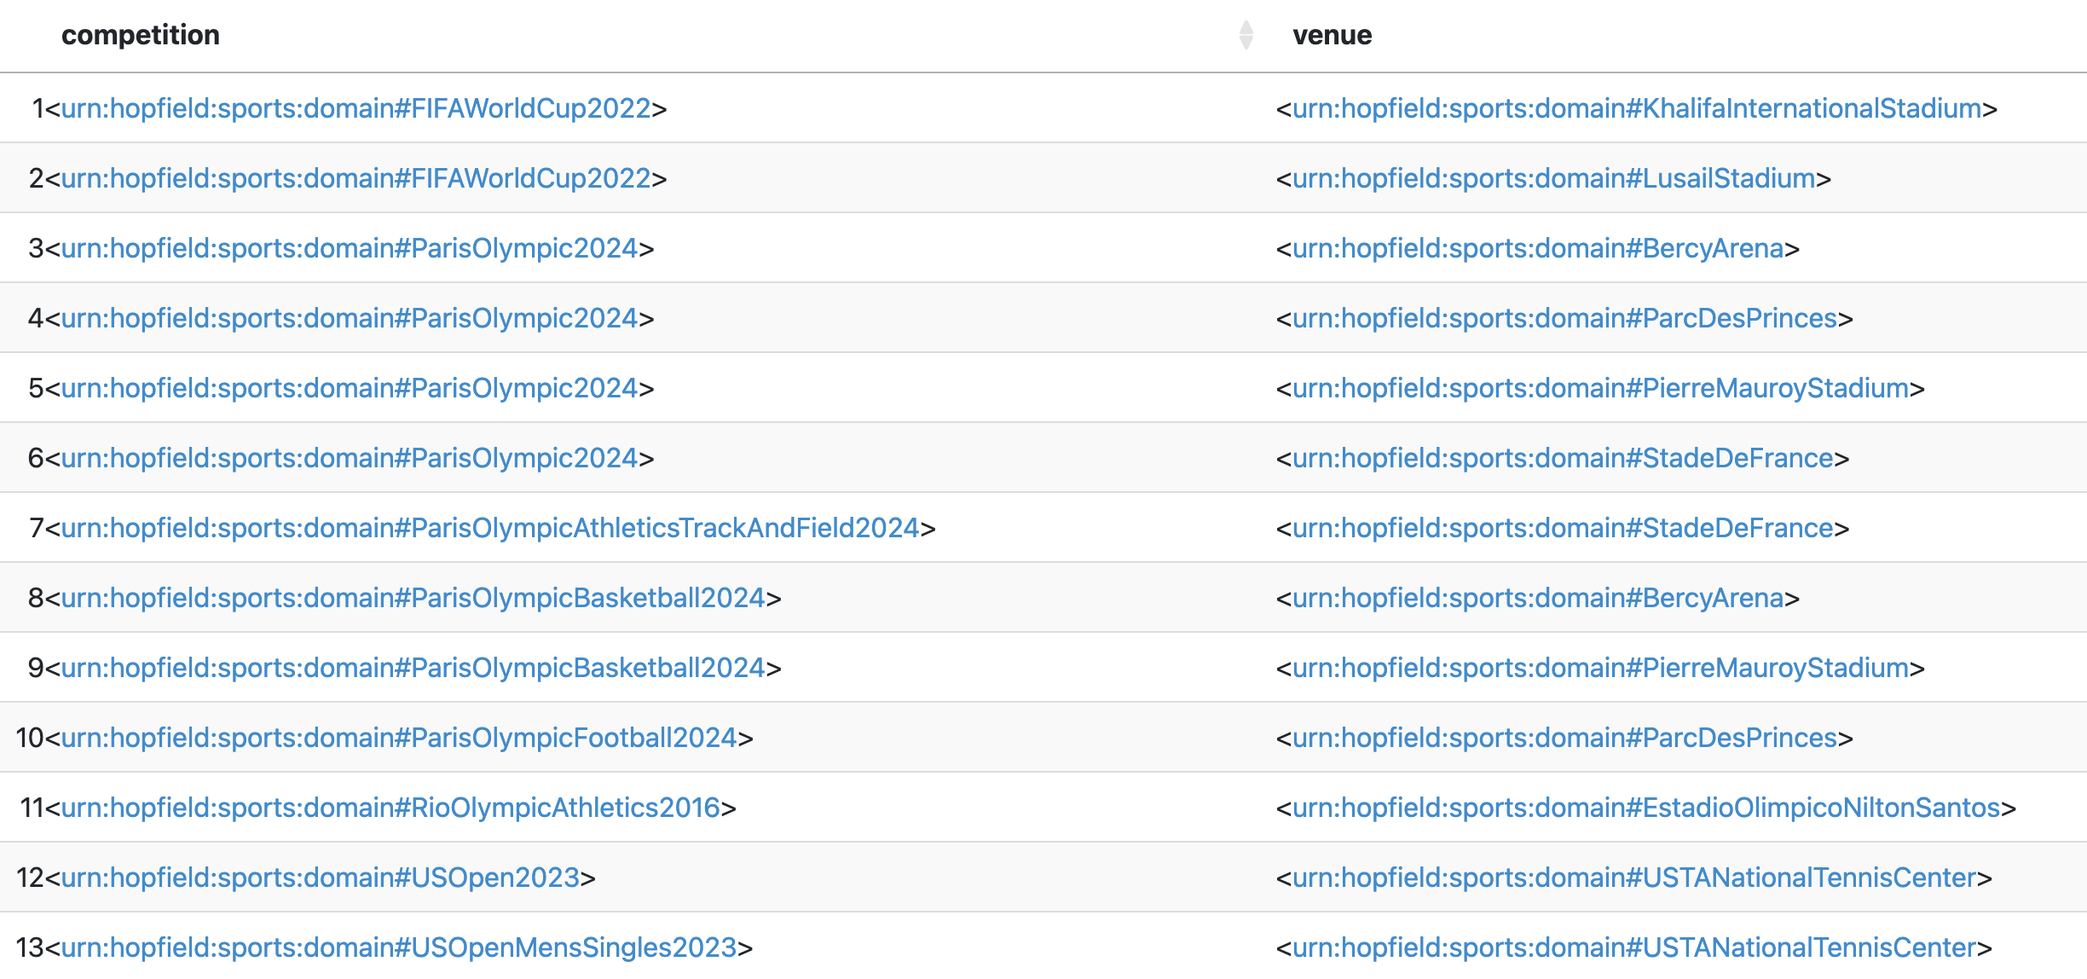
Yanming Gong | SPARQL Example 1: G07 hasRecordedVenue
PREFIX sports: <urn:hopfield:sports:domain#>
SELECT ?competition ?venue WHERE {
?competition sports:hasRecordedVenue ?venue .
}
ORDER BY ?competition
What it retrieves
Can this ontology help users find information about competitions?
Example output
29
Notes:
1:20-1:45. Explain the three links: instance type, sport participation and current team.
The query uses class and property names from the current OWL file. Results come from declared memberOf statements.

Slide 31
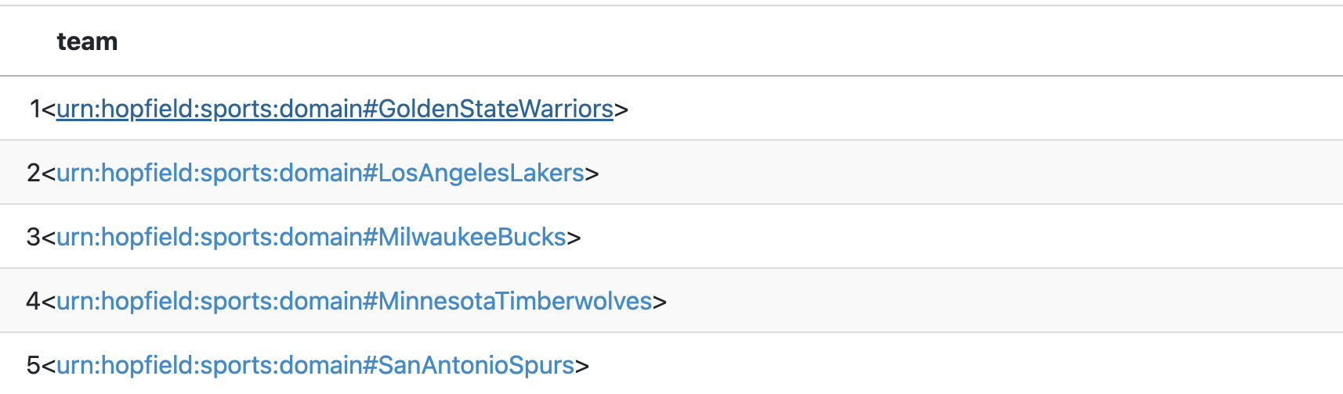
Yanming Gong | SPARQL Example 2: S08 hasTeam
PREFIX sports: <urn:hopfield:sports:domain#>
SELECT ?team WHERE {
?league a sports:SportsLeague ;
sports:hasTeam ?team .
FILTER(?league = sports:NBA)
}
ORDER BY ?team
What it retrieves
List teams linked to a league via hasTeam
Example output
30
Notes:
1:45-2:20. The final OWL models competitions and match results separately, so the query joins Competition, Venue, Match and MatchResult.
FIFAWorldCup2022 has two recorded venues in the current file, so the example uses GROUP_CONCAT. State any venue filter explicitly in a live demo.

Slide 32
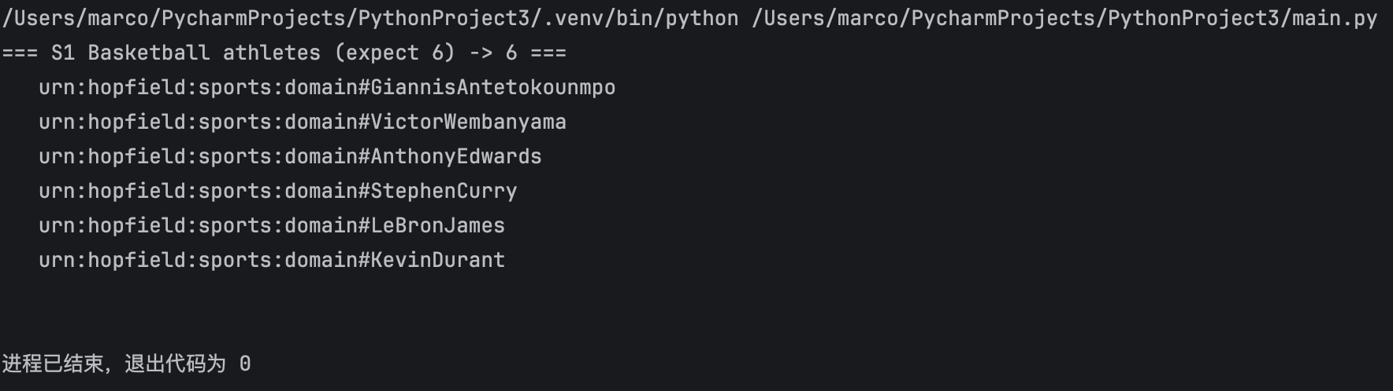
Yanming Gong | Python NLP Query Pipeline
Result:
AnthonyEdwards, GiannisAntetokounmpo, KevinDurant, LeBronJames, StephenCurry, VictorWembanyama (6)
LIVE DEMO
Which athletes play basketball?
Entity: Basketball
Intent: retrieve the athletes of a sport
PREFIX = "PREFIX sports: <urn:hopfield:sports:domain#> "
queries = {
"S1 Basketball athletes (expect 6)": """
SELECT ?athlete WHERE {
?athlete a sports:Athlete ;
sports:participatesIn sports:Basketball .
}""",
}
for name, q in queries.items():
rows = list(g.query(PREFIX + q))
print(f"=== {name} -> {len(rows)} ===")
for r in rows:
print(" ", " | ".join(str(x) for x in r))
print()
13
31
Notes:
2:20-3:30. Demonstrate the prototype with the natural-language input, entity recognition, generated SPARQL and result table.
Suggested demos: which sport Messi plays, and the score of the 2022 World Cup final. The second case exercises the match-result template.

Slide 33
Analyst Access, Reasoning and Data Quality
Presenter: Li Wenhan / Student ID: W261802107
Li Wenhan / Analyst | Reasoning | Validation
Assigned question set
ONTOLOGY AND DATA CONTRIBUTION
GENERAL / 2
Checked SportsAnalystRole, venue navigation, OwlReasoningCapability and SHACL validation coverage.
Separated query evidence, structural validation and reasoner-dependent conclusions.
G04 How can sports analysts use this ontology?
G10 How can reasoning improve the use of this ontology?
SPECIFIC / 3
S09 Which competitions take place at a particular venue?
S13 Is an athlete linked to a team that does not exist in the ontology?
S15 Can the ontology detect contradictory sports information?
Evidence: S09 returns FIFAWorldCup2022; S13 returns 0 rows as expected. SHACL source check passes; HermiT is pending.
32
Notes:
Li Wenhan的五题总览：G04与G10来自应用层，S09属于领域层反向路径，S13与S15属于质量验证层。

Slide 34
Li Wenhan question trace: analyst use, reasoning and validation
Contribution: analyst access, venue navigation, OwlReasoningCapability and SHACL validation. Evidence: S09 is executed; S13 is validated; HermiT consistency remains pending.
Question | Ontology model | SPARQL route | NLP intent and handling
G04 How can sports analysts use this ontology? | SportsAnalystRole PerformanceAnalysisBenefit TeamComparisonInformation | Return canAnalyze and the linked comparison catalogue | role_capability Entity: SportsAnalystRole Mapped
G10 How can reasoning improve the use of this ontology? | OntologyResource supports OwlReasoningCapability subclass, inverse, characteristics | Expose the capability path; run inference separately | reasoning_explanation State asserted versus inferred evidence
S09 Which competitions take place at a particular venue? | Venue hosts Competition or inverse hasRecordedVenue | Bind venue and traverse the inverse competition path | competitions_at_venue Entity: venue Executed: 1 competition
S13 Is an athlete linked to a team that does not exist in the ontology? | TeamMembership membershipTeam must resolve to SportsTeam | FILTER NOT EXISTS the required team type | integrity_missing_team Executed as Q10: expected 0 rows
S15 Can the ontology detect contradictory sports information? | 12 SHACL NodeShapes OWL disjointness functional constraints | Run SHACL for structure; run a reasoner for logical consistency | consistency_check SHACL pass and controlled violation HermiT pending
33
Notes:
Li Wenhan逐题映射：G04走分析能力；G10走推理能力说明；S09走Venue到Competition的反向属性；S13找悬空队伍类型；S15组合SHACL与OWL一致性检查。

Slide 35
Li Wenhan's five questions: three evidence routes
The route changes with the answer type: application capability, domain traversal or data-quality validation
G04 Sports analyst use
G10 Reasoning value
SportsAnalystRole
usesOntologyFor / canAnalyze
OwlReasoningCapability
Application-layer SELECT
plus reasoner explanation
Capability statement
with evidence status
01
APP LAYER
S09 Competitions at a venue
Venue [hosts] Competition
inverse of hasRecordedVenue
Inverse traversal
OPTIONAL final-match fields
Competition list
from recorded venues
02
DOMAIN
S13 Missing team target
S15 Contradictory data
TeamMembership
SportsTeam type contract
OWL axioms and 12 SHACL shapes
FILTER NOT EXISTS
SHACL and reasoner branch
Pass, issue or pending
with explicit boundary
03
QUALITY
One NLP router can support Li Wenhan's five questions, but it must select the correct evidence engine before it returns an answer.
34
Notes:
这一页把Li Wenhan的五题压缩成三条证据路线：应用能力、领域遍历和质量验证。NLP路由系统会根据答案类型选择工具。

Slide 36
SPARQL flow 1: From a venue to competitions and the final match
Li Wenhan / S09: combines an inverse property path, optional enrichment and ordered output rather than a single-hop lookup
PREFIX hs: <urn:hopfield:sports:domain#>
PREFIX rdfs: <http://www.w3.org/2000/01/rdf-schema#>
SELECT ?competition ?competitionLabel ?finalLabel
?homeScore ?awayScore ?resultText
WHERE {
?competition ^hs:hasRecordedVenue hs:LusailStadium ;
rdfs:label ?competitionLabel .
OPTIONAL {
?competition hs:finalMatch ?match .
?match hs:homeTeam ?homeTeam ;
hs:awayTeam ?awayTeam ;
hs:homeScore ?homeScore ;
hs:awayScore ?awayScore ;
hs:hasResult ?result .
?result hs:resultText ?resultText .
?homeTeam rdfs:label ?homeTeamLabel .
?awayTeam rdfs:label ?awayTeamLabel .
BIND(CONCAT(?homeTeamLabel, " vs ", ?awayTeamLabel)
AS ?finalLabel)
}
}
ORDER BY ?competitionLabel
01 ANCHOR
Resolve the venue IRI from its label or alias.
02 INVERSE PATH
Use ^hasRecordedVenue to start from Venue and reach Competition.
03 OPTIONAL ENRICHMENT
Add final-match teams, typed scores and result text without dropping competitions with no final.
Current evidence: executed with RDFLib and the v3.0 OWL file; returns FIFAWorldCup2022.
35
Notes:
SPARQL流程一：从Lusail Stadium出发，通过hasRecordedVenue的反向路径找赛事，再用OPTIONAL补充决赛队伍、数值比分和结果文本。重点是多跳和可选分支。

Slide 37
Li Wenhan | Python demo: S09
Which competitions take place at Lusail Stadium?
One natural-language question is resolved, converted to SPARQL and executed end to end with RDFLib.
Python query
Execution path
01 RESOLVE ENTITY
LusailStadium
from rdflib import Graph
question = "Which competitions take place at Lusail Stadium?"
g = Graph()
g.parse(OWL_FILE, format="xml")
query = """
PREFIX hs: <urn:hopfield:sports:domain#>
PREFIX rdfs: <http://www.w3.org/2000/01/rdf-schema#>
SELECT DISTINCT ?competitionLabel
WHERE {
?competition hs:hasRecordedVenue hs:LusailStadium ;
rdfs:label ?competitionLabel .
}
"""
rows = g.query(query)
print([str(r.competitionLabel) for r in rows])
02 SELECT INTENT
competitions_at_venue
03 EXECUTE
RDFLib + SPARQL / 1 result
Actual output
Competition | Recorded venue
FIFAWorldCup2022 | Lusail Stadium
Answer: FIFAWorldCup2022 is recorded at Lusail Stadium. Status: one question executed on the v3.0 OWL file.
36
Notes:
这一页紧跟 S09 的 SPARQL 流程，用 RDFLib 对一个真实问题做端到端演示：先把 Lusail Stadium 解析为实体，再选择 competitions_at_venue 意图，执行 SPARQL，最后得到 FIFAWorldCup2022。强调这是当前本体 v3.0 文件上的一次实际执行结果。

Slide 38
NLP pipeline for Li Wenhan's five questions
The intent router chooses an application query, a domain traversal, or a validation tool before execution
TEXT
Normalise, tokenise,
remove stopwords,
lemmatise
ONTOLOGY NER
Longest match over
labels, aliases and
individual names
INTENT ROUTER
Role capability
Venue search
Integrity check
SLOT FILLING
Resolve IRIs and
literal filters;
ask if ambiguous
TOOL SELECT
SPARQL, SHACL
or reasoner
by intent
GROUNDED REPLY
Rows, violations,
path and evidence
status
Question | Recognised entity | Intent and tool | Response boundary
G04 | SportsAnalystRole | role_capability SPARQL application path | Declared capability and target
G10 | OwlReasoningCapability | reasoning_explanation Capability path plus reasoner | Asserted versus inferred
S09 | Venue label or IRI | competitions_at_venue Inverse SPARQL path | Recorded competitions only
S13 | Team and membership | integrity_missing_team FILTER NOT EXISTS | Empty result covers tested check
S15 | Consistency request | consistency_check SHACL plus reasoner | Pass, issue or pending
Li Wenhan's pipeline must surface uncertainty: unsupported intents are refused, ambiguous entities trigger clarification, and validation results keep structural and logical checks separate.
37
Notes:
这是Li Wenhan五题的NLP管线：先识别竞技分析、推理、场馆、完整性或一致性意图，再选择SPARQL、SHACL或reasoner。返回答案时必须同时显示路径和证据状态。

Slide 39
Tests for Li Wenhan's five questions
The evidence states distinguish validated routes, mapped routes, partial component evidence and deferred reasoning
2
Validated
S09, S13
1
Mapped
G04
1
Partial
S15
1
Deferred
G10
Question | Route | Observed evidence | Interpretation
G04 | SportsAnalystRole to capability | Application assertions and route mapping | Mapped; no dedicated G04 execution
G10 | Capability plus OWL reasoning | OWL declarations recorded; HermiT unavailable | Deferred; do not claim a consistency verdict
S09 | Venue inverse hasRecordedVenue | Executed with RDFLib using one venue filter | Validated; returns FIFAWorldCup2022
S13 | FILTER NOT EXISTS TeamMembership check | Q10 returned 0 rows in RDFLib and Fuseki | Validated for the tested type rule
S15 | SHACL plus OWL consistency | Source graph conforms; fixture fails as designed | Partial; structured checks work, logic verdict pending
S09 and S13 now have executed evidence. G04 remains mapped, G10 is deferred and S15 is partial until a compatible reasoner run is preserved.
38
Notes:
Li Wenhan的五题测试：S13已验证；G04和S09仅有映射证据；S15为部分证据；G10因HermiT兼容性而延期。答辩时不要把这些题都说成已经端到端执行。

Slide 40
Li Wenhan's limitations and next steps
Two evidence gaps remain in my work: G04 and reasoner-backed checks; S09 and S13 now have executed evidence.
My limitations
My improvements
01 G04 is mapped only. I have not preserved an end-to-end query result for analyst capability.
02 G10 and S15 are incomplete. HermiT rejected xsd:date values, so I cannot yet demonstrate inferred facts or an OWL consistency verdict.
01 Produce a reproducible G04 case: question, generated SPARQL, returned capabilities and expected answer.
02 Test a date-compatible reasoner profile on valid and contradictory fixtures; label asserted versus inferred results and keep SHACL separate.
40
Notes:
这一页只保留 Li Wenhan 个人工作的两项主要不足。S09 已经通过新增的 Python 实操页完成端到端执行，S13 已验证；仍需补齐 G04 的可复现查询证据，以及 G10、S15 所需的兼容日期类型推理器结果。

Slide 41
MIDTERM STATUS
A traceable ontology, mapped questions and a working prototype
01
Ontology baseline
63 classes, 79 modeling properties and 241 individuals
02
Traceability
All 25 questions have ontology routes; 11 have dedicated query or validation evidence
03
Next milestone
Complete the NLP and reasoner regression, then capture final defence evidence
Questions & feedback
42
Notes:
总结：已经具备可讲解的本体、25题追溯和可运行原型。下一步集中完成全题NLP回归、推理器证据和最终答辩材料。

