Slide 1

Term Project
UniGrade_Gachon | for every grade
201935001 강건영
201935021 김수경
201935023 김수현
201931418 전종민

Slide 2
INDEX
01 Motivation
04 Error During Implementation
02 Algorithm
05 Role
03 Video
06 Realization

Slide 3
01
Motivation
While studying for the test,
we wondered which subject we should take first
for the rest of period to get good grades
so, we made a program that organizes an efficient study sequence
that can maximize grades over a short period of time

Slide 4
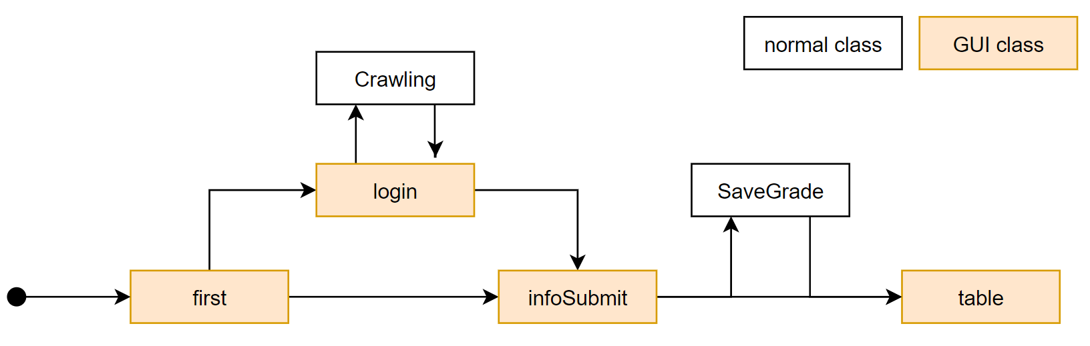
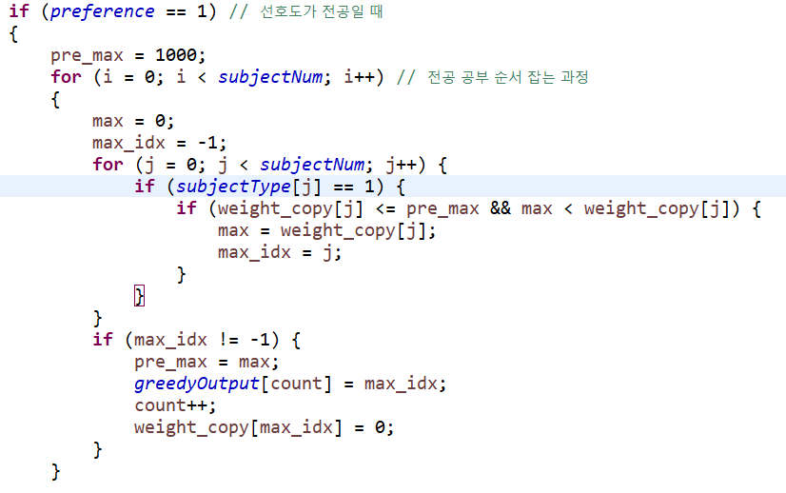
02
Algorithm
Using Greedy

Slide 5
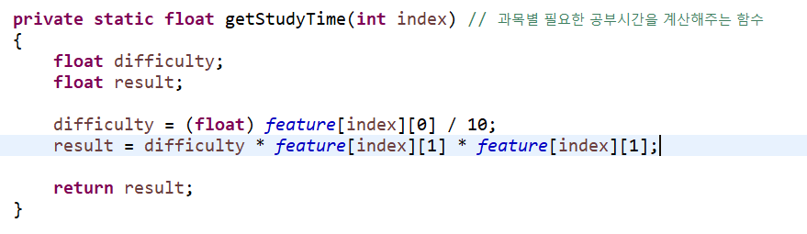
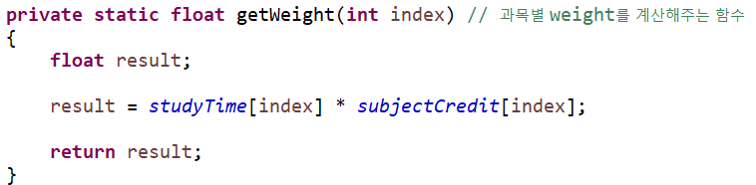
02
Algorithm - Greedy
Input
1. Number of credits by subject, difficulty level, ppt amount
2. Enter exam schedule by subject
- the date of the examination by subject
- taking a test in the order of the date
3. Select preferences for culture or major
Using Greedy algorithm, we use weight
required study time per subject * number of credits

Slide 6
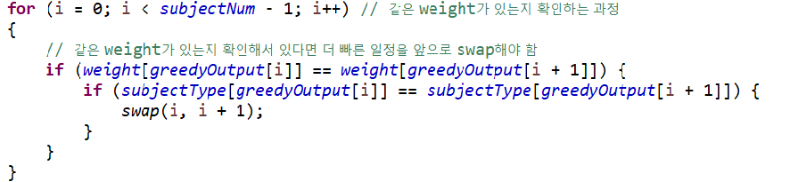
02
Algorithm - Greedy
Output
Liberal Arts
Major
1. If you select Major
2. Start subjects which is highest weighting
( If there is same weight, ealier exam schedule is selected )
Algorithm > Computer Programming > DataBase
3. Likewise major, Liberal Arts also same

Slide 7
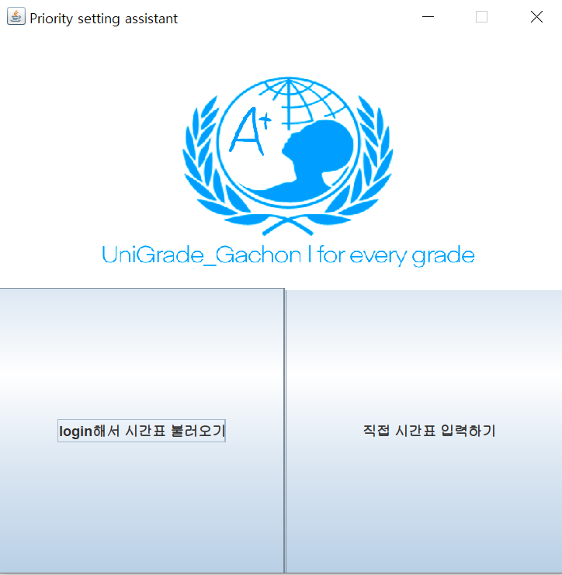
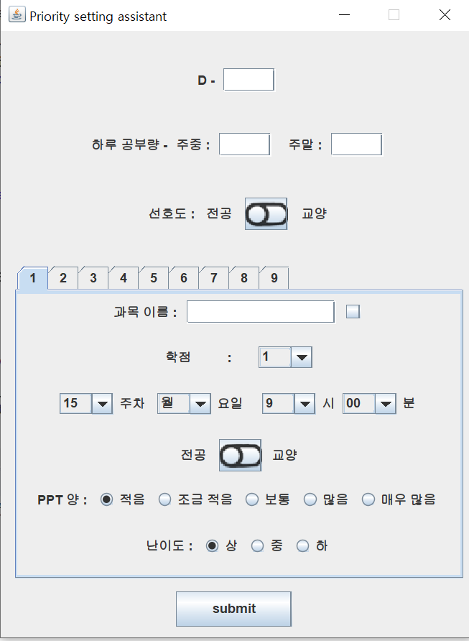
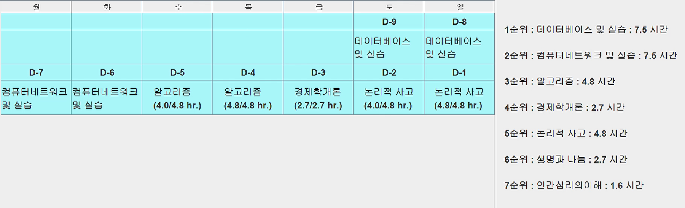
02
Algorithm - GUI
output

Slide 8
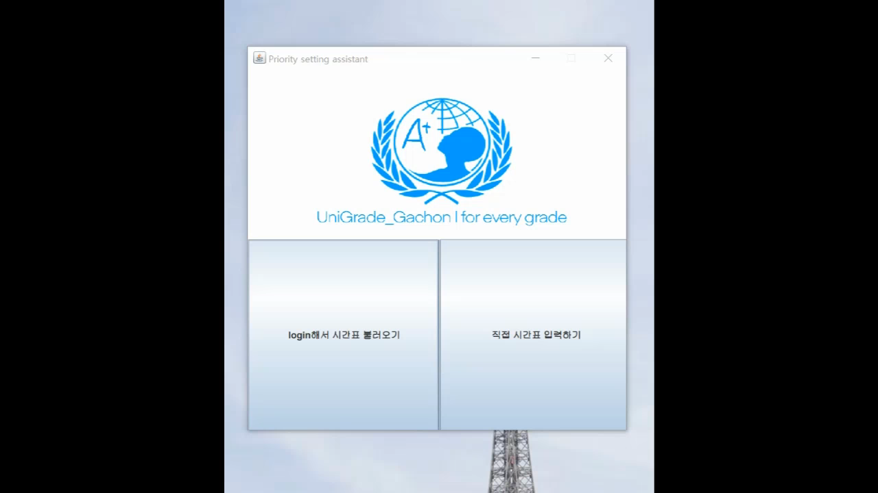
03
Video

Slide 9


04
Error During Implementation
Variable Setting Error
Print Wrong Output
SaveGrade’s code
input GUI
input variables incorrectly connected
Communication Problems
As the output we expected did not come out, we analyzed the code again and found the cause.
Again, send algorithm to team member who take on Output, we solve this problem
Communication is important in team

Slide 10
05
Role
Kang Gun Young
Implement SaveGrade code’s algorithm and a function
to obtain the weight and studyTime required by Greedy algorithm
Kim Su Gyeong
Implement swap function and input receiving function
Kim Su Hyeon
Implement intput GUI and
part where crawling timetable on the school website when log in
Jeon Jong Min
Implement output GUI with JTable and Label

Slide 11
06
Realization
By making elements of the project one by one, I could learn and experience a lot of major knowledge from each other.
It was a good experience because my coding ability was much better
than when I was alone.
Kang Gun Young
Kim Su Gyeong
I learned more by implementing algorithms together as a team.
And I think this experience will be very helpful when I go into society.
Through communication and division of labor, I could feel the joy of collaboration. It was refresh to apply to a problem you can think of, not to solve a common coding test problem.
Kim Su Hyeon
Jeon Jong Min
Through this opportunity, I was happy to have the experience of implementing algorithms that I thought with my team members in a visible way through Java.

Slide 12
THANK YOU!

