Slide 1
Team project - first proposal
Team 5
201931418 전종민
201935001 강건영
201935021 김수경
201935023 김수현

Slide 2
Motivation
As I listen to the lecture and do my homework, the exam period is coming soon.
There are many subjects to study for the exam, but there is not enough time.
Which subject should I study first to get credit by studying efficiently?

Slide 3

Goal
"With only a week left until the exam period, which subject should I study first to make the most of my grades?“
a program that organizes an efficient study sequence that can maximize grades over a short period of time.

Slide 4


Programing language
or

Slide 5
Algorithm
Motive : (Greedy algorithm) Fashionable dressmaker's problem
Input :
Amount of test study by subject
credits by subject
exam schedule
career field
liberal arts or major preference
Output :
efficient study sequence
Option :
career field => Prioritize major subjects

Slide 6
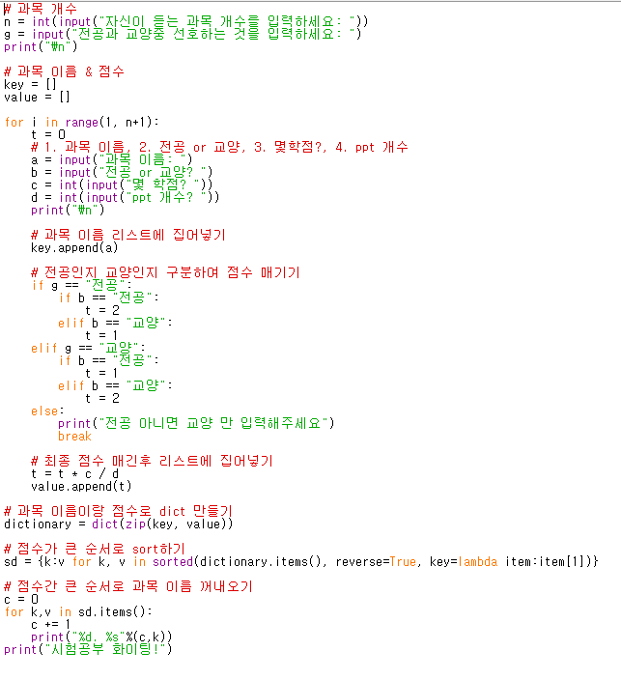
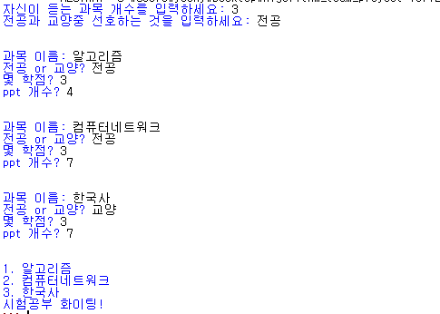
Prototype
Code
result

Slide 7
Thank you for your attention

