Slide 1
CSS 422 Hardware and Computer Organization
Computer Arithmetic
Professor: Yang Peng
The slides are re-produced by the courtesy of
Dr. Arnie Berger and Dr. Wooyoung Kim

Slide 2
Topic
Computer Arithmetic
IEEE floating point
Chapter 2.4, 2.5 (Null)

Slide 3
How to represent a real number in binary?

Slide 4
From Real to Binary Numbers
Let’s convert decimal number 3.8125 to a binary number
Integer part: the same as the integer binary 11₂ = 3
Fractional part:
Multiply the fraction by two
Write down the integer part on right
Repeat 1 and 2 until there is no fractional part on left
Read the integer part on right, from top to bottom
0.8125 * 2 = 0.625 + 1
0.625*2 = 0.25 + 1
0.25 *2 = 0.5 + 0
0.5*2 = 0.0 + 1
0.0 STOP HERE
3.8125₁₀ = 0011.1101₂

Slide 5
From Binary to Real Numbers
Binary I_{m}I_{m-1}…I₁I₀.F₁F₂F₃…F_{n-1}F_{n} =
Decimal I*2^{m} + I*2^{m-1} + … + I*2⁰ + F*2⁻¹ + F*2⁻²
+ … + F*2^{-(n-1)} + F*2^{-n}
10.101₂ = 1*2¹ + 0*2⁰ + 1*2⁻¹ + 0*2⁻² + 1*2⁻³
= 2 + 0.5 + 0.125 = 2.625

Slide 6
Real Numbers and Errors
Many fractions are repeating infinitely
E.g., convert 0.6 to binary
0.6 * 2 = 0.2 -----1
0.2 * 2 = 0.4 -----0
0.4 * 2 = 0.8 -----0
0.8 * 2 = 0.6 -----1
0.6 * 2 = 0.2 -----1
0.2 * 2 = 0.4 -----0
0.4 * 2 = 0.8 -----0
0.8 * 2 = 0.6 -----1
So, 0.6 → 0.1001100110011001….. (will be repeated infinitely)
Integer

Slide 7
Rounding and Truncation
Keep the number of bits finite
Truncation: The simplest technique – just drop unwanted bits
E.g., 0.1101101 → 0.1101
Rounding: Better technique, but a bit complicated
If the value of the lost digits is greater than half of the least-significant bit of the retained digits, add 1 to the LSB; otherwise drop.
E.g., 0.1101101: If I want to lose the last three bits, what shall I do?
0.1101101 = 0.1101 + 0.0000101
→ 0.1101 + 0.0001
= 0.1110
LSB of retained digits: 0.0001 = 2⁻⁴
Lost digits: 0.0000101 = (2⁻⁵+ 2⁻⁷) > 2⁻⁴ / 2

Slide 8
How to represent a real number in a computer system?

Slide 9
Real Numbers in a Computer System
Two main approaches: Fixed-point vs. Floating-point
Fixed-point representation (NOT used now)
Divide the bits into integer part and fraction part
The “Point” is fixed
Easier but less flexible
Floating-point representation (IEEE standard)
Divide the bits into sign, exponent and mantissa
The “Point” is floating
Match with scientific notation
Flexible but more complex

Slide 10
Fixed-Point Representation
Fixed-point representation
Divide the bits for integer part and fraction part
For example, 3.625₁₀ = 11.101₂
Not flexible
What if you really need to represent 1.984 * 10⁽⁻¹²³⁾ in computer?
How many bits will be needed? ( more than 372 bits)
0 | 0 | 1 | 1 | 1 | 0 | 1 | 0
Integer part
Fractional part

Slide 11
Floating-Point Representation
Floating-point representation
Divide the bits into sign, exponent and mantissa
IEEE floating-point format
IEEE short real or single precision: 32 bits
IEEE long real or double precision: 64 bits
Sign (1) | Exponent (8) | Mantissa(23)
Sign (1) | Exponent (11) | Mantissa(52)

Slide 12
Floating-Point Representation
- Single Precision
Steps to convert a real number to IEEE Single Precision floating-point representation
Convert decimal to binary
Normalize: moving the point left or right
Add 127 to the exponent
Mantissa is the one after the floating point in the normalized form
If the mantissa part is less than 23 bits, add zeros at the end
Put the corresponding numbers into each field
IEEE Floating point converter:
http://babbage.cs.qc.cuny.edu/IEEE-754.old/Decimal.html

Slide 13
Floating-Point Representation
- Single Precision
32-bit (single precision) format
Let’s represent a real number to floating-point format
E.g., -3.8125₁₀
= -11.1101₂ (note that the integer part is not 2’s complement)
= -1.11101*2¹ (normalize: scientific notation)
Sign bit = 1, because this is a negative number
Exponent bits = 1 + 127 (biased) = 128 = 10000000₂
Mantissa bits: 111 0100 0000 0000 0000 0000
Therefore, the real number in floating-point representation is:
1 100 0000 0 111 01 00 0000 0000 0000 0000₂ = $C0740000
Sign (1) | Exponent (8) | Mantissa(23)

Slide 14
Floating-Point Representation
- Single Precision
Normalization
“1” shall always appear as an integer part
No need to represent this bit in the format -> save one bit
Biased exponent
The exponent has 8 bits, meaning it can range from -127 to 127 (Here we assume that -128 will never appear).
Therefore, if we add 127 to the exponent, it will always be a non-negative number.
Assuming such a representation, 0~254 is then available for the exponent filed. How about 255?

Slide 15
Floating-Point Representation
- Double Precision
Steps to convert a real number to IEEE Double Precision floating-point representation
Convert decimal to binary
Normalize: moving the point left or right
Add 1023 to the exponent
Mantissa is the one after the floating point in the normalized form
If the mantissa part is less than 52 bits, add zeros at the end
Put the corresponding numbers into each field
IEEE Floating point converter:
http://babbage.cs.qc.cuny.edu/IEEE-754.old/Decimal.html

Slide 16
Floating-Point Representation
- Double Precision
64-bit (double precision) format
Let’s represent a real number to floating-point format
E.g., -3.8125₁₀
= -11.1101₂ (note that the integer part is not 2’s complement)
= -1.11101*2¹ (normalize: scientific notation)
Sign bit = 1, since negative
Exponent = 1 + 1023 (biased) = 1024 = 100 0000 0000₂
Mantissa: 1110 1000 0000 0000 0000 0000 0000 0000 0000 0000 0000 0000 0000
Therefore in floating-point representation,
1 100 0000 0000 1110 1000 0000 0000 0000 0000 0000 0000 0000 0000 0000 0000 0000₂ = $C00E800000000000
Sign (1) | Exponent (11) | Mantissa(52)

Slide 17
More about real numbers
Why using biased exponent?
Effect: changing negative exponent value to positive value
Motivation: for quick comparison (bit-by-bit) of two real numbers
Why adding 127 for single-precision floating numbers?
Effect: positive numbers in the rage of 0 to 254
Motivation: reserve 255 for special number usage

Slide 18
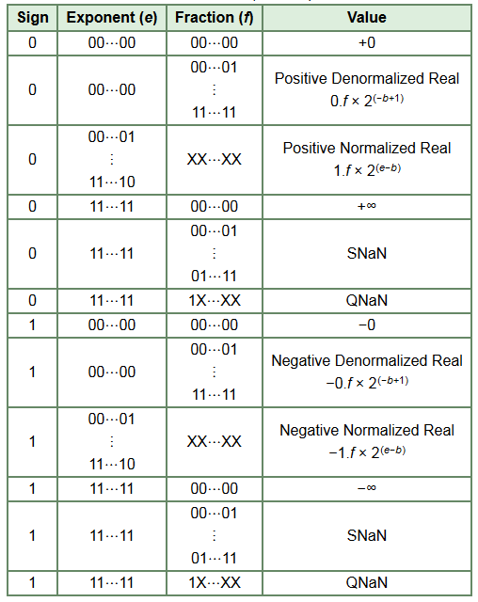
NaN: Not A Number
QNaN: Quiet NaN
generated from an operation when the result is not mathematically defined
denote indeterminate operations
SNaN: Signaling NaN
used to signal an exception when used in operations
can be to assign to uninitialized variables to trap premature usage
denote invalid operations

