Slide 1
CSS448 – Introduction to Compilers
Admin
Languages and Compilers
Why study Compilers?
LetsCode – Build a simple calculator
Compilers: from 30,000 feet
A Little History
Compilers: from 1,000 feet
Class Project

Slide 2
Admin
Course
CSS 448 “Introduction to Compilers”
Instructor: Jim Hogg
jimhogg@uw.edu
Classes
08:45 – 10:45, Tuesdays and Thursdays, in UW2 031
Office Hours
11:00-12:00 (after class) Tuesdays and Thursdays, or by appointment
Truly House
Assignments
9 Homeworks + 4 Projects - due date always a Sunday, by midnight
Mid-term Exam + Final Exam
Schedule
See Canvas Calendar. (Also Canvas|Files|Schedule.docx)

Slide 3
More Admin
Communication: we will use Canvas for everything – Lecture slides, homework, project, announcements, grading, etc
We shall cover:
Practice (Build our own interpreter, for the simple language Tog)
Theory (Regex, FSMs, Grammars, BNF, Recursive-Descent, ASTs, Calling Conventions, Stack Frames, Register Allocation, Optimization)
Help yourselves by:
Asking questions at any time; don’t delay, thinking it will all fall into place: it won't
Ask me to go slower (or faster)
Come to Office Hours
Read along in a textbook, or online
Learn by Doing: write code and experiment
Participation is not mandatory

Slide 4
Assumptions
Some experience in Linux/Unix
Some experience in C
Optional, but highly recommended: using an IDE (eg: Code::Blocks) and interactive debugger
Data structures & algorithms: arrays, trees
Assembly-level programming for any machine. But we will cover what's needed
You can fill in any gaps during the course: allow a little extra time for this

Slide 5
Things We All Know?
bit, byte, word, dword, qword
binary, hex
signed / unsigned integer
floating-point numbers
Multiples of Byte
1000 kilobyte kB
1000² megabyte MB
1000³ gigabyte GB
1000⁴ terabyte TB
1024 kibibyte KiB
1024² mebibyte MiB
1024³ gibibyte GiB
1024⁴ tebibyte TiB

Slide 6
Grading
Tentative: this may change
Homework H01-H09 30%
Project P01-P04 40%
Mid-Term Exam 2 hours 15%
Final Exam 2 hours 15%

Slide 7
Who Am I?
Jim Hogg
Part-time Lecturer
Previous
Microsoft: .NET and C++ Compiler Redmond 20 years
Digital (DEC): VMS Operating System Edinburgh 12 years
Oil Exploration Software London 4 years
Computational Physics London 6 years
BSc Physics, MSc Computer Science

Slide 8
Books, etc

Slide 9
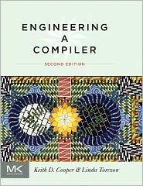
Books
The lectures will cover everything we need. But here is a good text that aligns with CSS-448. It covers much more than we will need
Engineering a Compiler
Cooper & Torczon; 2e; 2011
Solid; understandable; practical advice

Slide 10
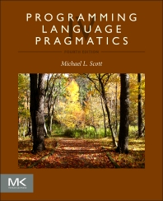
Books
Another book that covers computer languages, as well as their compilers.
(Note: the Kindle version mostly works)
Programming Language Pragmatics
Michael Scott; 4e; 2016
Excellent book, covering Languages and Compilers

Slide 11
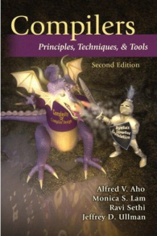
Books
Perhaps the most famous book on Compilers. Beautifully crafted, but broader and deeper than we will need.
Compilers: Principles, Techniques and Tools
Aho, Lam, Sethi, Ullman; 2e; 2011;
“The Dragon Book”
A Classic

Slide 12
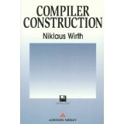
Books, continued
Compiler Construction
Wirth; 1996 (Turing Award Winner; invented “Pascal”)
“A refreshing antidote to heavy theoretical tomes”
Now free, from: http://www.ethoberon.ethz.ch/WirthPubl/CBEAll.pdf

Slide 13
Alternative Reading
The Lectures will cover everything we need. But, it’s sometimes helpful to see alternate descriptions. Here are a couple of good, online, free tutorials:
Crafting Interpreters. An excellent, humorous, gentle-but-precise, hands-on introduction to interpreters (which share many features of compilers), by Bob Nystrom (Google Dart team). Two interpreters for the invented “Lox” language – “jlox” in Java, and “clox” in C.
Let’s Build a Compiler, by Jack Crenshaw, 1988. “Seat-of-the-Pants” approach. Practical. Written in Pascal, targeting 68k assembler.

Slide 14
Programming Setup
We will use Linux for coding. You can use UWB’s Linux Cluster. Or your own computer.
See https://github.com/pisanorg/w/wiki/css-linux-lab for how to start
For Demos, I am using either 64-bit Ubuntu Linux, or Windows-10, on my laptop.
For C development, I will use Code:Blocks IDE, and gcc compiler. (Both are available, free, for Linux, Mac and Windows. Running Code::Blocks on Linux or Windows, in my experience, behaves identically)
For any assembly programming, I will use yasm. (Available free, for Linux, Mac and Windows)
Note: you can develop the project, and homeworks, on Mac or Windows. But if any of the projects, or homework, asks for a program that runs, then it must run on Linux.

Slide 15
Compilers are ...

Slide 16
What is a Compiler?
A program that translates one language into another language
Examples:
C into x86 machine code
Java into Bytecode
French to Finnish (using Google Translate)
Tog into x64 assembly code
int main() {
printf(“hello”);
}
gcc
001101011001010001101010010111010001110011.......

Slide 17
Terminology
Compiler
Source Language
Implementation Language
Target Language
Source | Implementation | Target
C++ | C | x86 assembler
Pascal | Pascal | pcode
Tog | C | x64 assembler
Fortran | BAL | IBM machine code

Slide 18
What is a JIT Compiler?
prog.java
Compiler
prog.class
Source Code
Implementation Language
Bytecode
prog.class
JIT Compiler
Bytecode
Implementation Language
Machine Code
In Memory
Java Runtime

Slide 19
Quiz
How many computer languages have been invented?
About 700
How many spoken languages are there on earth?
About 6,500
List as many computer languages as you can
Why do we seem to need so many computer languages?

Slide 20
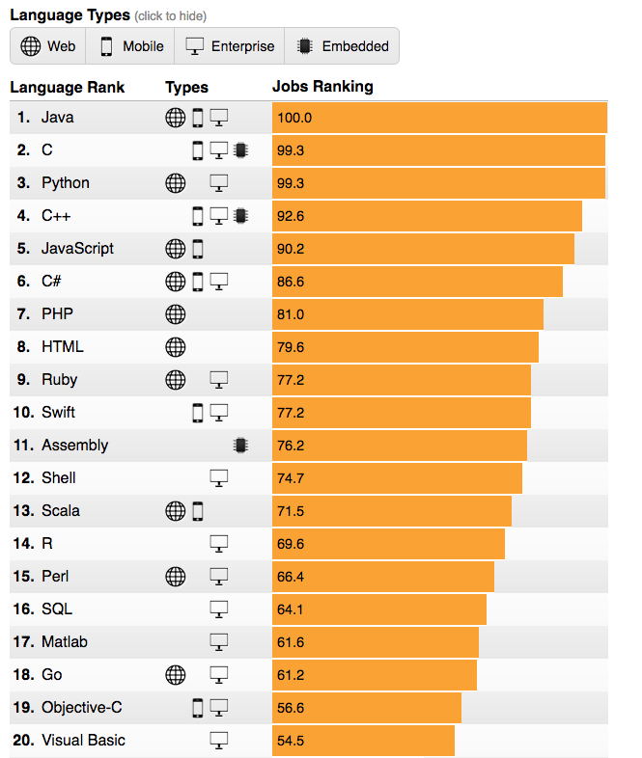
Programming Language, by Job Market

Slide 21
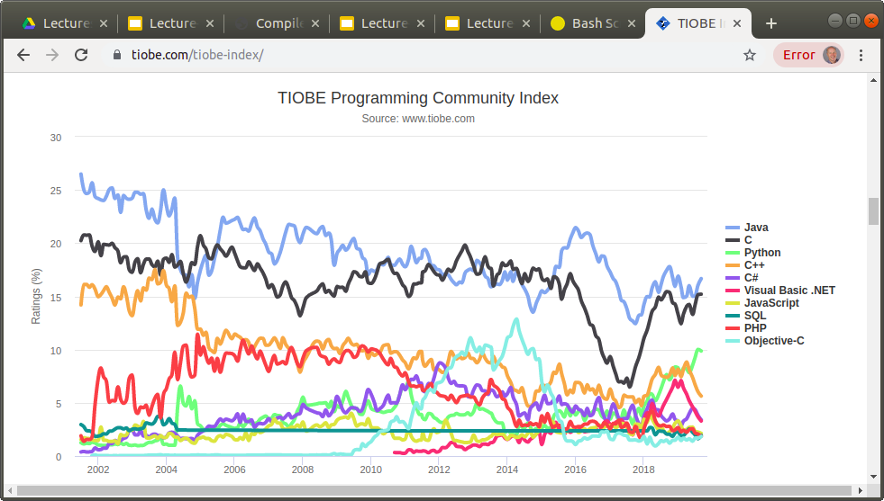
https://www.tiobe.com/tiobe-index/

Slide 22
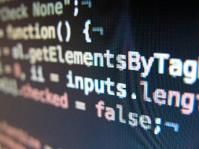
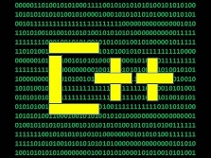



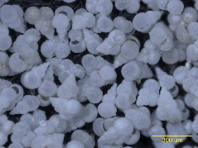
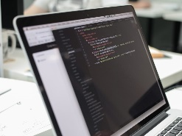
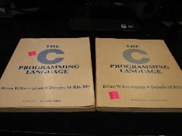
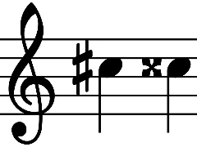

Most Popular Programming Languages on Github – Nov ‘19
JavaScript
Python
Java
PHP
C#
C++
TypeScript
Shell
C
Ruby

Slide 23
Compilers, from 30,000 feet
int numpos(int* a, int len) {
int n = 0;
for (int i = 0; i < len; ++i) {
if (a[i] > 0) ++n;
}
return n;
}
Execute this:
How? Computers only know 1’s and 0’s
First need to translate (ie, compile) into 1’s and 0’s
Those 1’s and 0’s are called machine code

Slide 24
Compiler Output
Offset Code Opcode Operands
0000 55 pushq %rbp
0001 4889E5 movq %rsp, %rbp
0004 48897DE8 movq %rdi, -24(%rbp)
0008 8975E4 movl %esi, -28(%rbp)
000b C745F800 movl $0, -8(%rbp)
000000
0012 C745FC00 movl $0, -4(%rbp)
000000
0019 EB22 jmp .L2
001b 8B45FC movl -4(%rbp), %eax
001e 4898 cltq
0020 488D1485 leaq 0(%rax,4), %rdx
00000000
0028 488B45E8 movq -24(%rbp), %rax
002c 4801D0 addq %rdx, %rax
002f 8B00 movl (%rax), %eax
....
Binary Machine Code:
55 48 89 E5 48 89 7D E8 89 ...
Textual Assembly Code:
pushq %rbp
movq %rsp, %rbp
...

Slide 25
Why Study Compilers?
“If you don't know how compilers work, then you don't know how computers work. If you're not 100% sure whether you know how compilers work, then you don't know how they work” – Steve Yegge
Be a better programmer
Insight into languages, compilers, and hardware
What’s all that stuff in the debugger?
Compiler techniques are everywhere
Little languages, verifiers, Lint, query languages, Verilog, Mathematica
Draws from many corners of CS
Finite State Automata, Regex, Grammars, Trees, Graphs
Links to Hardware
ISA, pipeline, multi-issue, cache, SIMD, multi-core, memory consistency
“If you are not confused by quantum physics compiling then you haven’t really understood it” – Niels Bohr

Slide 26
How Best to Understand Compilers?
Only by actually writing an interpreter or compiler will you really understand the language you are using.
For example, what is the output from the following tiny program?
void inc(int a) { a = a + 1; }
int main() {
int x = 1;
printf("%d ", x); inc(x); printf("%d \n", x);
int a = 5;
printf("%d ", a); inc(a); printf("%d \n", a);
}

Slide 27
If you want to win a Turing Award ...
Why Study Compilers?
1966 Alan Perlis 1972 Edsger Dijkstra 1974 Donald Knuth 1976 Michael Rabin and Dana Scott 1977 John Backus 1978 Bob Floyd 1979 Ken Iverson 1980 Tony Hoare
1984 Niklaus Wirth 1987 John Cocke 1991 Robin Milner 2001 Ole-Johan Dahl and Kristen Nygaard 2003 Alan Kay 2005 Peter Naur 2006 Fran Allen 2008 Barbara Liskov

Slide 28
Theory and Practice
Compilers have been studied for 70 years
Lots of valuable theory
Finite State Automata; grammars; parsing; semantic checks; optimization; register allocation, etc
This class will lean towards practical
We will build an end-to-end interpreter
Deeper insight than disconnected theories (ie, most textbooks)
Better preparation for interviews, and a career in software
More fun
But we will also study theory
You need a nodding acquaintance with lex, yacc, Chomsky hierarchy, bottom-up parsing, instruction selection, optimization, register allocation
Beware the perils of ignoring theory – seat-of-the-pants invention

Slide 29
Project

Slide 30
Project
Best way to learn about compilers and interpreters is to build one
Course project
Interpreter for Tog – a simple imperative language
Built using C (not C++)
Hand-built scanner and parser (not Flex; not Bison)
Complete gradually, step-by-step, during the quarter
Interpreter should execute all given example Tog programs:
Factorial, Fibonacci, etc
What I cannot build, I do not understand — Richard Feynman

Slide 31
Class Project
We will write an Interpreter for a simple language called Tog
# exam01.tog
fun main =
var x:num
let x = 42
say x
nl
nuf
# is a line comment
Function definitions: fun and nuf
Variables declared with "var x : num" or "var y : str"
No semi colons
No commas

Slide 32
Another Example : fac.tog
# fac.tog - Factorial function
fun fac:num n:num =
var sum:num
var i:num
let sum = 1
let i = 1
while i <= n do
let sum = sum * i
let i = i + 1
elihw
ret sum
nuf
fun main =
var upto:num
var answer:num
var announce:str
var is:str
let upto = 7
let answer = call fac upto
let announce = 'Factorial of '
let is = ' is '
say announce say upto say is
say answer nl
nuf

Slide 33
Things to notice about Tog
If statements are bracketed by if and fi
While statements are bracketed by while and elihw
Invoke a function using call
ret means return
If you were inventing Tog, some questions to consider:
How long can variable names be?
Would you make variable names case-sensitive?
What features would you add to Tog to make it better?

Slide 34
Implementation Language
We will write our interpreter in C
We will not use C++

Slide 35
Why Choose C?
C is low-level. But it’s simple and easy to learn. It’s adequate for writing compilers
Recall that Linux is written in C, not C++
The C Programming Language — A language which combines the flexibility of assembly language with the power of assembly language

Slide 36
Why not choose C++?
C++ is higher-level. But it’s exceedingly complex and hard to learn in full. It contains lots of ‘hidden magic’ that obscures what’s going on
C++: Hard to learn and built to stay that way
In C++ it's harder to shoot yourself in the foot, but when you do, you blow off your whole leg – Bjarne Stroustrup

Slide 37
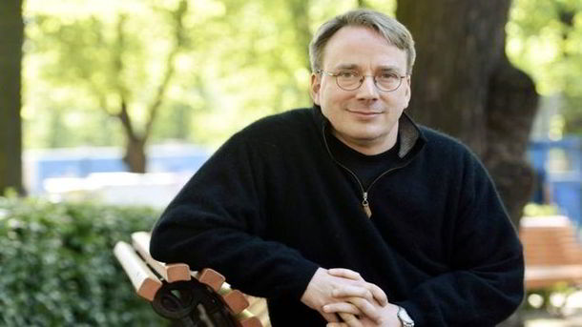
What Does Linus Torvalds Think of C++ ?
“C++ is a horrible language. It's made more horrible by
the fact that a lot of substandard programmers use it, to
the point where it's much much easier to generate total
and utter crap with it…. In other words, the only way to do good, efficient, and system-level and portable C++ ends up to limit yourself to all the things that are basically available in C.”

Slide 38
Interesting Quotes
Writing in C or C++ is like running a chain saw with all the safety guards removed
It's not that I'm surrounded by incompetence that bothers me, it's that I fit in so well
Weeks of programming can save you hours of planning

Slide 39
The next 10 weeks
FrontEnd
BackEnd
Intro
Let’s build a calculator
Lexical Analysis + Regex
Grammars + EBNF
LL (Recursive Descent) Parsing
LR Parsing
ASTs
Semantic Checking
Intermediate Representation (IR)
Optimization
x86
Codeshape
Instruction Scheduling
Register Allocation
How far we get depends!
We shall spend most time on FrontEnd
Optimization is a huge, fascinating topic; but time will only allow us an overview
BackEnd includes some neat algorithms and pretty pictures
FrontEnd algorithms are generally simple, O(n)
Optimization and BackEnd algorithms are mostly NP-Hard

Slide 40
LetsCode

Slide 41
LetsCode – cal01
Description:
Examples:
Write a simple “calculator” program in C
Accepts a pair of single-digit numbers
Accepts operator: “+” or “-”
No spaces!
Prints out result
? 1+2 = 3 ? 1-5 = -4

Slide 42
Demo – cal01

Slide 43
cal01
#include <stdio.h>
int main() {
while (1) { // forever loop
printf("? "); // prompt
int i1 = getchar() - '0'; // eg: 1
char op = getchar(); // eg: '+'
int i2 = getchar() - '0'; // eg: 2
int ans = 0; // answer
if (op == '+') {
ans = i1 + i2; // eg: 1+2
} else if (op == '-') {
ans = i1 - i2; // eg: 1-2
}
printf("= %d \n", ans); // eg: "= 3"
getchar(); // discard '\n'
}
}
Quiz :
What if user enters newline ?
What if user enters a+b ?

Slide 44
Extending cal01
For homework, we shall extend this simple calculator as follows:
1-digit integers; no spaces Eg: 3+4 (cal01)
Spaces; integers with >1 digit Eg: 32 + 47 (scanf)
Real numbers Eg: 1.2 * 25.7 (double)
Multiple operations Eg: 3 + 4 * 5 - 6 * 7 (gets, strtok)
Single-letter Variables Eg: x = 12; y = x + 1 (real lexer!)
Error messages Eg: abc = 42
Operator precedence Eg: 3 + 4 * 5 => 23, not 35
Parentheses Eg: (3 + 4) * 5 - 6 * 7
Unary minus Eg: -42, or perhaps ~42

Slide 45
Compilers: a Closer Look

Slide 46
Interpreter versus Compiler
cal01 is an INTERPRETER
It reads our program - eg: “3+4”
It analyzes what the program means
It executes our program and prints the result
If instead we had built cal01 as a COMPILER
It would read our program - eg: “3+4”
It would analyze what the program means
It would create a file, holding binary machine code, that we can execute later, to discover the result of our program

Slide 47
Interpreters & Compilers
Data
online
Program
Interpreter
Results
Data
offline
Program
Compiler
Binary
Results

Slide 48
Quiz: Interpreters & Compilers
Compilers:
May translate one language to another – eg:?
May translate a language into “byte code” – eg:?
But usually translate a language to binary machine code – eg:?
Interpreters – eg: ?
run 10X-50X slower than a compiled binary
are more immediate & fun
but use similar techniques as compilers
JIT (“Just In Time”) Compilers – eg: ?
Compile just before (nanosec, μsecs) binary is required
Balance throughput against Code Quality (CQ)

Slide 49
Compilers, from 1,000 feet
Structure of a Compiler, approximately:
Front end: analyze
Read source program; understand its structure and meaning
Specific to the source language used
Back end: synthesize
Generate equivalent target language program
Mostly unaware of the source language use
Source
Front End
Back End
Target
Quiz: Why "frontend" and "backend"? Why not just "front" and "back"?

Slide 50
Compiler : Job Description
recognize legal programs; complain about illegal ones
generate correct code!
manage storage of all variables/data
agree with OS & linker on target format (when generating native machine code)
optionally: produce “good” code
“good” = fast, compact, low-power (pick some)
optionally: use machine resources effectively
Registers (eg: all GPRs; SIMD; GPU)
Instructions & function units (eg: floating-point)
Memory hierarchy (small footprint; cache-aware)
Notes:
Au02: from Cooper’s slides

Slide 51
How do Frontend & Backend Communicate?
Need some sort of Intermediate Representation, or “IR”
Front end maps source into IR
Back end maps IR to target machine code
Example IR: like assembly code, but with infinite number of registers
Example IR: add a, b, c => a = b + c; no registers
Example IR: Java Bytecode
Source
Front End
IR
Back End
Target
Notes:
Au02: from Cooper’s slides

Slide 52
Monolithic Compiler
If we did not separate a compiler into frontend and backend:
x86
Fortran
x64
c
ARM-32
C++
ARM-64
C#
IA-64
4 languages x 5 targets => 4 * 5 = 20 compilers

Slide 53
Separate Frontend & Backend
x86
FORTRAN
x64
c
IR
ARM-32
C++
ARM-64
C#
IA-64
IR = Intermediate Representation
4 frontends + 5 backends => 4 + 5 = 9 compilers

Slide 54
More Detail
Simple compilers have 2 parts:
Source
Front End
Back End
Target
High-performance compilers have 3 parts:
Source
Front End
Optimizer
Back End
Target
Optimizer is sometimes jokingly called the "Middle End"

Slide 55
Programming Language - Differences
What ‘style’ – Procedural, Object-Oriented, Functional
Domain-Specific Language (DSL)
make, Lex, Yacc, Bash, grep, awk, SQL, HTML, XML, DOS, git
Spacing
Is whitespace important? (cf: Fortran: DOI=1,5X=X+3CONTINUE)
Line-oriented? (1 statement on each line – BASIC)
‘Semi-colon-oriented’? (separate/terminate statements with “;”)
Does layout matter? (eg: blocks must be indented, as in Python)
Casing
Are variables case-blind (eg: total == TOTAL == TotAL)
Perhaps only keywords are case-blind? (eg: while == WHILE == wHILe)
What’s the maximum length of a name?
Variable scope rules – lexical or dynamic?
Variables: local, global, nested, instance, static/class?
Functions? First-class Functions? Nested function declarations (“local” functions)?
Call ByVal, ByRef
Dynamic Storage? Garbage-collected?
Recursion
Static or Dynamic Types?
Pointers?
Closures or “Lambda”s
Classes? Prototypes?

Slide 56
Programming Language – Differences, 2
Inheritance? – Single or Multiple?
Precedence and Associativity
Operator overloading?
In what order are terms evaluated in an expression?
Eg: f(1) – f(3)
In what order are function arguments evaluated?
Eg: f(g(3) + h(9, “x”))
Short-Circuit Evaluation? Eg:
x = 7; if (x < 9 || f(x) > 20) ... // is f(x) actually called?
x = 7; if (x > 9 && f(x) > 20) ... // is f(x) actually called?
Function Overloading? Eg:
volume(int s) { return s * s * s; } // cube
volume(int l, int w, int b) { return l * w * b; } // cuboid
Operator overloading? Eg:
struct Time { int mins, secs; }
Time* operator+(Time& t1, Tim& t2) { ... }
Time* t3 = t1 + t2;
Portable? Or platform-independent?
Multi-threaded?

Slide 57
Compiler/Language Terminology
Data Types (eg: int, double, string, Unicode)
Pointers
ValueTypes vs ReferenceTypes
Static vs Dynamic Typing
Local vs global
Shadowing/Occlusion
Variable Scope and Lifetime
Heap Storage
Array, Dictionary
Function/Procedure
Recursion
Calling Convention
Assembler Code, Registers
Caller-saved, Callee-saved, Scratch
Nested Functions, Static Link
Short-circuit evaluation
Procedural, Object-Oriented, Functional
Coroutine
Dynamic Dispatch, Virtual Functions
Threads
Stack Frame, Dynamic Link
Compiler vs Interpreter
Closure
Garbage Collection
Just-in-Time (JIT) Compiler
Quiz: describe any of the above terms you recognize

Slide 58
Compiler Phases
BackEnd
chars
Lexer
tokens
Parser
AST
Semantic
Checker
AST
AST to IR
IR
source
target
A Compiler is divided into several phases
Originally, a phase required a pass over the source code; perhaps even a rewind, and re-read of a mag tape
But now we can hold the entire program, source and IR, in memory
We can think of the BackEnd as just performing Code Generation
Most Compiler Introductory classes cover only the FrontEnd. But we will also peek inside the BackEnd. In high-performance compilers, we discover it adds many more phases, and optimizes our code to look nothing like we would imagine

Slide 59
Frontend Compiler Phases
chars
Lexer
tokens
Parser
AST
Semantic
Checker
AST
source
Lexer: Convert char-stream to token-stream
Lexer, since it performs “lexical analysis”
Also called a Scanner or Tokenizer
Usually discards white space & comments but NOT for Python or Haskell
An English novel consists of many letters (of the alphabet).
They are grouped into words, separated by spaces.
Think of Tokens as like "words" in a novel.

Slide 60
Frontend Compiler Phases
chars
Lexer
tokens
Parser
AST
Semantic
Checker
AST
source
Parser: Reads token-stream; generates AST (Abstract Syntax Tree)
Prog
If
then
=
==
Var:a
Const:1
+
Var:b
Var:a
Const:1

Slide 61
Frontend Compiler Phases
chars
Lexer
tokens
Parser
AST
Semantic
Checker
AST
source
Semantic Checker. Examples:
Type-Check: i = 3 + true
Variable binding: i = 1 + j, but which “j”?
Number and type of function arguments: eg: length(3, "abc", 42)
Generally think of semantic checks as checks that are "far apart" in the program text

Slide 62
Frontend Compiler Phases
chars
Lexer
tokens
Parser
AST
Semantic
Checker
AST
source
Lexer and Parser can be generated automagically
Tokens specified by regex - read by lex or flex to create a Lexer
Syntax specified by a grammar - read by yacc or bison to create a Parser "yacc" - Yet Another Compiler-Compiler
But for the Tog interpreter, we will build Lexer and Parser ‘by-hand’

Slide 63
Tools for generating Lexer and Parser
regex
grammar
lex
flex
yacc
bison
chars
Lexer
tokens
Parser
AST
Semantic
Checker
AST
source

Slide 64
But … what is a Token?
A Token is the smallest element of a computer program that is meaningful to the compiler
Tokens fall into different categories. Eg:
Identifier, or Name x count printf
Keyword int class while
Numbers 42 3.9 1.6E-19
Operator + >= <<
Punctuation { ) ;
A Keyword is just an Identifier in form; but it's regarded as "special" in that source language
64

Slide 65
Token Spotting in C++
class keyword
C identifier
{ punctuation
class C {
public int fac(int n) { // factorial
int nn;
if (n < 1)
nn = 1;
else
nn = n * fac(n-1);
return nn;
}
}
public keyword
int keyword
fac identifier
( punctuation
int keyword
n identifier
) punctuation
{ punctuation

Slide 66
History

Slide 67
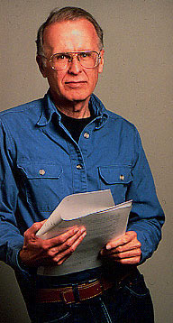
A Little History
50s
FORTRAN I (1957)
John Backus, IBM
Competitive with hand-optimized code
60s
New languages: ALGOL, LISP, COBOL, SIMULA
Formal notations for syntax, especially BNF
Stack frames, recursive functions, heap storage, block scope, etc.
70s/80s
Tools to build compiler front-ends (lex, yacc)
New languages (functional; object-oriented)
New architectures (RISC, parallel, memory hierarchy)

Slide 68
More History
OO
Just-in-time compilers (JITs)
Intel’s Itanium 30-year Experiment (1989 – 2019) - “Itanic”
Spread of Compiler techniques: Software analysis, verification, security
Phased compilation. Eg: C++ template meta-programming
Dynamic languages – eg: JavaScript, Ruby, Python …
Multi-core; SIMD; GPU

Slide 69
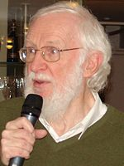
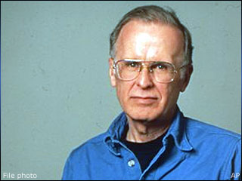

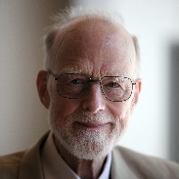
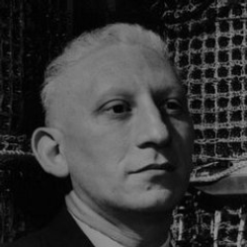
ALGOL-60
All-Star Attendees
What did ALGOL-60 look like? . . . Pascal
“The meetings were exhausting, interminable, and exhilarating. One became aggravated when one's good ideas were discarded along with the bad ones of others” (Alan Perlis)
“Here is a language so far ahead of its time that it was not only an improvement on its predecessors but also on nearly all its successors” (Tony Hoare)

Slide 70
http://james-iry.blogspot.com/2009/05/brief-incomplete-and-mostly-wrong.html
1801 - Joseph Marie Jacquard uses punch cards to instruct a loom to weave "hello, world" into a tapestry. Redditers of the time are not impressed due to the lack of tail call recursion, concurrency, or proper capitalization
1940s - Various "computers" are "programmed" using direct wiring and switches. Engineers do this in order to avoid the tabs vs spaces debate
1970 - Niklaus Wirth creates Pascal, a procedural language. Critics immediately denounce Pascal because it uses "x := x + y" syntax instead of the more familiar C-like "x = x + y". This criticism happens in spite of the fact that C has not yet been invented.
1983 - Bjarne Stroustrup bolts everything he's ever heard of onto C to create C++. The resulting language is so complex that programs must be sent to the future to be compiled by the Skynet artificial intelligence. Build times suffer.

Slide 71
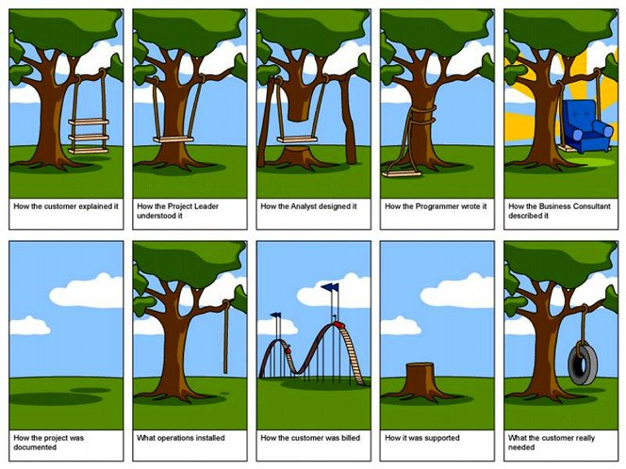
22 + 33 + 450 - 4

