Slide 1
CSS 448 – Introduction to Compilers
Calculator
cal, Improved
What went wrong?
Operator precedence
Infix, Postfix
Postfix Evaluation
Infix-to-Postfix conversion

Slide 2
Learning C?
C is a very small, and simple language. If you already know Java, then learning C should be easy.
CSS-448 uses a naive style of C programming, aimed at easy understanding.
However, if you want help in ramping up, then take a look at the following book – it’s free for download by UWB students:
Bradley, Aaron R., Programming for Engineers: A Foundational Approach to Learning C and Matlab, 2011, ISBN 978-3642233029. Available as a PDF through the University of Washington library http://alliance-primo.hosted.exlibrisgroup.com/UW:all:CP71129050430001451
Eg: Chapter 1 explains memory layout, pointer, pointer-to-pointer, call-by-val, call-by-ref and stack frame
Eg: Chapter 2 explains if, else, while, for and recursion

Slide 3
cal01

Slide 4
cal01
#include <stdio.h>
int main() {
while (1) { // forever loop
printf("? "); // prompt
int i1 = getchar() - '0'; // eg: 1
if (i1 < 0) continue; // eg: newline
char op = getchar(); // eg: '+'
int i2 = getchar() - '0'; // eg: 2
int ans = 0; // answer
if (op == '+') {
ans = i1 + i2; // eg: 1+2
} else if (op == '-') {
ans = i1 - i2; // eg: 1-2
}
printf("= %d \n", ans); // eg: "= 3"
fflush(stdin); // discard any junk
}
}
cal01 is a simple calculator. It copes with + and –
Quiz : what does getchar() – ‘0’ actually do?
Quiz: what if user enters a letter instead of a digit?
Let’s extend cal01 to cope with more complex operations

Slide 5
Extending cal01
For homework, we shall gradually extend this simple calculator as follows:
1-digit integers; no spaces Eg: 3+4 (cal01)
Spaces; integers with >1 digit Eg: 32 + 47 (scanf)
Real numbers Eg: 1.2 * 25.7 (double)
Multiple operations Eg: 3 + 4 * 5 - 6 * 7 (gets, strtok)
Single-letter Variables Eg: x = 12; y = x + 1 (real lexer)
Error messages Eg: abc = 42
Operator precedence Eg: 3 + 4 * 5 => 23, not 35
Parentheses Eg: (3 + 4) * 5 - 6 * 7
Unary minus Eg: -42
Beware gets – buffer overflow and security exploits

Slide 6
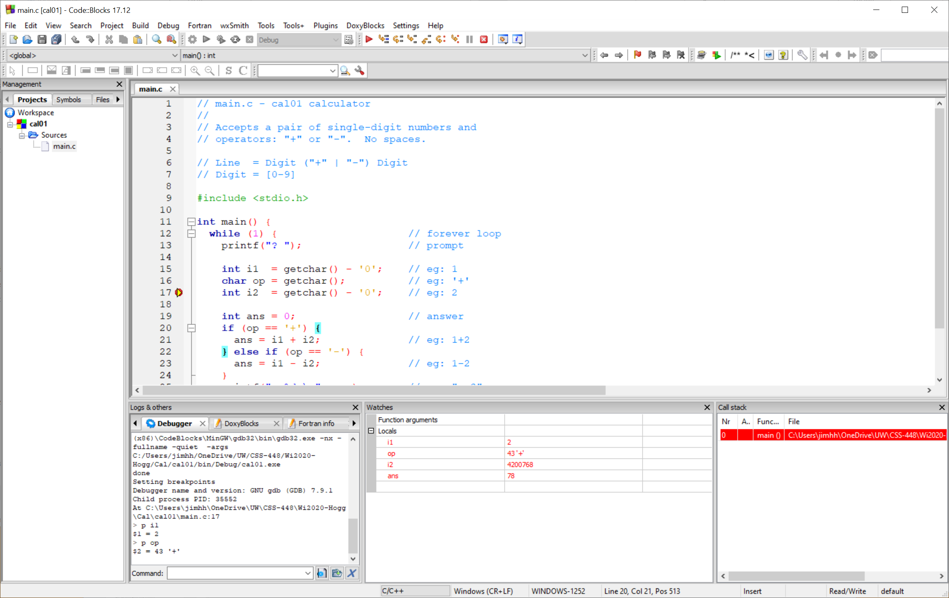
Code::Blocks Demo

Slide 7
Code::Blocks
Code::Blocks is an Interactive Development Environment (IDE)
It’s free and open-source. Runs on Linux, Windows and Mac.
Recommend you use this, or another IDE of your choice (eg: Eclipse, GNAT Programming Studio, Visual Studio Code, CodeLite, NetBeans, CLion, etc.)
Advantages of using an IDE:
Good Editor + Refactoring
Syntax Highlighting
Code Completion
Background Compilations to find syntax errors (not Code::Blocks, alas)
Integrated Compiler & Linker
“Debug” or “Release” mode
Interactive Debugger

Slide 8
cal01

Slide 9
cal01
#include <stdio.h>
int main() {
while (1) { // forever loop
printf("? "); // prompt
int i1 = getchar() - '0'; // eg: 1
if (i1 < 0) continue; // eg: newline
char op = getchar(); // eg: '+'
int i2 = getchar() - '0'; // eg: 2
int ans = 0; // answer
if (op == '+') {
ans = i1 + i2; // eg: 1+2
} else if (op == '-') {
ans = i1 - i2; // eg: 1-2
}
printf("= %d \n", ans); // eg: "= 3"
fflush(stdin); // discard junk
}
}
Quiz : How would you add the following changes:
Calculate double instead of int
Add error checking
Add support for * and /

Slide 10
cal35
#include <stdio.h>
int main() {
while (1) { // forever loop
printf("? "); // prompt
double a = getchar() - '0'; // eg: 1
char op = getchar(); // eg: '+'
while (op != '\n') {
double b = getchar() - '0'; // eg: 2
if (op == '+') a += b; // eg: 3
if (op == '-') a -= b;
if (op == '*') a *= b;
if (op == '/') a /= b;
op = getchar(); // eg: '-'
}
printf("= %lf \n", a); // eg: "= 3.00000"
}
}
Single-digit numbers
No spaces
double
+ - * /

Slide 11
cal35 - Demo
1+2
1+2-3+4
2*3+4
2+3*4
3.000000
4.000000
10.00000
20.00000
What went wrong?

Slide 12
Precedence

Slide 13
Precedence
1+2
1+2-3+4
2*3+4
2+3*4
3.000000
4.000000
10.00000
20.00000
What went wrong?
According to the usual rules of high-school algebra:
* and / are applied before + or –
* and / have a higher PRECEDENCE than + and -
2 + (3 * 4) = 14

Slide 14
How Humans Parse an Expression
1+2*3+4*5*6+7
As accepted by our calculator
1 + 2 * 3 + 4 * 5 * 6 + 7
Prettier but equivalent
1 + 2 * 3 + 4 * 5 * 6 + 7
Eyeball the expression, and evaluate the parts with higher precedence first
1 + 6 + 4 * 5 * 6 + 7
1 + 6 + 120 + 7
134

Slide 15
How should our Calculator Parse these Expressions?
1+2*3+4*5*6+7
As accepted by our calculator
1 + 2 * 3 + 4 * 5 * 6 + 7
Prettier but equivalent
Making the computer work the same as humans is really quite messy – and inefficient, requiring multiple scans over the expression
Instead, we will convert the expression to POSTFIX form and then evaluate

Slide 16
Prefix, Infix, Postfix

Slide 17
Prefix, Infix, Postfix
1 + 2
+ is the operator. 1 and 2 are operands. This is how expressions are written in conventional arithmetic. It’s called INFIX notation.
+ 1 2
PREFIX notation: operator written before operands. Also known as Polish notation
1 2 +
POSTFIX notation: operator written after operands. Also known as reverse Polish notation, or RPN
Polish? – after Jan Łukasiewicz, a Polish logician and philosopher

Slide 18
Quiz: Postfix
Postfix
Result?
Infix?
3 4 +
3 4 5+ *
3 4 5* +

Slide 19
Quiz: Postfix : Answers
Postfix
Result?
Infix?
3 4 +
7
3 + 4
3 4 5 + *
27
3 * (4 + 5)
3 4 5 * +
23
3 + 4 * 5
Note: Postfix notation does not require parentheses!
Used in early HP calculators
Used in the Forth programming language

Slide 20
Evaluating Postfix

Slide 21
How to Evaluate a Postfix Expression
3 4 +
if element is an operand, push onto stack
if element is an operator, apply
Top-Of-Stack
Stack grows up the page

Slide 22
How to Evaluate a Postfix Expression
3 4 +
if element is an operand, push onto stack
if element is an operator, apply
3
Top-Of-Stack

Slide 23
How to Evaluate a Postfix Expression
3 4 +
if element is an operand, push onto stack
if element is an operator, apply
4
3

Slide 24
How to Evaluate a Postfix Expression
3 4 +
if element is an operand, push onto stack
if element is an operator, apply
4
3
Pop the top two items off the stack. Apply the operator to them. Push result back onto the stack

Slide 25
How to Evaluate a Postfix Expression
3 4 +
if element is an operand, push onto stack
if element is an operator, apply
7

Slide 26
Quiz: Evaluate Postfix Expression
3 4 5 + *
Fill in the contents of the stack for the 6 steps in the evaluation

Slide 27
Quiz: Evaluate Postfix Expression : Answer
3 4 5 + *
5
4
4
9
3
3
3
3
27

Slide 28
Quiz: Evaluate Postfix Expression
3 4 5 - +
Fill in the contents of the stack for the 6 steps in the evaluation

Slide 29
Quiz: Evaluate Postfix Expression : Answer
3 4 5 - +
5
4
4
-1
3
3
3
3
2
Fill in the contents of the stack for the 6 steps in the evaluation

Slide 30
Java & C#

Slide 31
Evaluate Postfix Expression
Evaluating a Postfix Expression is how Java and C# work at the ByteCode level. The compiler translates Infix expressions into Postfix format.
Also how the Forth language works – except the User has to write his code in Postfix notation directly

Slide 32
Java Bytecode Example : Really a Stack Architecture!
0: iconst_1
1: istore_1
2: iconst_2
3: istore_2
4: iload_1
5: iload_2
6: iadd
7: istore_3
8: return
push int constant of 1
pop int value into local var #1
push int constant of 2
pop int value into local var #2
push int value of local var #1
push in value of local var #2
int add (top two values on stack)
pop int value into local var #3
return
public static void main(String[] args) {
int a = 1;
int b = 2;
int c = a + b;
}
1 2 +
2
1
2
1
1
3
push 1
pop a
push 2
pop b
push a
push b
iadd
pop c

Slide 33
Postfix : More Operators
+ addition
- subtraction
* multiplication
/ division
^ power
( left parenthesis
) right parenthesis
eg: 2^3 = 8
(2 + 3) * 4 ^ 2 – (8 /2) * 9 * 3

Slide 34
Postfix Evaluator

Slide 35
Postfix
Evaluator
double eval(char* pe) { // postfix expression
Stk* stk = stkNew();
double a = 0.0, b = 0.0; // operands
while (*pe != 0) {
if (isdigit(*pe)) {
stkPush(stk, *pe - '0');
skip(&pe); // skip whitespace
} else {
b = stkPop(stk);
a = stkPop(stk);
switch (*pe) {
case '+': a += b; stkPush(stk, a); break;
case '-': a -= b; stkPush(stk, a); break;
case '*': a *= b; stkPush(stk, a); break;
case '/': a /= b; stkPush(stk, a); break;
case '^': a = pow(a, b); stkPush(stk, a); break;
default: a = 0.0; break;
}
skip(&pe); // skip whitespace
}
}
return a;
}
infix
(1+2)*3^4
postfix
12+34^*

Slide 36
Postfix
Evaluator
// what to #include ??
typedef struct { int top; double stack[1]; } Stk;
Stk* stkNew() {
Stk* stk = malloc(sizeof(Stk) + 100 * sizeof(double));
stk->top = -1;
return stk;
}
void stkPush(Stk* stk, double d) { stk->stack[++stk->top] = d; }
double stkPop (Stk* stk) { return stk->stack[stk->top--]; }
void skip(char** p) { ++*p; while (**p == ' ') ++*p; }
int main() {
char* postExp = "2 3 4 * 5 + ^";
double d = eval(postExp);
printf("%s = %lf \n", postExp, d);
}
Quiz: Why just malloc? Why not calloc? What will stk contain?
Stk
-1
top
stack[0]
stack[1]
. . . .
stack[100]

Slide 37
Quiz: #include
Discover what header files need to be added to the postfix evaluator to make it compile and run
What steps would you take to answer this question?

Slide 38
Quiz : #include : Answer
Discover what header files need to be added to this program to make it
compile and run
#include <math.h> // pow
#include <stdio.h> // printf
#include <stdlib.h> // malloc
#include <ctype.h> // isdigit

Slide 39
Infix to Postfix Converter

Slide 40
Recap : Where we got to?
We want to write a program that evaluates any infix expression. Eg:
(2 + 3) * 4 ^ 2 – 5 * 6 * (7 + 8) + 9
Humans parse this expression easily, using our knowledge of operator precedence
But it’s hard to write a program to do this – need to scan the expression multiple times
If we could only convert the original infix expression to postfix form, we could evaluate the result. So, we need to write an infix-to-postfix converter

Slide 41
Infix to Postfix Algorithm
infix
2 + 3 * 4 + 5
List of input Tokens is called infix
Create empty opstack for storing operators
Create empty list for output called postfix
opstack
postfix
Scan infix from left to right:
If token is an operand, append it to postfix
If token == ( push it on opstack
If token == ) pop opstack until the corresponding ( is removed. Append each operator to postfix
If token is * / + or - push onto opstack. But first remove any operators already on opstack of higher or equal precedence and append them to postfix
When input tokens are exhausted check opstack. Pop each remaining operator onto postfix

Slide 42
Infix to Postfix : 1 + 2 * 3 ^ 4
infix
stack
postfix
Precedence
1 + 2 * 3 ^ 4
1 + -
2 * /
3 ^
4 ( )

Slide 43
Infix to Postfix : 1 + 2 * 3 ^ 4 : Answer
infix
stack
postfix
Precedence
1 + 2 * 3 ^ 4
1 + -
2 * /
3 ^
4 ( )
+ 2 * 3 ^ 4
1
2 * 3 ^ 4
+
1
* 3 ^ 4
+
1 2
3 ^ 4
+ *
1 2
^ 4
+ *
1 2 3
4
+ * ^
1 2 3
+ * ^
1 2 3 4
1 2 3 4 ^ * +

Slide 44
Infix to Postfix Algorithm
infix
stack
postfix
1 + 2 ^ 3 * 4
Notes:
Order of operands is preserved
Order of operators may not be preserved
Operators in stack appear in strictly increasing precedence
So cannot have two identical operators adjacent on the stack
1 + 2 * 3 ^ 4
1 2 3 4 ^ * +
+ * ^

Slide 45
Quiz : Infix to Postfix Example
infix
stack
postfix
1 + 2 ^ 3 * 4

Slide 46
Infix to Postfix Example : Answer
infix
stack
postfix
1 + 2 ^ 3 * 4
+ 2 ^ 3 * 4
1
2 ^ 3 * 4
+
1
^ 3 * 4
+
1 2
3 * 4
+ ^
1 2
* 4
+ ^
1 2 3
4
+ *
1 2 3 ^
+ *
1 2 3 ^ 4
1 2 3 ^ 4 * +

Slide 47
Infix to Postfix Example : 2 * (3 + 4 * 5)
Precedence
infix
stack
postfix
1 + -
2 * /
3 ^
4 ( )
2 * (3 + 4 * 5)

Slide 48
Infix to Postfix Example : 2 * (3 + 4 * 5) : Answer
Precedence
infix
stack
postfix
1 + -
2 * /
3 ^
4 ( )
2 * (3 + 4 * 5)
* (3 + 4 * 5)
2
(3 + 4 * 5)
*
2
3 + 4 * 5)
* (
2
+ 4 * 5)
* (
2 3
4 * 5)
* ( +
2 3
* 5)
* ( +
2 3 4
5)
* ( + *
2 3 4
)
* ( + *
2 3 4 5
* ( + *
2 3 4 5 * + *

Slide 49
Quiz
Quiz :
Tog only supports simple expressions, such as 3 or 4 + 5.
How would a Tog user write a statement such as: let x = 3 + 4 * 5 ?

Slide 50
Answer
Quiz :
Tog only supports simple expressions, such as 3 or 4 + 5.
How would a Tog user write a statement such as: let x = 3 + 4 * 5 ?
The user should break the calculation into simpler steps: simple enough that Tog supports that simplified expression. Eg:
let t1 = 4 * 5
let x = 3 + t1
t1 is just a temporary variable

Slide 51
Summary
Faced with a complicated user expression, such as:
e * sigma * area * ( t ^ 4 – ambient ^ 4) // Stefan-Boltzman radiative power
we now know how to make a compiler evaluate it, taking account of precedence and parentheses; by converting it into Postfix form. Take a moment to appreciate this as simply awesome
This completes our coverage of arithmetic expressions
Tog is designed to allow only very simple expressions, avoiding the need to implement an Infix-to-postfix converter, or a Postfix evaluator. This frees up time to study other, more interesting, parts of compilers

Slide 52
Quiz : Infix to Postfix : More Exercises
infix
stack
postfix
1 + 2 ^ 3 * 4
1 2 3 ^ 4 * +
a ^ 3 + (2 – 3) * 5
Precedence
a + (b^c + d) / e
1 + -
2 * /
3 ^
4 ( )
e * sigma * area * ( t ^ 4 – ambient ^ 4)
e * s * a * ( t ^ 4 – v ^ 4)

