Slide 1

Computer Vision Homework 2
TA：黃一釗
Email： daniel851218@gmail.com
Robot Vision Lab (Room 122)

Slide 2
Homework 2
Give one image with Salt & Pepper Noise (noise_image.png) for testing as follow:
Mean Filter：decide the kernel size, stride size, padding size by yourself. (save as output1.png)
Median Filter：decide the kernel size, stride size, padding size by yourself. (save as output2.png)
Image Histogram：accumulate the number of each pixel value, then draw a histogram for each image. (save as : noise_image_his.png, output1_his.png, output2_his.png)
Compare：Please describe what you observe on two output images generated by two different filters in your report.
※ There are totally 5 images in your report.

Slide 3
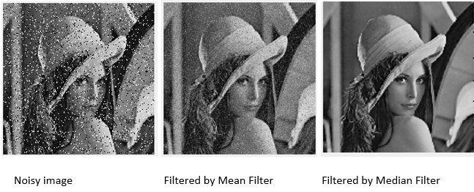
Mean Filter and Median Filter

Slide 4
Example：3*3 Mean Filter
As the kernel size increases, the image will become more blurry.
image
152 | 124 | 252 | 163 | 32 | 67
128 | 40 | 220 | 190 | 142 | 216
68 | 157 | 24 | 30 | 140 | 36
81 | 7 | 25 | 149 | 155 | 41
22 | 33 | 100 | 131 | 75 | 67
69 | 44 | 44 | 167 | 231 | 161
129
1/9 | 1/9 | 1/9
1/9 | 1/9 | 1/9
1/9 | 1/9 | 1/9
*
=
$$\left\lfloor \frac{1}{9}\left(152+124+252+128+40+220+68+157+24\right)\right\rfloor =129$$

Slide 5
Example：3*3 Median Filter
It’s a nonlinear filter.
152 | 124 | 252 | 163 | 32 | 67
128 | 40 | 220 | 190 | 142 | 216
68 | 157 | 24 | 30 | 140 | 36
81 | 7 | 25 | 149 | 155 | 41
22 | 33 | 100 | 131 | 75 | 67
69 | 44 | 44 | 167 | 231 | 161
128
Sorting：24, 40, 68, 124, 128, 152, 157, 220, 252
image
※ Please implement the sorting algorithm by yourself.

Slide 6
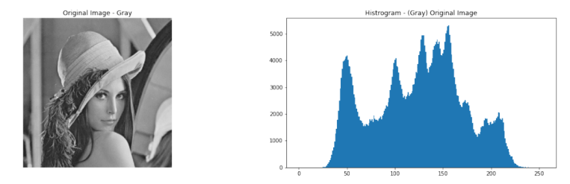
Image Histogram
Count the number of each pixel’s intensity (0~255)
Create a table to record the number of each pixel’s intensity.
You can draw the histogram by using the functions of matplotlib.

Slide 7
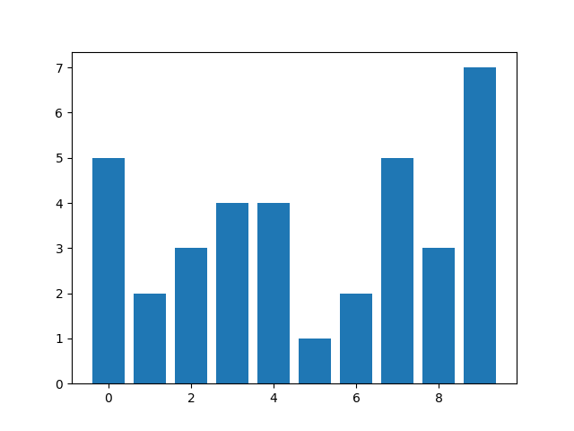
Example：Image Histogram
1 | 3 | 7 | 3 | 0 | 7
5 | 2 | 3 | 9 | 1 | 4
4 | 9 | 4 | 7 | 7 | 6
2 | 7 | 8 | 5 | 6 | 0
1 | 9 | 0 | 4 | 2 | 1
0 | 3 | 8 | 9 | 8 | 9
value | 0 | 1 | 2 | 3 | 4 | 5 | 6 | 7 | 8 | 9
#num | 5 | 2 | 3 | 4 | 4 | 1 | 2 | 5 | 3 | 7
statistics
draw histogram
image
※ The sum of #num must be equal to width of image * height of image

Slide 8
Grading
Program (80%)
Mean Filter (25%)
Median Filter (25%)
Image Histogram (20%)
Coding Style (10%)
Report (20%)
Please explain your code.
Please compare two result images that were generated by two different filters and describe what you observe.
Please describe the difference between three histograms, and explain the reason.
Please paste five output images in your report.

Slide 9
Folder Structure
Python
C/C++
610415024_hw2/
├─ test_img/
│ ├─ noise_image.png
├─ result_img/
│ ├─ output1.png
│ ├─ output2.png
│ ├─ noise_image_his.png
│ ├─ output1_his.png
│ ├─ output2_his.png
├─ 610415024_hw2.py
├─ 610415024_hw2.pdf
├─ Readme.txt
610415024_hw2/
├─ project_hw2/
│ ├─ test_img/
│ │ ├─ noise_image.png
│ ├─ result_img/
│ │ ├─ output1.png
│ │ ├─ output2.png
│ │ ├─ noise_image_his.png
│ │ ├─ output1_his.png
│ │ ├─ output2_his.png
│ ├─ include/
│ │ ├─ func.h
│ ├─ func.cpp
│ ├─ main.cpp
├─ 610415024_hw2.pdf
├─ Readme.txt
※ Please compress your folder to a zip file.
For example：610415024_hw2.zip

Slide 10
Deadline
2023/04/24 (Mon) 23:59:59
For each hour late, 10% of the total score will be deducted.
Please submit to eCourse2.
Please finish your homework independently.

Slide 11
Thanks for your attention

