Slide 1

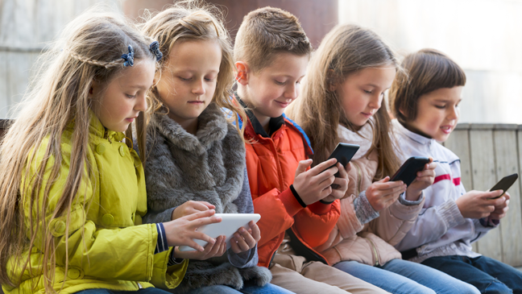


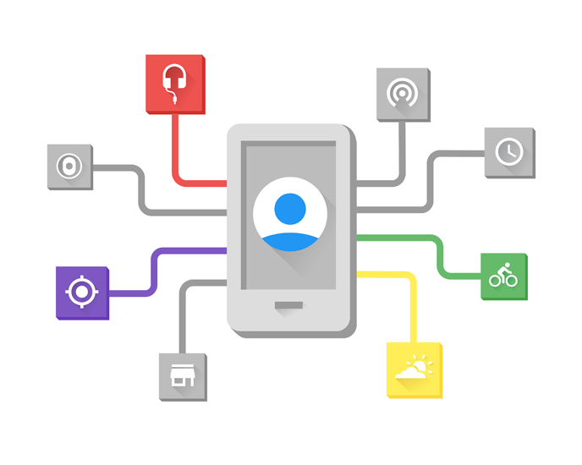
Parents
Friends
Children
Teachers
Weather App
Weather API

