Slide 1

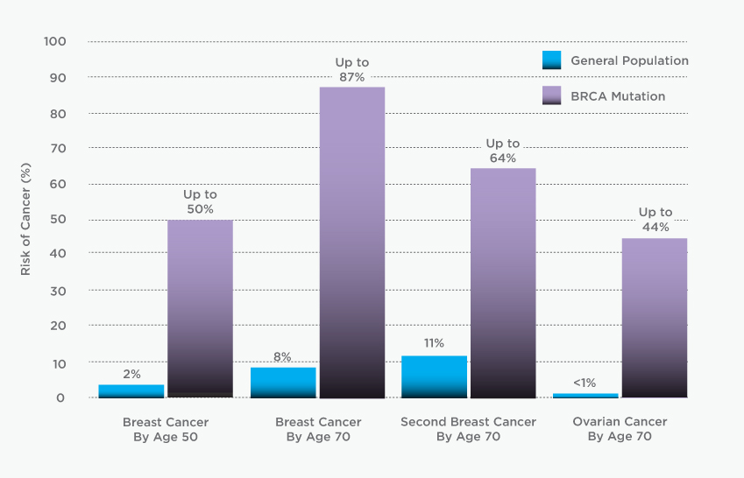
BRCA1 & BRCA2
People who carry a mutation in either of these genes have a condition called Hereditary Breast and Ovarian Cancer (HBOC) syndrome.2-3 They have an up to 87 percent risk of developing breast cancer by age 70.
Source: Myriad Genetics

Slide 2
Myriad Genetics
With 17 years of experience, millions of tests looking for thousands of mutations in the genes, and a $500 million investment, the company was able to amass a huge database that tells which DNA changes increase cancer risk and by how much, and which are inconsequential blips in DNA
In 1996, the company classified 40 percent of mutations as being of uncertain significance because it did not have enough information to know what they meant. By 2004, the figure was down to 20 percent. Now it is just 3 percent.
They find out the meaning by seeing the same mutation in at least 20 other people, asking whether they had cancer and, if so, what type.

Slide 3





Translational Research and Clinical Support
Annotate, interpret, classify, report on clinically relevant variants
NGS Workflow
Upstream primary and secondary analysis
Interpretation, classification, reporting
Sequencing
Alignment
Variant calling
Annotation, evidence synthesis
Biological interpretation / lab reporting
Complete analysis, interpretation and reporting workflow support
Called human variant
Basic, Translational and Clinical Research and Discovery
Clinical Decision Support
Human Variant Causality
Variant Interpretation
& Reporting

Slide 4
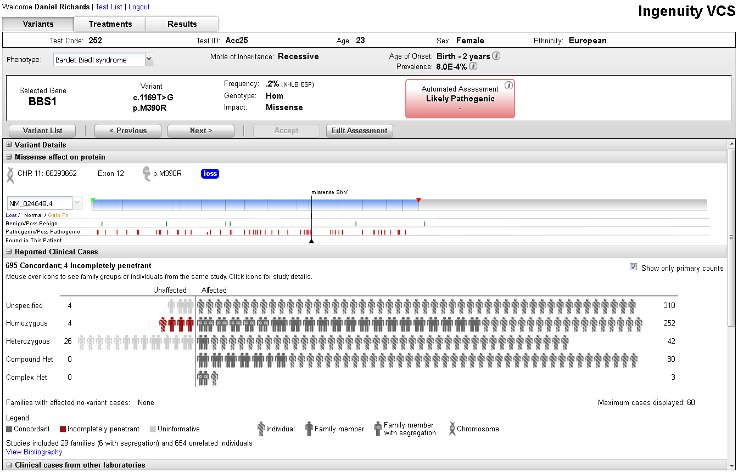
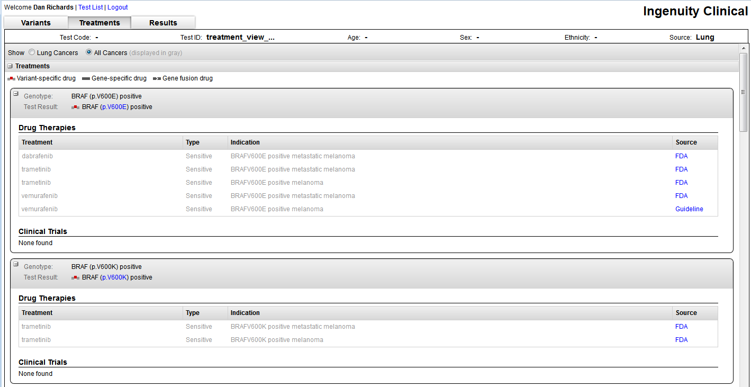
Evidence-based clinical decision support software
Better and faster clinical assessments of observed variants
Pre-curated CLINCIAL EVIDENCE, DRUG LABELS, GUIDELINES, TRIALS for variant classification and treatment selection
Rules-based decision support SOFTWARE that provides computed classifications based upon evidence and lab defined rules
Customizable variant annotation, filtering and classification, reporting WORKFLOW support
REPORTING engine for reporting to clinics and physicians – either results export or template enabled
Notes:
DEMO
@Sean – we need to make sure that you are fully training to do this demo. I’d like to sit down with you and Dan and go through a demo but also take screenshots that we could use as a back up.

Slide 5


Lab test interpretation and reporting workflow support
Automation of annotation, filtration, classification, reporting
Lab sets up test product, selects classification rules and reporting methods
Lab director reviews clinical assessment and signs out report
Ordering physician
Patholoigist /Oncologist
Lab Director
Test definition
Clinical sample
Test order
Clinical lab staff
Technician
Raw test data
Informatics / Software
Variant Calls
Clinical Geneticist
Internal Report
Test
details
Classification & Treatment Selection
Patient
Called
variants
Test order includes patient and relevant clinical information
Patient/ clinical
data
Ingenuity Clinical is an evidence-based decision support system intended as an aid in the interpretation of variants observed in genomic sequencing data. The program evaluates genomic variants in the context of published biomedical literature, professional association guidelines, and publicly available databases and annotations. Based on this evaluation, the Ingenuity Software proposes a classification and bibliographic references to aid in the interpretation of observed variants. The software is NOT intended as a primary diagnostic tool by physicians or to be used as a substitute for professional healthcare advice.
Public
Literature
Internal / LSDBs

Slide 6
Clinical decision support requirements differ
Hereditary and Somatic testing require different classification methods
Detected variants
Published biomedical literature
Professional association guidelines
Segregation studies
Population frequency
Amino acid conservation
Predictions: PolyPhen, SIFT, etc.
Splicing predictions
Hereditary /Germline:
Synthesis of evidence
ACMG Guidelines
Configurable by Lab
Configurable by Test
Computed classification
Variant
annotation/ filtering
Clinical data
Custom knowledge
Variant
classification
Family testing
Additional info
Benign
Likely
benign
Uncertain
Significance
Likely pathogenic
Pathogenic
classification & bibliographic references to aid in interpretation
Courtesy of Heidi Rehm, Partners Healthcare
Somatic Cancer:
Clinical relevance of variant
Target-ability /action-ability
Approved therapies
Patient cancer type
Other cancer types
Prognostic /diagnostic info
Clinical trials
Targetable / Actionable
Clinically relevant somatic variant
Same cancer type (approved /on label)
Other cancer types (inferred /off-label)
Prognostic

Slide 7
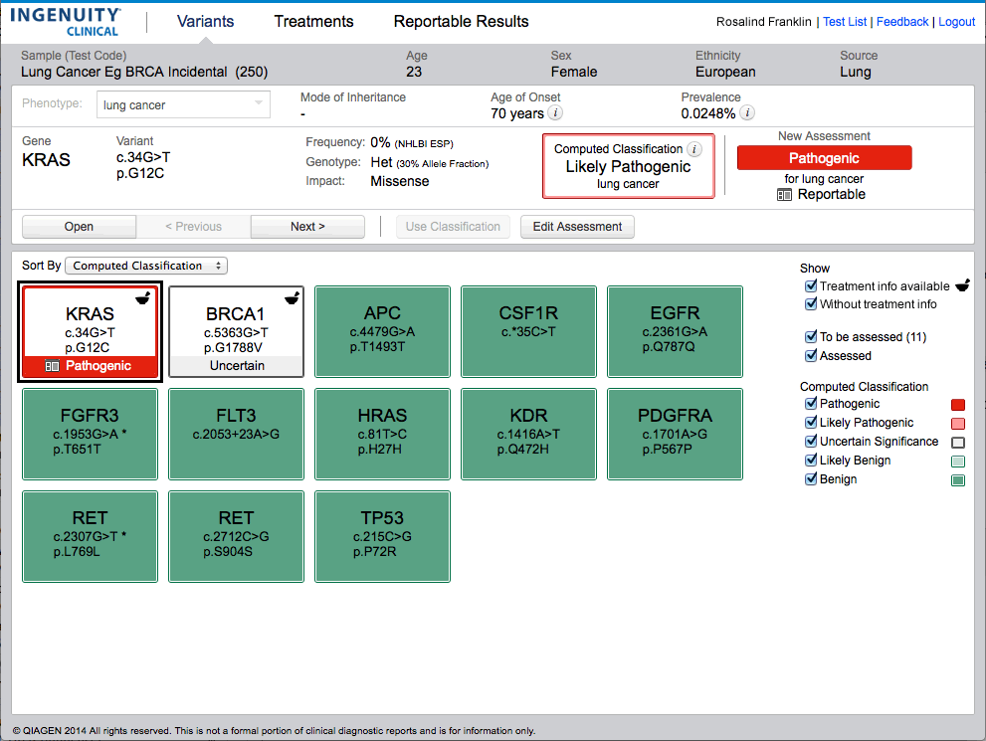
Visual display of variants detected
Configurable based upon lab’s filter preferences
Initial classifications based upon ACMG guidelines or lab defined rules

Slide 8
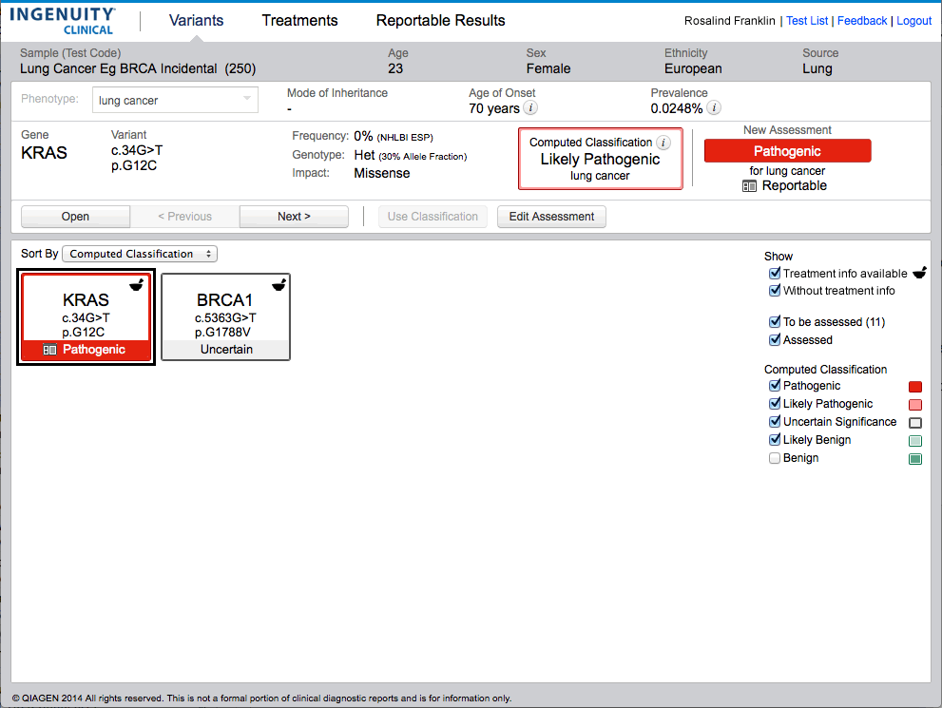
Further review and prioritization of detected variants
Removed variants at 5% or greater frequency in ESP/1000G

Slide 9
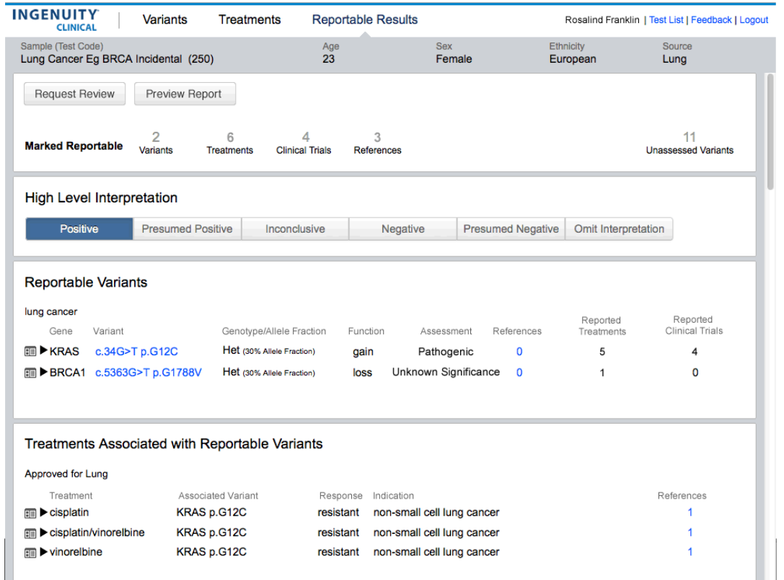
Initial review of reportable results
Configurable based upon lab-defined reporting rules

Slide 10
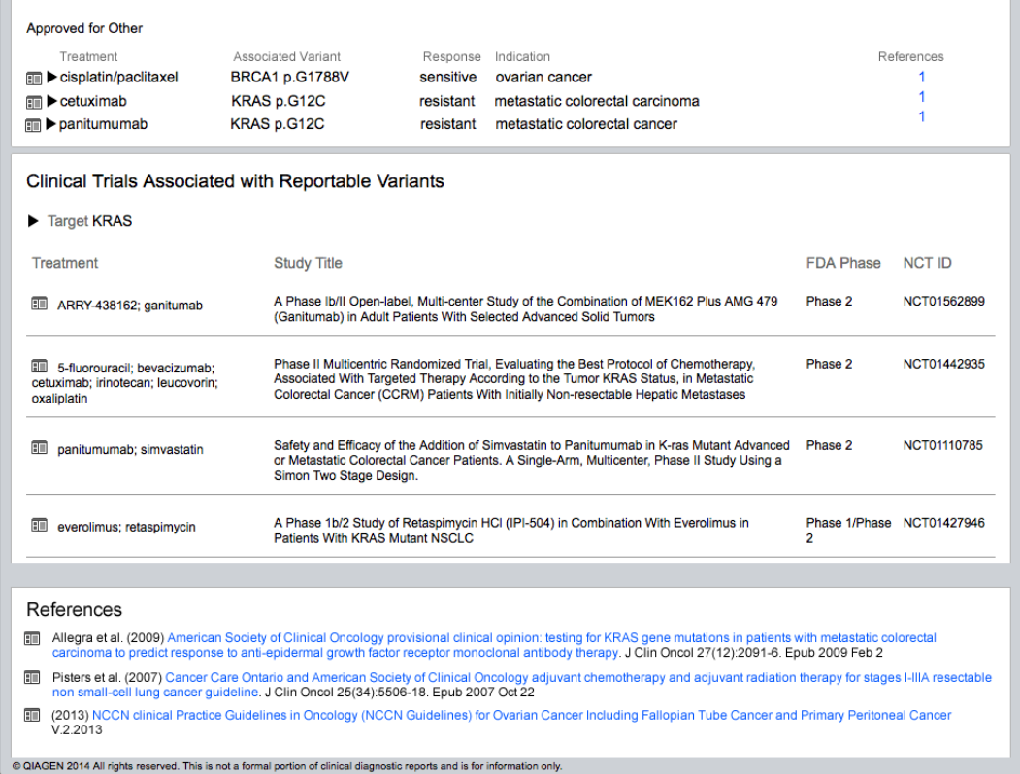
Reportable results continued – additional therapies
Review treatments in other cancers, clinical trials, and references

Slide 11
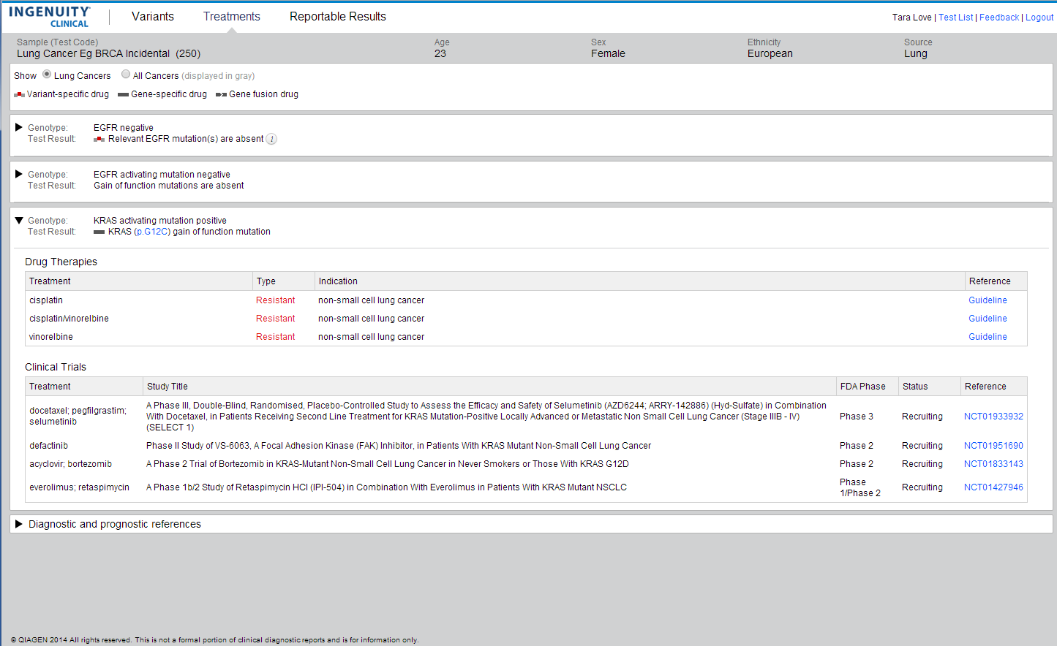
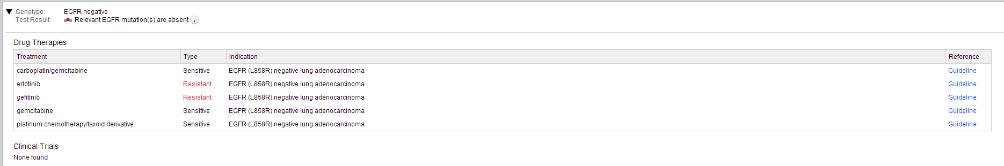
Review treatment options by genotype
Casting a wider net and linking directly out to clinical trials

Slide 12
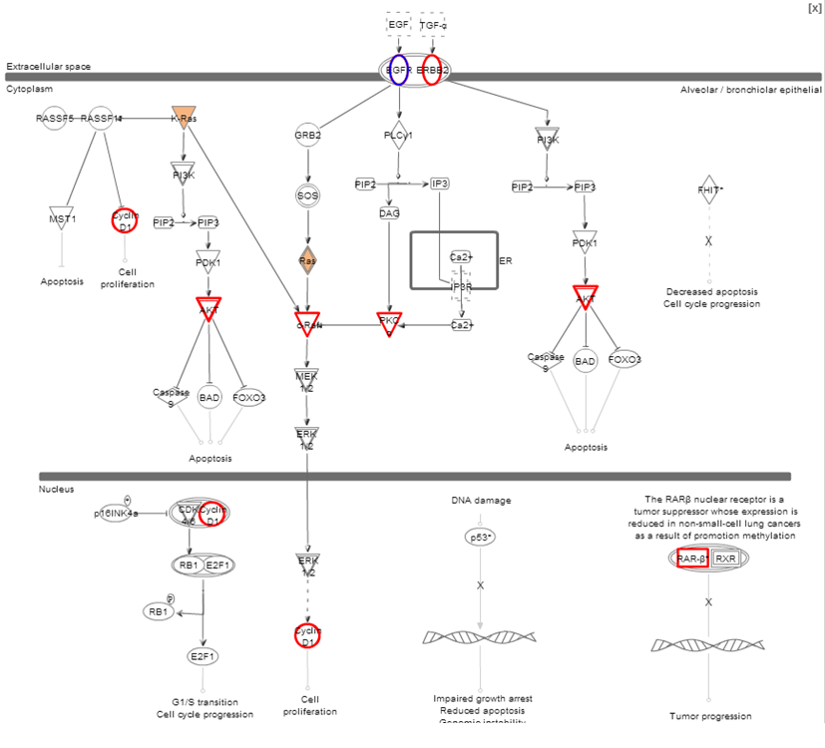
Investigate pathway based treatment options
Identify therapies for druggable targets in common pathways

Slide 13
Investigating a potential hereditary incidental finding
Assessing biological significance of the BRCA1 variant

Slide 14
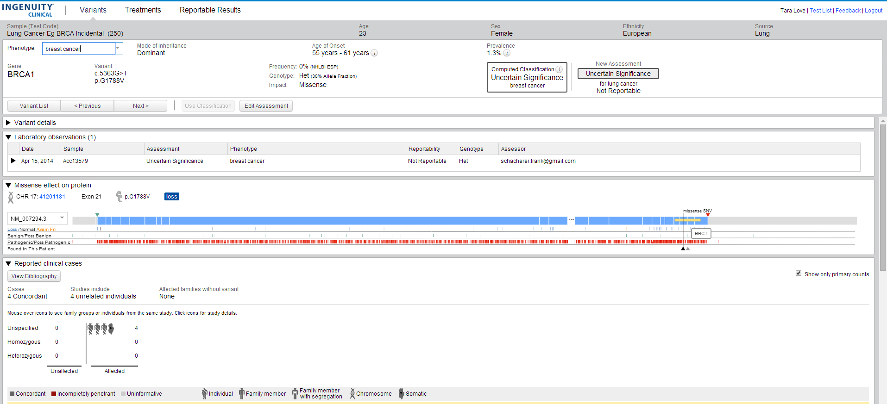
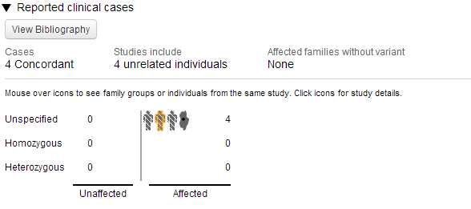
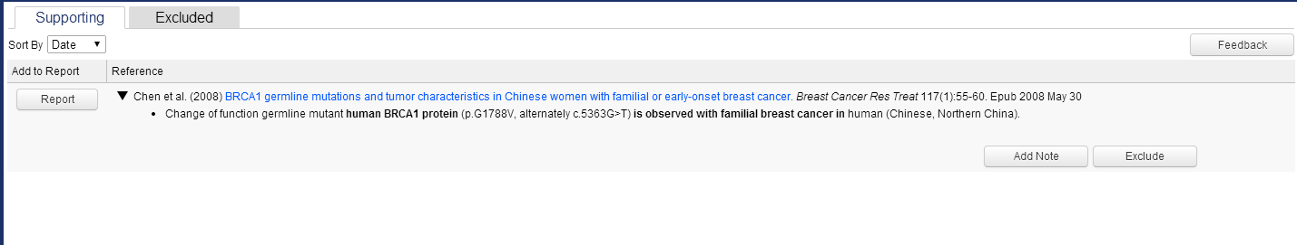
Making a quick evidence-based assessment
Review prior lab observations, domain location, reported cases

Slide 15
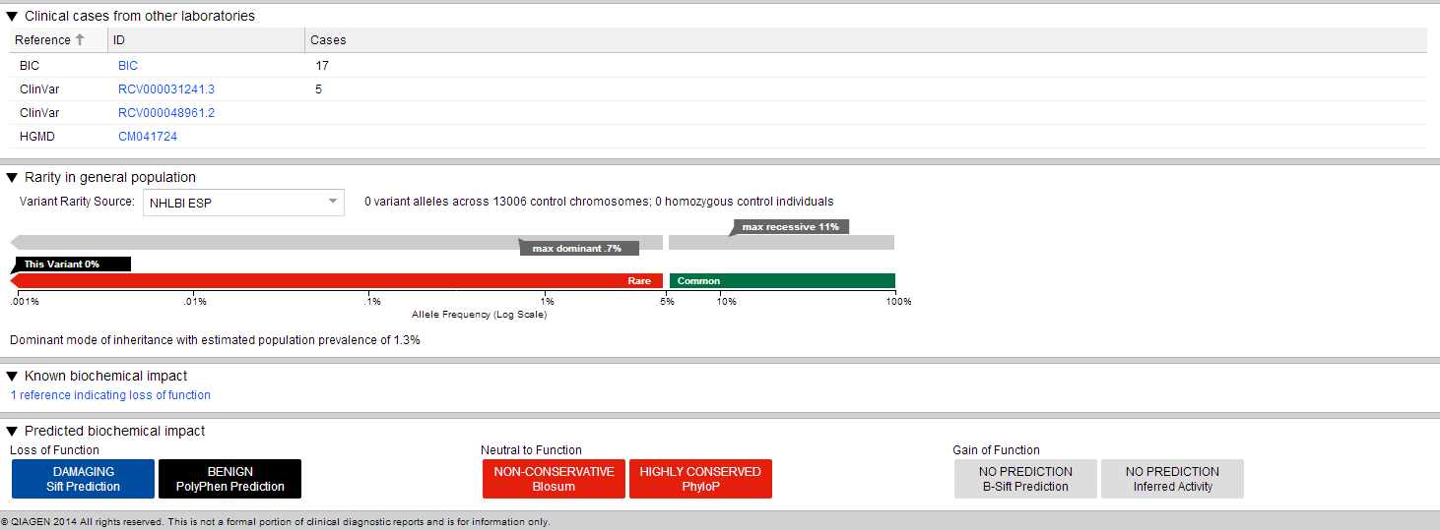
Additional annotation sources, prediction algorithms
Review 3rd party annotations and functional data
Integrate internal lab variant classifications and annotations databases into private instance

Slide 16
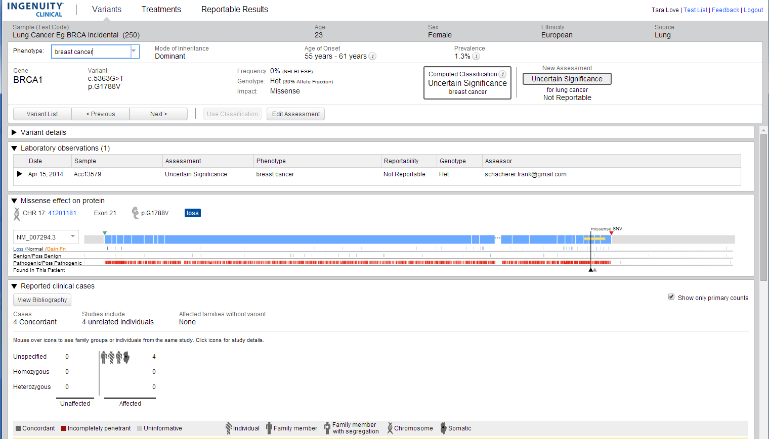
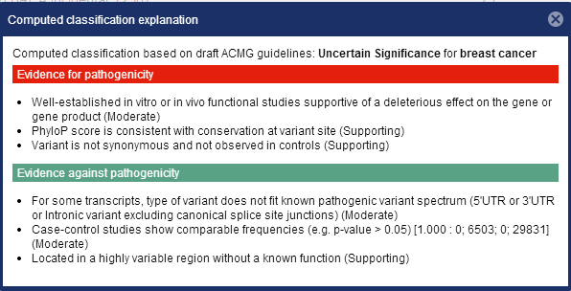
View rationale for rules-based computed classification
Accept or override computed classification

Slide 17
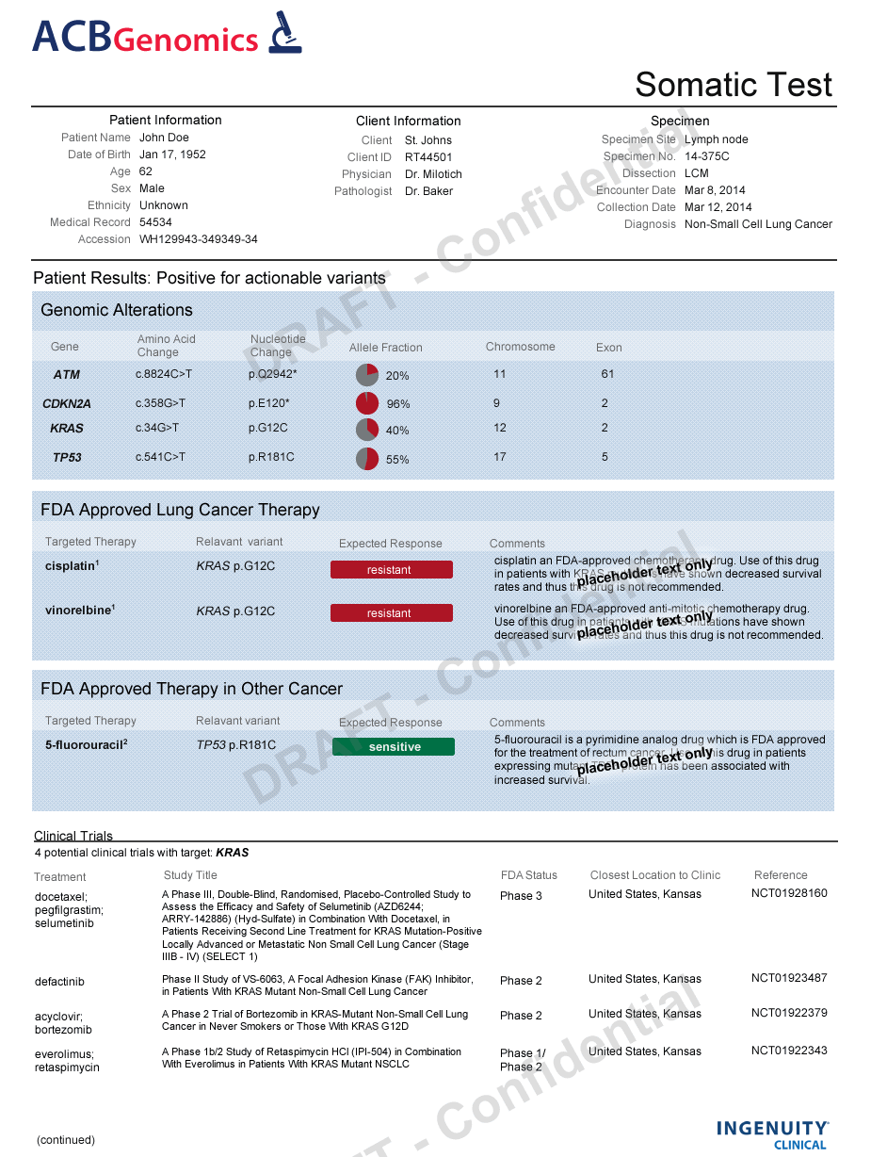
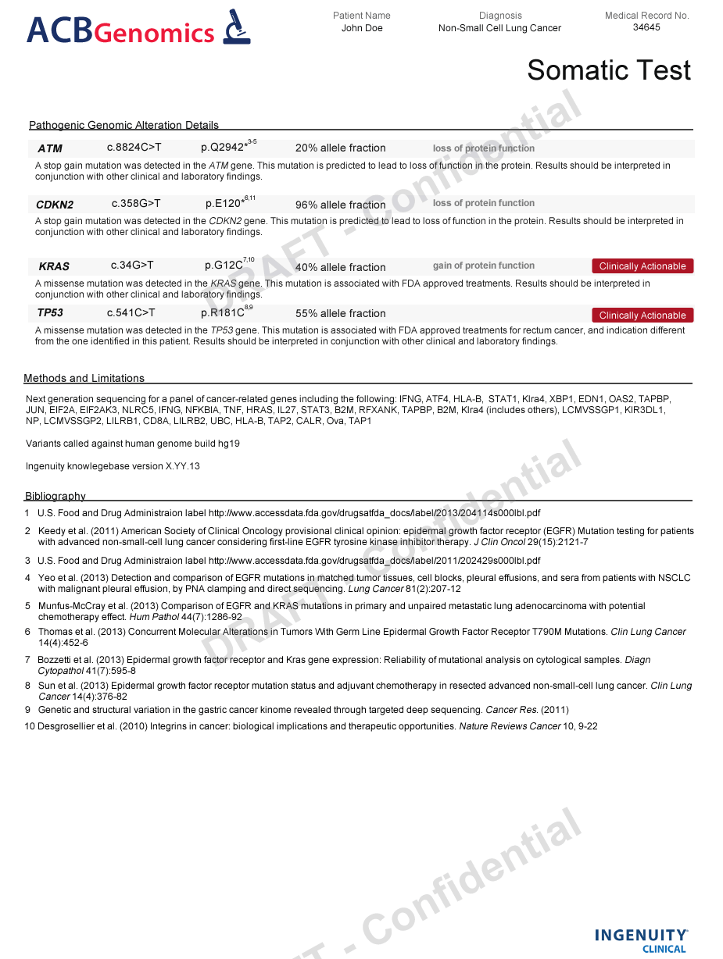
IC Product – Custom Reporting

