Slide 1
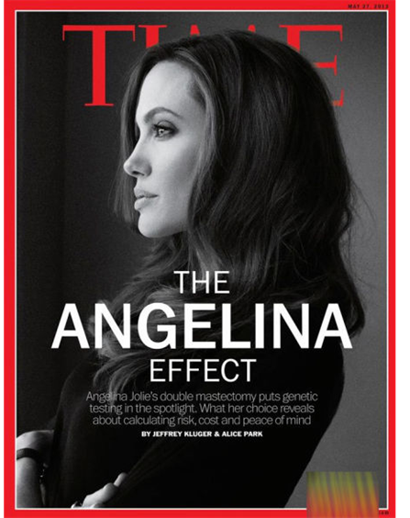
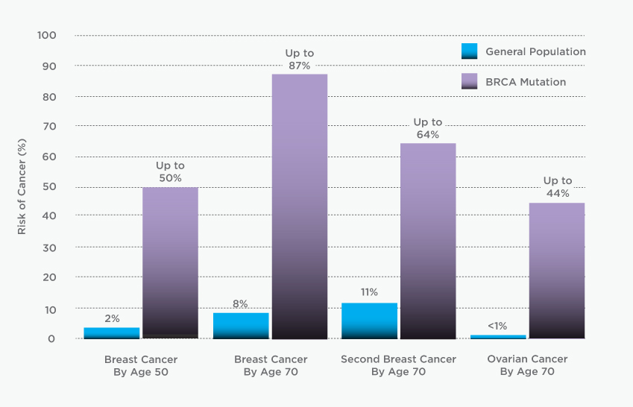
BRCA1 & BRCA2
People who carry a mutation in either of these genes have a condition called Hereditary Breast and Ovarian Cancer (HBOC) syndrome.2-3 They have an up to 87 percent risk of developing breast cancer by age 70.
Source: Myriad Genetics

Slide 2
Myriad Genetics
With 17 years of experience, millions of tests looking for thousands of mutations in the genes, and a $500 million investment, the company was able to amass a huge database that tells which DNA changes increase cancer risk and by how much, and which are inconsequential blips in DNA
In 1996, the company classified 40 percent of mutations as being of uncertain significance because it did not have enough information to know what they meant. By 2004, the figure was down to 20 percent. Now it is just 3 percent.
They find out the meaning by seeing the same mutation in at least 20 other people, asking whether they had cancer and, if so, what type.

Slide 3
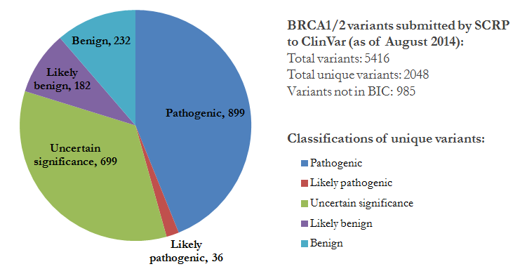
SCRP (Sharing Clinical Reports Project) & ClinVar
SCRP: a volunteer, grass-roots effort by asking cancer clinics and doctors to provide them with all the Myriad data they have from patients who have been tested.

Slide 4
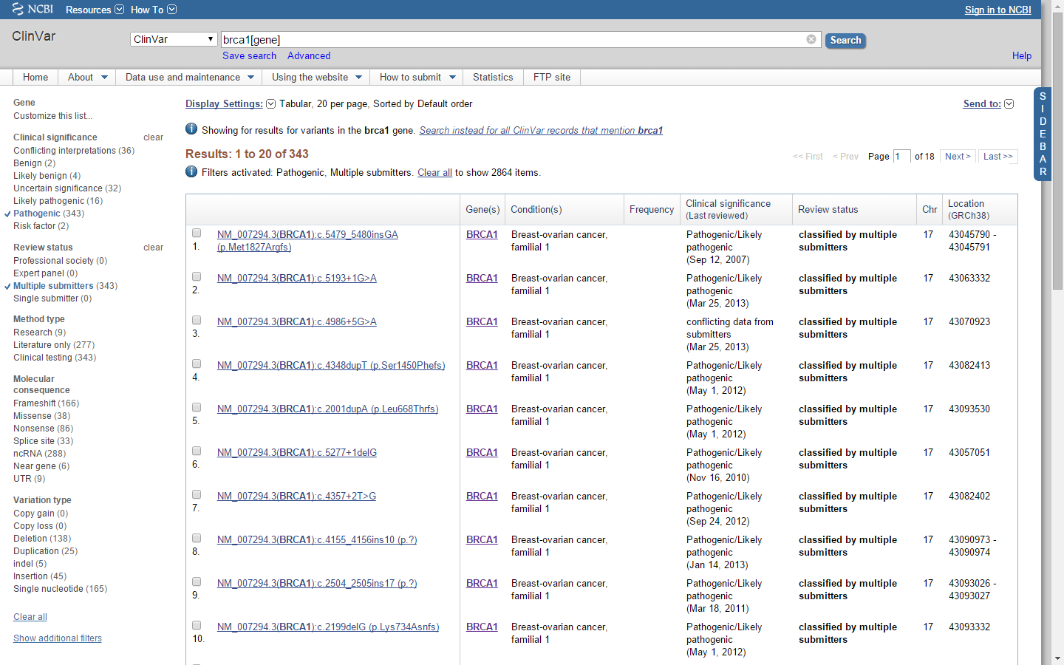
ClinVar: BRCA1 (for example)

