Slide 1
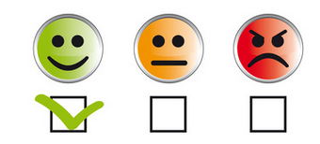

Analyzing Sentiment in GitHub Pull Requests
MS Project by: Kang-il Park
Department of Computer Science and Engineering
Software Engineering Research and Empirical Studies Lab
Committee Members
Bonita Sharif (Advisor), Hamid Bagheri, Witty Srisa-an

Slide 2

Motivation
The expression of sentiment has influence in software engineering
Umer et al. concluded that out of 40,000 reports on Bugzilla, 82.62% of accepted reports displayed positive sentiment while 71.63% of rejected reports displayed negative sentiment
Understanding the full extent of the influence of sentiment
Can help software engineers develop a method of communication that is more effective and collaborative

Slide 3
Research Questions
RQ1: How do current state of the art sentiment analysis tools compare when analyzing sentiment in GitHub pull requests?
RQ2: How does sentiment expressed in pull requests compare to sentiment expressed in commit messages?

Slide 4
Contributions
Compared multiple sentiment analysis tools with the same dataset
Detailed the process of how multiple tools can be compared with the same dataset
Compared the effectiveness of analyzing sentiment of one part of a dataset (pull request comments) vs. another (commit messages)
Notes:
I feel like there should be more information on how to do this
Analyzing Pull Requests is important due to the collaborative nature of GitHub and because of that, understanding sentiment allows more effective collaboration

Slide 5
Related Work
A notable tool for sentiment analysis is SentiStrength by M. Thelwall et al.
Strength scale of 1-5, both positive and negative
Created because previous tools focused on product opinions with complete sentences rather than short, informal text in social media that are not grammatically correct
Guzman et al. conducted a case study on 29 GitHub projects with SentiStrength
SentiStrength was run on commit comments
Results displayed a high standard deviation despite the relatively neutral average

Slide 6
Related Work – Continued
Domain-specific variations in the meaning of frequently used terms provide worse results for messages in a software engineering context
Islam et al. developed a modified version of SentiStrength, SentiStrength-SE with a domain-specific dictionary and heuristics to achieve an overall accuracy of 81% vs 66% of SentiStrength
SentiStrength-SE was used to determine whether GitHub pull requests that introduce bugs to a given system had sentiment
Pull requests with bugs had 28% negative comments vs 17.9% negative comments of pull requests without bugs
Notes:
Everyone talks in a different way, and software engineers at work talk to each other differently from the general public
(because of abudance of words in the ‘problem’ lexicon)
- “The challenges of sentiment detectionin the social programmer ecosystem” by N. Novielli

Slide 7
Related Work – Continued
SentiCR was developed by Ahmed et al. after determining that studies often used SentiStrength or NLTK with poor accuracy and contradictory results
Based on 1600 code review comments from 20 open source projects on Gerrit, sentiment can be predicted with up to 83% accuracy
69% accuracy of SentiStrength
72% accuracy of NLTK

Slide 8
Data Extraction
Pull request information from the GHTorrent dataset were extracted
Comments and commit messages from 54 GitHub pull requests
Faster than using a crawler such as Percival, as API access has rate limits
Available in both Google’s BigQuery and downloadable CSVs
44 Projects with at least 100 stars and pull request comments with quickly recognizable sentiment were chosen
SQL script returned IDs of projects internal to GHTorrent, as IDs used by the API were not used
A subset of GHTorrent containing 22895 pull request comments was downloaded

Slide 9
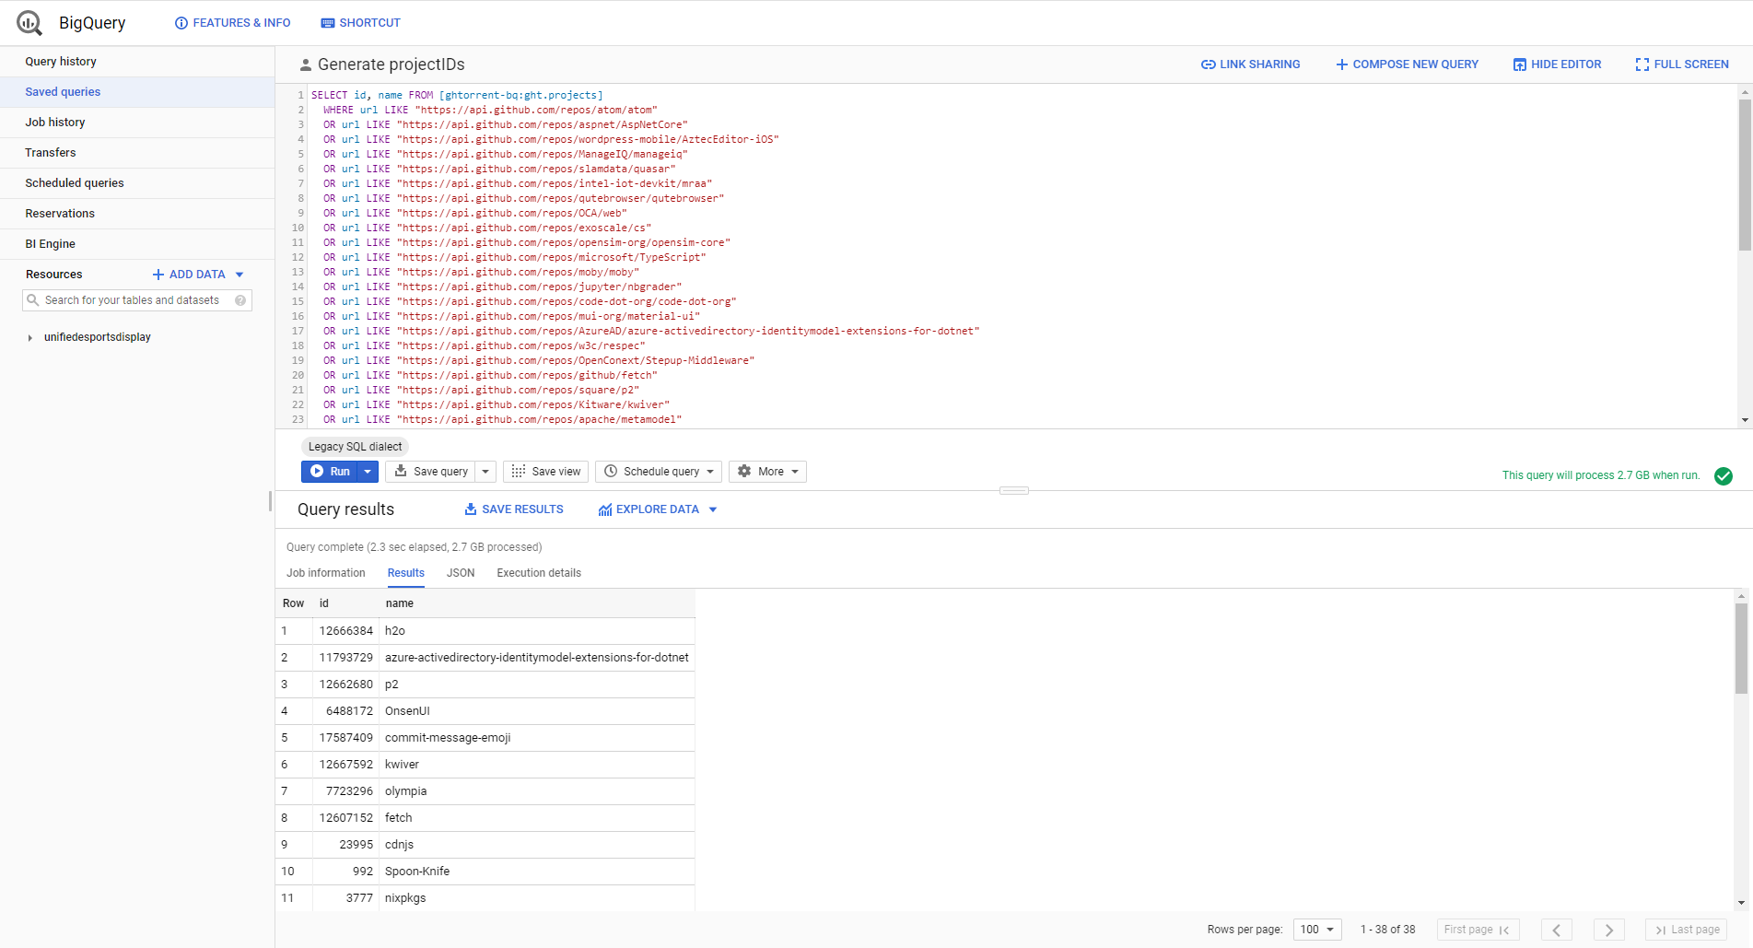
Data Extraction – GHTorrent

Slide 10
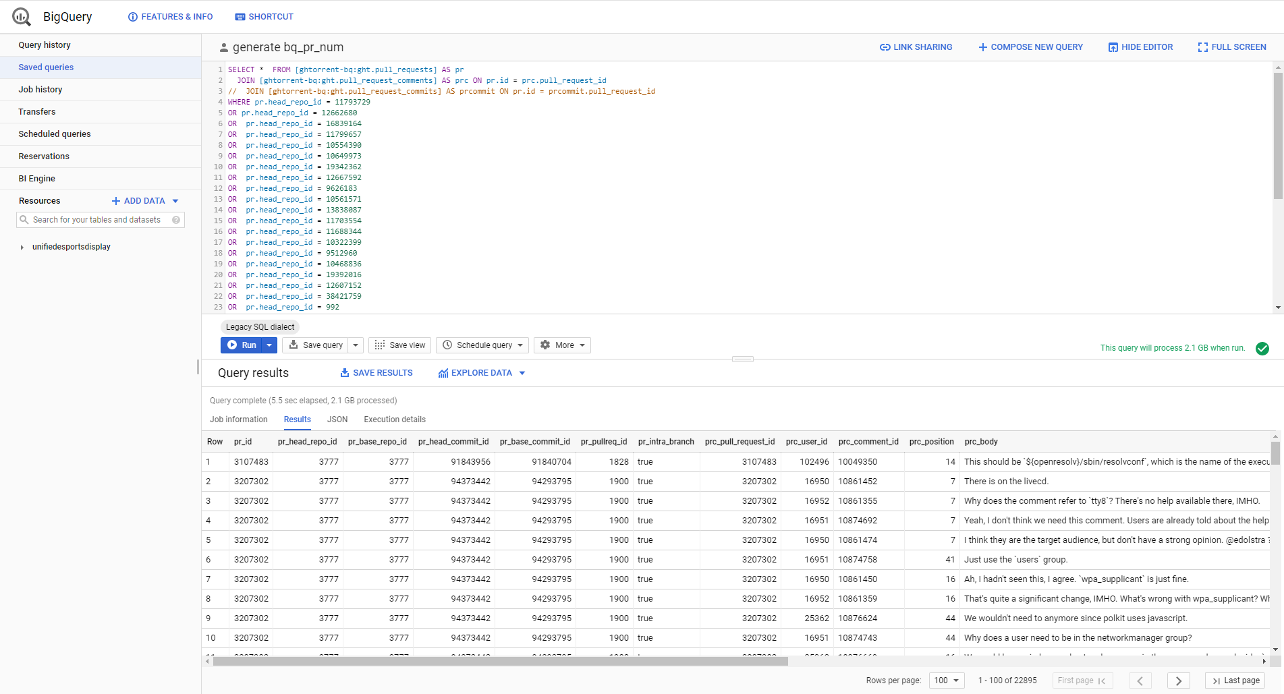
Data Extraction – GHTorrent

Slide 11
Data Extraction – Processing with R
R script was used to further narrow dataset with comments more likely to contain detectable sentiment
Comments containing emojis were used as an indicator that sentiment was expressed by the user
54 pull request comment threads and 30 commit messages were chosen
Pull request text was copied from web browser manually
Commit messages were obtained via API

Slide 12
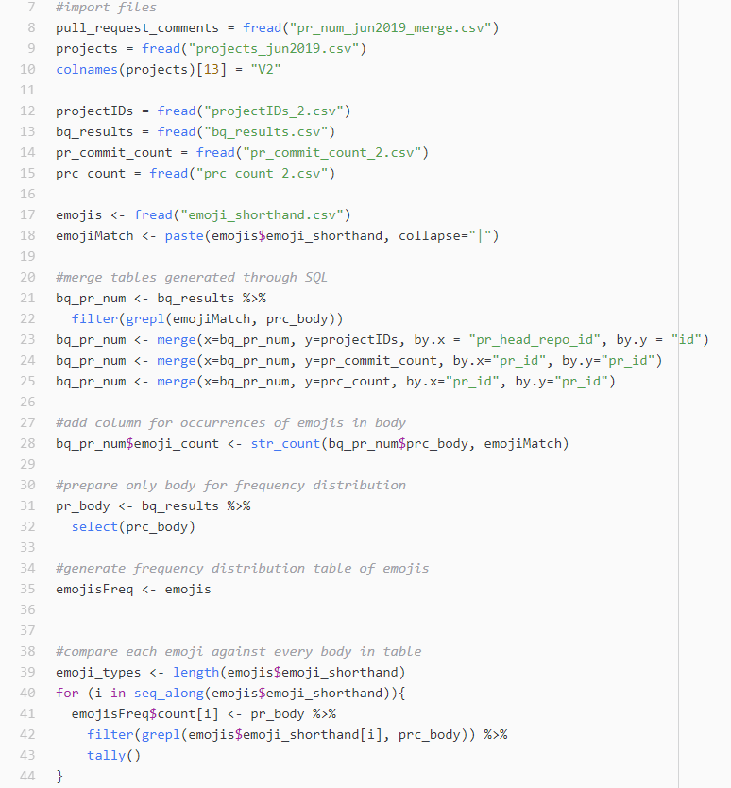
Data Extraction – Processing with R

Slide 13
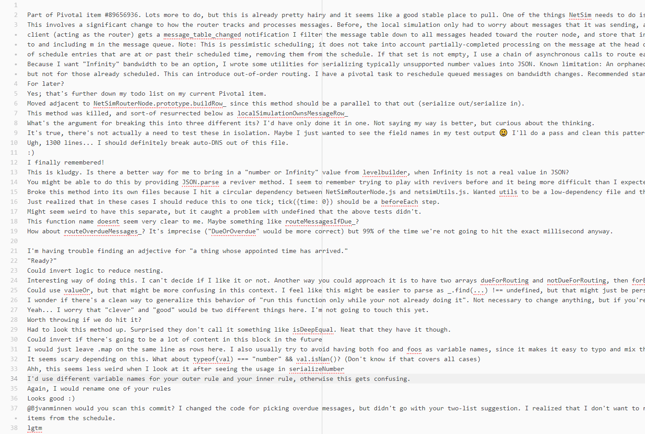
Notes:
Data Extraction – Processing with R

Slide 14
Data Extraction – Processing with R

Slide 15
Data Extraction – Processing with R
This method was killed, and sort-of resurrected below as localSimulationOwnsMessageRow_
What's the argument for breaking this into three different its? I'd have only done it in one. Not saying my way is better, but curious about the thinking.
It's true, there's not actually a need to test these in isolation. Maybe I just wanted to see the field names in my test output 😃 I'll do a pass and clean this pattern up across my entity tests.
Ugh, 1300 lines... I should definitely break auto-DNS out of this file.

Slide 16
Subject Systems and Tasks
Sentiment Analysis tools analyzed
SentiStrength
SentiStrength-SE
SentiCR
NLTK
Stanford CoreNLP
SentiStrength-SE and SentiCR are designed specifically for the software engineering domain
Each tool ran through 54 GitHub pull request comment conversations and 30 commit messages

Slide 17
Sentiment Analysis Tools
Each sentiment analysis tool provides a different criteria and scoring system
Everything will be standardized to positive, negative, neutral
If a tool does not provide a general label for a comment, strongest emotion will be taken into consideration

Slide 18
SentiStrength
Scores range from:
-1 (not negative) to -5 (extremely negative)
1 (not positive) to 5 (extremely positive)
Overall sentiment will be determined based on net score (e.g. 0 is neutral, -2 is negative, 3 is positive)
GUI is provided with options for processing entire folders at once

Slide 19
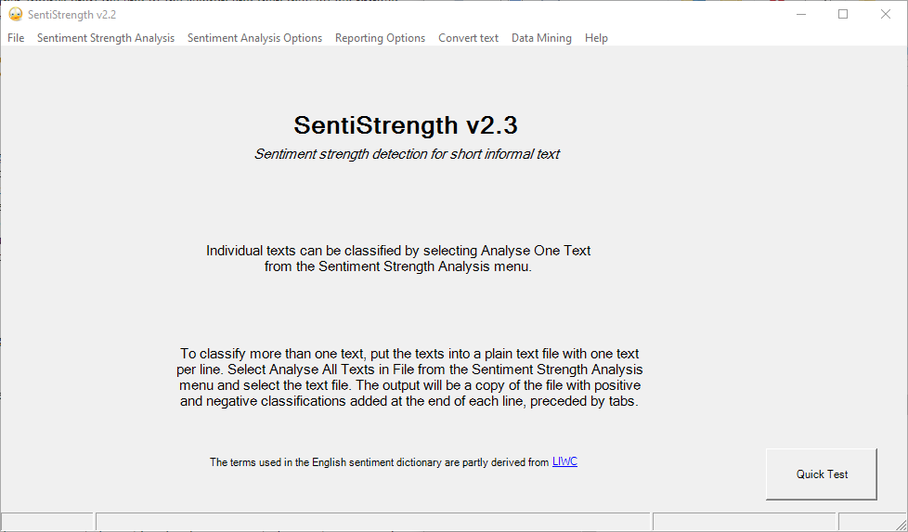
SentiStrength – Continued

Slide 20
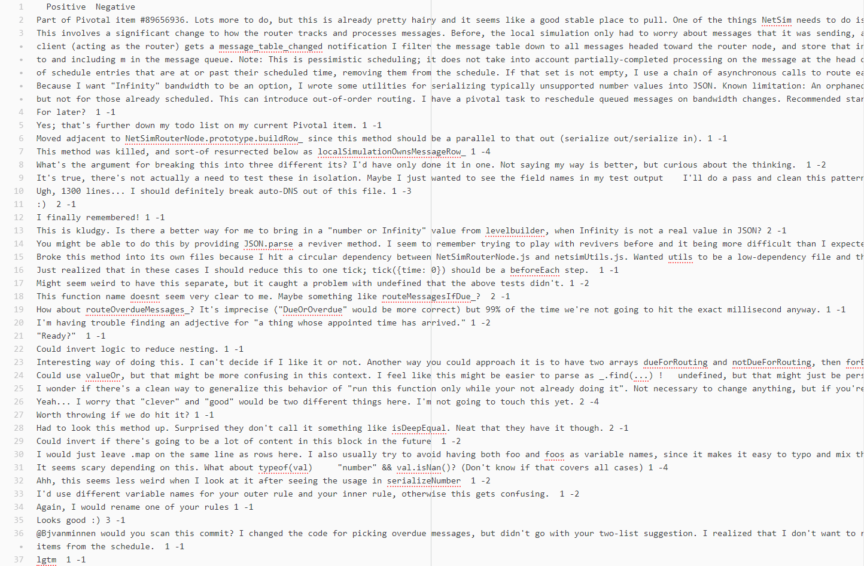
Notes:
SentiStrength – Continued

Slide 21
SentiStrength – Continued

Slide 22
SentiStrength – Continued
This method was killed, and sort-of resurrected below as localSimulationOwnsMessageRow_
Negative
What's the argument for breaking this into three different its? I'd have only done it in one. Not saying my way is better, but curious about the thinking.
Negative
It's true, there's not actually a need to test these in isolation. Maybe I just wanted to see the field names in my test output 😃 I'll do a pass and clean this pattern up across my entity tests.
Neutral
Ugh, 1300 lines... I should definitely break auto-DNS out of this file.
Negative

Slide 23
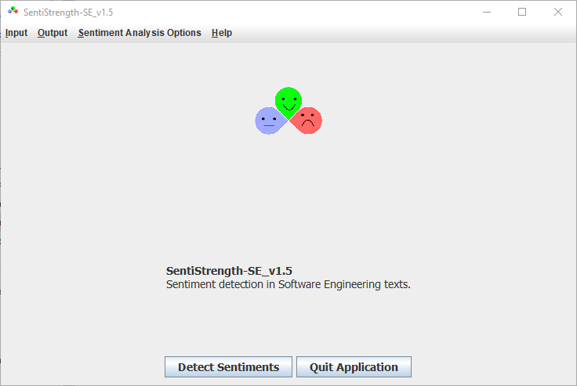
SentiStrength-SE
Same scoring system as SentiStrength, as it is a modified version
GUI is also provided, but not as intuitive

Slide 24
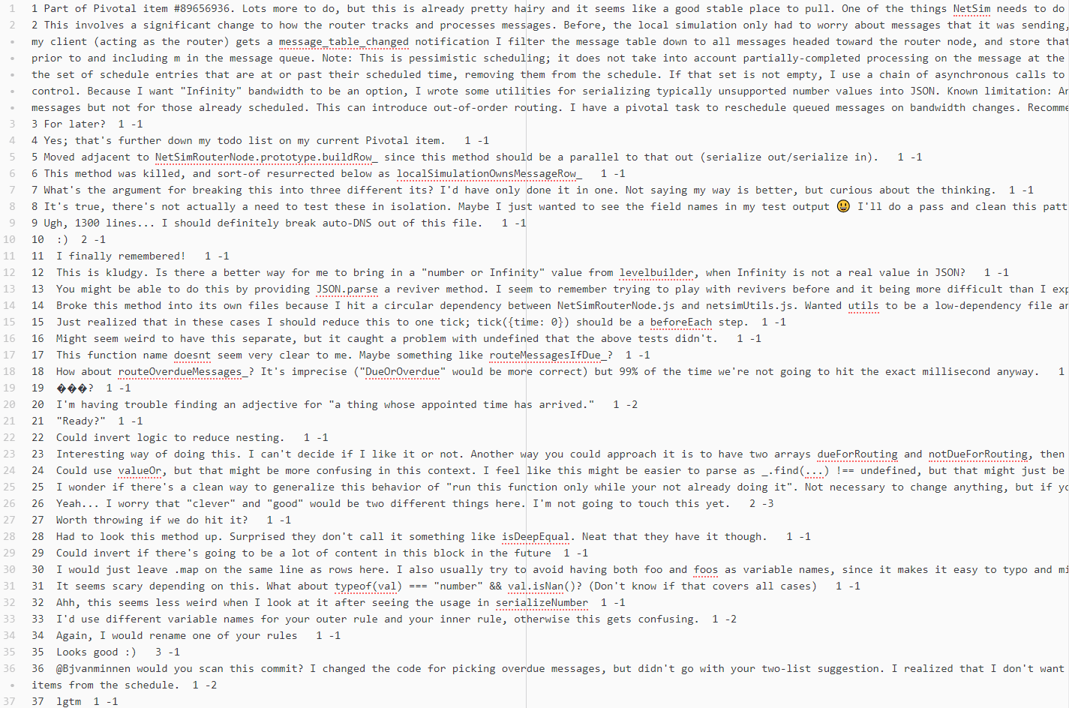
Notes:
SentiStrength-SE – Continued

Slide 25
SentiStrength-SE – Continued

Slide 26
SentiStrength-SE – Continued
This method was killed, and sort-of resurrected below as localSimulationOwnsMessageRow_
Neutral
What's the argument for breaking this into three different its? I'd have only done it in one. Not saying my way is better, but curious about the thinking.
Netural
It's true, there's not actually a need to test these in isolation. Maybe I just wanted to see the field names in my test output 😃 I'll do a pass and clean this pattern up across my entity tests.
Netural
Ugh, 1300 lines... I should definitely break auto-DNS out of this file.
Neutral

Slide 27
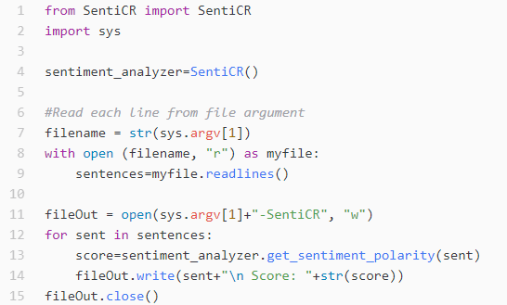
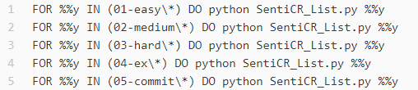
SentiCR
Available as a Python script in a publicly available GitHub repository
Single score ranging from positive to negative
A series of scripts were written to run SentiCR over multiple files and directories

Slide 28
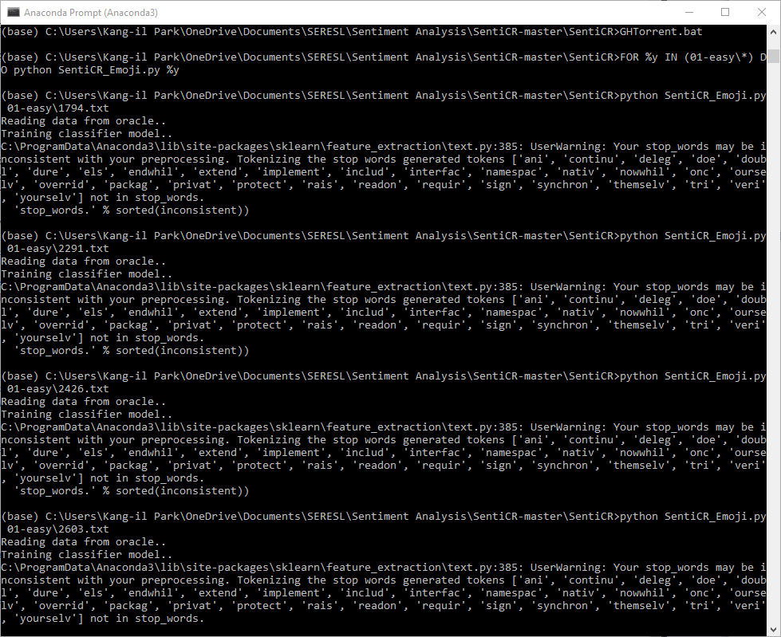
Notes:
SentiCR – Continued

Slide 29
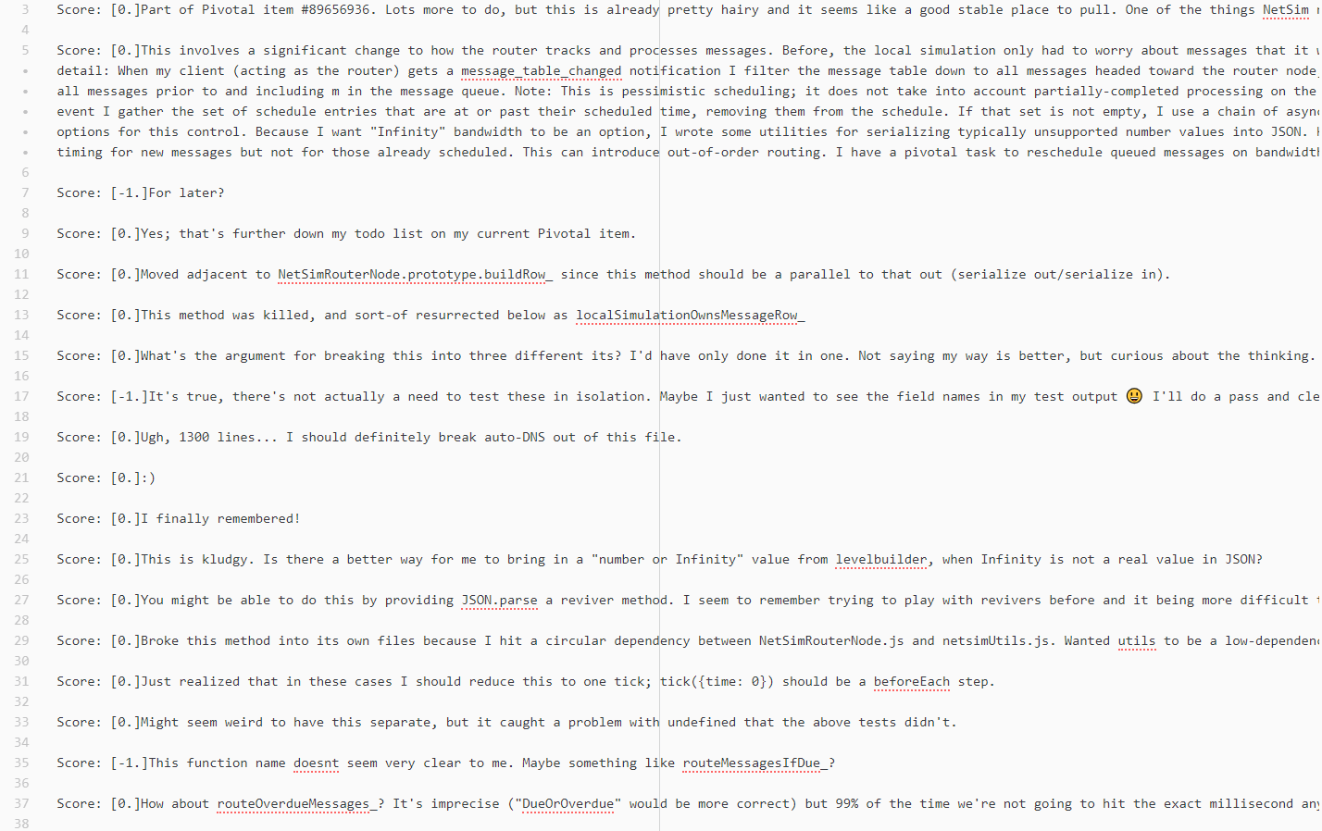
Notes:
SentiCR – Continued

Slide 30
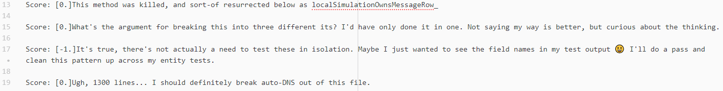
SentiCR – Continued

Slide 31
SentiCR – Continued
This method was killed, and sort-of resurrected below as localSimulationOwnsMessageRow_
Neutral
What's the argument for breaking this into three different its? I'd have only done it in one. Not saying my way is better, but curious about the thinking.
Neutral
It's true, there's not actually a need to test these in isolation. Maybe I just wanted to see the field names in my test output 😃 I'll do a pass and clean this pattern up across my entity tests.
Negative
Ugh, 1300 lines... I should definitely break auto-DNS out of this file.
Netural

Slide 32
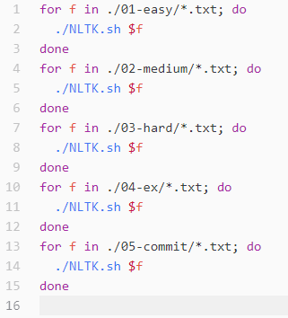
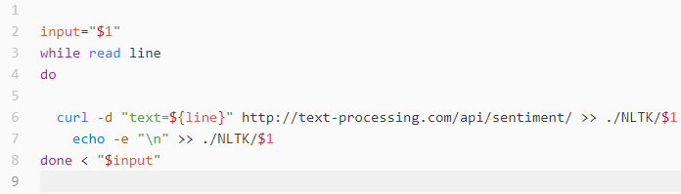
NLTK
An online API version of NLTK was accessed via Curl
3 probabilities of positive, negative, neutral were returned
Label was given based on highest probability
Scripts were written to run NLTK over multiple files and directories

Slide 33
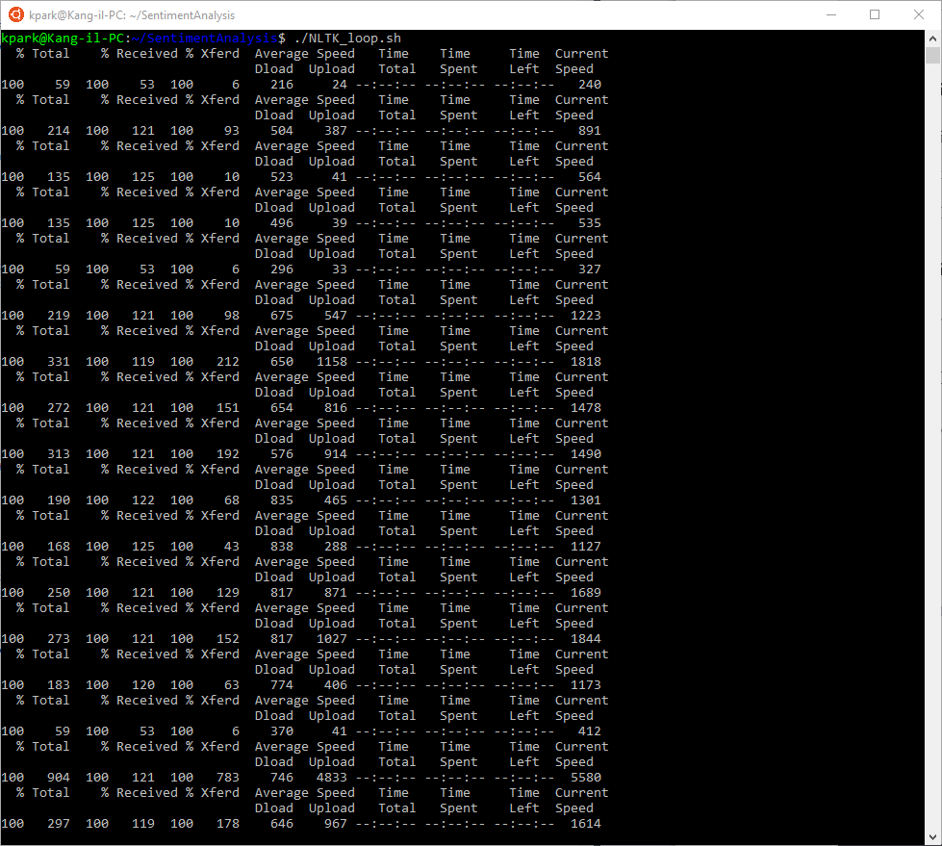
Notes:
NLTK – Continued

Slide 34
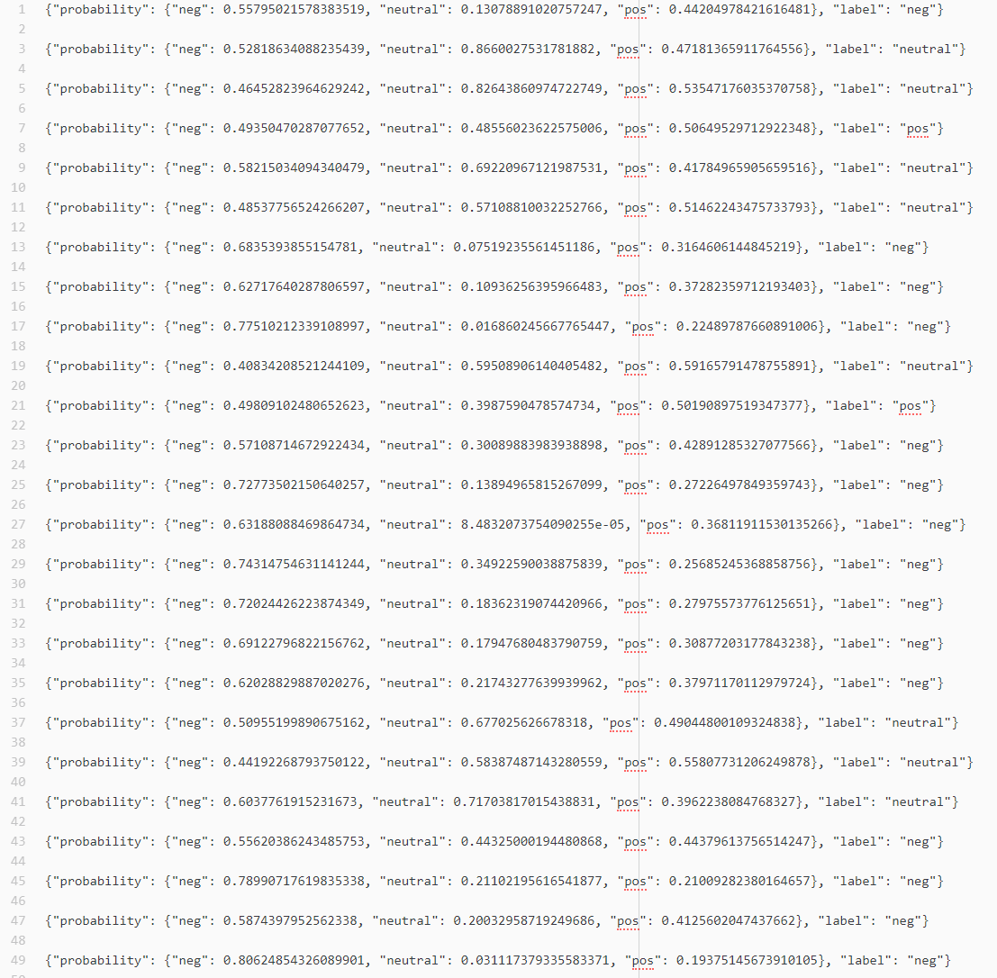
NLTK – Continued

Slide 35
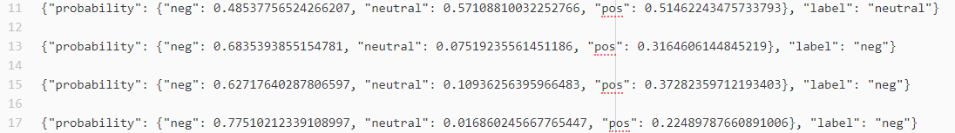
NLTK – Continued

Slide 36
NLTK – Continued
This method was killed, and sort-of resurrected below as localSimulationOwnsMessageRow_
Neutral
What's the argument for breaking this into three different its? I'd have only done it in one. Not saying my way is better, but curious about the thinking.
Negative
It's true, there's not actually a need to test these in isolation. Maybe I just wanted to see the field names in my test output 😃 I'll do a pass and clean this pattern up across my entity tests.
Negative
Ugh, 1300 lines... I should definitely break auto-DNS out of this file.
Negative

Slide 37
Stanford CoreNLP
Generates a sentiment parse tree and combines each node for a general sentiment
Sentiment ranges from very negative to very positive
Stanford CoreNLP was downloaded and ran locally
Another series of scripts were used to run program over multiple directories as well

Slide 38
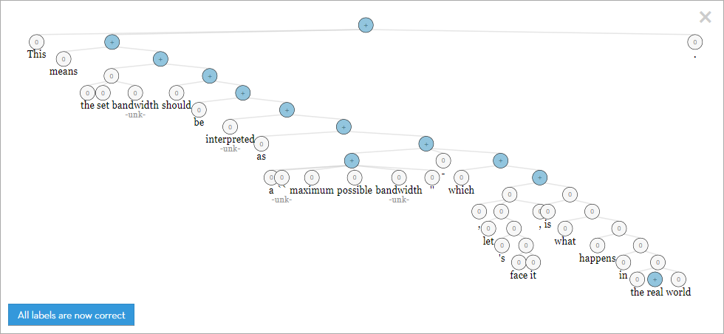
Stanford CoreNLP – Continued

Slide 39
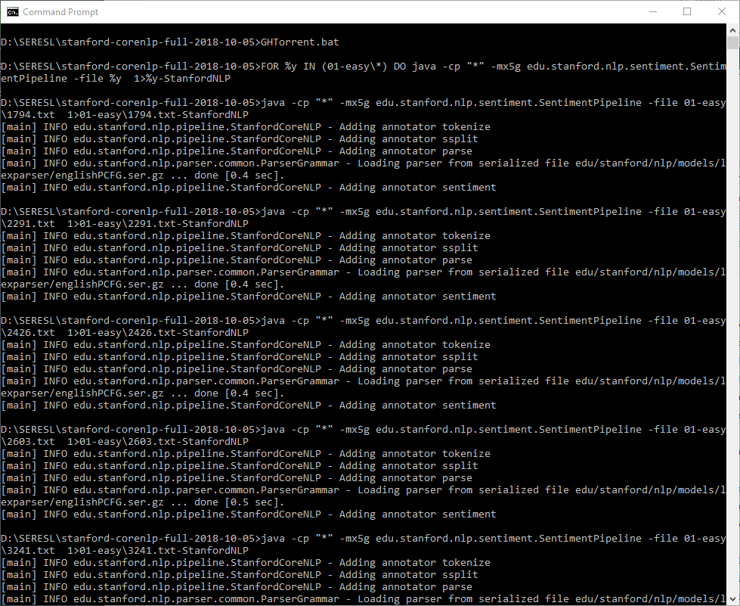
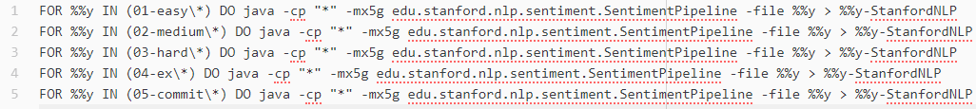
Stanford CoreNLP – Continued

Slide 40
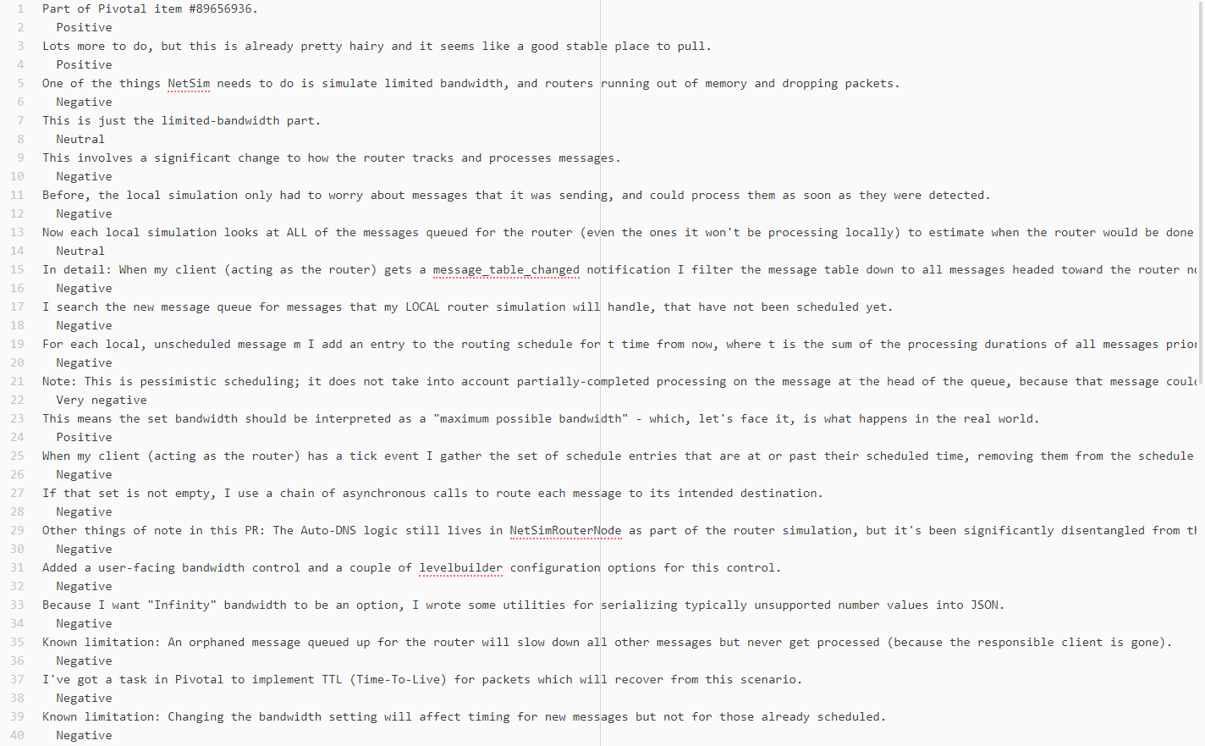
Stanford CoreNLP – Continued

Slide 41
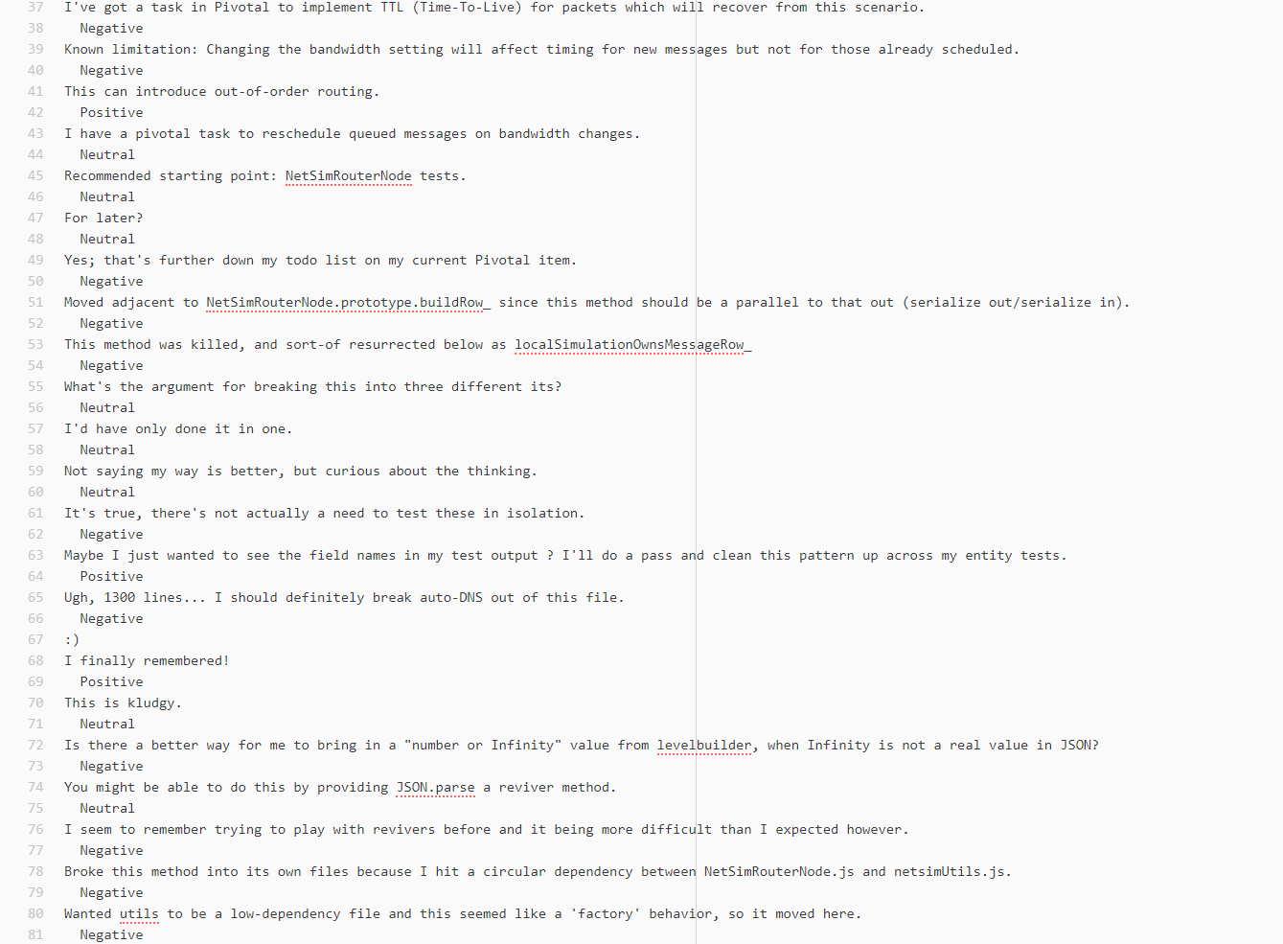
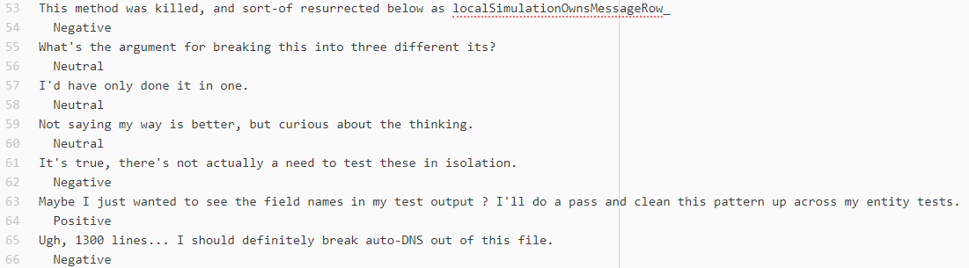
Stanford CoreNLP – Continued

Slide 42
Stanford CoreNLP – Continued
This method was killed, and sort-of resurrected below as localSimulationOwnsMessageRow_
Negative
What's the argument for breaking this into three different its? I'd have only done it in one. Not saying my way is better, but curious about the thinking.
Neutral
It's true, there's not actually a need to test these in isolation. Maybe I just wanted to see the field names in my test output 😃 I'll do a pass and clean this pattern up across my entity tests.
Neutral
Ugh, 1300 lines... I should definitely break auto-DNS out of this file.
Negative

Slide 43
Pre-processing
R Script was used to combine results from all 5 tools
Imported every output file and combine them into tables
Exported to CSV for further processing as spreadsheet

Slide 44
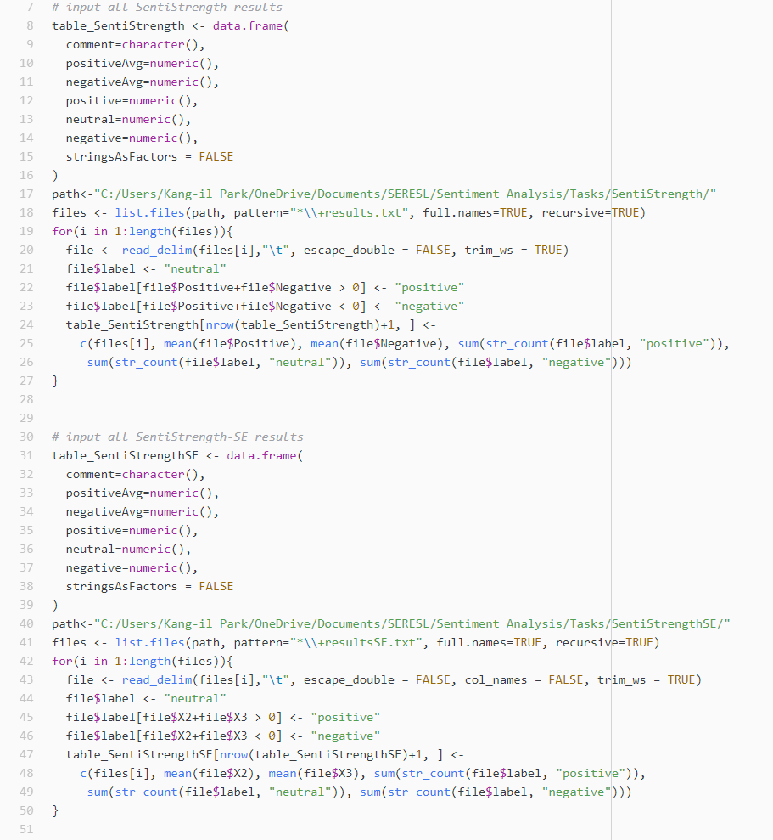
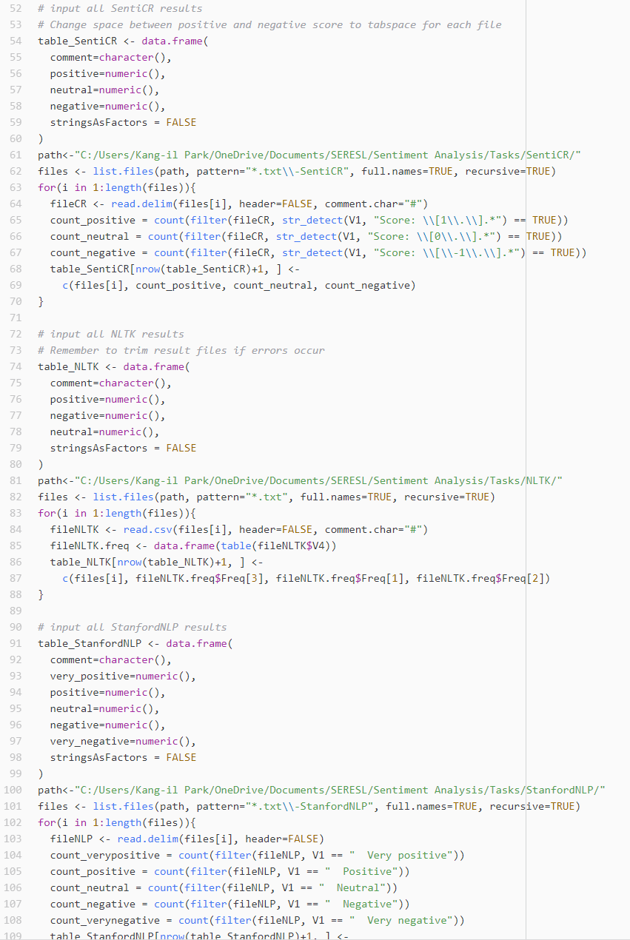
Pre-processing

Slide 45
RQ1 Results
How do current state of the art sentiment analysis tools compare when analyzing sentiment in GitHub pull requests?

Slide 46
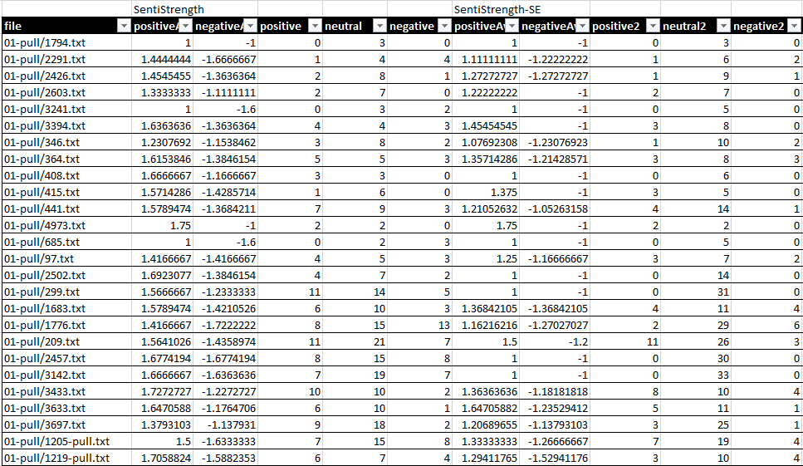
RQ1 Results – Continued

Slide 47
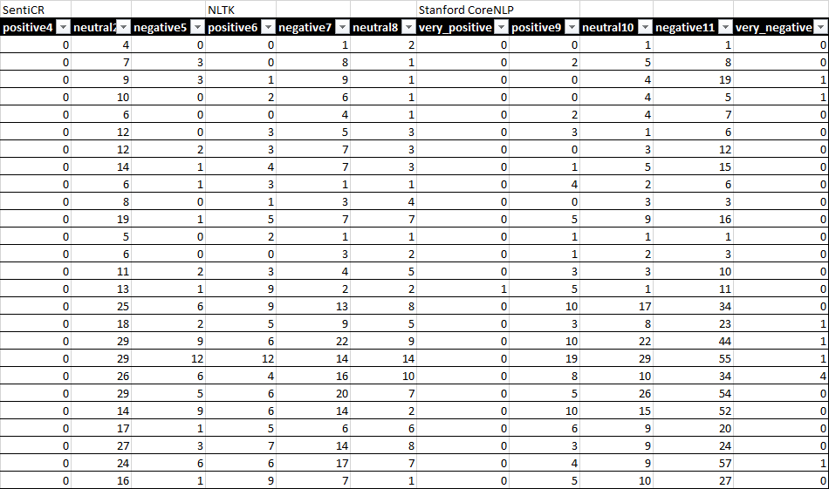
RQ1 Results – Continued

Slide 48
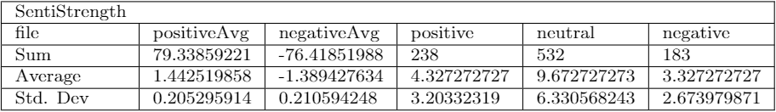
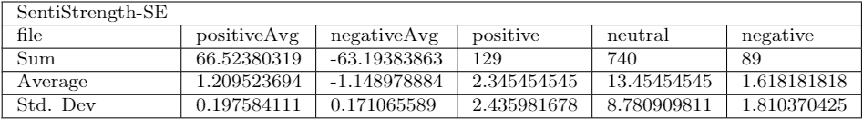
RQ1 Results – Continued

Slide 49
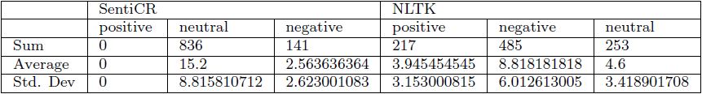
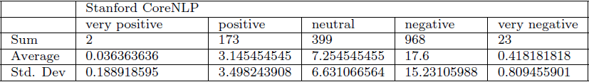
RQ1 Results – Continued

Slide 50
RQ1 Results
How do current state of the art sentiment analysis tools compare when analyzing sentiment in GitHub pull requests?
SentiStrength-SE and SentiCR are more likely to interpret pull request comments as neutral
Other tools are far more likely to interpret a given comment as negative
NLTK is 244% (or 3.44 times) more likely to interpret a comment as negative
SentiStrength is 20.9% more likely to interpret a comment as negative

Slide 51
RQ2 Results
How does sentiment expressed in pull requests compare to sentiment expressed in commit messages?

Slide 52
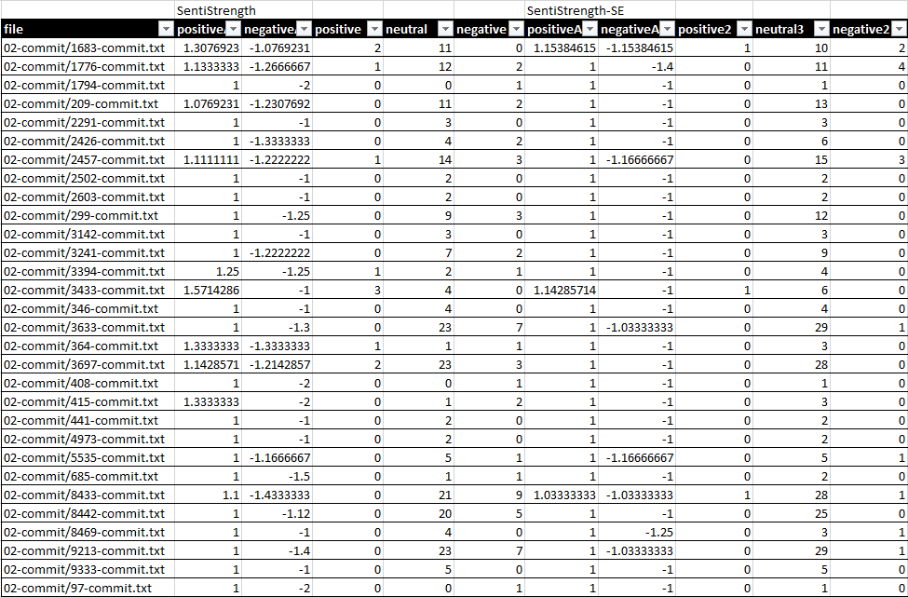
RQ2 Results – Continued

Slide 53
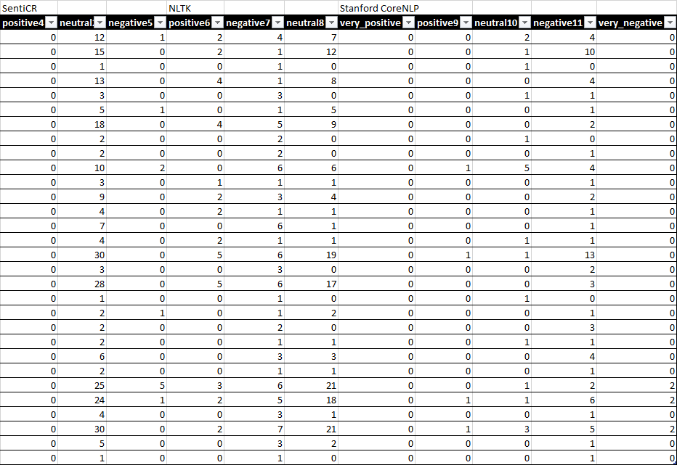
RQ2 Results – Continued

Slide 54
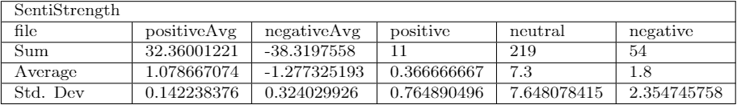
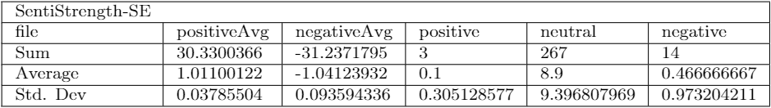
RQ2 Results – Continued

Slide 55
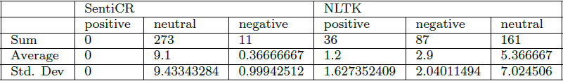
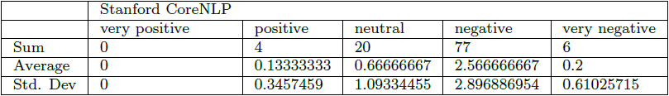
RQ2 Results – Continued

Slide 56
RQ2 Results
How does sentiment expressed in pull requests compare to sentiment expressed in commit messages?
(From Pull Request comments to Commit messages) Of sentiment interpreted by SentiStrength-SE, SentiCR, and NLTK:
Average positive strength from 1.21 to 1.01 and average negative strength of -1.15 to -1.04 for SentiStrength-SE
Percentage of negative comments reduced from 14.43% to 3.87% and 50.79% to 30.63% for SentiCR and NLTK
For SentiStrength and Stanford CoreNLP
Average positive strength from 1.44 to 1.08 and average negative strength from -1.39 to -1.28, but standard deviation goes from 0.21 to 0.324
Negative comments go from 63.32% to 77.57% for Stanford CoreNLP
Notes:
Another thing to note, Stanford CoreNLP gets 0 “very positive” commit messages

Slide 57
Threats to Validity
Internal
Multiple settings and parameters are available for each tool with the potential to dramatically alter results
Everything is run with out-of-the-box settings
External
Number of repositories in dataset may not be comprehensive enough
Active projects with at least 100 stars were chosen
Construct
Number of comments expressing sentiment in dataset may not be comprehensive enough
Pull requests with criteria for sentiment expression are chosen
Conclusion
Every repository may provide different results for a given tool
Multiple large projects with explicit expression of sentiment was used
Notes:
Conclusion: For example, each repository may have different contributors with differing mannerisms in terms of how they write their comments.

Slide 58
Discussion and Implications
RQ1: How do current state of the art sentiment analysis tools compare when analyzing sentiment in GitHub pull requests?
Designing a tool specifically for the software engineering domain provides more useful results
Despite the fact that Stanford CoreNLP is arguably the most sophisticated tool, results are inaccurate due to being trained from movie reviews
RQ2: How does sentiment expressed in pull requests compare to sentiment expressed in commit messages?
More studies should use pull request comments for dataset rather than commit messages, as pull request comments tend to be conversational threads vs. commit messages being titles

Slide 59
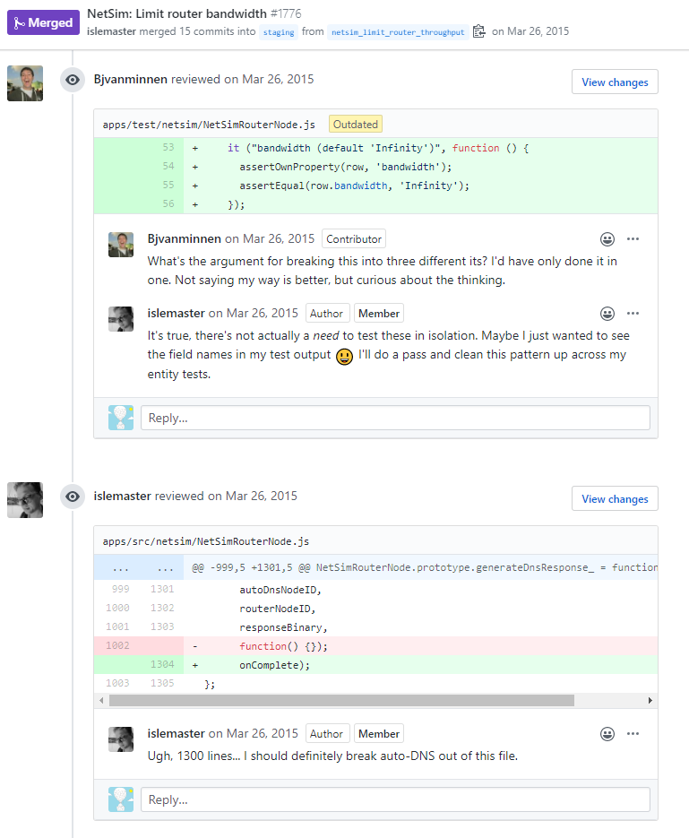
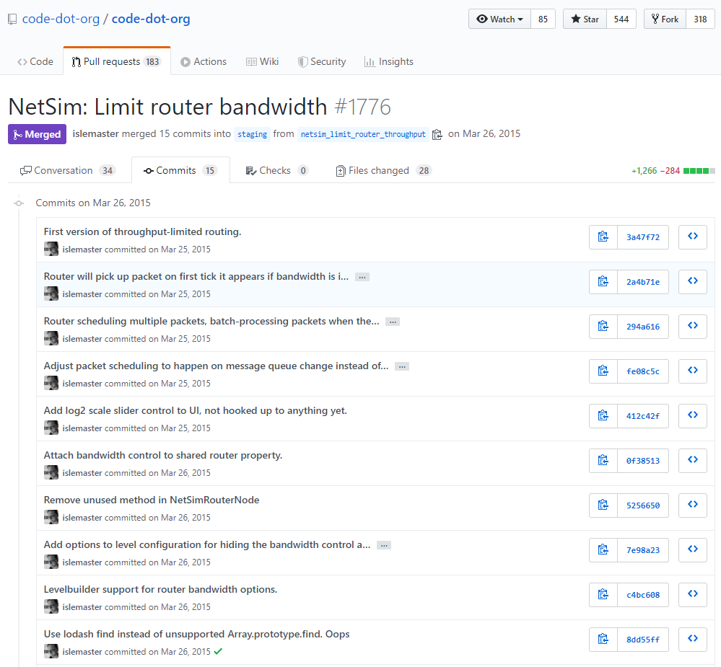
Discussion and Implications

Slide 60
Conclusions and Future Work
A comparison of multiple sentiment analysis tools across the same dataset shows increased accuracy with tools designed for the software engineering domain
When messages from GitHub are used for sentiment analysis studies, pull request comments provide more sentiment than commit messages
Possible Future Work:
Comparing tool results against human results
Especially because emojis were not taken into consideration
A tool that can easily compare multiple sentiment analysis tools against each other

Slide 61
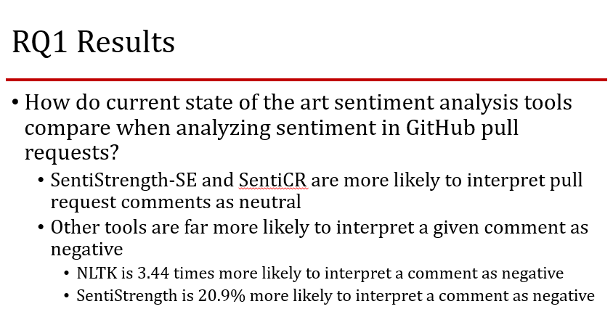
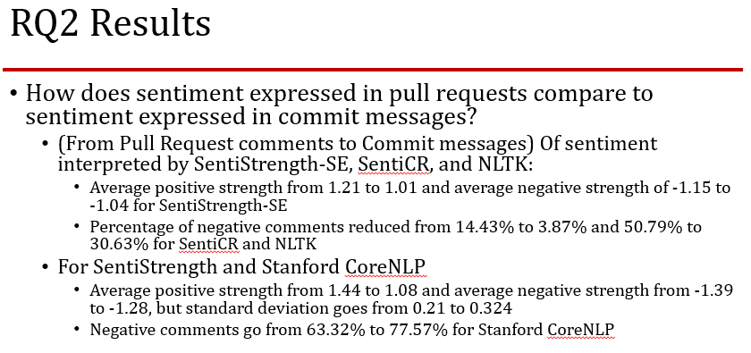
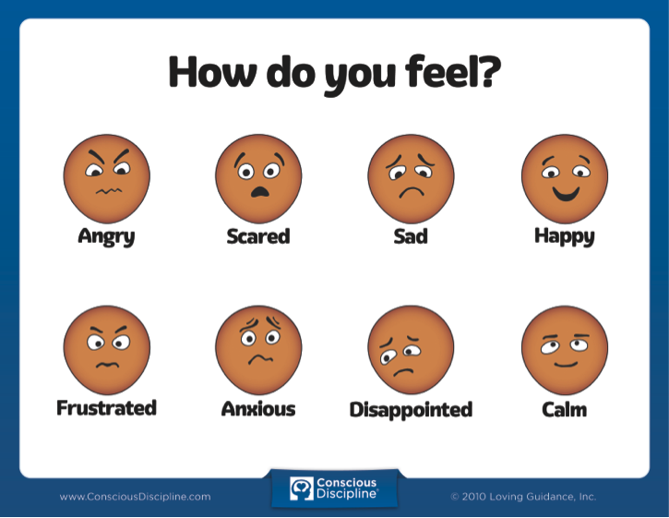
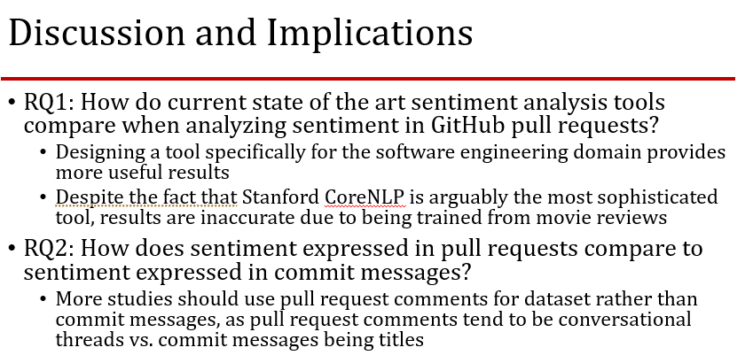


Thank you!

