Slide 1
Enriching Word Vector
With Subword Information
Bag of Tricks
for Efficient Text Classification
Piotr Bojanowski, Edouard Grave,
Armand Joulin, Tomas Mikolov
Facebook AI Research
(TACL ‘17)
Piotr Bojanowski, Edouard Grave,
Armand Joulin, Tomas Mikolov
Facebook AI Research
(EACL ‘17)
Kang Cho
chokang92 @ korea.ac.kr
Data Intelligence Lab, Koera University
2019.09.11

Slide 2
Enriching Word Vector
With Subword Information
Piotr Bojanowski, Edouard Grave,
Armand Joulin, Tomas Mikolov
Facebook AI Research
(TACL ‘17)

Slide 3
Problem Statement
How to improve word representations
using morphological information?

Slide 4
Motivation
communication
communicative
communicatively

Slide 5
Motivation
communication
communicative
communicatively

Slide 6
Motivation
communication
communicative
communicatively
[0 0 0 0 1 0 0 ]
[0 0 0 1 0 0 0 ]
[0 0 0 0 0 0 1 ]

Slide 7
Motivation
communication
communicative
communicatively
[0 0 0 0 1 0 0 ]
[0 0 0 1 0 0 0 ]
[0 0 0 0 0 0 1 ]
Not enough

Slide 8
Motivation
communication
communicative
communicatively
[0 0 0 0 1 0 0 ]
[0 0 0 1 0 0 0 ]
[0 0 0 0 0 0 1 ]
Not enough
happy-day

Slide 9
Motivation
communication
communicative
communicatively
[0 0 0 0 1 0 0 ]
[0 0 0 1 0 0 0 ]
[0 0 0 0 0 0 1 ]
Not enough
happy-day
Out-of-vocabulary

Slide 10
Motivation
communication
communicative
communicatively
[0 0 0 0 1 0 0 ]
[0 0 0 1 0 0 0 ]
[0 0 0 0 0 0 1 ]
Not enough
happy-day
Out-of-vocabulary
What is this?

Slide 11
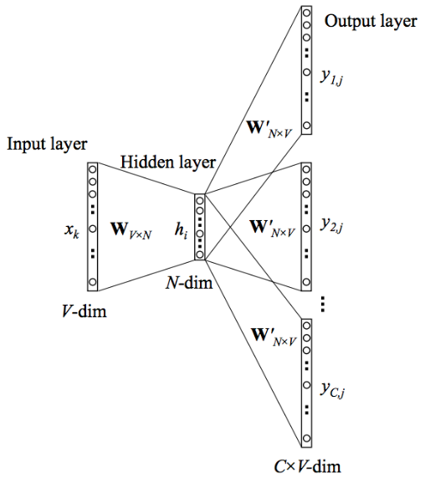
Previous Work
[Word2Vec]
(Distributed Representations of Words and Phrases and their Compositionality,
Tomáš Mikolov, Ilya Sutskever, Kai Chen, Greg S. Corrado, and Jeff Dean. 2013b)
Missing word internal information
Out-of-vocabulary word
Problem
Notes:
COMMUNICATION / COMMUNICATIVE

Slide 12
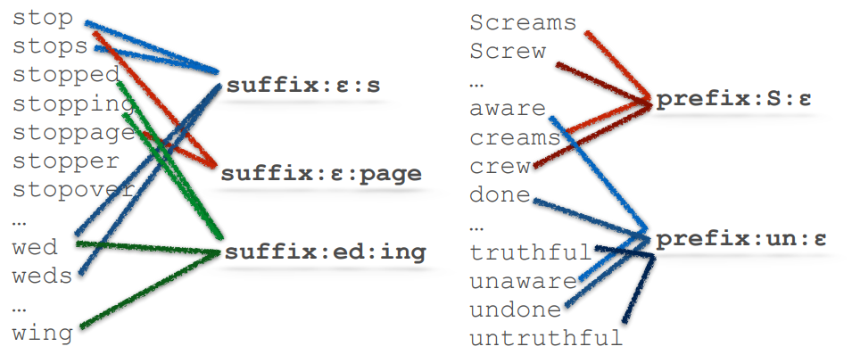
Previous Work
[Unsupervised Morphology Induction Using Word Embeddings]
(Radu Soricut, Franz Och .2015)
- From vocabulary, extract morphological information. (prefix & suffix only)
Notes:
COMMUNICATION / COMMUNICATIVE

Slide 13
Previous Work
[Unsupervised Morphology Induction Using Word Embeddings]
(Radu Soricut, Franz Och .2015)
- From vocabulary, extract morphological information. (prefix & suffix only)
Notes:
COMMUNICATION / COMMUNICATIVE

Slide 14
Contribution
They suggest an extension of the continuous skip-gram model,
which takes into account subword information.
2. The model solves the out-of-vocabulary problem.
They present a simple model without complex methods of extracting
morphological information.
Notes:
전체적인 문장 다듬을 것, 문법확인

Slide 15
Model
[Subword model]
Character
N-grams
Embedding
of N-grams
<wh
Embedding
Layer
whe
Hidden
Layer
Output Layer
Score
Softmax
it
is
〮〮〮
〮〮〮
〮〮〮
〮〮〮
〮
〮
〮
word
vocabulary
re>
SUM
<where>

Slide 16
Model
How to split a word?
Example) ‘where’
N-grams
2-gram : <w, wh, he, er, re, e>
3-gram : <wh, whe, her, ere, re>
4-gram : <whe, wher, here, ere>
5-gram : <wher, where, here>
6-gram : <where, where>

Slide 17
Model
How to split a word?
Example) ‘where’
N-grams
Special sequence
2-gram : <w, wh, he, er, re, e>
3-gram : <wh, whe, her, ere, re>
4-gram : <whe, wher, here, ere>
5-gram : <wher, where, here>
6-gram : <where, where>
< where >

Slide 18
Model
How to split a word?
Example) ‘where’
N-grams
Special sequence
2-gram : <w, wh, he, er, re, e>
3-gram : <wh, whe, her, ere, re>
4-gram : <whe, wher, here, ere>
5-gram : <wher, where, here>
6-gram : <where, where>
< where >
?

Slide 19
Model
What is the special boundary symbols “<“, “>” ?
- If not?
Trigram of where
actual word of her
whe, her, ere
her
Notes:
<her> / her →마지막정리

Slide 20
Model
What is the special boundary symbols “<“, “>” ?
- If not?
Trigram of where
actual word of her
whe, her, ere
her
Notes:
<her> / her →마지막정리

Slide 21
Model
What is the special boundary symbols “<“, “>” ?
- If not?
Trigram of where
actual word of her
whe, her, ere
her
Need to distinguish between them
Notes:
<her> / her →마지막정리

Slide 22
Model
What is the special boundary symbols “<“, “>” ?
- If not?
Trigram of where
actual word of her
whe, her, ere
her
Need to distinguish between them
- Adding the symbols
Trigram of where
actual word of her
<wh, whe, her, ere, re>
<her>
Notes:
<her> / her →마지막정리

Slide 23
Model
What is the special boundary symbols “<“, “>” ?
- If not?
Trigram of where
actual word of her
whe, her, ere
her
Need to distinguish between them
- Adding the symbols
Trigram of where
actual word of her
<wh, whe, her, ere, re>
<her>
Notes:
<her> / her →마지막정리

Slide 24
Model
[Subword model]
Considering subword information
Character
N-grams
Embedding
of N-grams
<wh : [ 0.02 0.03 -0.01 〮〮〮 0.01 ]
whe : : [ 0.01 0.18 0.05 〮〮〮 -0.05 ]
〮
〮
〮
where> : [ 0.01 0.03 0.09 〮〮〮 -0.01 ]
<where> : [ 0.13 0.06 -0.12 〮〮〮 0.03 ]
<wh
Embedding
Layer
whe
Hidden
Layer
〮〮〮
〮〮〮
SUM
re>
SUM
where : [ 0.16 0.03 -0.07 〮〮〮 0.02 ]
word representation
<where>

Slide 25
Model
[Subword model]
Character
N-grams
Embedding
of N-grams
<wh
Embedding
Layer
whe
Hidden
Layer
Output Layer
Score
Softmax
it
is
〮〮〮
〮〮〮
〮〮〮
〮〮〮
〮
〮
〮
word
vocabulary
re>
SUM
<where>
Computation cost is too expensive.

Slide 26
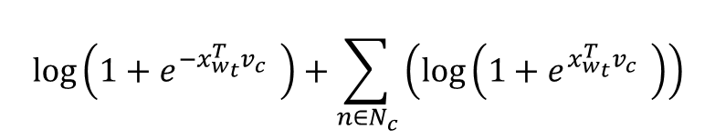
Model
[Subword model]
Negative Sampling
ex) Where are you going?
< Positive >
Select a word in context words.
ex) ‘are’ or ‘you’
< Negative >
Select other words in the vocabulary
by the number of negative sampling.
Hidden
Layer
Output Layer
Score
Sigmoid
‘Positive’
‘Negative’
‘Negative’
‘Negative’
Loss function
$$\log\left(1+e^{−x_{w_{t}}^{T}v_{c} }\right)+\sum_{n∈N_{c}}{\left(\log\left(1+e^{x_{w_{t}}^{T}v_{c} }\right)\right)}$$

Slide 27
Model
[Subword model]
Subword Information
Negative Sampling
Embedding
Layer
Hidden
Layer
Output Layer
〮〮〮
〮〮〮
‘Positive’
‘Negative’
‘Negative’
‘Negative’
SUM

Slide 28
Experiment
Source Code
https://github.com/facebookresearch/fastText
Dataset
Data | Description
Wikipedia dump | Corpus
2013 WMT | Language pairs (English-French, English-German, English-Spanish)
The Europarl and news commentary | Language pairs (English – Russian)
Notes:
자세한 Description을 쓸것 / 접근가능한지 아닌지

Slide 29
Experiment
Baseline
The Skip-gram and CBOW models from the Word2Vec.
The morphological models.
Model Variant
Variants | Vector
sisg- | Using Null Vector
sisg | Summing the n-gram vector
Notes:
3번째 experiment rnn tran 그것도 베이스라인

Slide 30
Experiment
[Model Variant]
FastText sisg-
FastText sisg
<ha : : [ 0.01 0.04 -0.05 〮〮〮 0.01 ]
hap : : : [ 0.02 0.08 0.01 〮〮〮 -0.03 ]
〮
〮
〮
y-day> --: [ 0.01 0.02 0.01 〮〮〮 0.00 ]
<happy-day> : [ 0.00 0.00 0.00 〮〮〮 0.00 ]
happy-day : [ 0.00 0.00 0.00 〮〮〮 0.00 ]
SUM
<happy-day> : [ 0.12 0.01 -0.05 〮〮〮 0.01 ]
Notes:
LMGTFY : Let Me Google that for you

Slide 31
Experiment
[Model Variant]
FastText sisg-
FastText sisg
<ha : : [ 0.01 0.04 -0.05 〮〮〮 0.01 ]
hap : : : [ 0.02 0.08 0.01 〮〮〮 -0.03 ]
〮
〮
〮
y-day> --: [ 0.01 0.02 0.01 〮〮〮 0.00 ]
<happy-day> : [ 0.00 0.00 0.00 〮〮〮 0.00 ]
If ‘happy-day’ is not in the vocabulary,
the word vector is treated as null.
happy-day : [ 0.00 0.00 0.00 〮〮〮 0.00 ]
SUM
<happy-day> : [ 0.12 0.01 -0.05 〮〮〮 0.01 ]
Notes:
LMGTFY : Let Me Google that for you

Slide 32
Experiment
[Model Variant]
FastText sisg-
FastText sisg
<ha : : [ 0.01 0.04 -0.05 〮〮〮 0.01 ]
hap : : : [ 0.02 0.08 0.01 〮〮〮 -0.03 ]
〮
〮
〮
y-day> --: [ 0.01 0.02 0.01 〮〮〮 0.00 ]
<happy-day> : [ 0.00 0.00 0.00 〮〮〮 0.00 ]
If ‘happy-day’ is not in the vocabulary,
the word vector is treated as null.
happy-day : [ 0.00 0.00 0.00 〮〮〮 0.00 ]
SUM
<happy-day> : [ 0.12 0.01 -0.05 〮〮〮 0.01 ]
If there is no specific n-gram of ‘happy-day’ ,
only those n-grams are null.
Notes:
LMGTFY : Let Me Google that for you

Slide 33
Experiment
[Task]
Given pairs of words
Human judgement of similarity
ex) (pair words) tiger : cat
human judgement similarity 7.35
the cosine similarity 6.82
Analogy task
ex) ‘King’ – ‘Man’ + ‘Woman’ = ?
Notes:
싹다 마침표 / 대문자 / Second 수정

Slide 34
Experiment
[Task]
Given pairs of words
Human judgement of similarity
ex) (pair words) tiger : cat
human judgement similarity 7.35
the cosine similarity 6.82
Analogy task
ex) ‘King’ – ‘Man’ + ‘Woman’ = ?
How closely the model
fits similarly to human judgment!
Notes:
싹다 마침표 / 대문자 / Second 수정

Slide 35
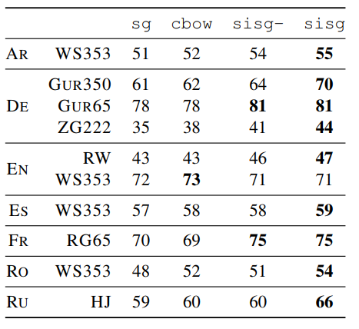
Experiment
[Human similarity judgement]
First,
The model outperforms the baselines.
Second,
The model is powerful
about Rare Words.
(unit : %)
Notes:
싹다 마침표 / 대문자 / Second 수정

Slide 36
Experiment
[Human similarity judgement]
(unit : %)
First,
The model outperforms the baselines.
Second,
The model is powerful
about Rare Words.
Notes:
싹다 마침표 / 대문자 / Second 수정

Slide 37
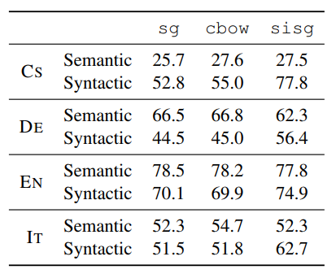
Experiment
[Word analogy task]
(unit : %)
First,
The subword information
improves the syntactic task.
Second,
The semantic performance degrades rather than the baseline.
Notes:
말을 조금더 자세하게 다듬을 것

Slide 38
Experiment
[Word analogy task]
(unit : %)
First,
The subword information
improves the syntactic task.
Second,
The semantic performance degrades rather than the baseline.
Notes:
말을 조금더 자세하게 다듬을 것

Slide 39
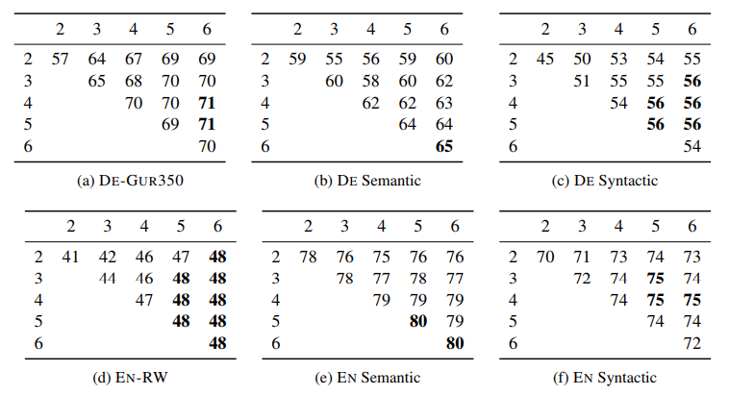
Experiment
[Effect of the size of n-grams]
(unit : %)
First,
Using long n-grams
helps in semantic analogies.
Second,
Character
bigrams are
not informative.
N
N
N
N
N
N
N
N
N
N
N
N
Reasonable n-grams size is 3~6
Notes:
뭐에대한 퍼포먼스, ngram 정확한 해석 (어디에서 어디까지 그램이냐)

Slide 40
Experiment
[Effect of the size of n-grams]
(unit : %)
First,
Using long n-grams
helps in semantic analogies.
Second,
Character
bigrams are
not informative.
N
N
N
N
N
N
N
N
N
N
N
N
Reasonable n-grams size is 3~6
Notes:
뭐에대한 퍼포먼스, ngram 정확한 해석 (어디에서 어디까지 그램이냐)

Slide 41
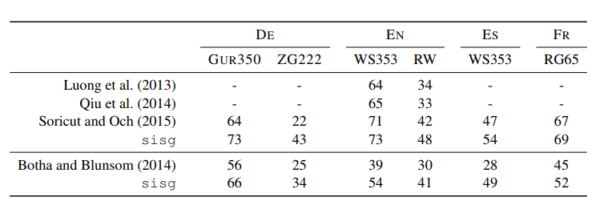
Experiment
[Comparison with morphological representations]
(unit : %)
The approach outperforms other morphological models.
Notes:
논문 다시 읽어볼것 -> 아마 임베딩이랑 다르게 접근했을 가능성ㅇ ㅣ있음

Slide 42
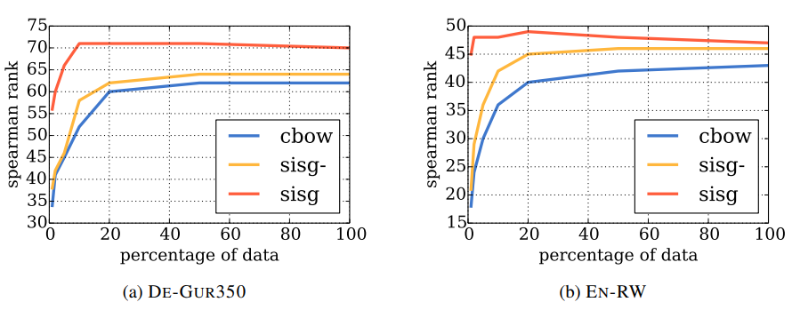
Experiment
[Effect of the size of the training data]
First,
Their model performs better than the baseline.
Second,
Even with fewer datasets, The approach provides
a better word vectors than baseline.
.
Notes:
특정 분야의 경우, 특정분야의 단어들로 모델링하는 것이 효율적 -> 하지만 데이터가 희귀하다 -> 해당 모델 적절
주어 동사 꼭 붙여서

Slide 43
Conclusion
The model prove the effect by expressing word vectors
using subword information.
The model outperforms word2vec skip-gram model
about OOV word problem.
Because of the structural simplicity, the subword model does not require any preprocessing.
Notes:
마침표

Slide 44
Q&A
Q & A
Notes:
FastText 수정사항 embedding
논문두개합치기
해싱 어떻게든
실험은 분리, / 정확한설명덧붙어ㅕ서
Task 각각에 대해 간단하게

Slide 45
Bag of Tricks
for Efficient Text Classification
Piotr Bojanowski, Edouard Grave,
Armand Joulin, Tomas Mikolov
Facebook AI Research
(EACL ‘17)

Slide 46
Problem Statement
How to classify sentences efficiently
with shallow model?

Slide 47
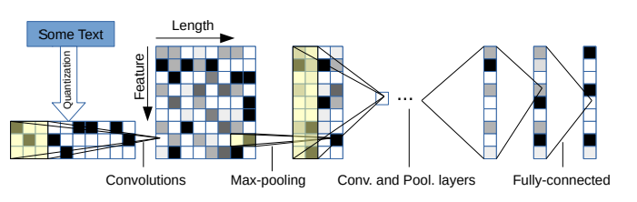
Previous work
[Character-level Convolution Networks]
(Xiang Zhang, Junbo Zhao, Yann LeCun. 2015)

Slide 48
Previous work
[Character-level Convolution Networks]
(Xiang Zhang, Junbo Zhao, Yann LeCun. 2015)

Slide 49
Previous work
[Character-level Convolution Networks]
Input
Convolutions
Max-pooling
Fully-Connected
Embedding 300
t
kernel
Frame 1024
h
e
kernel
Fixed
Length
1014
〮
〮
〮
Frame 1024

Slide 50
Previous work
[Character-level Convolution Networks]
Input
Convolutions
Max-pooling
Fully-Connected
Embedding 300
t
kernel
Frame 1024
h
e
kernel
Fixed
Length
1014
〮
〮
〮
Frame 1024

Slide 51
Previous work
[Character-level Convolution Networks]
Input
Convolutions
Max-pooling
Fully-Connected
Embedding 300
t
kernel
Frame 1024
h
e
kernel
Fixed
Length
1014
〮
〮
〮
Frame 1024

Slide 52
Previous work
[Character-level Convolution Networks]
Input
Convolutions
Max-pooling
Fully-Connected
Embedding 300
t
kernel
Frame 1024
h
e
kernel
Fixed
Length
1014
〮
〮
〮
Frame 1024

Slide 53
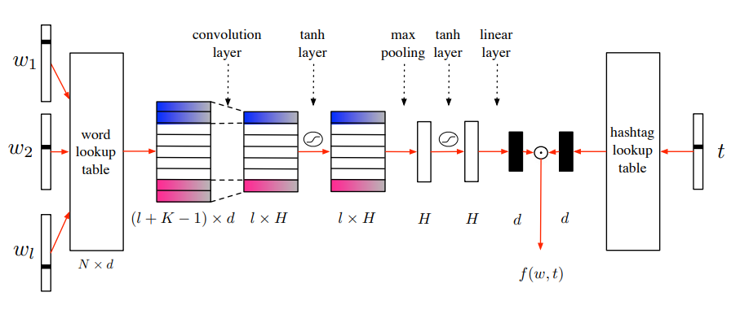
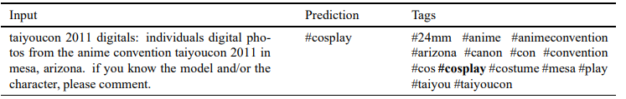
Previous work
[Tagspace]
(Jason Weston, Sumit Chopra, Keith Adams. 2014)

Slide 54
Previous work
[Tagspace]
(Jason Weston, Sumit Chopra, Keith Adams. 2014)

Slide 55
Contribution
1. They use n-grams to suggest a simple and efficient way
to reflect the context.
2. Their model trains quickly and has performance on par
with deep learning classifiers.
When there are a lot of labels, they provide an efficient way of using hierarchical methods.

Slide 56
Model
[FastText for text classification]
Word
N-grams
Word
representation
can
Embedding
Layer
i
Hidden
Layer
Output Layer
Score
Softmax
Very Negative
Negative
buy
〮〮〮
〮〮〮
〮〮〮
〮
〮
〮
an
Positive
Very Positive
apple
Average
?

Slide 57
Model
Word N-grams
Example Sentence : Can I buy an apple?
Unigram. : [ can, i, buy, an, apple, ? ]
Bigram .: [ can_i, i_buy, buy_an, an_apple, apple_? ]
[ can, i, buy, an, apple, ?, can_i, i_buy, buy_an, an_apple, apple_? ]

Slide 58
Model
Sentence representation
Sentence
Sentence Representation
can : [ 0.01 0.02 -0.01 〮〮〮 0.03 ]
i : [ 0.11 0.02 0.00 〮〮〮 -0.01 ]
〮
〮
〮
buy_an : [ 0.02 0.01 0.04 〮〮〮 -0.02 ]
apple_? : [ 0.05 0.04 -0.07 〮〮〮 0.01 ]
Can I buy an apple?
AVERAGE
Sentence
Representation
: [ 0.11 0.03 -0.01 〮〮〮 0.01 ]
Notes:
말로 풀어서 –많이 구체적으로

Slide 59
Model
[FastText for text classification]
Word
representation
can
Embedding
Layer
i
Hidden
Layer
Output Layer
Score
Softmax
#sports
#health
buy
〮〮〮
〮〮〮
〮〮〮
〮
〮
〮
an
#society
#science
apple
Average
?
If the number of classes is large,
the computation is expensive

Slide 60
Model
[Hierarchical Softmax]
Huffman Tree
3
Label | Encoding
#Society | 110
#science | 111
#health | 101
#sports | 100
#happy | 0
0
1
25
2
#happy
0
1
1
0
0
1
0
1
7
6
4
5
#sports
#health
#society
#science

Slide 61
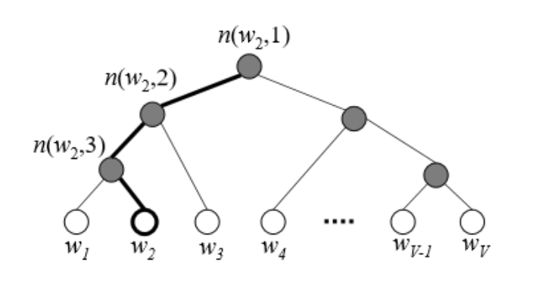






Model
[Hierarchical Softmax]
Output Layer
Hidden
Layer
$$n(w_{2},1)$$
Sigmoid
#Health
$$n(w_{2},2)$$
#sports
#health
〮 〮 〮
#society
#science
$$n(w_{2},3)$$
x x( )
Computational complexity
$$O\left(V\right){ O(log}_{2}{V})$$

Slide 62
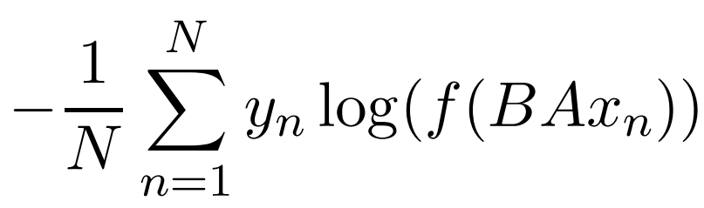
Model
[FastText for a sentence]
The number of classes is small
The number of classes is large
〮〮〮
〮
〮
〮
〮
〮
〮
〮〮〮
B
B
A
Softmax
A
Hierarchical
Softmax
$$x_{n}$$
$$x_{n}$$
Negative log-likelihood

Slide 63
Experiment
Source Code
https://github.com/facebookresearch/fastText
Dataset
Data | Description | Training size(sentence)
AG | News articles | 120,000
Sogou | News articles | 450,000
DBP | Crowd-sourced community from wikipedia | 560,000
Yelp | Yahoo reviews / Answers | 560,000, 650,000 / 1,400,000
Amz | Amazon reviews | 3,000,000 / 3,600,000
IMDB | Movie reviews
YFCC100M | Yahoo Flickr Creative Commons | 91,188,648
Notes:
Data는 이전 논문이던지 어디던지 분명히 찾을 수 있다. 반드시 찾을것

Slide 64
Experiment
Source Code
https://github.com/facebookresearch/fastText
Dataset
Data | Description | Training size(sentence)
AG | News articles | 120,000
Sogou | News articles | 450,000
DBP | Crowd-sourced community from wikipedia | 560,000
Yelp | Yahoo reviews / Answers | 560,000, 650,000 / 1,400,000
Amz | Amazon reviews | 3,000,000 / 3,600,000
IMDB | Movie reviews
YFCC100M | Yahoo Flickr Creative Commons | 91,188,648
Notes:
Data는 이전 논문이던지 어디던지 분명히 찾을 수 있다. 반드시 찾을것

Slide 65
Experiment
Baseline
- The state-of-the-art models in each dataset.
Model Variant
Variations | Difference
fastText | Using unigram
fastText, bigram | Adding bigram

Slide 66
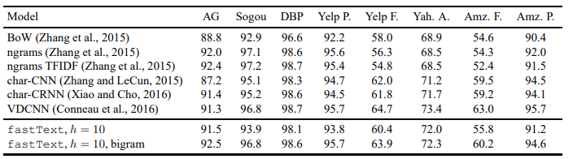
Experiment
[Sentiment analysis]
(unit : %)
First,
Better than char-CNN and char-CRNN, worse than VDCNN.
Second,
Adding bigram information improves the performance by 1-4%.

Slide 67
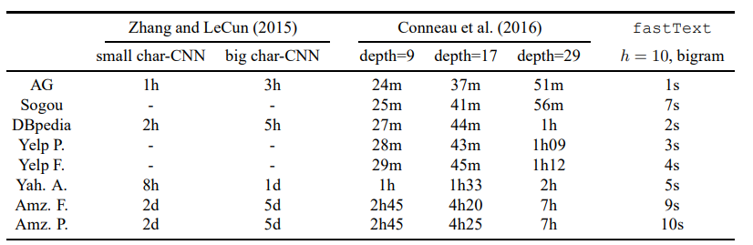
Experiment
[Sentiment analysis]

Slide 68
Experiment
[Sentiment analysis]

Slide 69
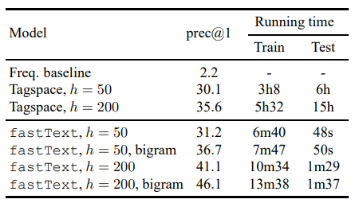
Experiment
[Tag prediction]
First,
The fastText model performs
Better than the baseline.
Second,
At test time, fastText is
much faster than Tagspace.

Slide 70
Experiment
Tagspace model
fastText model
Number of nodes
Sentence
representation
$$n(w_{2},1)$$
Sigmoid
$$n(w_{2},2)$$
$$n(w_{2},3)$$
Embedding

Slide 71
Conclusion
Their model obtains performance on par with recently proposed methods, while being much faster.
Their model is shallower than the baseline models.
They dramatically reduce computational complexity
by hierarchical softmax when the number of classes is large.
Notes:
Deep neural networks이론이 더 높은 representational power를 현재 shallow model보다 가지고있지만, 감정분석과 같은 간단한 분류믄제같은경우 그것을 평가할때 가장 적합한것이 무엇인지는 불명확하다

Slide 72
Q&A
Q & A
Notes:
FastText 수정사항 embedding
논문두개합치기
해싱 어떻게든
실험은 분리, / 정확한설명덧붙어ㅕ서
Task 각각에 대해 간단하게

