Slide 1
RISK FACTORS CONTRIBUTING TO ALLERGIC CONJUCTIVITIS AMONG PATIENTS ATTENDING TENWEK EYE HOSPITAL , BOMET COUNTY
PRESENTER : ANGELA WACEKE KAMAU
REG NO : HSM 212-0553/2020
SUPERVISORS
DR SHADRACK ASENA
DR LEONARD WANYONYI

Slide 2
BACKGROUND INFORMATION
Allergic conjunctivitis - inflammation of the conjunctiva secondary to an IgE-mediated hypersensitivity reaction, commonly triggered by environmental allergens (Ryder, & Benson, 2022)
prevalence estimates ranging from 15% to 40% (Ryder & Benson, 2022)
AC -classified into seasonal allergic conjunctivitis induced by seasonal pollens and perennial allergic conjunctivitis induced year-round by indoor allergens (Mahoney et al., 2023).

Slide 3
CONT
National Health and Nutrition Examination Survey studying the epidemiology of allergic Conjunctivitis, 6.4% and 29.7% of 20,010 patients reported ocular symptoms and combined Ocular and nasal symptoms, respectively.
40% of the population reported experiencing atleast occurrence of ocular symptoms in the past 12 months.

Slide 4
STATEMENT OF THE PROBLEM
prevalence of allergic disorders like asthma, rhinitis, and dermatitis has risen substantially worldwide, attributed to increased exposure to environmental allergens from pollution, changing lifestyles, and reduced microbial exposures (Moura et al., 2022).
Allergic conjunctivitis often coexists with these conditions as part of an atopic diathesis. As developing regions industrialize rapidly, a parallel rise in allergic eye disease is anticipated (Ghanwate & Shaikh, 2021).

Slide 5
cont
There is limited data on allergic conjunctivitis in Africa, especially East Africa, to quantify the growing burden and guide health policy and clinical practice (Moura et al., 2022).
This study aims at bridging this gap to inform interventions against this emerging public health threat.

Slide 6
METHODOLOGY
Study Design
cross-sectional design employing quantitative methods
Study Area
Tenwek eye Hospital
Study population
The study population will comprise all patients attending the ophthalmology outpatient clinic at Tenwek Hospital during the 6-month study period
The target population is 361 patients per month.

Slide 7
JUSTIFICATION
The prevalence rate of allergic conjunctivitis in Tenwek eye hospital is on the rise, causing blindness, thus reducing the patient's quality of life.
This could be attributed to the lack of published studies on allergic conjunctivitis in kenya
There is an urgent need to implement health education strategies to control the rise in the allergic conjunctivitis prevalence rate
A better understanding of risk factors for allergic conjunctivitis is needed to prevent and appropriately manage this condition.

Slide 8
OBJECTIVES
Broad objectives
To determine the risk factors contributing to allergic conjunctivitis among patients attending Tenwek Eye Hospital, Bomet County.
Specific Objectives
To determine the prevalence of allergic conjunctivitis among eye clinic patients attending Tenwek Eye Hospital, Bomet County.
To identify socio-demographic factors contributing to allergic conjunctivitis among patients attending Tenwek Eye Hospital, Bomet County

Slide 9
cont
To assess systemic co-morbidities factors contributing to allergic conjunctivitis among patients attending Tenwek Eye Hospital, Bomet County
To evaluate household related factors contributing to allergic conjunctivitis among patients attending Tenwek Eye Hospital, Bomet County

Slide 10
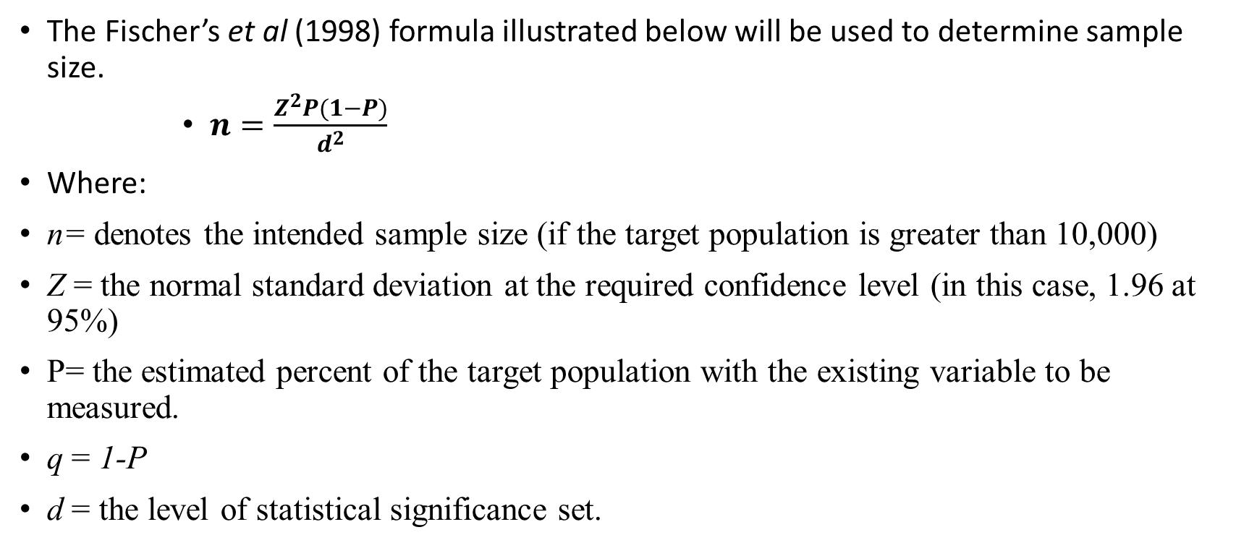
Calculation of sample size
The Fischer’s et al (1998) formula illustrated below will be used to determine sample size.
$n=\frac{Z^{2}P(1−P)}{d^{2}}$
Where:
n= denotes the intended sample size (if the target population is greater than 10,000)
Z = the normal standard deviation at the required confidence level (in this case, 1.96 at 95%)
P= the estimated percent of the target population with the existing variable to be measured.
q = 1-P
d = the level of statistical significance set.

Slide 11
For a population of more than 10,000 people, the sample would be;
Therefore n = 1.96² (0.50) (1-0.50) =384
(0.05) (0.05)

Slide 12
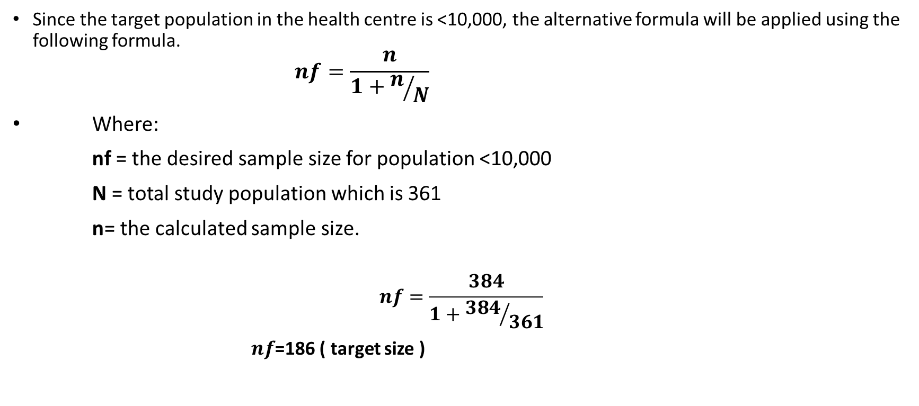
cont
Since the target population in the health centre is <10,000, the alternative formula will be applied using the following formula.
$$nf=\frac{n}{1+n/N}$$
Where:
nf = the desired sample size for population <10,000
N = total study population which is 361
n= the calculated sample size.
$$nf=\frac{384}{1+{384}/{361}}$$
$nf$=186 ( target size )

Slide 13
Sampling Technique
A consecutive sampling technique will be utilized to recruit the required participants. This method involves enrolling all sampling units that meet the inclusion criteria until the desired sample size is achieved
Data Collection Techniques and Tools
Primary data will be collected through a questionnaire administered to the study participants

Slide 14
Data analysis
. Data analysis will be conducted using SPSS statistical software
Descriptive statistics ie frequencies, standard deviation and mean will be used to summarize, organize and simplify the data collected.
Odds Ratio (OR) and 95% Confidence Interval (CI) will be used to estimate the strength of association between independent variables and the dependent variable
Tables, bar charts, graphs and pie charts will be used to present results

Slide 15
Ethical consideration
Approvals will be requested from ;
Jomo Kenyatta University of Agriculture and Technology-Ethical Review Committee for ethical approval
Tenwek Eye Hospital administration approval
informed consent will be obtained from the respondents

Slide 16
references
Mahoney, M. J., Bekibele, R., Notermann, S. L., Reuter, T. G., & Borman-Shoap, E. C. (2023). Pediatric Conjunctivitis: A Review of Clinical Manifestations, Diagnosis, and Management. Children, 10(5), 808. https://www.mdpi.com/2227-9067/10/5/808
Mahoney, M. J., Bekibele, R., Notermann, S. L., Reuter, T. G., & Borman-Shoap, E. C. (2023). Pediatric Conjunctivitis: A Review of Clinical Manifestations, Diagnosis, and Management. Children, 10(5), 808. https://www.mdpi.com/2227-9067/10/5/808

Slide 17
Activity | 2023 |  |  | 2024
 | Aug-Sept | Oct-Nov | Dec | Jan-Feb
Developing proposal title and writing of proposal
Ethical approval and Data collection
Data analysis
Final presentation
Data dissemination

Slide 18
Budget
Item | Quantity | Unit Cost (Kes) | Total Cost (Kes)
Printed Questionnaires | 100 | 20 | 2,000
Ballpoint Pens | 50 | 50 | 2,500
Clipboards | 5 | 300 | 1,500
Printer Ink Cartridges | 5 | 1,000 | 5,000
Internet Data Bundles | 25GB | 1 | 1,500
Printed Consent Forms | 500 | 20 | 10,000
External Hard Drive for Data Storage | 1 | 5,000 | 5,000
Statistical Software License (Stata) | 1 | 25,000 | 25,000
Research Assistant Stipend | 2 RA for 6 months | 5,000 | 30,000
Transport Reimbursement for Participants | 100 patients | 300 | 30,000
Binding of Final Dissertation | 5 copies | 1,000 | 5,000
Contingency | - | - | 4,500
Total Budget |  |  | 122,000

Slide 19
ACKNOWLEDGEMENT
JKUAT
Clinical medicine department
Supervisors
Mr shadrack Asena
Mr leonard wanyonyi

