Slide 1
Supply Chain SQL Project
A Complete Analysis Using Structured Query Language
Subject: Database Management Systems
Presented by: SQL Analytics Team
Coverage: Level 1 Basic → Level 2 Intermediate → Level 3 Advanced → Level 4 Expert
Academic Presentation • SQL Supply Chain

Slide 2
Agenda
Project Overview
Level 1 — Basic
01
02
Database schema and table structure
Data exploration, demographics, filtering
Level 2 — Intermediate
Level 3 — Advanced
03
04
Revenue analysis, rankings, supplier insights
Bulk buyers, premium suppliers, city networking
Level 4 — Expert
Key Insights
05
06
Savings analysis, market research & competition
Summary of findings and conclusions

Slide 3
Project Overview — Database Schema
Customer
Orders
OrderItem
Product
Supplier
id, firstname, lastname
city, country, phone
id, customerid, orderdate
totalamount, status
id, orderid, productid
quantity, unitprice
id, productname, supplierid
unitprice, isdiscontinued
id, companyname, contactname
country, phone
Relationships: Customer → Orders → OrderItem ← Product ← Supplier
▸ This project analyzes a Supply Chain database containing 5 interconnected tables.
▸ Queries are organized across 4 levels of complexity — from basic SELECT statements to expert-level CTEs and subqueries.
▸ Key goals: understand customer behavior, track orders, evaluate supplier performance, and perform revenue analysis.

Slide 4
What we explore in this level:
LEVEL 1
✦ Data Exploration — read all 5 tables
✦ Customer Demographics by country
✦ Active Inventory filtering
✦ Supplier-Product catalog via JOIN
✦ Regional customer search (Mexico)
✦ High-value items per customer
✦ Top supplier by product count
✦ Order trends by month & year
✦ Supplier concentration by country
✦ Inactive customers (no orders)
Basic Queries

Slide 5
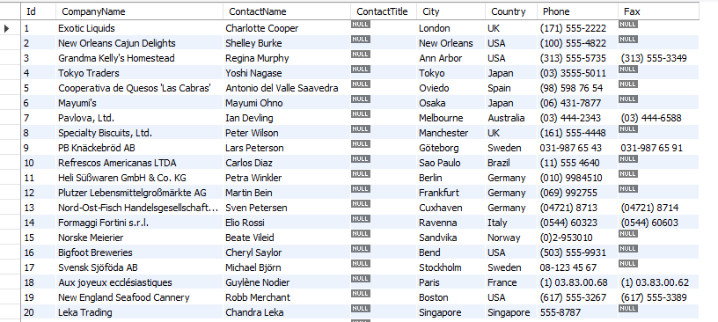
Q1
Data Exploration — Read All Tables
Description
SQL Query
Query Result
SELECT all records from each of the
5 core tables in the database:
• supplier • product
• orderitem • orders
• customer
Helps understand raw data structure
and volume before any analysis.
SELECT * FROM supplier;
SELECT * FROM product;
SELECT * FROM orderitem;
SELECT * FROM orders;
SELECT * FROM customer;
Supply Chain SQL Project • Query 1 • Data Exploration — Read All Tables

Slide 6
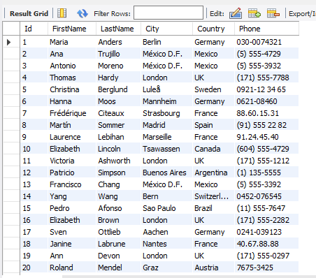
Q2
Customer Demographics — Count by Country
Description
SQL Query
Query Result
Count how many customers exist
in each country.
Results sorted from highest to
lowest to identify the most
dominant customer markets.
SELECT country,
COUNT(id) AS count_cust
FROM customer
GROUP BY country
ORDER BY count_cust DESC;
Supply Chain SQL Project • Query 2 • Customer Demographics — Count by Country

Slide 7
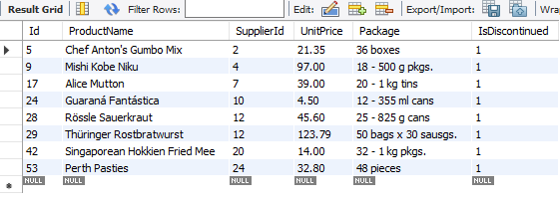
Q3
Active Inventory — Non-Discontinued Products
Description
SQL Query
Query Result
Display all products that are
currently active (not discontinued).
Filters using the isdiscontinued
flag — only live inventory shown.
SELECT * FROM product
WHERE isdiscontinued >= '1';
Supply Chain SQL Project • Query 3 • Active Inventory — Non-Discontinued Products

Slide 8
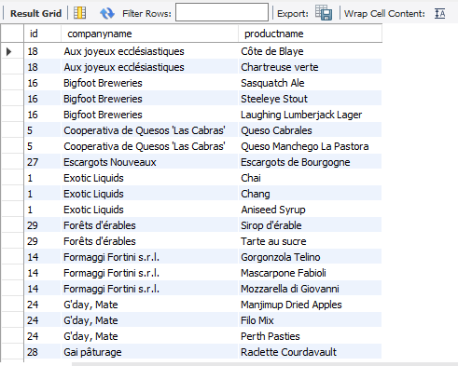
Q4
Supplier Catalog — Company & Product Names
Description
SQL Query
Query Result
List every supplier's company name
alongside the products they supply.
Uses an INNER JOIN between the
Supplier and Product tables on
the supplierid foreign key.
SELECT s.id,
s.companyname,
p.productname
FROM supplier s
JOIN product p
ON s.id = p.supplierid;
Supply Chain SQL Project • Query 4 • Supplier Catalog — Company & Product Names

Slide 9
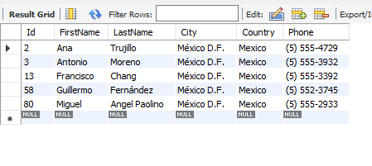
Q5
Regional Search — Customers in Mexico
Description
SQL Query
Query Result
Filter customer records to show
only those residing in Mexico.
Simple WHERE clause filtering
on the country column.
SELECT * FROM customer
WHERE country = 'Mexico';
Supply Chain SQL Project • Query 5 • Regional Search — Customers in Mexico

Slide 10
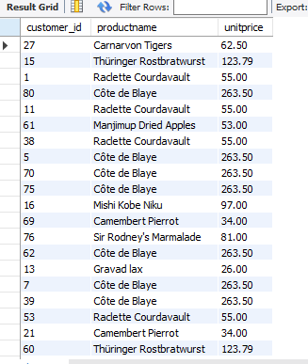
Q6
High-Value Items — Most Expensive per Customer
Description
SQL Query
Query Result
Identify the most expensive product
ordered by each customer.
Uses a correlated subquery with
MAX(unitprice) grouped per
customer to filter top items.
SELECT c.id, p.productname,
p.unitprice
FROM customer c
JOIN orders o ON c.id=o.customerid
JOIN orderitem oi ON o.id=oi.orderid
JOIN product p ON p.id=oi.productid
WHERE (c.id, p.unitprice) IN (
SELECT c.id, MAX(p.unitprice)
FROM product p ...
GROUP BY c.id
);
Supply Chain SQL Project • Query 6 • High-Value Items — Most Expensive per Customer

Slide 11

Q7
Top Suppliers — Highest Product Count
Description
SQL Query
Query Result
Find which supplier provides the
greatest number of distinct products.
Uses a CTE (Common Table
Expression) with COUNT, then
selects the maximum count result.
WITH max_p AS (
SELECT s.id,
COUNT(p.id) AS cnt_prod
FROM supplier s
JOIN product p
ON p.supplierid = s.id
GROUP BY s.id
)
SELECT * FROM max_p
WHERE cnt_prod IN (
SELECT MAX(cnt_prod) FROM max_p
);
Supply Chain SQL Project • Query 7 • Top Suppliers — Highest Product Count

Slide 12
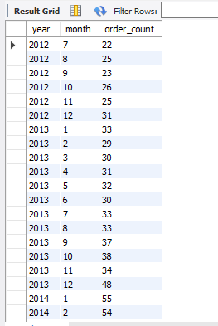
Q8
Order Trends — Monthly & Yearly Count
Description
SQL Query
Query Result
Display how many orders were placed
in each month and year.
Extracts YEAR and MONTH from
orderdate field and groups results
in ascending chronological order.
SELECT YEAR(orderdate) AS year,
MONTH(orderdate) AS month,
COUNT(id) AS order_count
FROM orders
GROUP BY YEAR(orderdate),
MONTH(orderdate)
ORDER BY year ASC, month ASC;
Supply Chain SQL Project • Query 8 • Order Trends — Monthly & Yearly Count

Slide 13
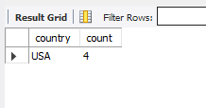
Q9
Supplier Concentration — Country with Most Suppliers
Description
SQL Query
Query Result
Find which country has the maximum
number of suppliers.
Uses a window function
COUNT() OVER(PARTITION BY country)
inside a CTE, then filters to max.
WITH max_c AS (
SELECT country,
COUNT(id) OVER(
PARTITION BY country) AS count
FROM supplier
)
SELECT DISTINCT * FROM max_c
WHERE count IN (
SELECT MAX(count) FROM max_c
);
Supply Chain SQL Project • Query 9 • Supplier Concentration — Country with Most Suppliers

Slide 14
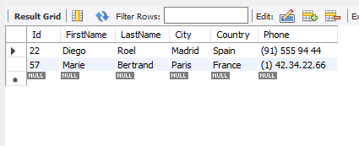
Q10
Inactive Customers — Never Placed an Order
Description
SQL Query
Query Result
Identify all customers who have
never placed a single order.
Uses NOT IN with a subquery
on the orders table to find
customers absent from order history.
SELECT * FROM customer
WHERE id NOT IN (
SELECT customerid
FROM orders
);
Supply Chain SQL Project • Query 10 • Inactive Customers — Never Placed an Order

Slide 15
What we explore in this level:
LEVEL 2
✦ Product Demand — rank by total quantity
✦ Annual Performance — orders per year
✦ Revenue Analysis — total revenue by year
✦ Top Spender — highest spending customer
✦ Customer Ranking — by total order amount
✦ Order History — per customer order dates
✦ Supplier Revenue — top 3 suppliers
✦ Customer Loyalty — latest order dates
✦ Order Details — order + product + supplier
Intermediate Queries

Slide 16
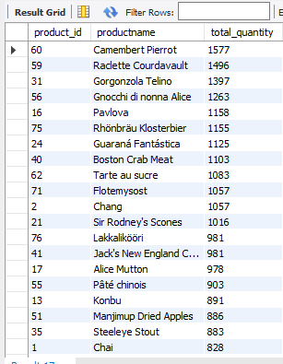
Q1
Product Demand — Rank by Total Quantity
Description
SQL Query
Query Result
Rank products by total quantity
ordered across all customer orders.
Joins OrderItem with Product,
sums quantities, and sorts from
most to least demanded.
SELECT p.id AS product_id,
p.productname,
SUM(oi.quantity) AS total_qty
FROM orderitem oi
JOIN product p ON p.id=oi.productid
GROUP BY p.id, p.productname
ORDER BY total_qty DESC;
Supply Chain SQL Project • Query 1 • Product Demand — Rank by Total Quantity

Slide 17
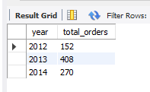
Q2
Annual Performance — Orders Delivered Per Year
Description
SQL Query
Query Result
Count the total number of orders
delivered in each calendar year.
Uses YEAR() function to extract
year from orderdate and groups
the count accordingly.
SELECT YEAR(orderdate) AS year,
COUNT(id) AS total_orders
FROM orders
GROUP BY YEAR(orderdate);
Supply Chain SQL Project • Query 2 • Annual Performance — Orders Delivered Per Year

Slide 18
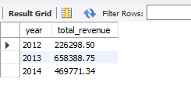
Q3
Revenue Analysis — Total Revenue Each Year
Description
SQL Query
Query Result
Calculate total revenue generated
in each year.
Sums the totalamount column from
the orders table, grouped by year
for trend analysis.
SELECT YEAR(orderdate) AS year,
SUM(totalamount) AS total_revenue
FROM orders
GROUP BY YEAR(orderdate);
Supply Chain SQL Project • Query 3 • Revenue Analysis — Total Revenue Each Year

Slide 19
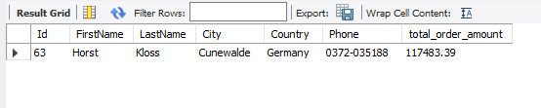
Q4
Top Spender — Customer with Highest Total Spend
Description
SQL Query
Query Result
Find the single customer who has
spent the most money overall.
Joins Customer with Orders, sums
totalamount, orders descending,
and returns top 1 record.
SELECT c.*,
SUM(totalamount) AS total_amt
FROM customer c
JOIN orders o ON o.customerid=c.id
GROUP BY c.id
ORDER BY SUM(totalamount) DESC
LIMIT 1;
Supply Chain SQL Project • Query 4 • Top Spender — Customer with Highest Total Spend

Slide 20
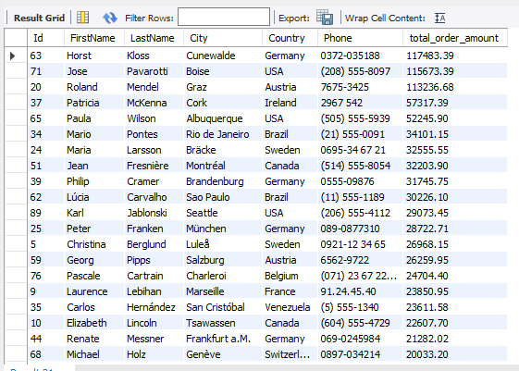
Q5
Customer Ranking — All Customers by Spend
Description
SQL Query
Query Result
List every customer along with
their total order amount.
Same as Top Spender but returns
ALL customers ranked from highest
to lowest spender.
SELECT c.*,
SUM(totalamount) AS total_amt
FROM customer c
JOIN orders o ON o.customerid=c.id
GROUP BY c.id
ORDER BY SUM(totalamount) DESC;
Supply Chain SQL Project • Query 5 • Customer Ranking — All Customers by Spend

Slide 21
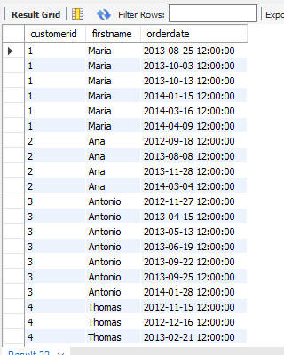
Q6
Order History — Per Customer Order Dates
Description
SQL Query
Query Result
List each customer's order dates
in chronological order.
Useful for analyzing purchase
frequency and customer buying
patterns over time.
SELECT c.id AS customerid,
c.firstname,
o.orderdate
FROM customer c
JOIN orders o ON o.customerid=c.id
ORDER BY customerid, orderdate;
Supply Chain SQL Project • Query 6 • Order History — Per Customer Order Dates

Slide 22
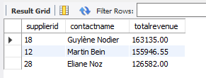
Q7
Supplier Revenue — Top 3 by Revenue
Description
SQL Query
Query Result
Identify the top 3 suppliers based
on total revenue generated.
Joins 4 tables, multiplies
quantity × unit price per item,
and ranks suppliers accordingly.
SELECT s.id, s.contactname,
SUM(quantity * oi.unitprice)
AS totalrevenue
FROM supplier s
JOIN product p ON s.id=p.supplierid
JOIN orderitem oi ON oi.productid=p.id
JOIN orders o ON o.id=oi.orderid
GROUP BY s.id, s.contactname
ORDER BY totalrevenue DESC LIMIT 3;
Supply Chain SQL Project • Query 7 • Supplier Revenue — Top 3 by Revenue

Slide 23
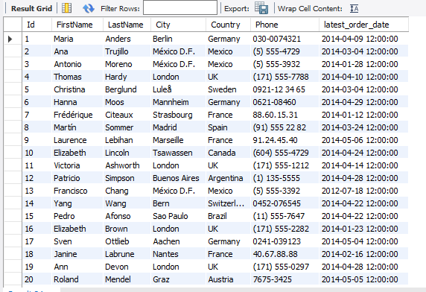
Q8
Customer Loyalty — Latest Order Date per Customer
Description
SQL Query
Query Result
Show the most recent order date
for every customer.
Uses MAX(orderdate) grouped by
customer to find when each
customer last made a purchase.
SELECT c.*,
MAX(orderdate) AS latest_order
FROM customer c
JOIN orders o ON o.CustomerId=c.id
GROUP BY c.id;
Supply Chain SQL Project • Query 8 • Customer Loyalty — Latest Order Date per Customer

Slide 24
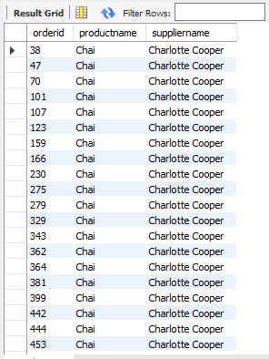
Q9
Order Details — Order + Product + Supplier
Description
SQL Query
Query Result
For every order, show the Order ID,
Product Name, and Supplier Name.
Joins 4 tables to create a full
order detail view connecting
orders back to their suppliers.
SELECT oi.orderid,
p.productname,
s.contactname AS suppliername
FROM supplier s
JOIN product p ON p.supplierid=s.id
JOIN orderitem oi ON oi.productid=p.id
JOIN orders o ON o.id=oi.orderid;
Supply Chain SQL Project • Query 9 • Order Details — Order + Product + Supplier

Slide 25
What we explore in this level:
LEVEL 3
✦ Bulk Buyers — customers with 10+ orders
✦ Small Orders — quantity of exactly 1
✦ Premium Suppliers — unit price above 100
✦ City-Based Networking — same city & country
Advanced Queries

Slide 26
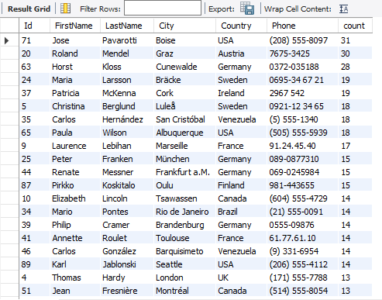
Q1
Bulk Buyers — Customers with 10+ Orders
Description
SQL Query
Query Result
Find customers who have placed
more than 10 orders total.
Uses a CTE with COUNT() window
function partitioned by customer,
then filters for count > 10.
WITH product_ordered AS (
SELECT DISTINCT c.*,
COUNT(o.id) OVER(
PARTITION BY c.id) AS count
FROM customer c
JOIN orders o ON o.customerid=c.id
)
SELECT * FROM product_ordered
WHERE count > 10
ORDER BY count DESC;
Supply Chain SQL Project • Query 1 • Bulk Buyers — Customers with 10+ Orders

Slide 27
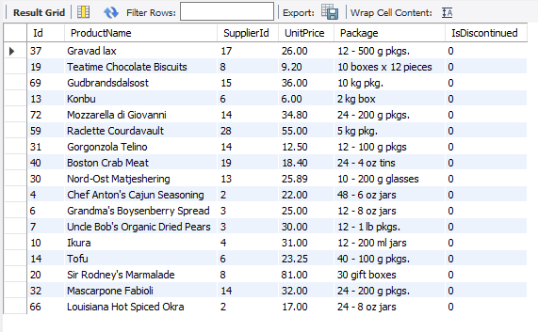
Q2
Small Orders — Items Ordered with Quantity = 1
Description
SQL Query
Query Result
List all product details for items
that were ordered in a quantity
of exactly 1.
Simple JOIN between Product and
OrderItem, filtering where
quantity equals 1.
SELECT p.*
FROM product p
JOIN orderitem oi
ON oi.productid = p.id
WHERE quantity = 1;
Supply Chain SQL Project • Query 2 • Small Orders — Items Ordered with Quantity = 1

Slide 28
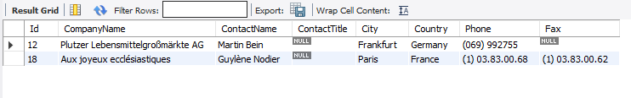
Q3
Premium Suppliers — Unit Price Above 100
Description
SQL Query
Query Result
Identify suppliers whose products
were sold at a unit price above 100.
Joins Supplier, Product, and
OrderItem. Uses DISTINCT to
avoid duplicate supplier rows.
SELECT DISTINCT s.*
FROM supplier s
JOIN product p ON p.SupplierId=s.id
JOIN orderitem oi
ON oi.productid = p.id
WHERE oi.unitprice > 100;
Supply Chain SQL Project • Query 3 • Premium Suppliers — Unit Price Above 100

Slide 29
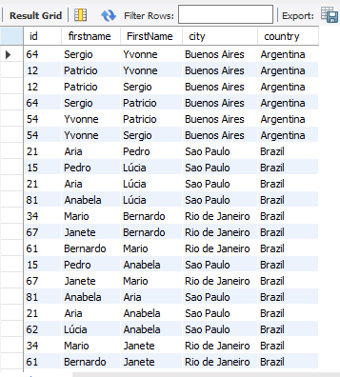
Q4
City-Based Networking — Same City & Country
Description
SQL Query
Query Result
Find pairs of customers who live
in the same city and country.
Self-join on the customer table
using (city, country) as the join
key. WHERE prevents self-matching.
SELECT DISTINCT
c1.id, c1.firstname,
c2.FirstName, c1.city,
c1.country
FROM customer c1
JOIN customer c2
ON (c1.city, c1.country)
= (c2.city, c2.country)
WHERE c1.id <> c2.id
ORDER BY c1.country;
Supply Chain SQL Project • Query 4 • City-Based Networking — Same City & Country

Slide 30
What we explore in this level:
LEVEL 4
✦ Savings Analysis — discount savings per order
✦ Market Research Part A — high-demand products
✦ Market Research Part B — competitor mapping
Expert Queries

Slide 31
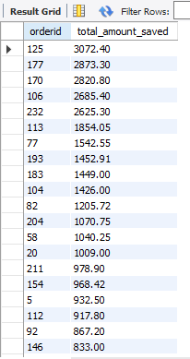
Q1
Savings Analysis — Discount Savings per Order
Description
SQL Query
Query Result
Calculate how much was saved per
order due to discounts.
Formula:
(Product Price − Sold Price) × Qty
summed per order.
Results ranked by highest savings.
SELECT oi.orderid,
SUM(
(p.unitprice - oi.unitprice)
* oi.quantity
) AS total_amount_saved
FROM product p
JOIN orderitem oi ON p.id=oi.productid
GROUP BY oi.orderid
ORDER BY total_amount_saved DESC;
Supply Chain SQL Project • Query 1 • Savings Analysis — Discount Savings per Order

Slide 32
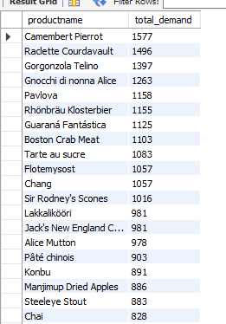
Q2a
Market Research — High-Demand Products
Description
SQL Query
Query Result
Help new supplier Mr. Kavin by
identifying the most demanded
products in the market.
Ranks all products by total
quantity ordered.
Useful for supply planning.
-- Part A: High-demand products
SELECT p.productname,
SUM(oi.quantity) AS total_demand
FROM product p
JOIN orderitem oi ON p.id=oi.productid
GROUP BY p.productname
ORDER BY total_demand DESC;
Supply Chain SQL Project • Query 2a • Market Research — High-Demand Products

Slide 33
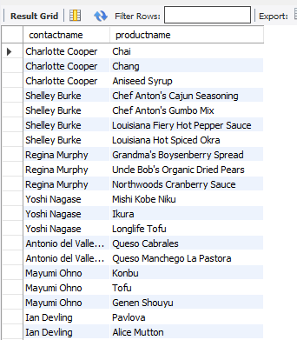
Q2b
Market Research — Competitor Mapping
Description
SQL Query
Query Result
Identify who Mr. Kavin's competitors
would be for each product.
Lists all existing suppliers and
the products they currently supply.
Gives a full competitive landscape
for strategic planning.
-- Part B: Competitor mapping
SELECT DISTINCT
s.contactname,
p.productname
FROM orderitem oi
JOIN product p ON p.id=oi.productid
JOIN supplier s
ON p.supplierid = s.id;
Supply Chain SQL Project • Query 2b • Market Research — Competitor Mapping

Slide 34
Key Insights & Summary
Customer Analysis
Order Trends
Identified customers by country, active regions, and spending patterns. Mexico leads in customer count.
Monthly/yearly order tracking reveals seasonality. Annual revenue computed for business reporting.
Supplier Performance
Product Intelligence
Top 3 suppliers by revenue identified. Country-wise supplier concentration mapped for strategy.
High-demand products ranked by total quantity. Discontinued vs active inventory clearly separated.
Advanced Analytics
Expert Queries
CTEs and window functions used for savings analysis, bulk buyer identification, and competitor mapping.
Mr. Kavin market research: identified high-demand products and existing supplier competition landscape.
23 Queries • 4 Complexity Levels • 5 Database Tables • Full Supply Chain Coverage

Slide 35
Thank You!
Supply Chain SQL Project — Complete Analysis
Queries Covered: Basic • Intermediate • Advanced • Expert
Tools: SQL • JOINs • CTEs • Window Functions • Subqueries
Open for Questions & Discussion

