Slide 1
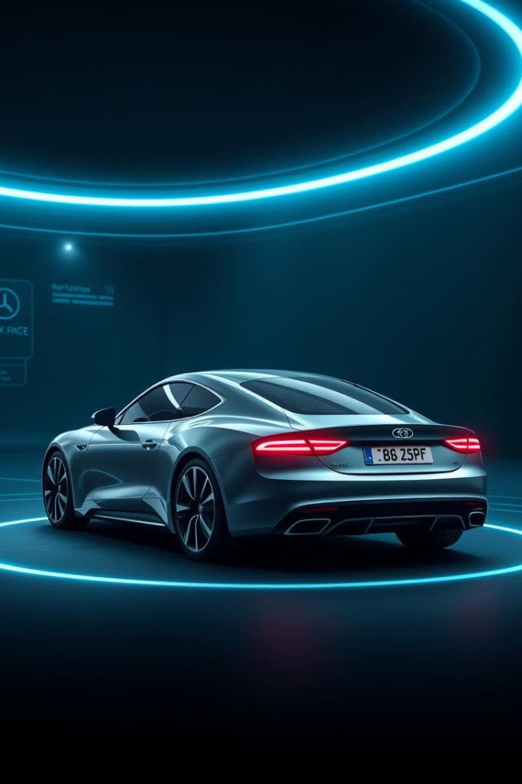
License Plate Detection System
This presentation introduces a comprehensive license plate detection system integrating multiple OCR engines and advanced computer vision techniques. Designed for high accuracy, the system combines deep learning and image processing to detect and recognize license plates in diverse images.
We'll explore the project overview, technologies, user interface, processing pipeline, customization options, and contributions made to this cutting-edge system tailored for developers and technical users interested in license plate recognition solutions.

Slide 2
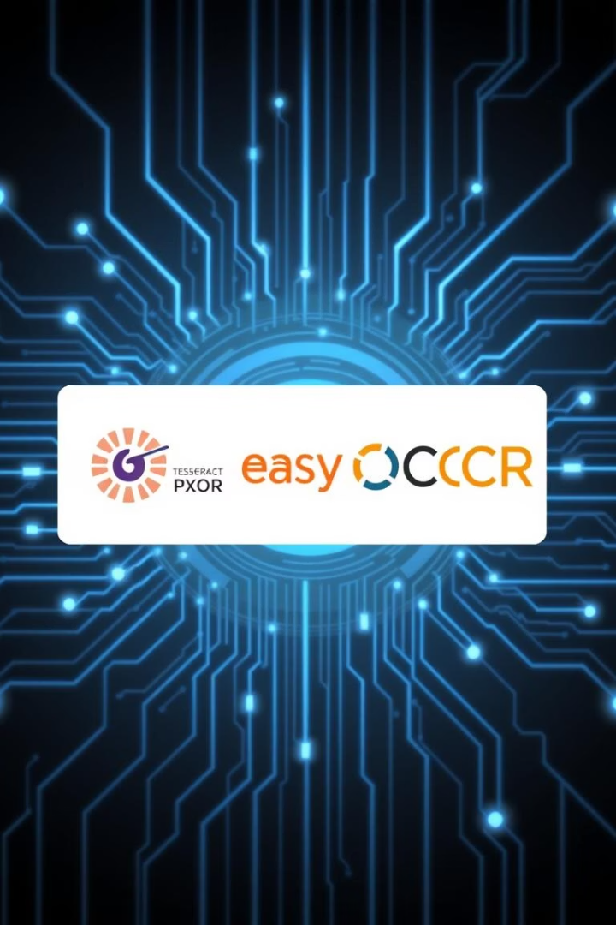
Project Overview and Core Features
Multi-Model Recognition
Utilizes multiple OCR engines including Tesseract, EasyOCR, PaddleOCR, and Microsoft's Transformer-based TrOCR to leverage diverse strengths.
Automatic Detection
Employs computer vision methods to automatically identify license plates from images without manual region selection.
Model Voting System
Combines outputs from all OCR models through a voting mechanism to enhance recognition accuracy and confidence.
User-Friendly GUI
Includes a graphical interface for easy image selection, OCR model configuration, and real-time results visualization.

Slide 3
Technologies and Tools Used
Programming Language and Libraries
OCR Engines and UI
Python 3.x for core development
PyTesseract: Python wrapper for Tesseract OCR
OpenCV for image processing and feature extraction
EasyOCR: Deep learning-based OCR tool
NumPy for numerical computations
PaddleOCR: High-accuracy open source OCR
Pillow (PIL) for image manipulation
Microsoft's TrOCR: Transformer-based OCR model
Tkinter for building the graphical user interface

Slide 4

Installation and Setup Instructions
Prerequisites
Ensure Python 3.7+ is installed and Tesseract OCR engine is available (included in OCR folder).
Clone Repository
Download project files using Git clone command from the official repository.
Install Dependencies
Run pip install with requirements.txt to setup all necessary Python packages.

Slide 5
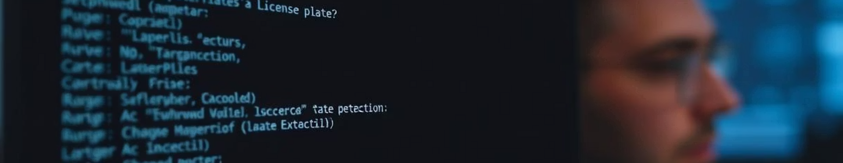
Using the System: Command Line Interface
1
Launch CLI
2
Image Processing Options
3
Select OCR Models
Run main script to start interactive command-line environment.
Configure which OCR engines to utilize per session for flexible testing.
Choose to process dataset images or provide custom image paths for recognition.

Slide 6



Using the System: Graphical User Interface
Browse and Select
Navigate image folders easily for input selection.
Model Selection
Interactive checkboxes to choose active OCR models.
Real-Time Results
Displays detected plates and confidence scores dynamically.

Slide 7
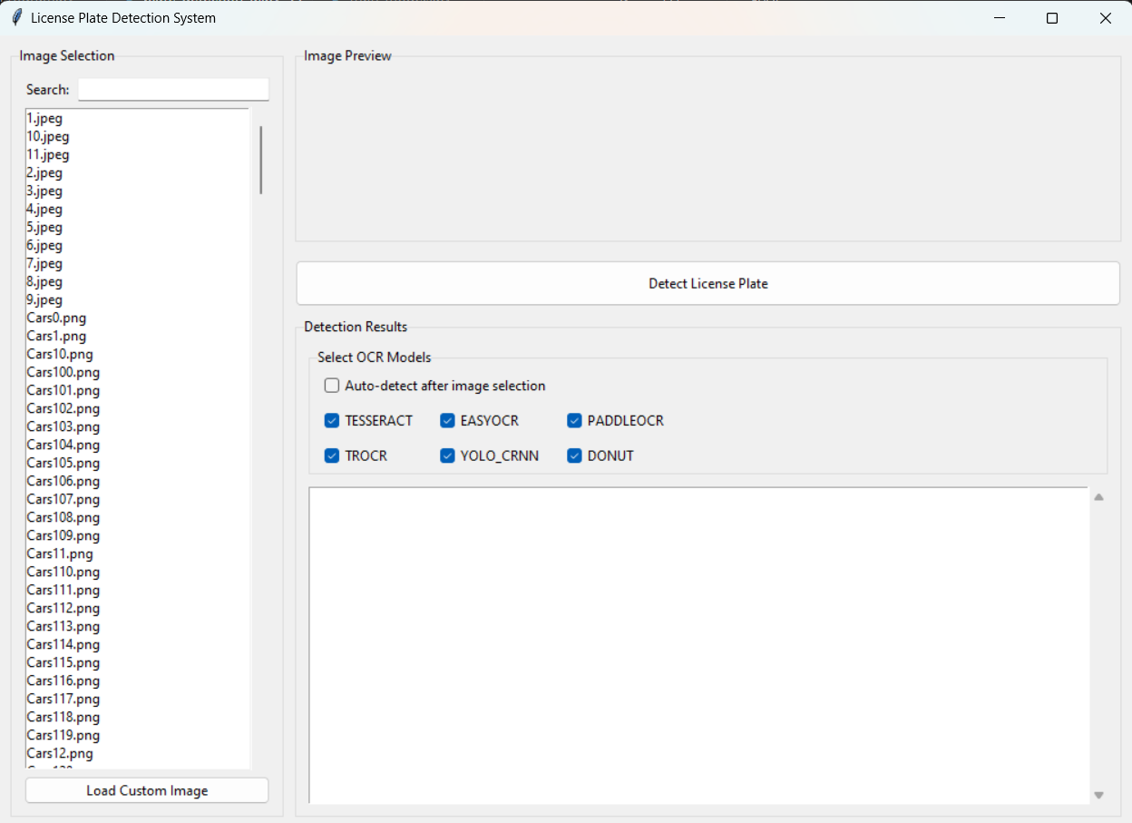
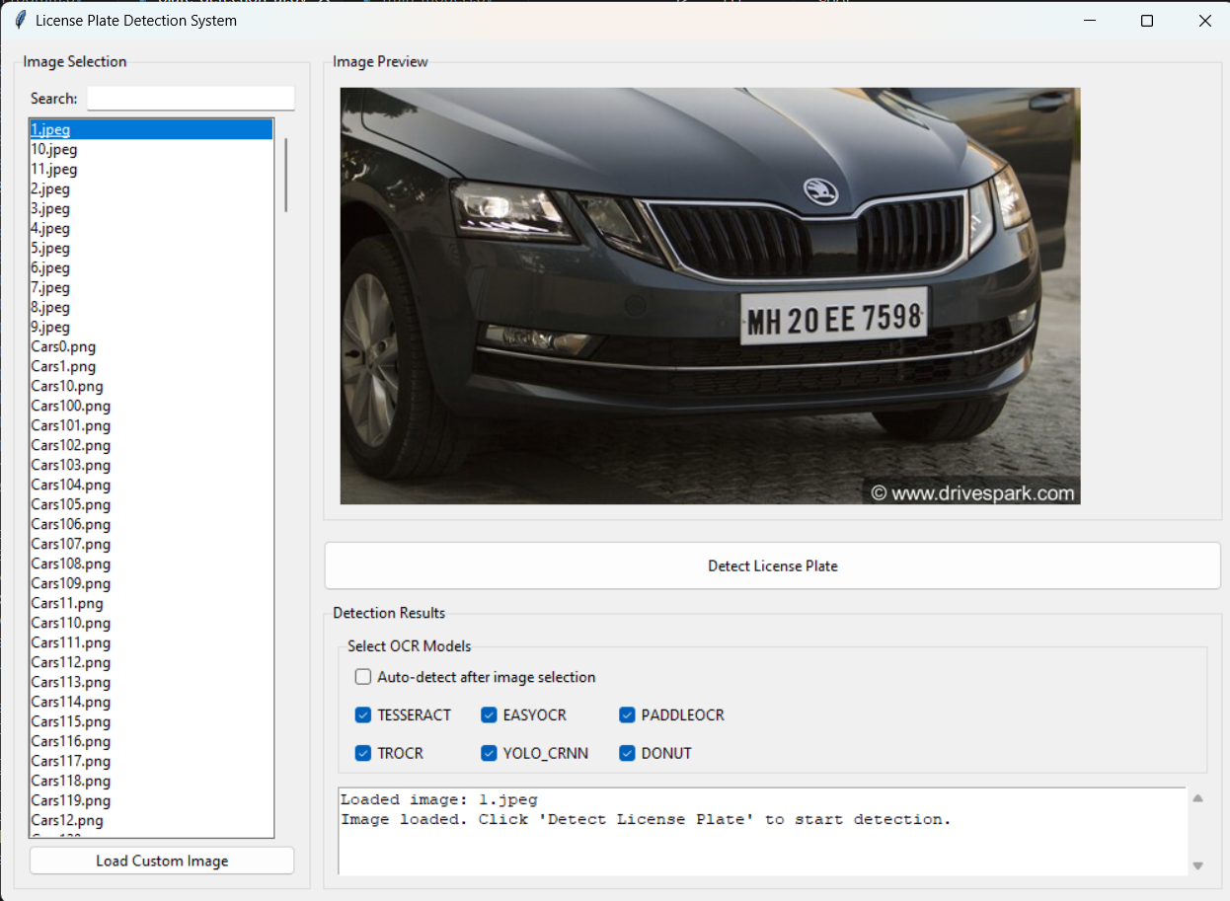


Graphical User Interface Showcase
Initial UI
Image Selection
Detection Results
The startup screen presenting the main menu and configuration options.
After choosing an image, the UI updates to show the loaded input for processing.
Output screen showing detected license plates highlighted with recognized text and confidence.

Slide 8









How the System Works: Processing Pipeline
Image Preprocessing
License Plate Detection
Techniques like blurring, thresholding, and morphological operations prepare input images for detection.
Computer vision algorithms identify potential license plate regions based on geometric features and contours.
Voting and Selection
OCR Processing
A voting system consolidates model outputs selecting the text with highest confidence and most frequency.
Multiple OCR engines independently read candidate regions and produce candidate text with confidence scores.

Slide 9
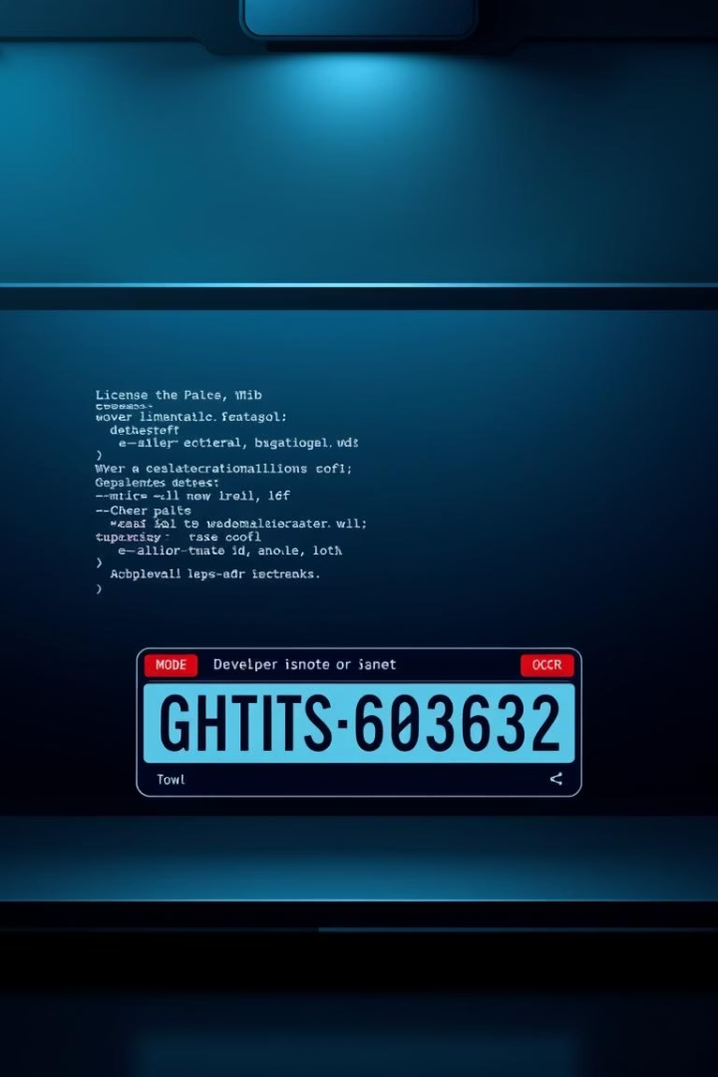



System Customization and Extensibility
Add New OCR Models
Tune Detection Parameters
Integrate additional OCR technologies to expand recognition capabilities.
Adjust computer vision thresholds and algorithms for various plate types and environments.
Train Custom Models
Use provided training scripts for specialized license plate datasets to improve performance.

Slide 10
Contributors and Acknowledgments
Key Contributors
Acknowledgments
Kanhaiya Chhaparwal
Tesseract OCR Community
Anuj Sule
EasyOCR Developers
Divyaksh Chachan
PaddleOCR Team
Harsh Kasundra
Microsoft for the TrOCR model
This collaborative effort combines expertise from multiple teams and open-source communities, contributing to an effective and extensible license plate recognition solution for technical users and developers worldwide.

