Slide 1

E-LEARNING
PORTAL

Slide 2
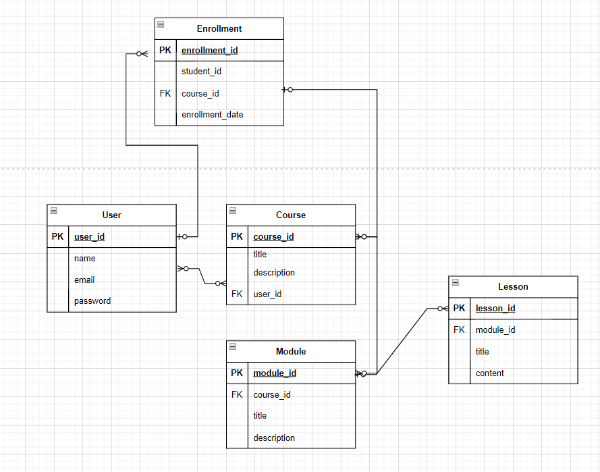
ER-DIAGRAM

Slide 3
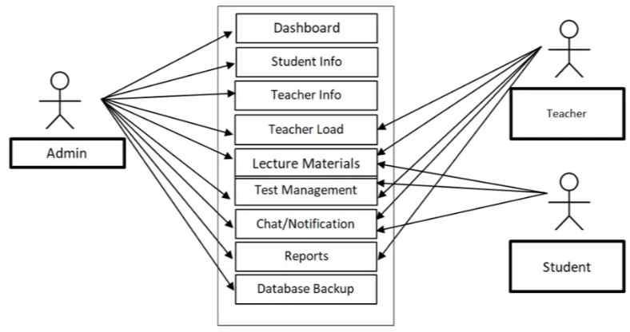
USE-CASE DIAGRAM

Slide 4
PROBLEM STATEMENT
Access to Learning Materials: Students need a centralized platform to access a variety of learning materials, including lectures, readings, and multimedia resources, in an organized and easily accessible manner.
Course Enrollment and Management: Enrolling in courses, managing schedules, and keeping track of course progress can be cumbersome without a streamlined and intuitive system.
Assignment Submission and Feedback: The process of submitting assignments and receiving timely feedback from instructors is often disjointed, leading to inefficiencies and delays in academic evaluation.
Student Engagement and Interaction: Active participation in discussions, forums, and peer interactions can be limited by the lack of integrated tools that foster communication and collaboration.
Academic Progress Tracking: Students and educators need effective tools to track academic progress, performance metrics, and overall learning outcomes.

Slide 5
OBJECTIVE
Provide a Unified Platform: Create a comprehensive online platform where students can access learning materials, participate in discussions, and manage their academic activities in a single location.
Facilitate Course Management: Implement features for course enrollment, schedule management, and progress tracking, making it easier for students and educators to manage and track academic activities.
Streamline Assignment Handling: Develop a system for assignment submission, grading, and feedback, ensuring a smooth and efficient process for both students and instructors.
Enhance Student Interaction: Integrate discussion forums, messaging systems, and collaboration tools to foster active student engagement and peer-to-peer interactions.
Monitor Academic Progress: Implement dashboards and reporting tools to help students and educators track academic progress, performance, and achievements.

Slide 6
THANK YOU

