Slide 1
Data Architecture Overview

Slide 2



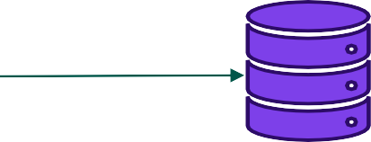








Data Sources
Dashboards
CRM
Batch
Data Quality Management
RDBMS
Staging DB
Consolidation Database
Technical/Business Metadata Management
Data Archive
Semantic layer
streamng
Structured and Un-structured data
BI reports & MIS
Social media
ETL/ELT
Process
Events click
Enterprise Datawarehouse
Replicated | Logical | DW Sandboxes
Logical Mart1 | Logical Mart2
Search
Other external sources
_{Data Mart 1}Data Mart 2
Page 37

