Slide 1




SMART INDIA HACKATHON 2026
TITLE PAGE
Problem Statement ID – SIH26034
Problem Statement Title- Software System to check compliance of Packaged Commodities under Legal Metrology(Packaged Commodities) Rules, 2011 by scanning products, images and labels.
Theme- Miscellaneous
PS Category- Software
Team ID-
Team Name- The Hexad Debuggers

Slide 2

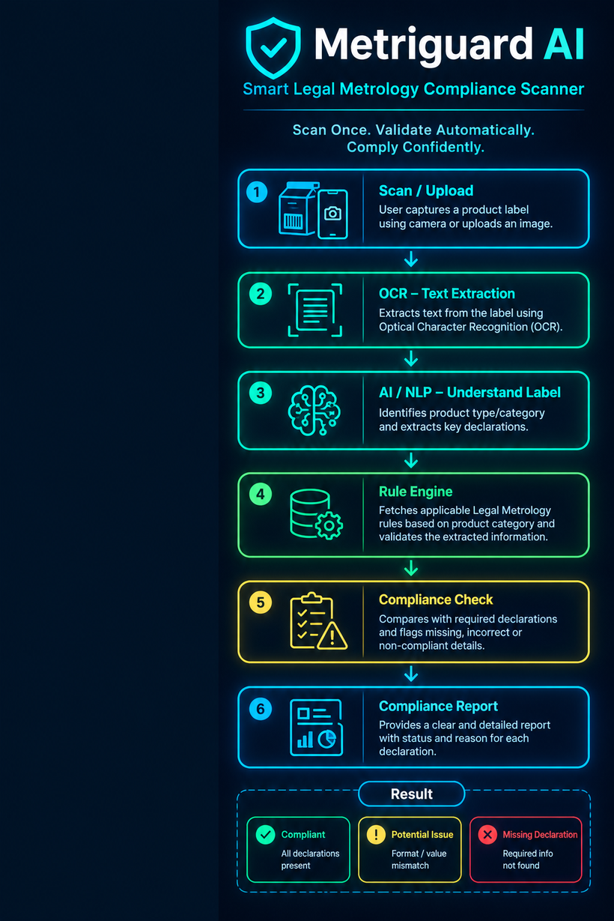
IDEA TITLE
The Hexad Debuggers
Proposed Solution
A smart AI-powered system that automatically scans, extracts, understands, and validates product label declarations against applicable Legal Metrology rules.
Key Benefits
Instant label scanning using image upload/camera.
OCR-based text extraction from product packaging.
Automated compliance checking against Legal Metrology requirements.
Clear compliance report highlighting missing or potentially incorrect declarations.
Innovation
Automated compliance screening – Automatically scans product packaging and checks required declarations.
Generic product processing – Works with different products using a general compliance pipeline, not product-specific logic.
Uncertainty-aware compliance – Shows YES when information is detected and UNCERTAIN when reliable detection is not possible. Poor image quality or OCR errors do not automatically mean non-compliance.
Explainable screening – Clearly identifies which required declarations were detected instead of simply showing FAIL.
@SIH Idea submission- Template
2
Notes:
2

Slide 3
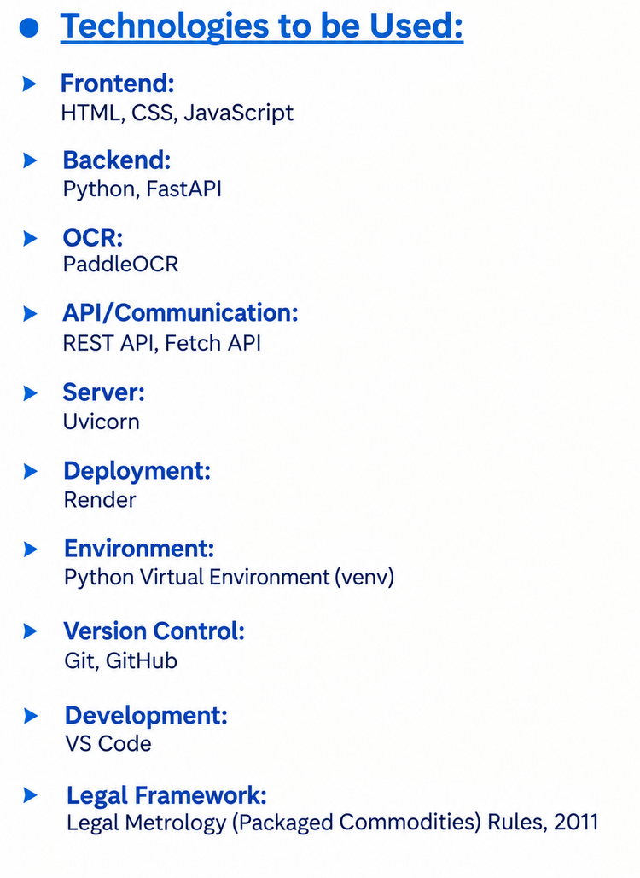
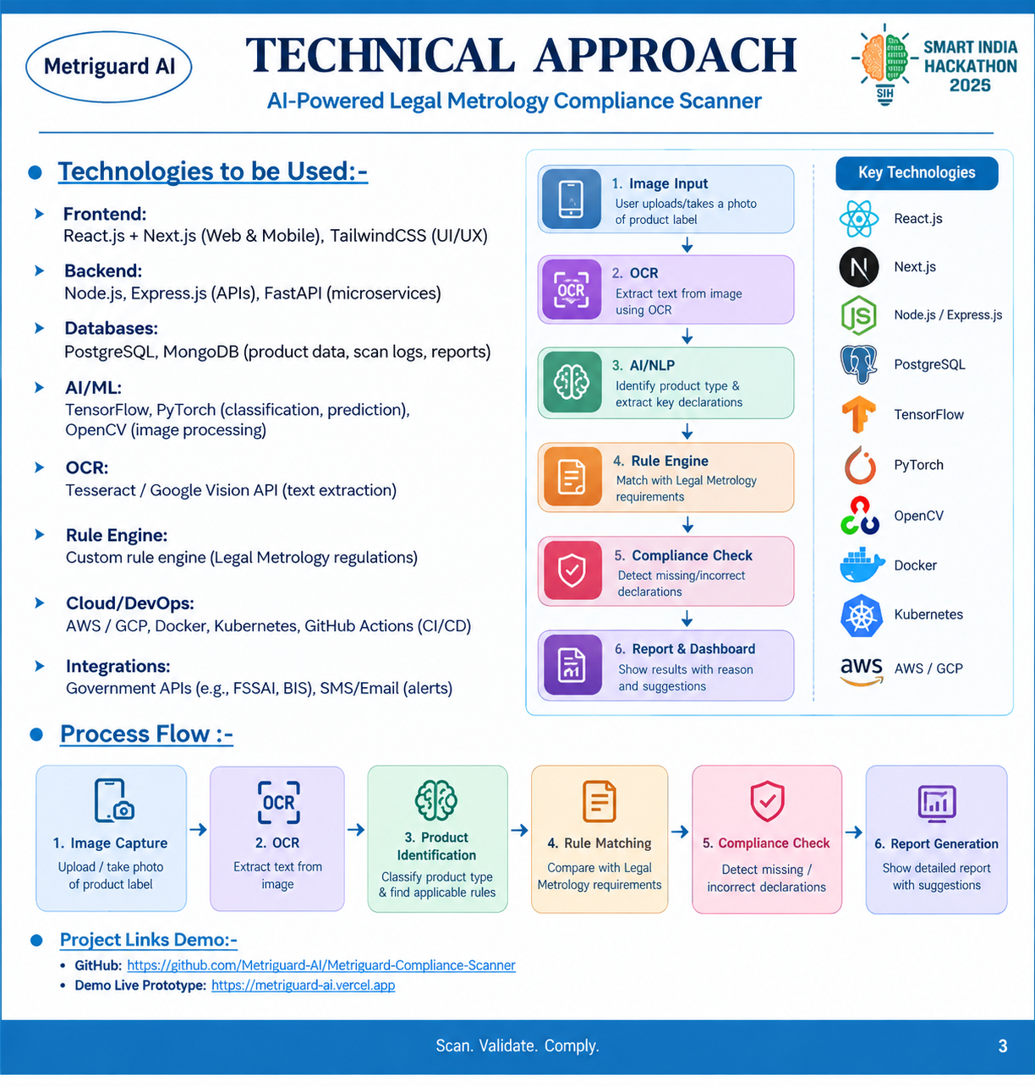
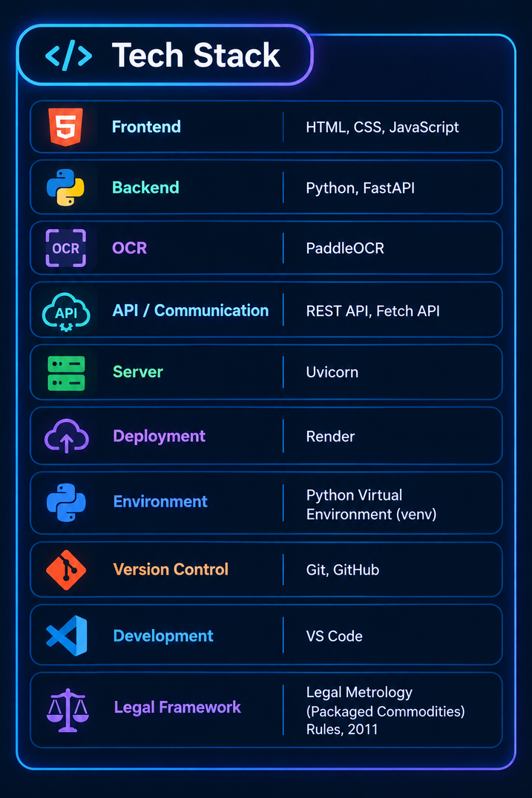
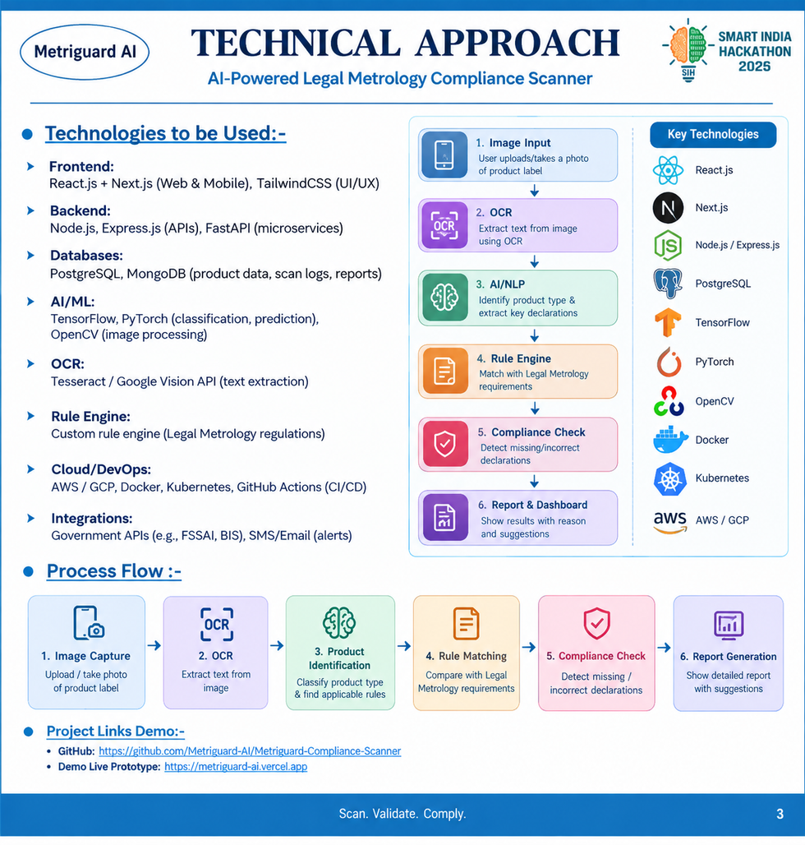
TECHNICAL APPROACH
The Hexad Debuggers
@SIH Idea submission- Template
3
Notes:
3

Slide 4



FEASIBILITY AND VIABILITY
The Hexad Debuggers
Feasibility
Uses existing OCR, image processing and AI/ML technologies to extract information from product labels.
Compliance rules can be implemented as a rule based validation engine based on Legal Metrology (Packaged Commodities) Rules, 2011.
Cloud/database infrastructure enables scalable storage of products, inspections and compliance reports.
Can be deployed as a web/mobile application with minimal additional hardware.
Potential challenges and risks
Poor image quality, blur or different label layouts may affect OCR accuracy.
Product labels may contain multiple languages and varying formats.
Legal requirements/rules may change over time.
Strategies for overcoming these challenges
Provide image-quality checks + retake guidance before scanning.
Use multilingual OCR + preprocessing for better extraction.
Maintain an editable, version-controlled compliance rule under database.
Combine AI/OCR with rule-based validation and human verification for critical cases.
@SIH Idea submission- Template
4
Notes:
4

Slide 5

IMPACT AND BENEFITS
The Hexad Debuggers
Potential impact on the target audience
Enforcement Officials: Faster and more systematic inspection of packaged commodities.
Manufactures & Sellers: Early identification of labelling errors and improved compliance.
Consumers: Better assurance that product information is complete, correct and transparent.
Benefits of the solution
Social: Promotes consumer awareness, transparency and fair trade practices.
Economic: Reduces manual inspection time and helps businesses avoid penalties due to accidental non-compliance.
Environmental: Reduces paper-based inspection records through digital reports and documentation.
Operational: Enables faster scanning, automated checks, searchable records and standardised compliance reports.
Long-term: Creates and digital compliance history that can support data-driven enforcement.
An AI-assisted, product-independent compliance screening system that converts packaging images into structured declarations and evaluates them against Legal Metrology requirements, while explicitly handling OCR uncertainty to avoid false compliance violations.
@SIH Idea submission- Template
5
Notes:
5

Slide 6

RESEARCH AND REFERENCES
The Hexad Debuggers
Details / Links of the reference and research work
Department of Consumer Affairs, Government of India — Legal Metrology
Legal Metrology (Packaged Commodities) Rules, 2011 & amendments
PaddleOCR Documentation
OCR and text extraction
FastAPI Documentation
Backend REST API development
Render Documentation
Cloud deployment
@SIH Idea submission- Template
6
Notes:
6

